Slide 1
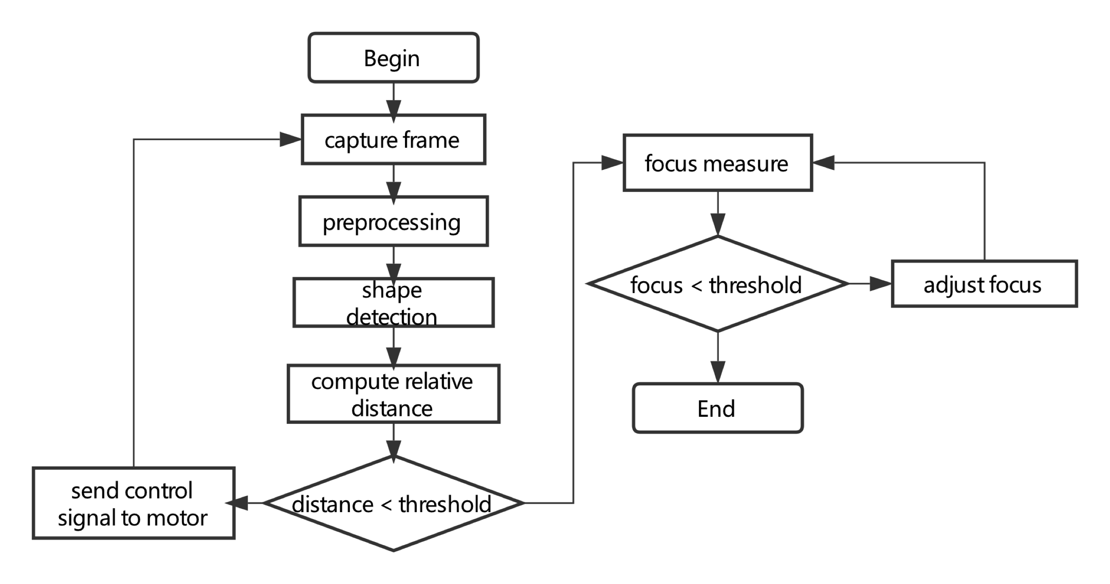
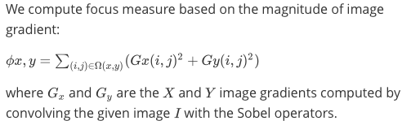
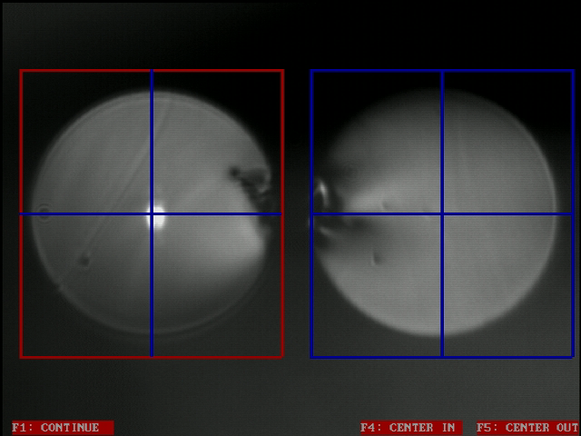
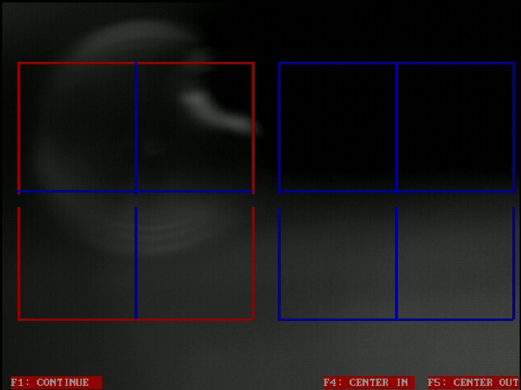

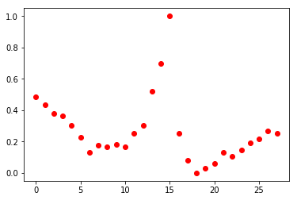
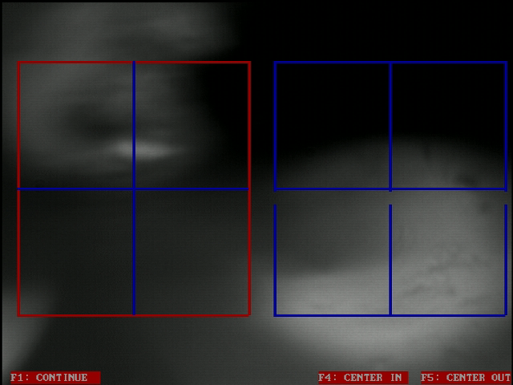
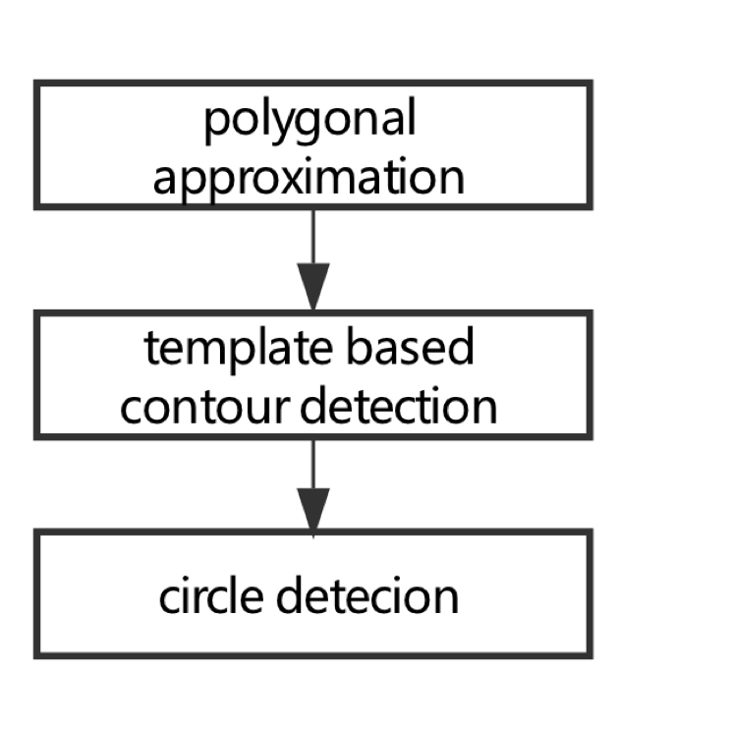
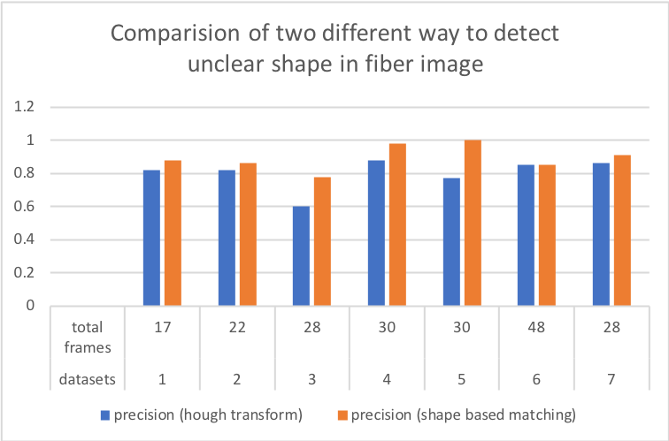
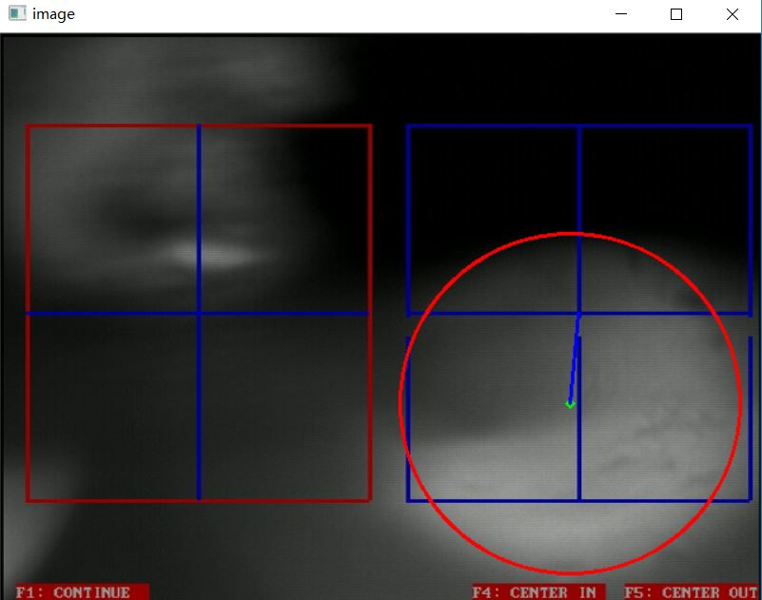
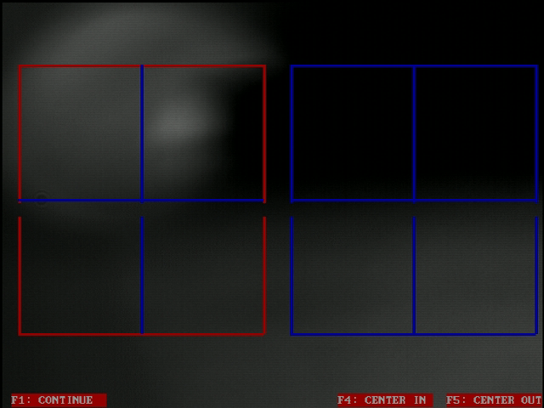

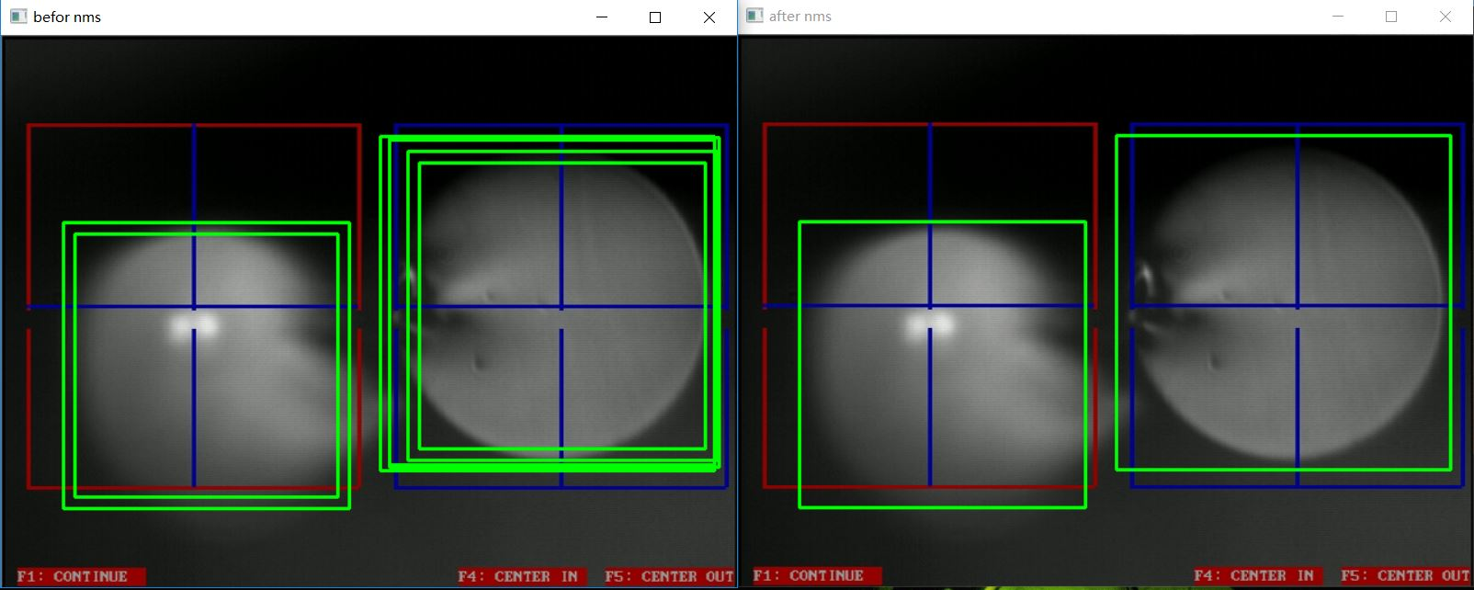
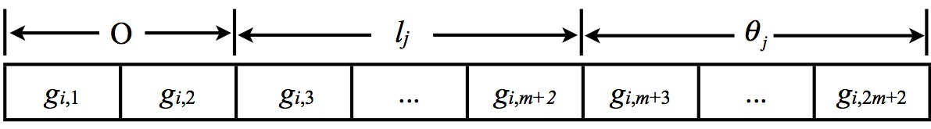
システムデザイン研究科 機械システム工学域 博士前期課程 公開期末評価 (2018/8/6)
久保田研究室 張海斌 18862678
Evolutionary Robot Vision for Target Detection
with Unclear Shape in Fiber Images
Background
Problems
Objectives
In the fiber connection process, the cross section of the two fibers can be observed by the camera. Robot vision can be used to perform target detection on the fiber cross-section to adjust the position and align the center of the two fibers.
In practice, the fiber center is not at the center of alignment and the focus is not properly adjusted. Therefore, there are mainly two problem to be solved. (1) detecting the target shape when in unclear state. (2) Computing the corresponding focus value.
In order to complete the fiber connection work more efficiently, it can be automatedly processed by using Robot vision for the above two cases. Therefore, The camera automatically recognizes the fiber target in different situation and adjusts the focus value.
Contents
Focus Measure
target
Pipeline
(1) Vulnerable to the environment, such as lighting changes, occlusion and background noise will have a greater impact on detection
normal
lighting change
(2) The video frame sometimes is not a perfect circles caused by blurriness.
The change of focus value in a video stream.
Unclear Shape detection
template
Hough transform
Steady-state genetic algorithm
Experiment
Circle can be expressed as 𝑟2=(𝑥−𝑎)^2+(𝑦−𝑏)^2
in the parameter space. Therefore, 𝜌=(𝑎,𝑏,𝑟).
Considering that in the fiber image the circle is not always perfect and can be polygonal, so we use SSGA based on template matching to detect contour.
We make a experiment on 7 videos to separately compute its successfully detection rate(). Comparing the way of hough transform and shape based matching, we can get results as follows.
algorithm:
1. Initialize each A[a,b,r] = 0;
2. Preprocessing images and get edge images;
3. Vote all possible circles in the accumulator.
4. The local maximum voting circle of accumulator A gives the round Hough space.
5. The maximum voting circle of the accumulator gives the circle.
Steps:
gray scale conversion from the color image by YUV model
simple color extraction
Using SSGA based on template matching for extracting a shape from the background image.
Shape based matching
Detection method | Datasets | Average Precision
Hough transform | 7 videos | 80.0%
shape based matching | 7 videos | 89.4%
The key of shape based matching is using gradient orientation. Once we have as many edges as possible if we want to find all the target shapes, we can use NMS to decrease the number and get a best shape left.
Step:
1.Create template
2.Template matching
3.Non-maximum suppression(NMS)
Circle template
An octagonal template
Conclusions
1. For unclear situations, shape based matching can significantly improve the successful detection rate.
2. For different videos, the stability of the detection circle is better.
Genotype in SSGA
Future work
Research Plan
・Object detection based on deep learning on iOS platform in next term.
・Acquire object coordinates using its 3D information.
・ Using iPhone to remotely control robot to grasp items.
・Establishment of environment for actual machine experiment.
・Experiment by actual machine.
2018.4~
2018.10~
2019.4~
2019.10~
修士1年前期
Target detection(iOS)
Remote control
Actual machine experiment
Simulation experiment
Start graduate thesis

