Slide 1
AI/ML Based Log Analysis and Diagnosis
Project Name – DeepLog

Slide 2
Business Value
Large volumes of customer field logs are difficult to manage with traditional manual analysis.
AI/ML enables smarter insights, turning raw data into business value.
Business Value
Higher quality
Lower return rates and fewer customer escalations
Greater efficiency
Automated, end-to-end log analysis
Smarter operations
Embedded AI for proactive radio supervision

Slide 3
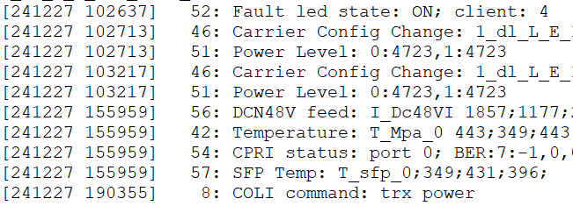
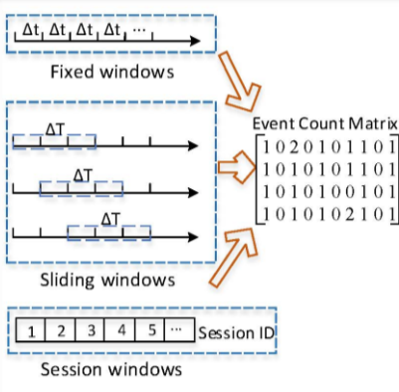
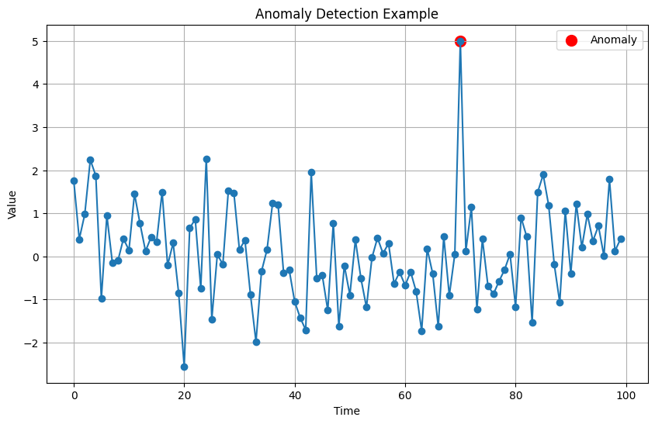
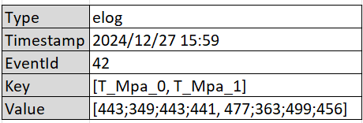
Workaround
AI/ML model based
Log collection
Log Parsing
Feature Extraction
Anomaly Detection or Classification
Deployment
Off-line tools
On-line inside product or data pipeline
Proactive log
PDP
Repair log

Slide 4
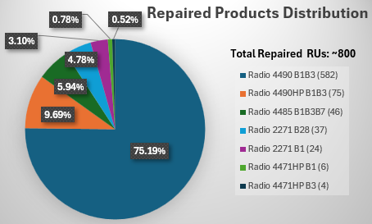
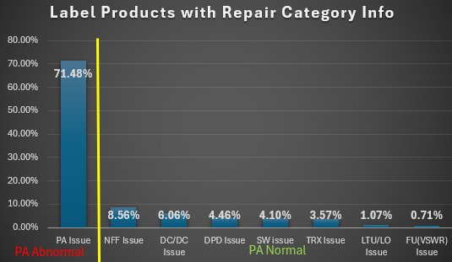
Data Collection and Labeling
Collect logs from radios in Repair Center. The overall samples are ~800.
Choose 70% for model training and 30% to verify predictions.
Use repair-categorization info for labeling.

Slide 5
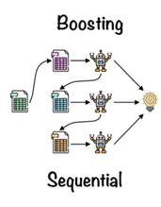
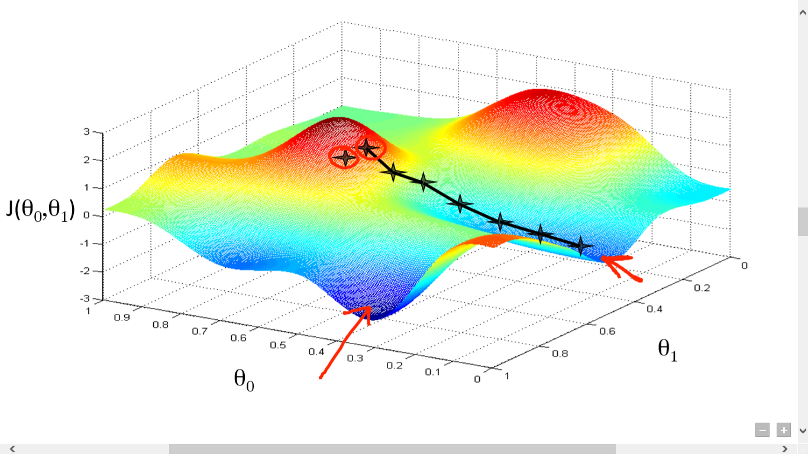
Model
Which:
XGBoost
Why:
Training dataset is tabular format
High performance and robust to noise
Support feature weight analysis
Align with manually pattern-analysis method in logical inference
How:
Ensemble learning techniques use multiple decision-trees to improve model performance.
Boosting build tress sequentially, and each tree focus on correcting the errors of its predecessors
XGBoost implements gradient boosting with highly accurate and build multiple Boosting trees in parallel

Slide 6
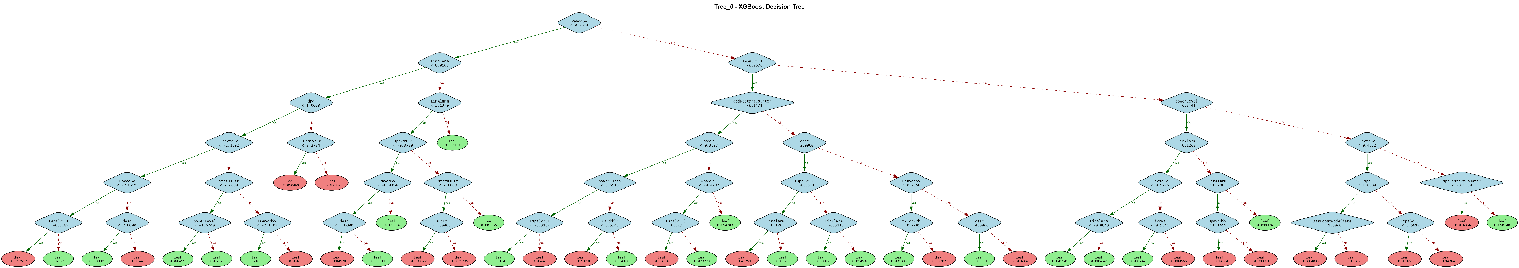
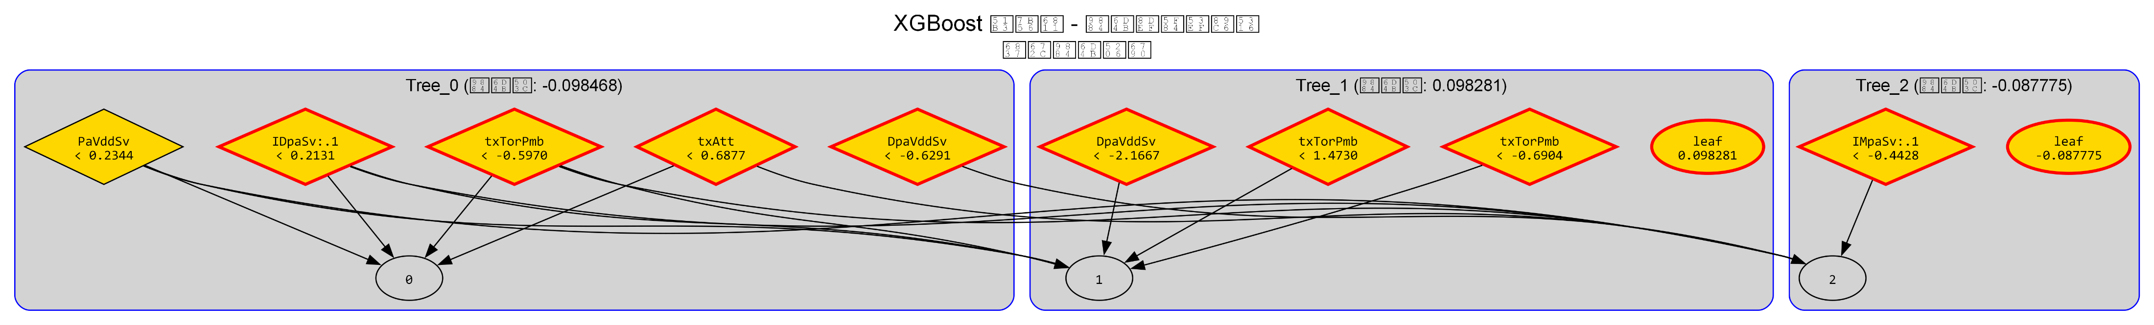
Training
Tree level: split node threshold; leaf weight (voting tendency)
Forest level: sum up scores from each trees to get the final score
… …

Slide 7
Parameter Tuning Strategy
Multi-dimensional tuning strategy – decoupling and synergy for XGBoost
GROUP | PARAMETER | KEY POINT | Character
Convergence Efficiency | learning_rate n_estimator | Step Size vs. Iteration Frequency | Learning Sustainability
Structural Robustness | max_depth min_child_weight | Growth Space vs. Splitting Constraints | Model Parsimony
Generalization Resilience | subsample colsubsample_bytree | Information Integrity vs. Stochastic Noise | Generalization
*Advanced Optimization: Regularization & Pruning | reg_alpha reg_lambda gamma | Structural Penalty & Complexity Control | The stringency of the learning algorithm imposed on the model.

Slide 8
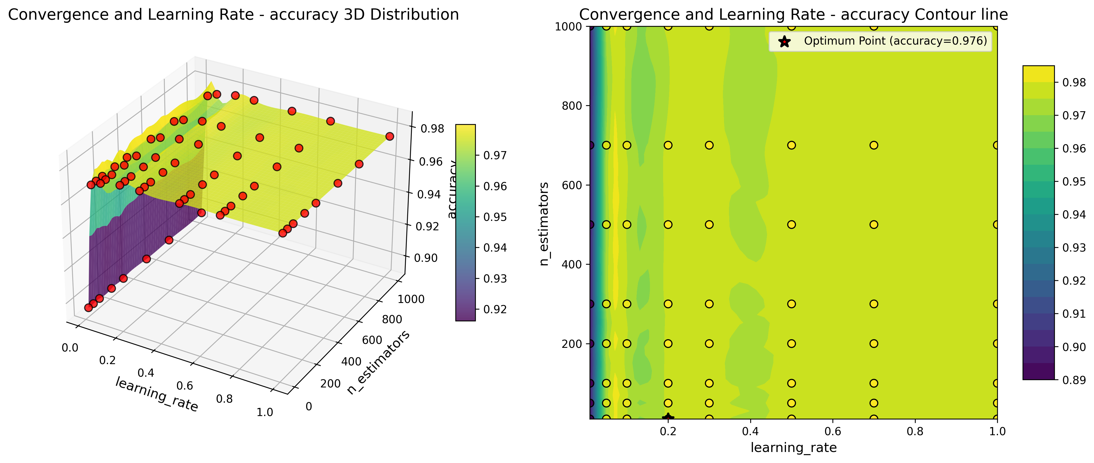
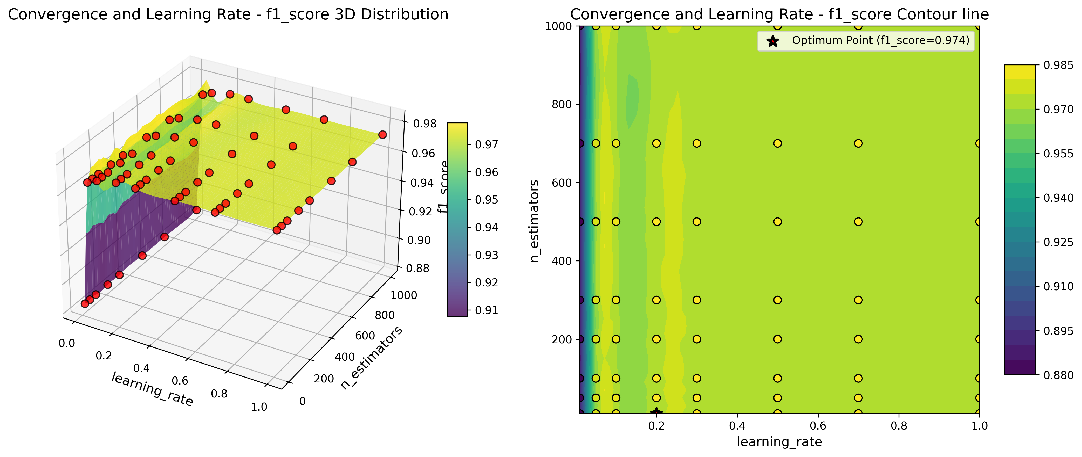

Slide 9
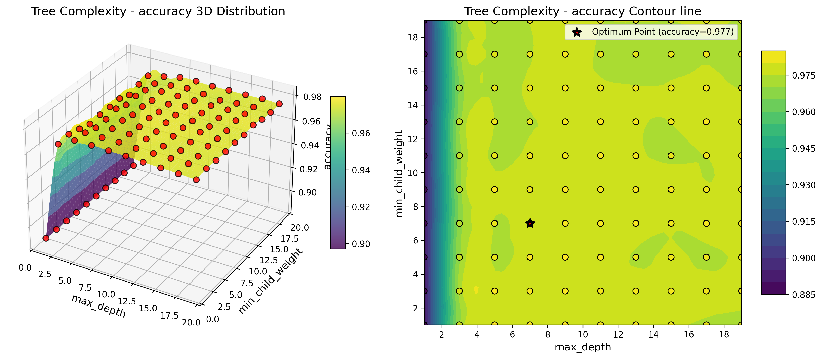
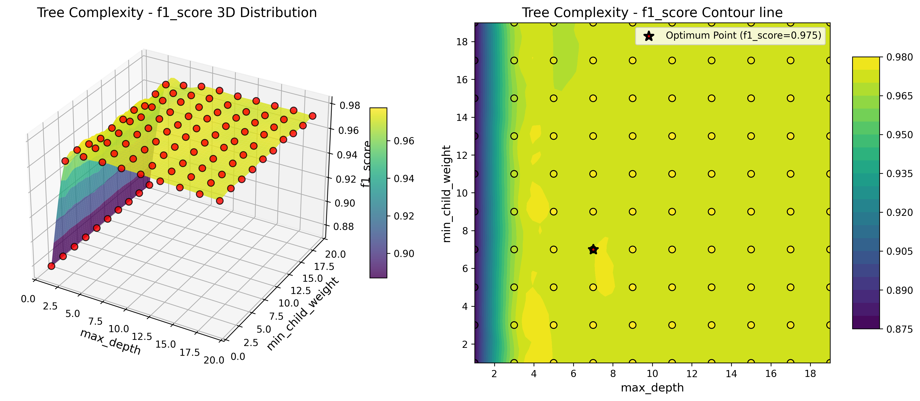

Slide 10
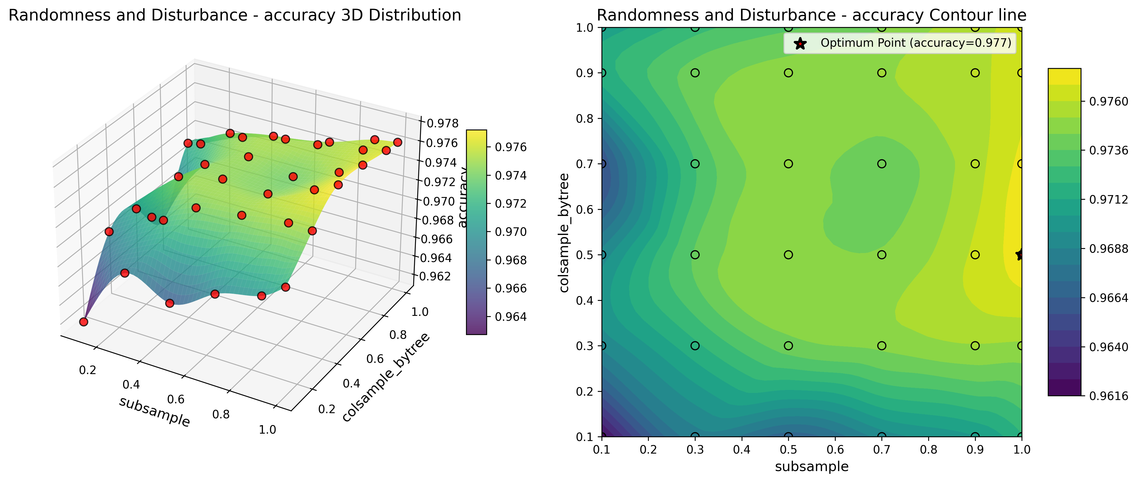

Slide 11
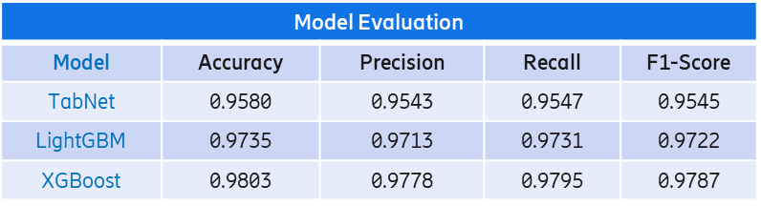
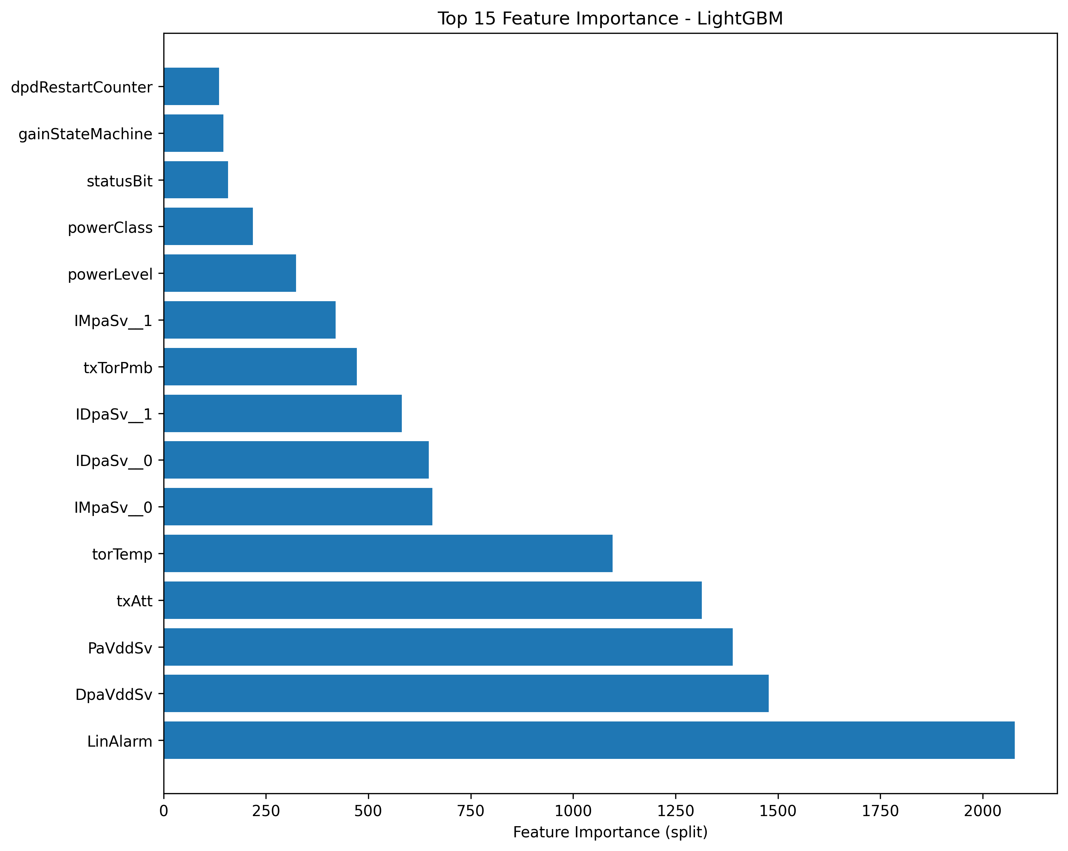
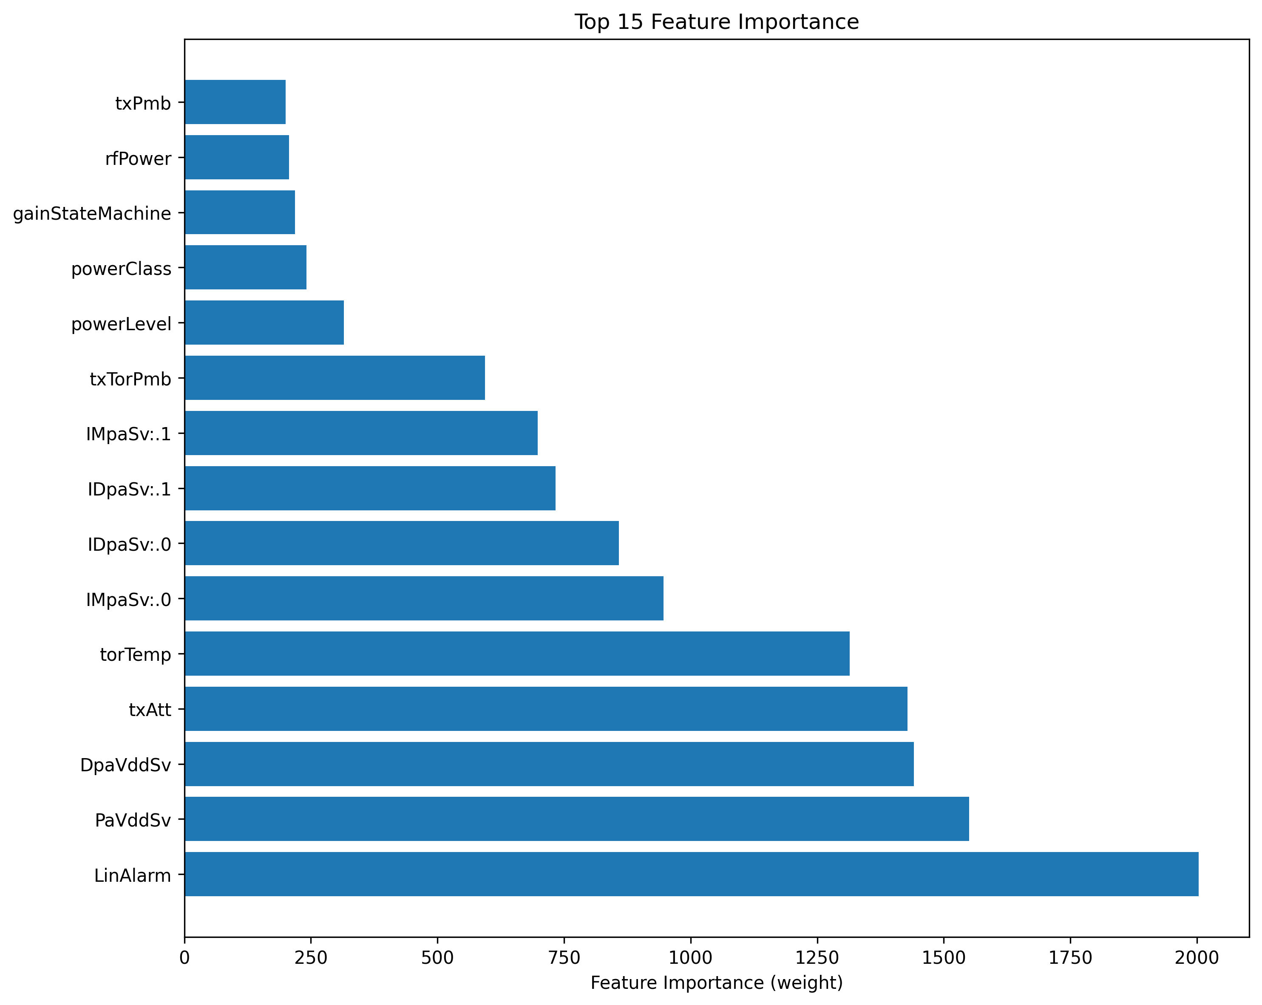
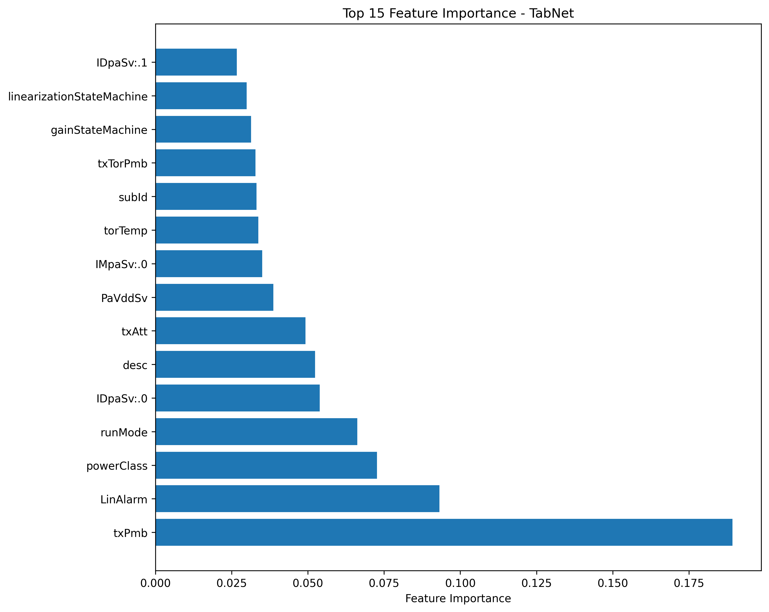
Model Evaluation
Evaluate ML models through key metrics
Accuracy: proportion of correct predictions
Precision: the radio of true positive predictions
Recall: the proportion of actual positives that were correctly identified
F1-Score: the harmonic mean of precision and recall
Feature importance list based on different models
LightGBM
XGBoost
TabNet

Slide 12
Validation without CGAN
TabNet Prediction
Categories | Milano PA Issue | Milano Non-PA Issue | Stockholm PA Issue | Stockholm Non-PA Issue
Samples to be Predicted | 23 | 13 | 92 | 57
Successfully Predicted | 17 | 9 | 51 | 37
Prediction Accuracy | 73.9% | 69.2% | 55.4% | 64.9%
LightGBM Prediction
Categories | Milano PA Issue | Milano Non-PA Issue | Stockholm PA Issue | Stockholm Non-PA Issue
Samples to be Predicted | 23 | 13 | 92 | 57
Successfully Predicted | 19 | 8 | 83 | 35
Prediction Accuracy | 82% | 61.5% | 90.2% | 61.4%
False prediction SN:
E23E736355 (4490 B1B3)
E23F086295 (4490 B1B3)
E23F110761 (4490 B1B3)
E23F273614 (4490HP B1B3)
E23F454041 (4490HP B1B3)
TU8U02G5N4 (4490 B1B3)
TU8U02HUK2 (4490 B1B3)
TU8U02MCT0 (4485 B1B3B7)
TU8U02UPFP (4485 B1B3B7)
False prediction SN:
CN39854078 (4471HP B3)
CN3A015366 (2271 B0C)
CN3A029786 (2271 B0C)
EA8C417136 (2271 B1)
XGBoost Prediction
Categories | Milano PA Issue | Milano Non-PA Issue | Stockholm PA Issue | Stockholm Non-PA Issue
Samples to be Predicted | 23 | 13 | 92 | 57
Successfully Predicted | 20 | 8 | 84 | 36
Prediction Accuracy | 87% | 61.5% | 91.3% | 63.2%
False prediction SN:
E23E736355 (4490 B1B3)
E23F086295 (4490 B1B3)
E23F110761 (4490 B1B3)
E23F273614 (4490HP B1B3)
E23F454041 (4490HP B1B3)
TU8U02G5N4 (4490 B1B3)
TU8U02HUK2 (4490 B1B3)
TU8U02MCT0 (4485 B1B3B7)
False prediction SN:
CN39854078 (4471HP B3)
CN3A015366 (2271 B0C)
CN3A029786 (2271 B0C)

Slide 13
Validation with CGAN (solve issue of imbalance of training samples)
TabNet Prediction
Categories | Milano PA Issue | Milano Non-PA Issue | Stockholm PA Issue | Stockholm Non-PA Issue
Samples to be Predicted | 23 | 13 | 92 | 57
Successfully Predicted | 17 | 12 | 51 | 52
Prediction Accuracy | 73.9% | 92.31% | 55.4% | 92.9%
False prediction SN:
E23F348642 (4490HP B1B3 FU/VSWR)
TU8U02PD3Y (4485 B1B3B7 DPD)
TU8U02FXPD (4490 B1B3 TRX)
TU8U02YVDV (4490 B1B3 DCDC)
TU8U02YXTT (4490 B1B3 DCDC)
False prediction SN:
CN3A038640 (2271 B0C NFF)
LightGBM Prediction
Categories | Milano PA Issue | Milano Non-PA Issue | Stockholm PA Issue | Stockholm Non-PA Issue
Samples to be Predicted | 23 | 13 | 92 | 57
Successfully Predicted | 19 | 11 | 83 | 49
Prediction Accuracy | 82% | 84.6% | 90.2% | 86%
False prediction SN:
DH80241600 (4490 B1B3 DPD)
DH80249190 (4490 B1B3 DPD)
DH80262770 (4490HP B1B3 DPD)
TU8U02CWAU (4490 B1B3 DPD)
TU8U02E183 (4490 B1B3 DPD)
TU8U02FXPD (4490 B1B3 TRX)
TU8U02P786 (4485 B1B3B7 DCDC)
TU8U0309J8 (4490 B1B3 DPD)
False prediction SN:
CN39854078 (4471HP B3)
CN3A015366 (2271 B0C)
CN3A029786 (2271 B0C)
EA8C417136 (2271 B1)
False prediction SN:
CN3A038640 (2271 B0C NFF)
EA8B956651 (2271 B28 NFF)
XGBoost Prediction
Categories | Milano PA Issue | Milano Non-PA Issue | Stockholm PA Issue | Stockholm Non-PA Issue
Samples to be Predicted | 23 | 13 | 92 | 57
Successfully Predicted | 20 | 11 | 84 | 49
Prediction Accuracy | 87% | 84.6% | 91.3% | 86%
False prediction SN:
DH80249190 (4490 B1B3 DPD)
DH80262770 (4490HP B1B3 DPD)
E23F115854 (4490 B1B3 DPD)
E23F348642 (4490HP B1B3 FU/VSWR)
TU8U02CWAU (4490 B1B3 DPD)
TU8U02E183 (4490 B1B3 DPD)
TU8U02YVDV (4490 B1B3 DCDC)
TU8U0309J8 (4490 B1B3 DPD)
False prediction SN:
CN39854078 (4471HP B3)
CN3A015366 (2271 B0C)
CN3A029786 (2271 B0C)
False prediction SN:
CN3A038640 (2271 B0C NFF)
EA8B956651 (2271 B28 NFF)

Slide 14
Validation with CGAN and Parameter Tuning
XGBoost Performance with Default Parameter Config
Categories | Milano PA Issue | Milano Non-PA Issue | Stockholm PA Issue | Stockholm Non-PA Issue
Samples to be Predicted | 23 | 13 | 92 | 57
Successfully Predicted | 20 | 11 | 84 | 49
Prediction Accuracy | 87.0% | 84.6% | 91.3% | 86.0%
Default Parameters Setting
learning_rate: 0.1
n_estimators: 100
max_depth: 6
min_child_weight: 1
reg_alpha: 0
reg_lambda: 1
gamma: 0
subsample: 0.8
colsample_bytree: 0.8
False prediction SN:
CN39854078 (4471HP B3)
CN3A015366 (2271 B0C)
CN3A029786 (2271 B0C)
False prediction SN:
CN3A038640 (2271 B0C NFF)
EA8B956651 (2271 B28 NFF)
False prediction SN:
E23E736355 (4490 B1B3)
E23F086295 (4490 B1B3)
E23F110761 (4490 B1B3)
E23F273614 (4490HP B1B3)
E23F454041 (4490HP B1B3)
TU8U02G5N4 (4490 B1B3)
TU8U02HUK2 (4490 B1B3)
TU8U02MCT0 (4485 B1B3B7)
False prediction SN:
DH80249190 (4490 B1B3 DPD)
DH80262770 (4490HP B1B3 DPD)
E23F115854 (4490 B1B3 DPD)
E23F348642 (4490HP B1B3 FU/VSWR)
TU8U02CWAU (4490 B1B3 DPD)
TU8U02E183 (4490 B1B3 DPD)
TU8U02YVDV (4490 B1B3 DCDC)
TU8U0309J8 (4490 B1B3 DPD)
XGBoost Performance with Updated Parameter Config
Categories | Milano PA Issue | Milano Non-PA Issue | Stockholm PA Issue | Stockholm Non-PA Issue
Samples to be Predicted | 23 | 13 | 92 | 57
Successfully Predicted | 20 | 12 | 85 | 50
Prediction Accuracy | 87.0% | 92.3% | 92.4% | 87.7%
Updated Parameters Setting
learning_rate: 0.2
n_estimators: 10
max_depth: 7
min_child_weight: 7
reg_alpha: 0
reg_lambda: 0
gamma: 0
subsample: 1.0
colsample_bytree: 0.5
False prediction SN:
CN39854078 (4471HP B3)
CN3A029786 (2271 B0C)
EA8C417136 (2271 B1)
False prediction SN:
EA8B956651 (2271 B28 NFF)
False prediction SN:
E23E736355 (4490 B1B3)
E23F086295 (4490 B1B3)
E23F110761 (4490 B1B3)
E23F328806 (4490HP B1B3)
TU8U02G5N4 (4490 B1B3)
TU8U02HUK2 (4490 B1B3)
TU8U02MCT0 (4485 B1B3B7)
False prediction SN:
DH80249190 (4490 B1B3 DPD)
DH80262770 (4490HP B1B3 DPD)
E23F115854 (4490 B1B3 DPD)
E23F348642 (4490HP B1B3 FU/VSWR)
TU8U02CWAU (4490 B1B3 DPD)
TU8U02E183 (4490 B1B3 DPD)
TU8U02P786 (4485 B1B3B7 DCDC)

Slide 15
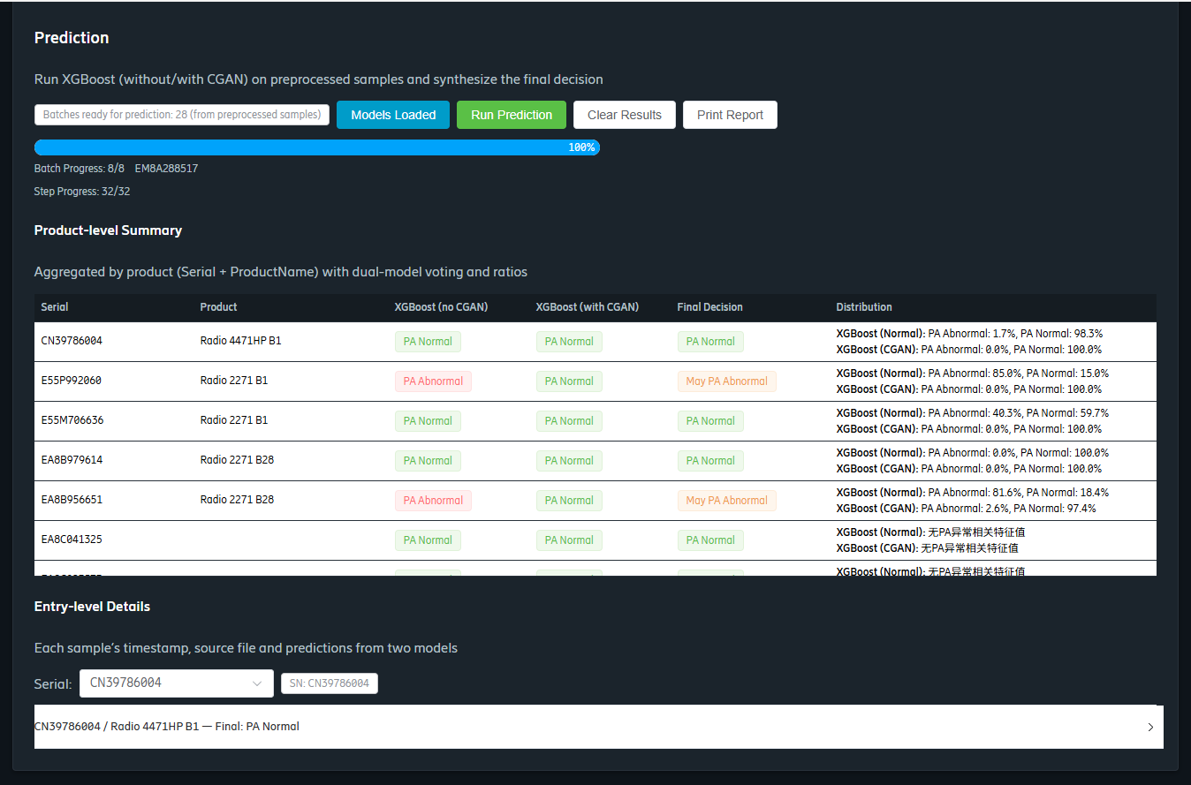
DeepLog Web Tool

