Slide 1
MSI 5102 | Type 2 Project
Handwritten Digit Recognition
MNIST Dataset | KNN | Logistic Regression | MLP | CNN
Experiment Report & Model Comparison

Slide 2
Agenda
01
Dataset & Workflow
02
KNN — Pipeline & Grid Search Result
03
Logistic Regression — Pipeline & Grid Search Result
04
MLP Neural Network & CNN
05
Final Model Comparison
06
Dimensionality Reduction (PCA & t-SNE)
07
Ablation Study
08
Conclusions
MSI 5102 | MNIST Digit Recognition

Slide 3
01
Dataset & Workflow

Slide 4
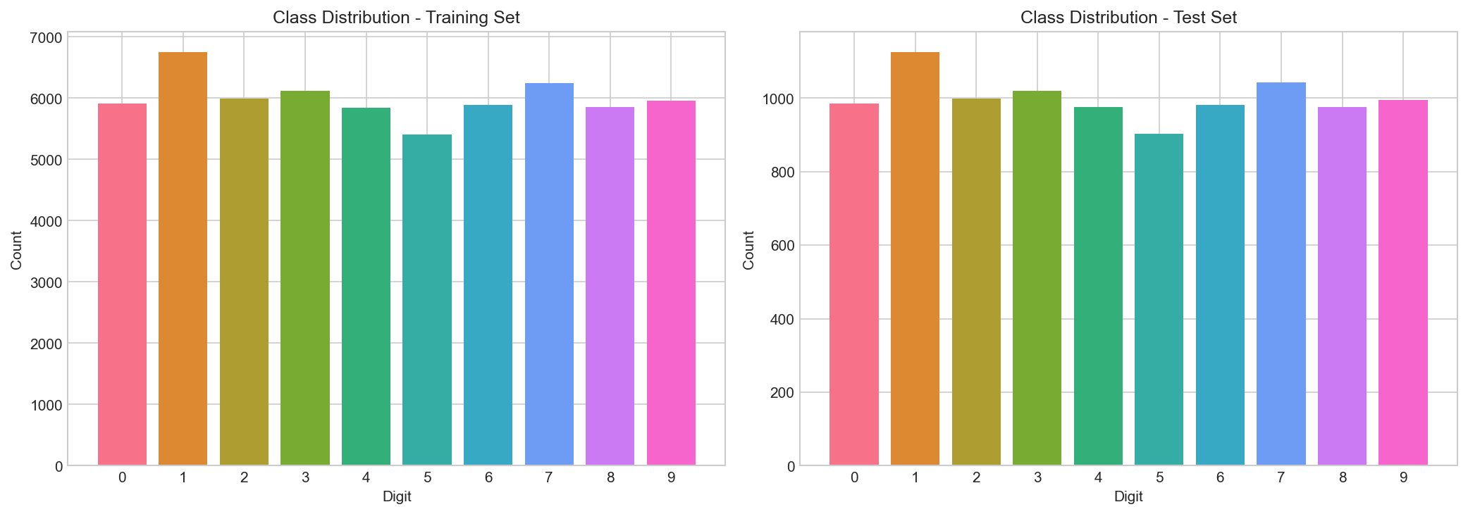
Dataset & Workflow
60,000 train / 10,000 test (follows MNIST benchmark)
Load & normalize MNIST
70,000 grayscale images (28x28)
10 classes (digits 0-9)
Pixels normalized to [0, 1]
GridSearchCV for KNN & LR (Pipeline)
Train MLP & CNN (54K train / 6K val)
Evaluate all models on test set (10K)
PCA & t-SNE visualization
MSI 5102 | MNIST Digit Recognition

Slide 5
02
K-Nearest Neighbors (KNN)

Slide 6
KNN — Pipeline (PCA + KNN)
Search Space (5-Fold CV)
Best Configuration
PCA variance: 0.90, 0.95, 0.99
k: 1, 3, 5, 7, 9
Weights: uniform, distance
Metric: euclidean, manhattan
60 combinations x 5 folds = 300 fits
Metric: euclidean
k = 3, weights = distance
PCA variance retained: 0.90
Best CV accuracy: 0.9758
Search time: 510.55 s
Test Accuracy: 97.74% Train: 0.22s | Predict: 0.25s
MSI 5102 | MNIST Digit Recognition

Slide 7
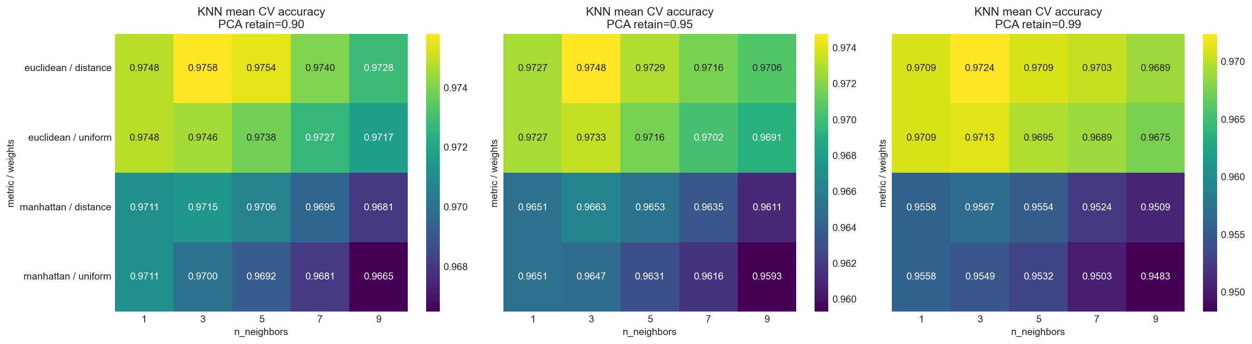
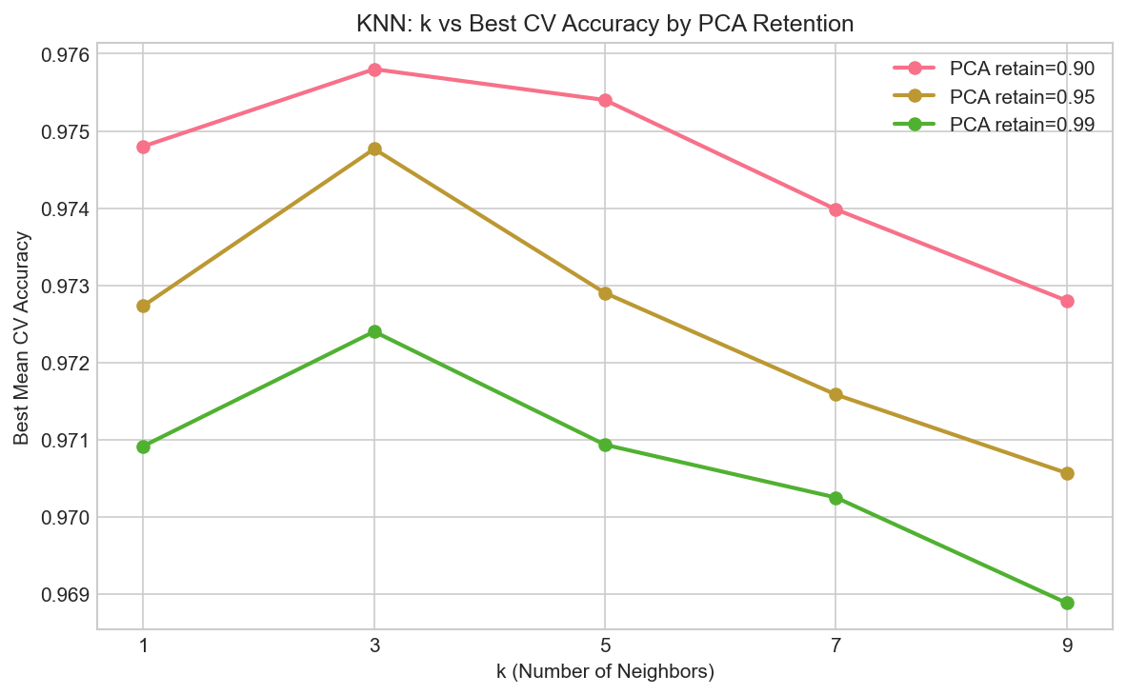
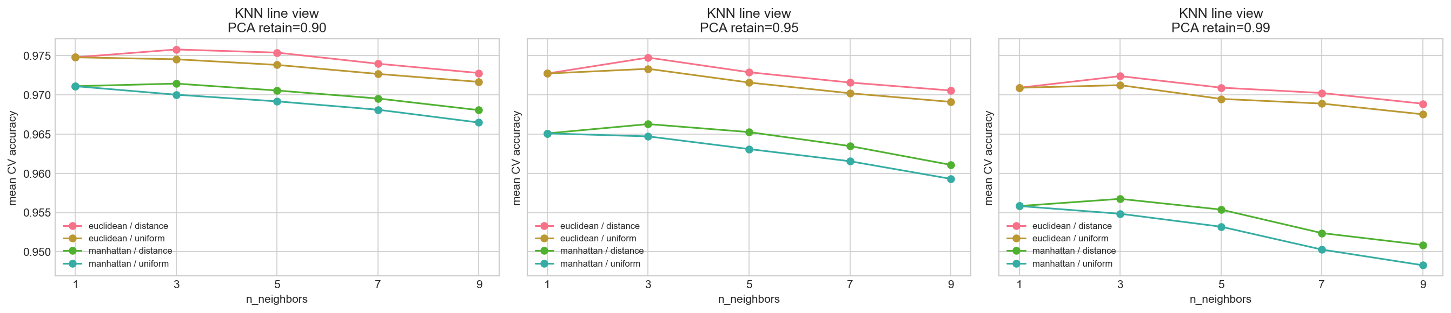
KNN — GridSearchCV Result
Best results: k=3 with PCA retention 0.9
MSI 5102 | MNIST Digit Recognition

Slide 8
KNN — Key Observations
Euclidean distance consistently outperformed Manhattan distance
Retaining 90% PCA variance was better than 95% or 99%
Distance-weighted voting slightly outperformed uniform voting
Top-ranked configurations were tightly clustered — KNN is relatively stable once metric and PCA retention are well-chosen
Insight
Lower PCA retention (90%) acts as implicit regularization, reducing noise from less informative components and improving KNN's distance-based decisions.
MSI 5102 | MNIST Digit Recognition

Slide 9
03
Logistic Regression

Slide 10
Logistic Regression — Pipeline (PCA + LR)
Search Space (5-Fold CV)
Best Configuration
PCA variance: 0.90, 0.95, 0.99
C: 0.01, 0.1, 1.0, 10.0
Solver: lbfgs, saga
Penalty: L2
24 combinations x 5 folds = 120 fits
C = 0.1, solver = lbfgs
Penalty: L2
PCA variance retained: 0.99
Best CV accuracy: 0.9216
Search time: 626.57 s
PCA 0.99 dominated the top configurations — Logisitc Regression benefits from more features than KNN
lbfgs was substantially faster than saga at comparable accuracy
Logistic Regression clearly lagged behind KNN — linear boundary is limiting on MNIST
Test Accuracy: 92.27% Train: 0.86s | Predict: 0.008s
MSI 5102 | MNIST Digit Recognition

Slide 11
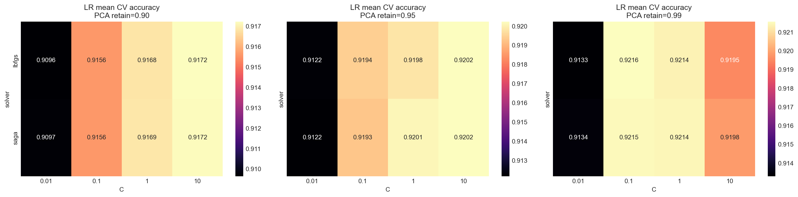
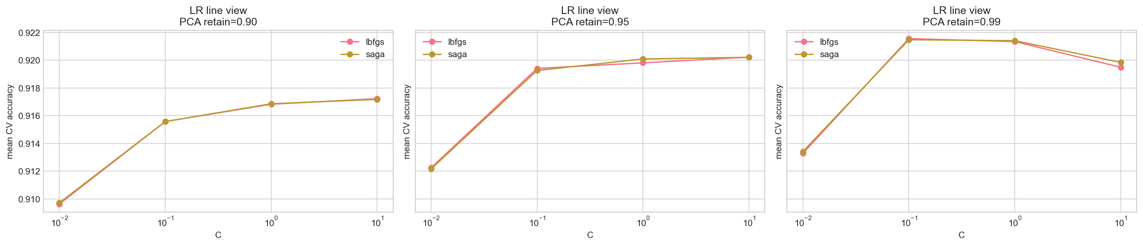
Logistic Regression — GridSearchCV Result
MSI 5102 | MNIST Digit Recognition

Slide 12
Logistic Regression — Key Observations
99% PCA dominated the highest-ranked configurations.
lbfgs and saga produced very similar validation accuracy near the top of the table.
lbfgs was substantially faster than saga for comparable accuracy, making it the better practical choice here.
Insight
Logistic Regression remained clearly below KNN and both neural models, indicating that a linear decision boundary is limiting on this task even after PCA.
MSI 5102 | MNIST Digit Recognition

Slide 13
04
MLP Neural Network & CNN

Slide 14
MLP — Multi-Layer Perceptron
Architecture
Training Configuration
784 -> 512 -> 256 -> 128 -> 10
Optimizer: AdamW
Learning rate: 0.0005
Weight decay: 1e-4
Scheduler: ReduceLROnPlateau
Augmentation: Gaussian noise (std=0.05)
Epochs: 50 (best checkpoint restored)
Best checkpoint epoch: 45
Best validation accuracy: 0.9875
5 layers
BatchNorm + ReLU + Dropout per layer
Dropout rates: 0.3, 0.3, 0.2
Input: flattened 28x28 images
Test Accuracy: 98.72% Best Epoch: 45 | Train: 32.19s | Predict: 0.024s
MSI 5102 | MNIST Digit Recognition

Slide 15
CNN — Convolutional Neural Network
Architecture
Training Configuration
Block 1: Conv(32) -> BN -> ReLU -> Conv(32) -> BN -> ReLU -> MaxPool -> Dropout(0.25)
Block 2: Conv(64) -> BN -> ReLU -> Conv(64) -> BN -> ReLU -> MaxPool -> Dropout(0.25)
Head: Linear(3136->256) -> BN -> ReLU -> Dropout(0.5) -> Linear(256->10)
Optimizer: AdamW (lr=0.0005, wd=1e-4)
Scheduler: ReduceLROnPlateau
Data augmentation (per-sample):
RandomRotation(+-10 deg)
RandomAffine(translate=10%)
Epochs: 50 (best checkpoint restored)
Best checkpoint epoch: 44
Best validation accuracy: 0.9978
Test Accuracy: 99.65% Best Epoch: 44 | Train: 347.3s | Predict: 0.066s
MSI 5102 | MNIST Digit Recognition

Slide 16
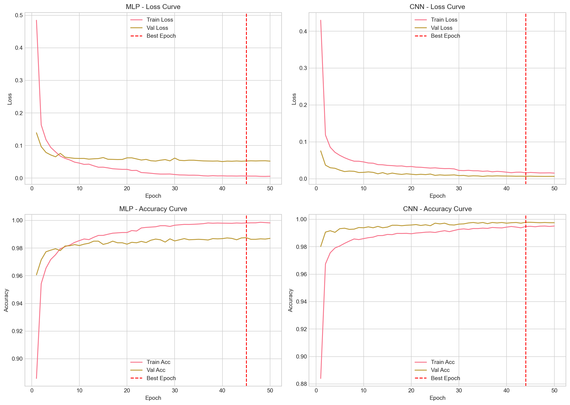
Neural Network Loss Curve & Best Checkpoint Epoch
Regularization
BatchNorm
Dropout
Weight decay
Data augmentation
Training Result
Best result of MLP at 45 epoch
Best result of CNN at 44 epoch
MSI 5102 | MNIST Digit Recognition

Slide 17
05
Final Model Comparison

Slide 18
Final Test-Set Comparison
Model | Test Accuracy | Train Time (s) | Predict Time (s)
CNN (Neural Network) | 99.65% | 347.29 | 0.066
MLP (Neural Network) | 98.72% | 32.19 | 0.024
KNN (Optimized) | 97.74% | 0.22 | 0.253
Logistic Regression | 92.27% | 0.86 | 0.008
MSI 5102 | MNIST Digit Recognition

Slide 19
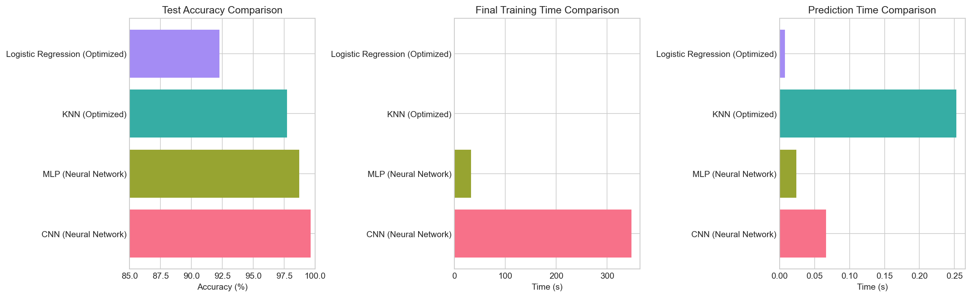
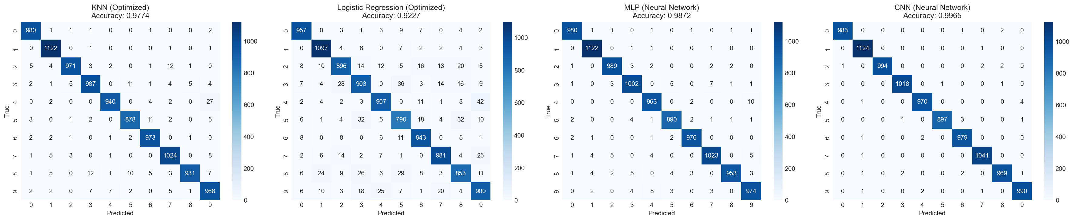
Final Test-Set Comparison
MSI 5102 | MNIST Digit Recognition

Slide 20
Summary of models and insights
Overall, model performance highlights the importance of non-linear feature learning for images, with deep learning models significantly outperforming linear and distance-based approaches on MNIST
Model | Strengths | Weaknesses | Other Remarks / Insights
CNN (Neural Network) | Best performance because it is able to capture non-linear, complex spatial features | High compute time, resource-heavy
MLP (Neural Network) | Strong performance,
KNN (Optimized) | Surprisingly competitive baseline. Easy to train. | Sensitive to distance metrics and hyperparameter selection
Logistic Regression | Fast and simple | Lowest relative accuracy because a linear decision boundary fundamentally limits performance on image classification.
MSI 5102 | MNIST Digit Recognition

Slide 21
06
Dimensionality Reduction

Slide 22
PCA & t-SNE Visualization
PCA (2D)
t-SNE (2D)
Variance explained: 16.70%
PC1: 9.54% | PC2: 7.16%
Shows broad global structure but heavy overlap among classes
Digits 0, 1, 6 show partial directional separation
Linear projection compresses too much information into 2 axes
Pre-step: PCA to 50D, then t-SNE to 2D
Perplexity = 30
Produces much more distinct local clusters
Most digits form compact, interpretable groups
Overlap appears between morphologically similar digits (e.g. 4/9, 3/5)
PCA = coarse global view | t-SNE = fine local class separability
MSI 5102 | MNIST Digit Recognition

Slide 23
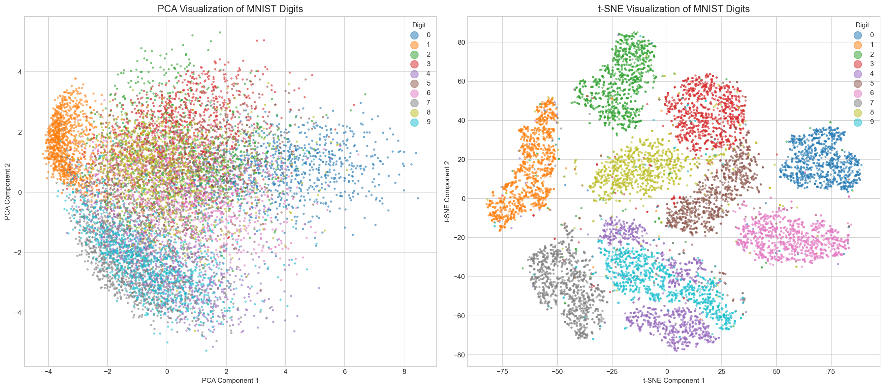
PCA & t-SNE Visualization
MSI 5102 | MNIST Digit Recognition
Notes:
[Tim]: Missing: Interpretation of clustering patterns t-SNE visualization is much better, ighly distinct clusters. It also shows some of the established ‘common misclassifications’ like 4 and 9, 3 and 8, 3 and 5. Why it is better? Because it preserves local non-linear structures and prioritises local neighbours, thereby similar points are placed closer together forming more distinct clusters.

Slide 24
PCA & t-SNE Visualization
t-SNE is visually superior, showing highly distinct clusters
PCA:
Prioritises global structure, results in heavy overlap among classes
Linear projection compresses too much information into 2 axes
Only digit 1 has the clearest directional separation
t-SNE:
Pre-step: PCA to 50D, then t-SNE to 2D, Perplexity = 30
Preserves non-linear structure and prioritises local neighbours
Produces much more distinct local clusters representing each class
Morphologically similar digits (e.g. 4 and 9, 3 and 5) are visually close / overlap each other
MSI 5102 | MNIST Digit Recognition
Notes:
[Tim]: Missing: Interpretation of clustering patterns t-SNE visualization is much better, ighly distinct clusters. It also shows some of the established ‘common misclassifications’ like 4 and 9, 3 and 8, 3 and 5. Why it is better? Because it preserves local non-linear structures and prioritises local neighbours, thereby similar points are placed closer together forming more distinct clusters.

Slide 25
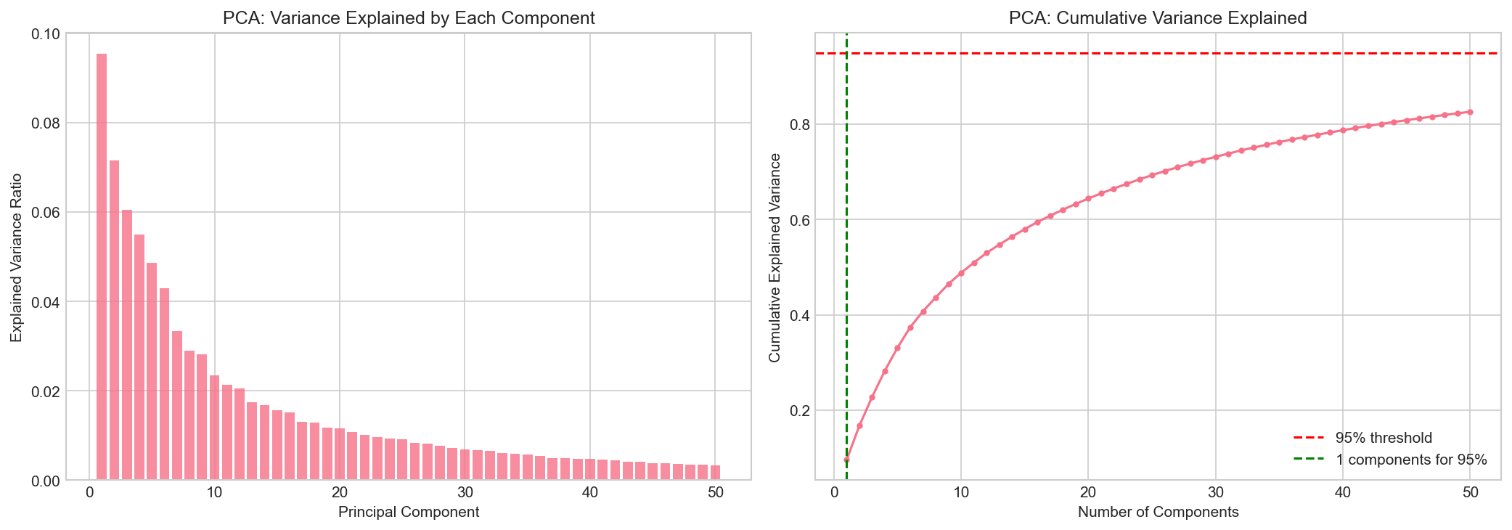
PCA & t-SNE Visualization
Only 16.7% of the data’s variance is captured in PCA 2D, hence not being representative
PCA:
PC1: 9.54% | PC2: 7.16%
Variance explained: 16.70%
MSI 5102 | MNIST Digit Recognition

Slide 26
07
Ablation Study

Slide 27
Partial Ablation — Optimizer & Weight Decay
Fixed architecture, best-checkpoint restoration. Single-run results (exploratory).
Run | Optimizer | Weight Decay | MLP Epoch/ValAcc | MLP Test | CNN Epoch/ValAcc | CNN Test
1 | Adam | 5e-5 | 40 / 0.9870 | 98.65% | 28 / 0.9970 | 99.57%
2 | AdamW | 5e-5 | 39 / 0.9875 | 98.49% | 38 / 0.9973 | 99.57%
3 | AdamW | 0 | 22 / 0.9878 | 98.46% | 35 / 0.9978 | 99.59%
4 | AdamW | 1e-5 | 30 / 0.9882 | 98.54% | 35 / 0.9977 | 99.58%
5 | AdamW | 1e-4 | 23 / 0.9877 | 98.60% | 30 / 0.9972 | 99.60%
MLP Findings
CNN Findings
More sensitive to optimizer & weight decay
Adam outperformed AdamW at fixed wd=5e-5
Best AdamW: wd=1e-4 -> 98.60%
Remarkably robust across all settings
Test accuracy range: 99.57% - 99.60%
wd=1e-4 marginally best (99.60%)
MSI 5102 | MNIST Digit Recognition

Slide 28
08
Conclusions

Slide 29
Main Conclusions
1
CNN is the strongest model — 99.65% test accuracy with per-sample data augmentation and best-checkpoint restoration.
2
MLP provides an excellent performance/complexity trade-off at 98.72%, especially after extending training and checkpoint selection.
3
KNN is a strong classical baseline (97.74%) — Euclidean distance + small k + 90% PCA retention is the sweet spot.
4
Logistic Regression peaks at 92.27% — a linear decision boundary fundamentally limits performance on image classification.
5
t-SNE reveals much clearer local class clusters than PCA, providing better visual insight into digit separability.
6
Ablation shows CNN is robust to optimizer/regularization choices, while MLP is more sensitive — AdamW + wd=1e-4 is a good default.
MSI 5102 | MNIST Digit Recognition

Slide 30
Thank You
Questions & Discussion

