Slide 1





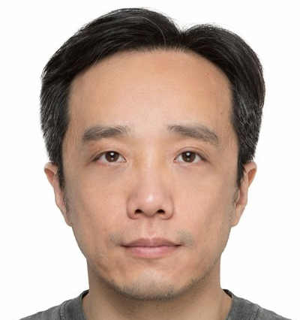
MSI 5102 | Type 2 Project | Group 6
Handwritten Digit Recognition
MNIST Dataset | KNN | Logistic Regression | MLP | CNN
Experiment Report & Model Comparison
Tim Gan (e1561523@u.nus.edu)
Guo Hao
(e1538515@u.nus.edu)
Guo Weijie
(e1539332@u.nus.edu)
Lu Biying
(e1553384@u.nus.edu)
Xu Jianfeng
(e1553618@u.nus.edu)
Jia Jie
(e1553212@u.nus.edu)

Slide 2
Agenda
01
Dataset & Workflow
02
Dimensionality Reduction (PCA & t-SNE)
03
KNN — Pipeline & Grid Search Result
04
Logistic Regression — Pipeline & Grid Search Result
05
MLP Neural Network & CNN
06
Final Model Comparison
07
Ablation Study
08
Conclusions
MSI 5102 | MNIST Digit Recognition

Slide 3
01
Dataset & Workflow

Slide 4
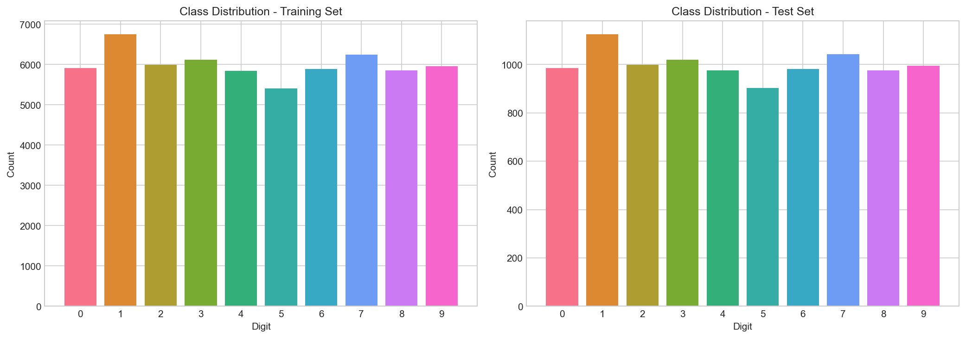
Dataset & Workflow
Load & normalize MNIST
70,000 grayscale images (28x28)
10 classes (digits 0-9)
Pixels normalized to [0, 1]
GridSearchCV for KNN & LR (Pipeline)
Train MLP & CNN (54K train / 6K val)
Evaluate all models on test set (10K)
PCA & t-SNE visualization
60,000 train / 10,000 test (follows MNIST benchmark)
MSI 5102 | MNIST Digit Recognition

Slide 5
Implementation Pipeline (5fold + PCA + Model)
KNN Python Pipeline
KNN Search Space
Pipeline(
steps=[
('pca', PCA(svd_solver='full', random_state=SEED)),
('knn', KNeighborsClassifier()),],
memory=pipeline_memory,
)
KNN_PARAM_GRID = {
'pca__n_components': [0.90, 0.95, 0.99],
'knn__n_neighbors': [1, 3, 5, 7, 9],
'knn__weights': ['uniform', 'distance'],
'knn__metric': ['euclidean', 'manhattan'],
}
LR Python Pipeline
LR Search Space
Pipeline(
steps=[
('pca', PCA(svd_solver='full', random_state=SEED)),
(‘lr’, LogisticRegression(max_iter=3000, random_state=SEED)),],
memory=pipeline_memory,
)
LR_PARAM_GRID = {
'pca__n_components': [0.90, 0.95, 0.99],
'lr__C': [0.01, 0.1, 1.0, 10.0],
'lr__solver': ['lbfgs', 'saga'],
'lr__penalty': ['l2'],
}
MSI 5102 | MNIST Digit Recognition
Notes:
两个传统模型可以共享一个清晰的调参框架
可以直接比较不同 PCA 保留比例下的表现
还能避免数据泄露，因为 PCA 在 CV fold 内拟合 假设当前这轮 CV 里：
fold-train 有 48000 条
fold-val 有 12000 条
用 fold-train 执行pca.fit(fold_train) 再分别做: fold_train_pca = pca.transform(fold_train) （把 fold_train 投影到 PCA 空间） fold_val_pca = pca.transform(fold_val) 用刚才只在 fold-train 上学出来的同一个 PCA 规则
把训练折和验证折都投影到同一个 PCA 空间里

Slide 6
02
Dimensionality Reduction

Slide 7
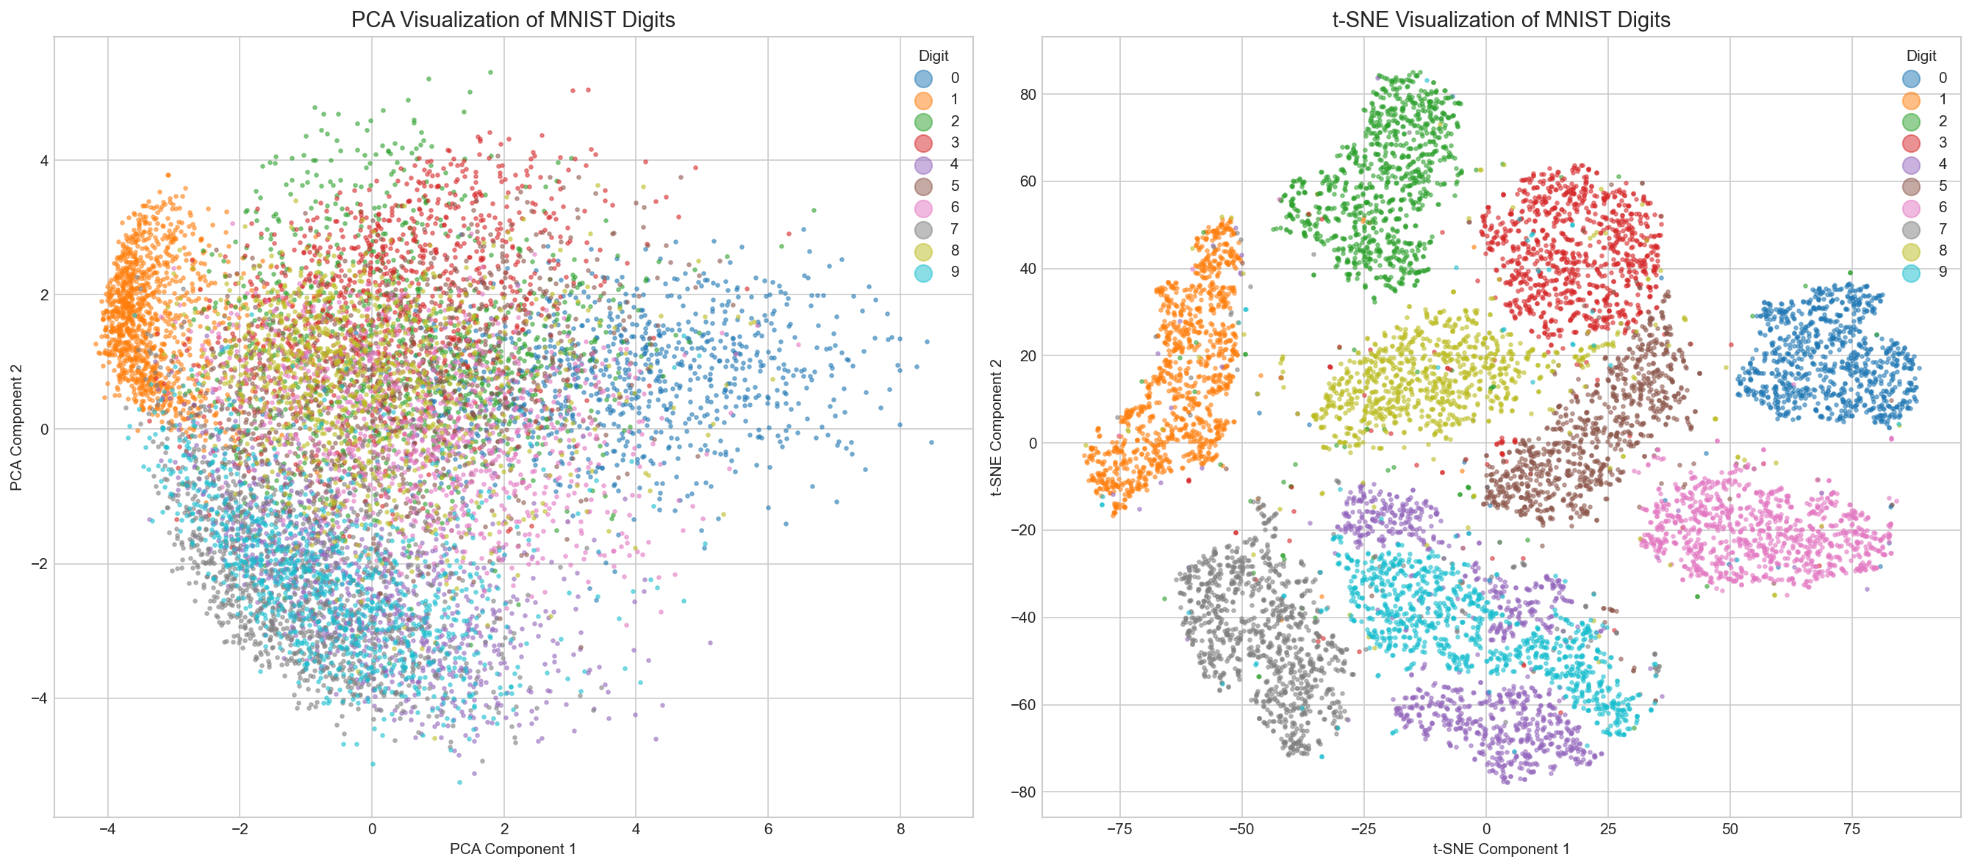
PCA & t-SNE Visualization
MNIST is a dense dataset; t-SNE is visually superior, showing highly distinct clusters
PCA:
Prioritizes global structure, results in heavy overlap among classes
Linear projection compresses too much information into 2 axes
Only digit 1 has the clearest directional separation
t-SNE:
Pre-step: PCA to 50D, then t-SNE to 2D, Perplexity = 30
Preserves non-linear structure and prioritizes local neighbors
Produces much more distinct local clusters representing each class
Morphologically similar digits (e.g. 4 and 9, 3 and 5) are visually close / overlap each other
MSI 5102 | MNIST Digit Recognition
Notes:
The PCA projection reveals broad global organization but substantial class overlap. Several digit classes exhibit directional tendencies in the 2D plane, yet the class clouds remain heavily entangled in the center of the projection. This is especially visible for digits with similar stroke patterns, such as `2`, `3`, `5`, `8`, and `9`. From an analytical perspective, the PCA plot supports the following interpretation: The t-SNE projection produces a much clearer organization of the data. Most digit classes form compact and visually coherent clusters, with only limited overlap between morphologically similar classes. Compared with PCA, t-SNE makes local neighborhood structure much more explicit.
This suggests that:
- in the original high-dimensional feature space, samples from the same class tend to form locally coherent neighborhoods
- class separation is more apparent in a nonlinear manifold view than in a linear 2D projection
- methods that exploit local or nonlinear structure are better aligned with the geometry of MNIST
----- [Tim]: Missing: Interpretation of clustering patterns t-SNE visualization is much better, ighly distinct clusters. It also shows some of the established ‘common misclassifications’ like 4 and 9, 3 and 8, 3 and 5. Why it is better? Because it preserves local non-linear structures and prioritises local neighbours, thereby similar points are placed closer together forming more distinct clusters.

Slide 8
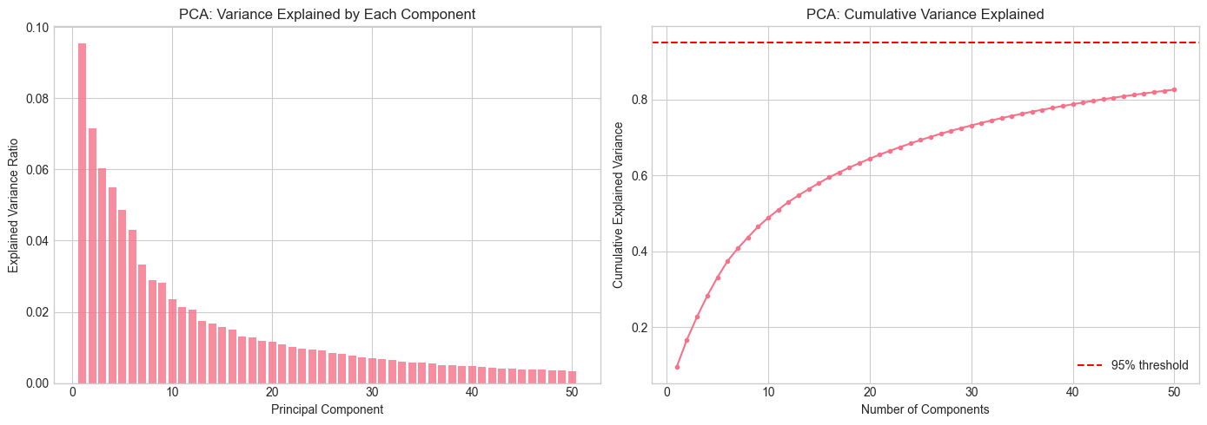
PCA & t-SNE Visualization
Only 16.7% of the data’s variance is captured in PCA 2D, hence not being representative
PCA:
PC1: 9.54% | PC2: 7.16%
Variance explained: 16.70%
the cumulative explained variance at 50 components is approximately 82.61%
PCA preserves variance in a linear sense and is more informative about global structure.
t-SNE preserves local neighborhood relationships and is more informative about cluster formation.
MSI 5102 | MNIST Digit Recognition
Notes:
- MNIST contains meaningful low-dimensional global structure.
- That global structure is not sufficient, in only two linear components, to separate classes cleanly.
- A purely linear low-dimensional view does not capture the full discriminative geometry of the dataset.
This observation is consistent with the model results. Logistic Regression, which relies on linear decision boundaries after PCA, performs substantially worse than KNN, MLP, and CNN. This interpretation is again consistent with the empirical model ranking:
- Logistic Regression is weakest
- KNN is substantially stronger because it leverages local neighborhood information
- MLP and CNN outperform both classical baselines because they learn nonlinear decision boundaries
- CNN performs best because it also exploits the spatial structure of the image

Slide 9
03
K-Nearest Neighbors (KNN)

Slide 10
KNN — Pipeline (PCA + KNN)
Search Space (5-Fold GridSearchCV)
Best Configuration
PCA variance: 0.90, 0.95, 0.99
k: 1, 3, 5, 7, 9
Weights: uniform, distance
Metric: euclidean, manhattan
60 (3x5x2x2) combinations x 5 folds = 300 fits
in total 60K training samples
PCA variance retained: 0.90
K: 3,
Weights: distance
Metric: euclidean
Best CV accuracy: 0.9758
Search time: 510.55 s
Test Accuracy: 97.74% Train: 0.22s | Predict: 0.25s
MSI 5102 | MNIST Digit Recognition
Notes:
distance 时距离越近权重越大

Slide 11
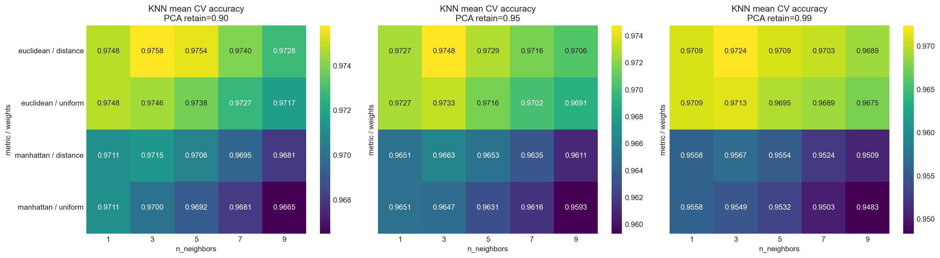
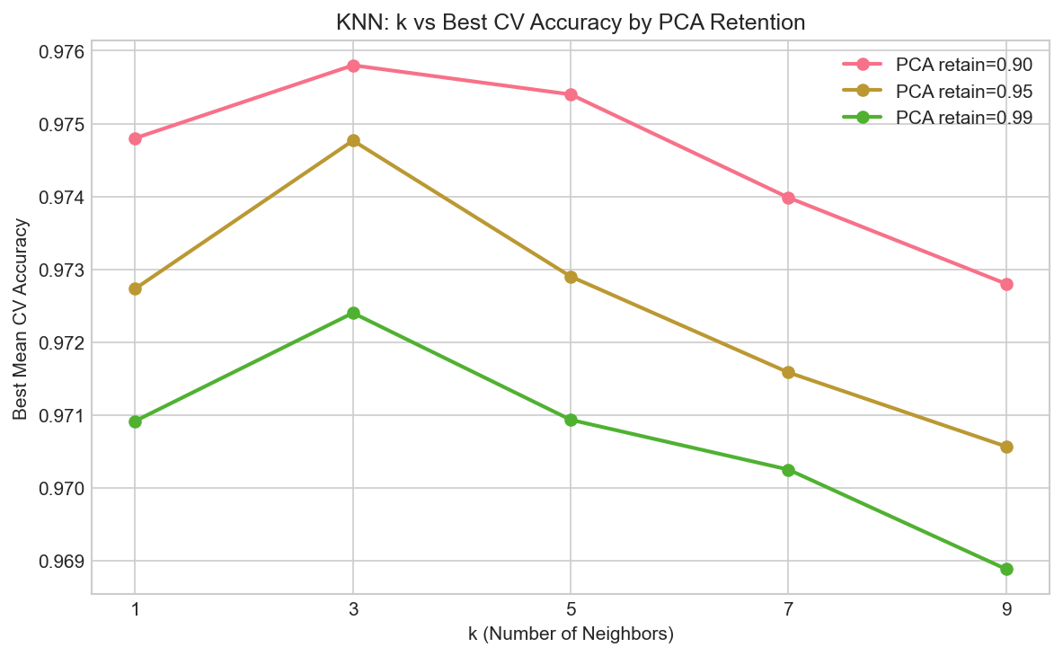
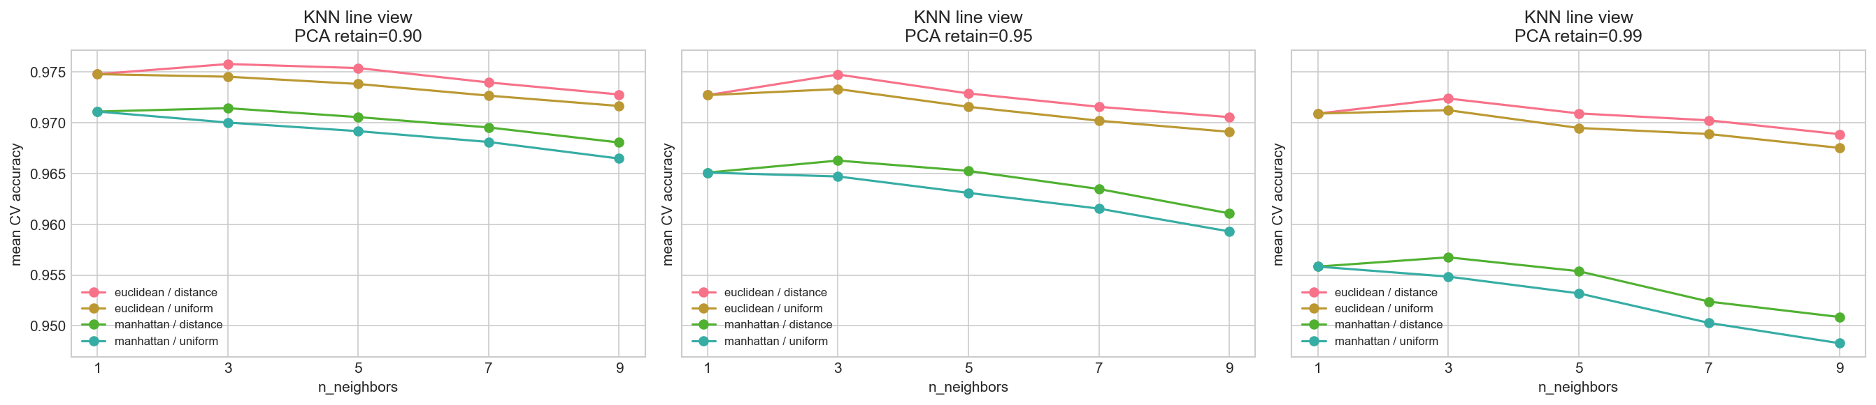
KNN — GridSearchCV Result
Best results: k=3 with PCA retention 0.9
MSI 5102 | MNIST Digit Recognition

Slide 12
KNN — Results & Key Observations
Number | precision | recall | f1-score | support
0 | 0.98 | 0.99 | 0.99 | 986
1 | 0.98 | 1 | 0.99 | 1125
2 | 0.99 | 0.97 | 0.98 | 999
3 | 0.97 | 0.97 | 0.97 | 1020
4 | 0.99 | 0.96 | 0.98 | 975
5 | 0.97 | 0.97 | 0.97 | 902
6 | 0.98 | 0.99 | 0.98 | 982
7 | 0.97 | 0.98 | 0.98 | 1042
8 | 0.99 | 0.95 | 0.97 | 975
9 | 0.95 | 0.97 | 0.96 | 994
Euclidean distance consistently outperformed Manhattan distance
Retaining 90% PCA variance was better than 95% or 99%
Distance-weighted voting slightly outperformed uniform voting
Top-ranked configurations were tightly clustered — KNN is relatively stable once metric and PCA retention are well-chosen
Insight
Lower PCA retention (90%) acts as implicit regularization, reducing noise from less informative components and improving KNN's distance-based decisions.
MSI 5102 | MNIST Digit Recognition
Notes:
1) “Since MNIST images are dense and represent smooth shapes, Euclidean distance better captures overall visual similarity, whereas Manhattan distance is more suited for sparse data like text.” 2) Although MNIST is dense, not all pixel variations are equally informative. Retaining 90% variance removes redundant and noisy components while preserving the key structural features of digits, improving KNN’s distance calculations
3) “In MNIST, small differences in pixel values can significantly affect digit identity, so giving higher weight to closer neighbours improves classification accuracy.”
4) “A small k works better because MNIST has locally distinct clusters, and using too many neighbours can mix similar-looking digits and reduce accuracy.” “The stability of top configurations suggests that MNIST has a well-structured feature space, where reasonable parameter choices consistently yield good performance.” These findings align with the nature of MNIST as a dense, continuous image dataset. Euclidean distance performs better because it captures global shape similarity, while distance-weighted voting improves sensitivity to subtle pixel differences. A small k works best due to locally distinct clusters, avoiding class mixing. Additionally, PCA at 90% removes redundant variation while preserving key structure. Together, these results reflect that MNIST has a well-structured, continuous feature space where local similarity and shape information are critical.

Slide 13
04
Logistic Regression

Slide 14
Logistic Regression — Pipeline (PCA + LR)
Search Space (5-Fold GridSearchCV)
Best Configuration
PCA variance: 0.90, 0.95, 0.99, raw(separated test)
C: 0.01, 0.1, 1.0, 10.0
Solver: lbfgs, saga
Penalty: L2
24 (3x4x2x1) combinations x 5 folds = 120 fits
PCA variance retained: 0.99
C = 0.1
Solver = lbfgs
Penalty: L2
Best CV accuracy: 0.9216
Search time: 626.57 s
PCA 0.99 dominated the top configurations — Logisitc Regression benefits from more features than KNN
lbfgs was substantially faster than saga at comparable accuracy
Logistic Regression clearly lagged behind KNN — linear boundary is limiting on MNIST
Test Accuracy: 92.27% Train: 0.86s | Predict: 0.008s
MSI 5102 | MNIST Digit Recognition
Notes:
We applied PCA to reduce dimensionality and remove noise, followed by Logistic Regression to learn linear decision boundaries across the 10 digit classes. We compared lbfgs and saga optimisers, and found that lbfgs performed better due to its stability on dense data like MNIST. The regularisation parameter C controls model flexibility, and a smaller value of 0.1 provided better generalisation. However, Logistic Regression underperforms overall because it is limited to linear boundaries, which are insufficient for complex image data PCA 先把图像压缩到更低维、噪声更少的线性子空间, Logistic Regression 再在这个子空间里学习 10 类 softmax 线性边界 lbfgs: 是二阶近似优化方法，适合中小到中等规模的稠密数据，收敛稳定，做多分类 softmax 很常见。
saga: 是随机梯度类方法，适合更大规模数据，也支持 L1、ElasticNet 这类稀疏正则。
C 控制正则强度
C 越小，正则越强
C 越大，模型越自由
Best parameters: {'C': 0.1, 'penalty': 'l2', 'solver': 'lbfgs’} Best CV accuracy: 0.9223 GridSearchCV total time: 3168.49s Estimated CV-only search time: 3166.08s GridSearchCV internal refit time: 2.41s Best estimator: LogisticRegression(C=0.1, max_iter=5000, penalty='l2', random_state=42)

Slide 15
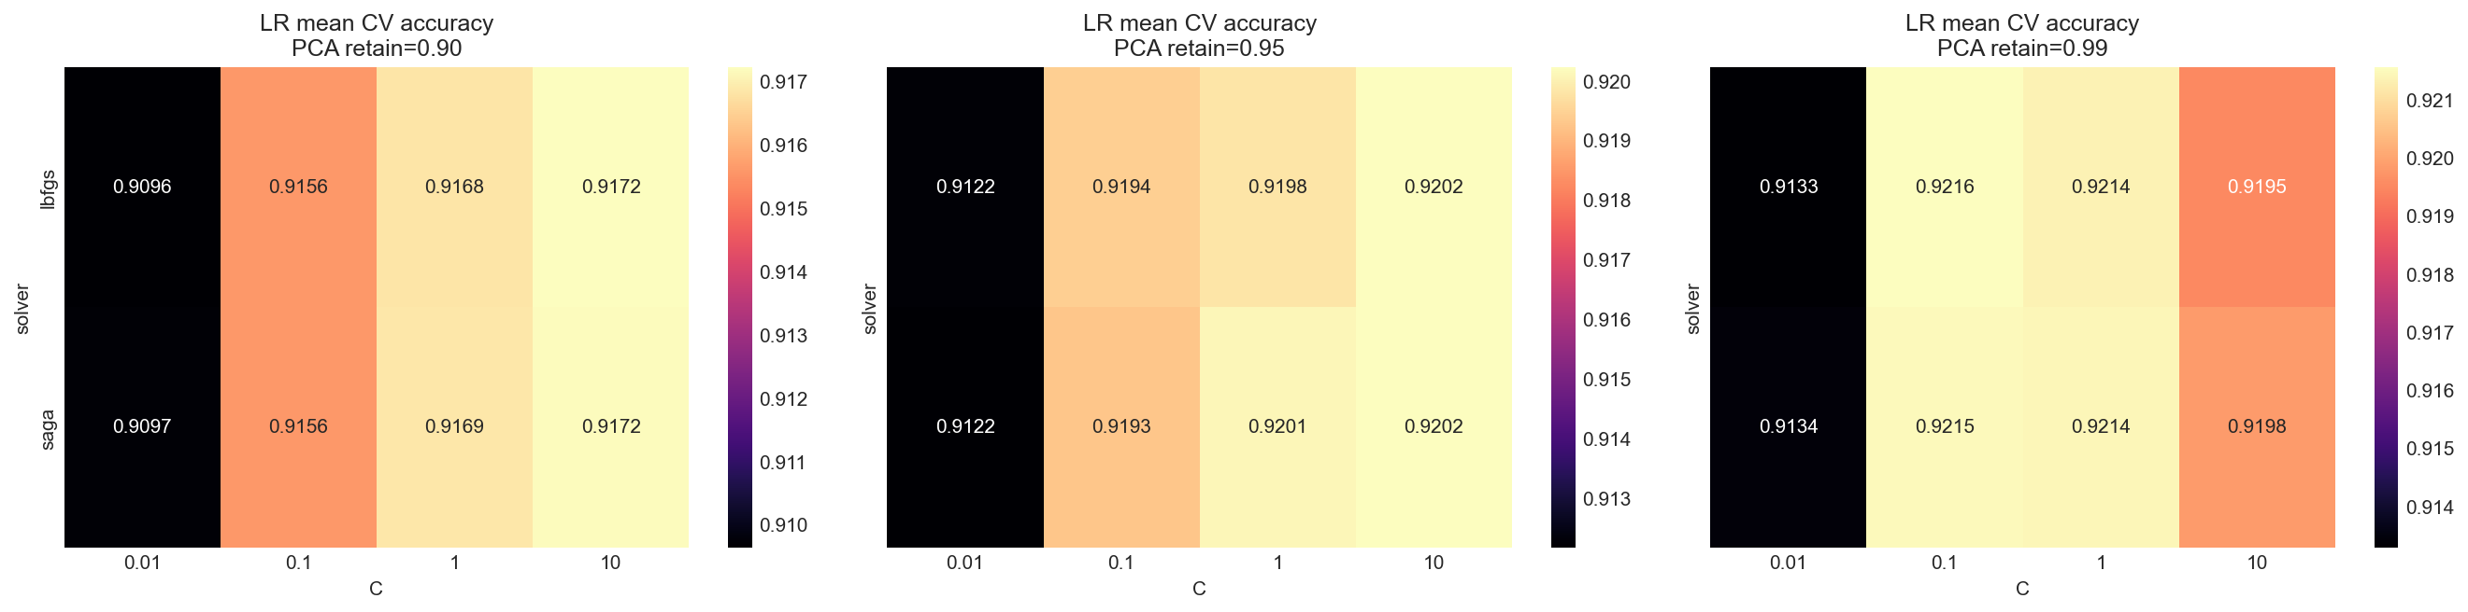
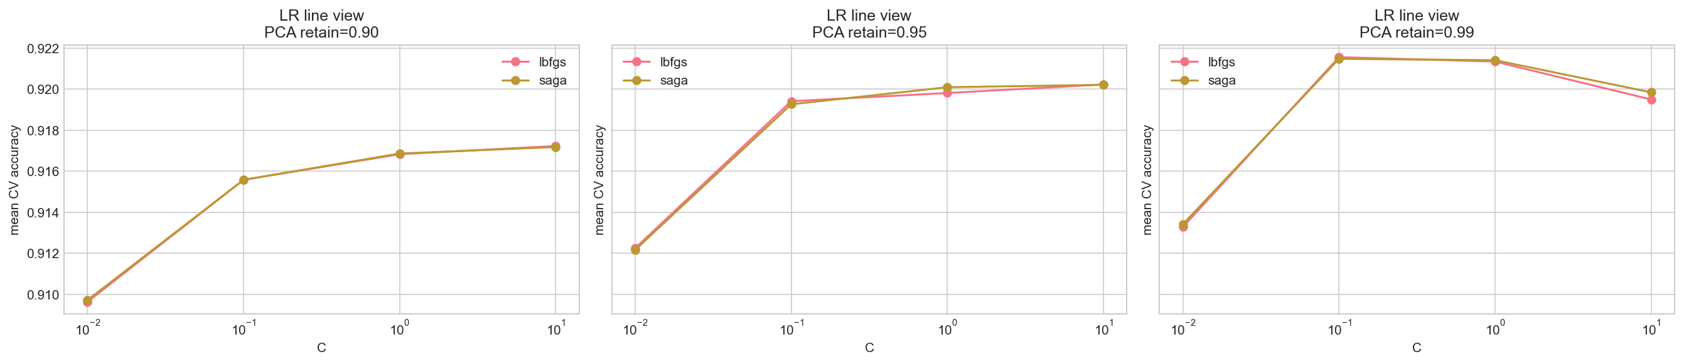
Logistic Regression — GridSearchCV Result
Best results: C=0.1 with PCA retention 0.99
MSI 5102 | MNIST Digit Recognition

Slide 16
Logistic Regression — Results &Key Observations
Number | precision | recall | f1-score | support
0 | 0.96 | 0.97 | 0.96 | 986
1 | 0.95 | 0.98 | 0.96 | 1125
2 | 0.92 | 0.9 | 0.91 | 999
3 | 0.9 | 0.89 | 0.89 | 1020
4 | 0.93 | 0.93 | 0.93 | 975
5 | 0.88 | 0.88 | 0.88 | 902
6 | 0.93 | 0.96 | 0.95 | 982
7 | 0.95 | 0.94 | 0.94 | 1042
8 | 0.9 | 0.87 | 0.89 | 975
9 | 0.89 | 0.91 | 0.9 | 994
99% PCA dominated the highest-ranked configurations.
lbfgs and saga produced very similar validation accuracy near the top of the table.
lbfgs was substantially faster than saga for comparable accuracy, making it the better practical choice here.
Insight
Logistic Regression remained clearly below KNN, indicating that a linear decision boundary is limiting on this task even after PCA. Raw image info doesn’t help on Logistic Regression.
MSI 5102 | MNIST Digit Recognition
Notes:
The best Logistic Regression configuration used C = 0.1 and retained 99% variance through PCA, indicating that the model benefits from more features. While both lbfgs and saga achieved similar accuracy, lbfgs was more efficient and therefore preferred. However, Logistic Regression significantly underperforms compared to other models because it is limited to linear decision boundaries, which are insufficient for capturing the complex, non-linear structure of handwritten digits

Slide 17
05
MLP Neural Network & CNN

Slide 18
Neural Network Architecture
Hidden Block 1
Hidden Block 2
Hidden Block 3
MLP
Input
784
Linear
784->
512
BN
ReLU
Linear
512->
256
BN
ReLU
Linear
256->
128
BN
ReLU
Linear128->
10
Output
10
classes
Dropout
Dropout
Dropout
CNN
Conv Block 1(32ch, 14x14)
Conv Block 2(64ch, 7x7)
Input
1x28x28
Conv2d
->
1, 32, 3x3
Conv2d
->
32, 32, 3x3
Max
Pool
Conv2d
->
32, 64, 3x3
Conv2d
->
64, 64, 3x3
Max
Pool
Flatten
3136
Classifier
Head
->256
->10
Output
10
classes
BN ReLU
BN ReLU
Dropout
BN ReLU
BN ReLU
Dropout
MSI 5102 | MNIST Digit Recognition
Notes:
1, 32, 3x3
1输入通道数，32输出通道数（卷积深度）3x3卷积大小 MaxPool(2) 池化窗口大小 2x2
stride 默认也是 2

Slide 19
MLP — Multi-Layer Perceptron
Architecture
Training Configuration
784 -> 512 -> 256 -> 128 -> 10
Optimizer: AdamW
Learning rate: 0.0005
Weight decay: 1e-4
Scheduler: ReduceLROnPlateau
Augmentation: Gaussian noise (std=0.05)
Epochs: 50 (best checkpoint restored)
Best checkpoint epoch: 45
Best validation accuracy: 0.9875
3 Blocks
BatchNorm + ReLU + Dropout per layer
Dropout rates: 0.3, 0.3, 0.2
Input: flattened 28x28 images
Test Accuracy: 98.72% Best Epoch: 45 | Train: 32.19s | Predict: 0.024s
MSI 5102 | MNIST Digit Recognition

Slide 20
CNN — Convolutional Neural Network
Architecture – VGG style
Training Configuration
Block 1: Conv(32) -> BN -> ReLU -> Conv(32) -> BN -> ReLU -> MaxPool -> Dropout(0.25)
Block 2: Conv(64) -> BN -> ReLU -> Conv(64) -> BN -> ReLU -> MaxPool -> Dropout(0.25)
Head: Linear(3136->256) -> BN -> ReLU -> Dropout(0.5) -> Linear(256->10)
Optimizer: AdamW (lr=0.0005, wd=1e-4)
Scheduler: ReduceLROnPlateau
Data augmentation (per-sample):
RandomRotation(+-10 deg)
RandomAffine(translate=10%)
Epochs: 50 (best checkpoint restored)
Best checkpoint epoch: 44
Best validation accuracy: 0.9978
Test Accuracy: 99.65% Best Epoch: 44 | Train: 347.3s | Predict: 0.066s
MSI 5102 | MNIST Digit Recognition
Notes:
“The superior performance of CNN highlights the importance of model-data alignment — models that exploit spatial structure significantly outperform generic models on image data.”
The MLP model treats each image as a flat vector of pixels, which causes it to lose important spatial relationships between neighbouring pixels. As a result, it struggles to capture meaningful patterns such as edges and shapes. In contrast, CNN preserves spatial structure through convolutional layers, allowing it to learn hierarchical features like edges and digit shapes. This makes CNN significantly more effective for image classification tasks like MNIST, resulting in higher accuracy and better generalisation.

Slide 21
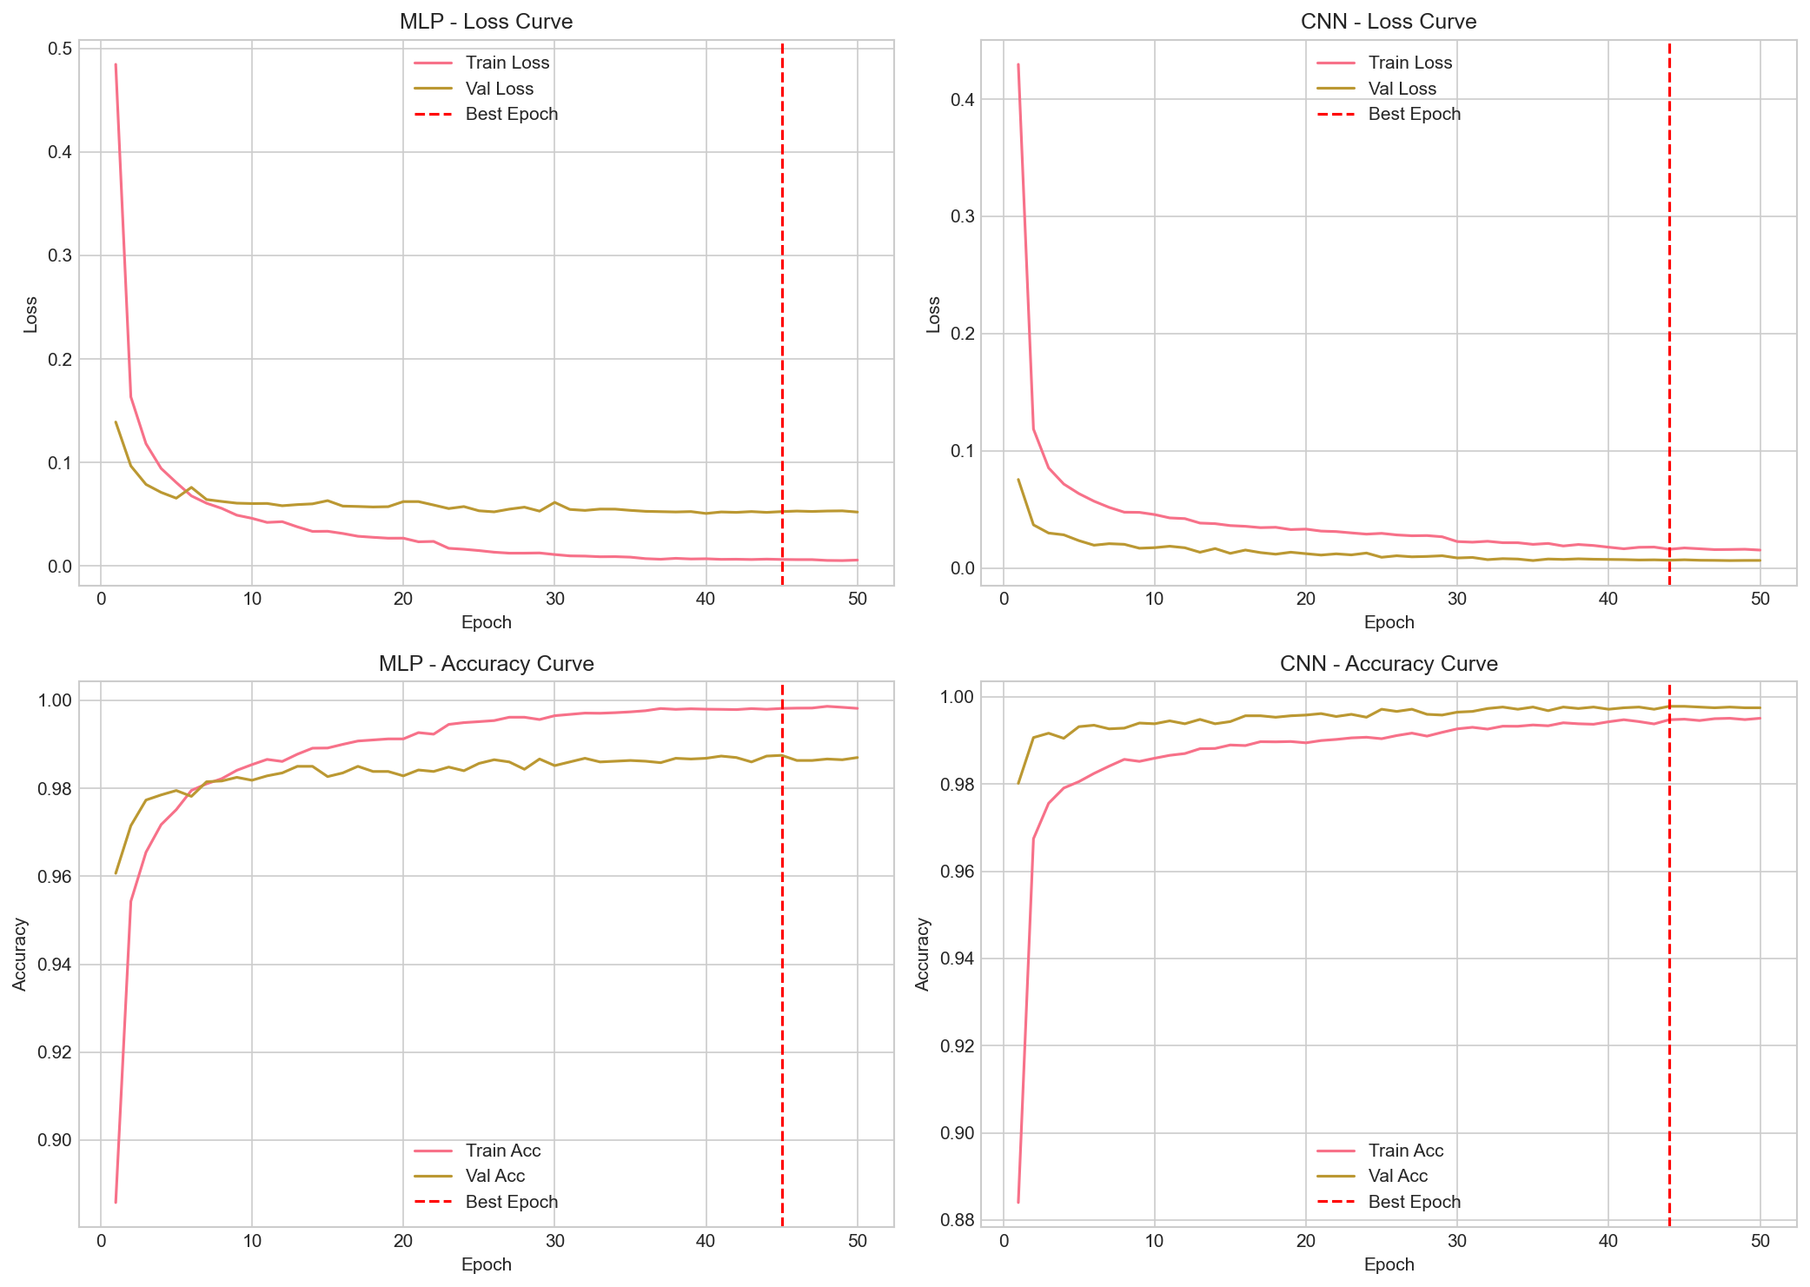
Neural Network Loss Curve & Best Checkpoint Epoch
Regularization
BatchNorm (BN size = 256)
Dropout
Weight decay
Early Stop
Data augmentation ( Rotation & Affine)
Training Result
Best result of MLP at 45 epoch
Best result of CNN at 44 epoch
MSI 5102 | MNIST Digit Recognition

Slide 22
06
Final Model Comparison

Slide 23
Final Results-Set Comparison
Model | Test Accuracy | Train Time (s) | Predict Time (s)
CNN (Neural Network) | 99.65% | 347.29 | 0.066
MLP (Neural Network) | 98.72% | 32.19 | 0.024
KNN (Optimized) | 97.74% | 0.22 | 0.253
Logistic Regression | 92.27% | 0.86 | 0.008
MSI 5102 | MNIST Digit Recognition

Slide 24
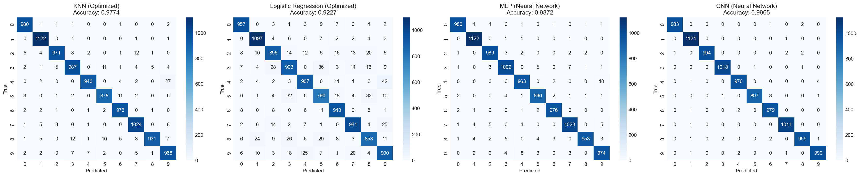
Final Results-Confusion Matrix
MSI 5102 | MNIST Digit Recognition

Slide 25
07
Ablation Study

Slide 26
Partial Ablation — Optimizer & Weight Decay
Fixed architecture, best-checkpoint restoration. Single-run results (exploratory).
Run | Optimizer | Weight Decay | MLP Epoch/ValAcc | MLP Test | CNN Epoch/ValAcc | CNN Test
1 | Adam | 5e-5 | 40 / 0.9870 | 98.65% | 28 / 0.9970 | 99.57%
2 | AdamW | 5e-5 | 39 / 0.9875 | 98.49% | 38 / 0.9973 | 99.57%
3 | AdamW | 0 | 22 / 0.9878 | 98.46% | 35 / 0.9978 | 99.59%
4 | AdamW | 1e-5 | 30 / 0.9882 | 98.54% | 35 / 0.9977 | 99.58%
5 | AdamW | 1e-4 | 23 / 0.9877 | 98.60% | 30 / 0.9972 | 99.60%
MLP Findings
CNN Findings
More sensitive to optimizer & weight decay
Adam outperformed AdamW at fixed wd=5e-5
Best AdamW: wd=1e-4 -> 98.60%
Remarkably robust across all settings
Test accuracy range: 99.57% - 99.60%
wd=1e-4 marginally best (99.60%)
MSI 5102 | MNIST Digit Recognition

Slide 27
08
Conclusions

Slide 28
Summary of Results
1
CNN is the strongest model — 99.65% test accuracy with per-sample data augmentation and best-checkpoint restoration.
2
MLP provides an excellent performance/complexity trade-off at 98.72%, especially after extending training and checkpoint selection.
3
KNN is a strong classical baseline (97.74%) — Euclidean distance + small k + 90% PCA retention is the sweet spot.
4
Logistic Regression peaks at 92.27% — a linear decision boundary fundamentally limits performance on image classification.
5
t-SNE reveals much clearer local class clusters than PCA, providing better visual insight into digit separability.
6*
Ablation shows CNN is robust to optimizer/regularization choices, while MLP is more sensitive — AdamW + wd=1e-4 is a good default.
MSI 5102 | MNIST Digit Recognition

Slide 29
Summary of models and insights
Overall, model performance highlights the importance of non-linear feature learning for images, with deep learning models outperforming linear and distance-based approaches on MNIST
Model | Performance | Why it Performs This Way on MNIST | Insight (What this reveals)
CNN | Best (99.65%) | Exploits local spatial patterns (edges, strokes) and builds hierarchical features | MNIST is spatially structured image data, not just numbers.
MLP | High (98.72%) | Can model non-linearity, but loses spatial structure when flattening images | Spatial relationships are important, but flattening is suboptimal
KNN (with PCA) | High (97.74%) | Benefits from dense pixel similarity; PCA keeps majority features, making local feature appears | MNIST clusters well in feature space, local similarity is strong
Logistic Regression | Moderate (92.27%) | Assumes linear separability, but digits overlap in complex ways | MNIST has inherently non-linear decision boundaries
MSI 5102 | MNIST Digit Recognition

Slide 30
Thank You
Questions & Discussion
Visit Our Repository for More Details
https://github.com/seaskyjj/MNIST-MSI

