Slide 1
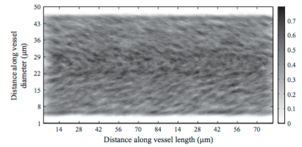
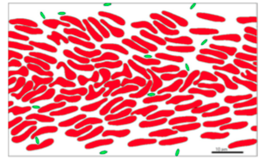
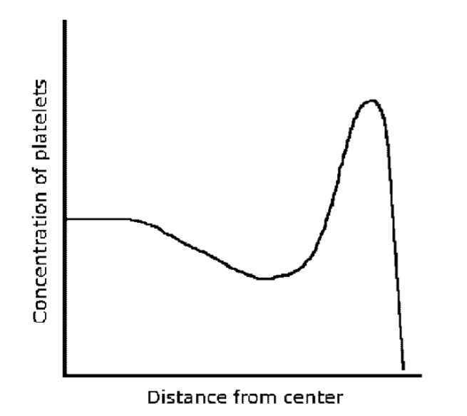
Margination of platelets
Fahraeus effect
Whole blood
Margination
Refs: Crowl & Fogelson (2010, 2011)

Slide 2
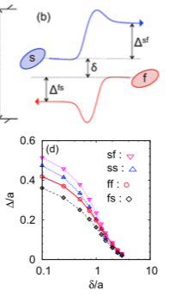
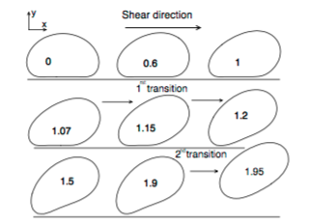
Explanation
Wall-induced migration
Shear-enhanced diffusion
Cantat & Misbah 1999
Kumar & Graham 2012

Slide 3
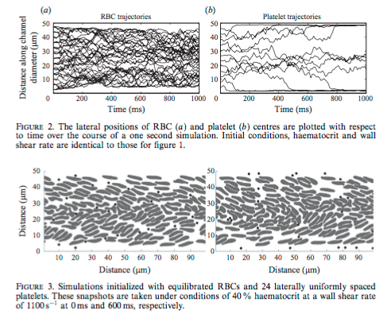
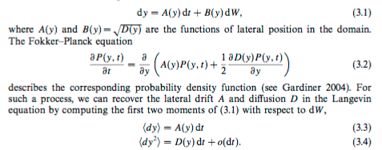
Existing reduced model
Crowl & Fogelson 2011

Slide 4
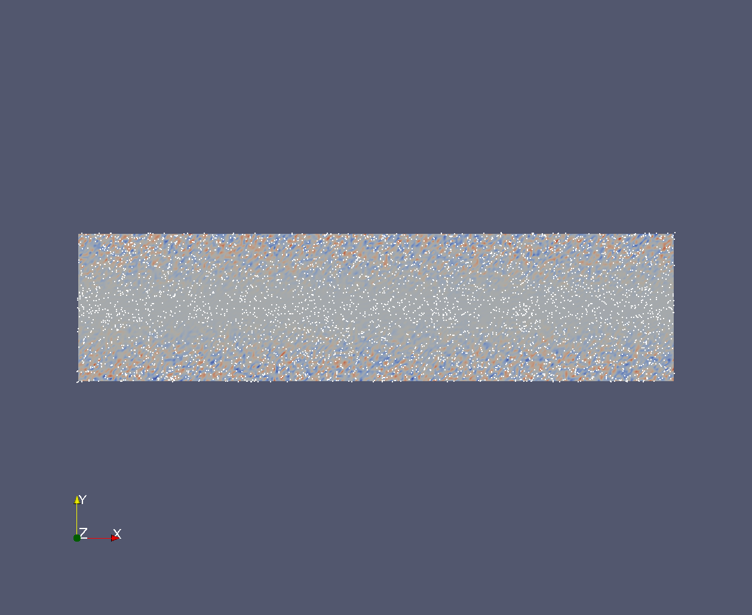
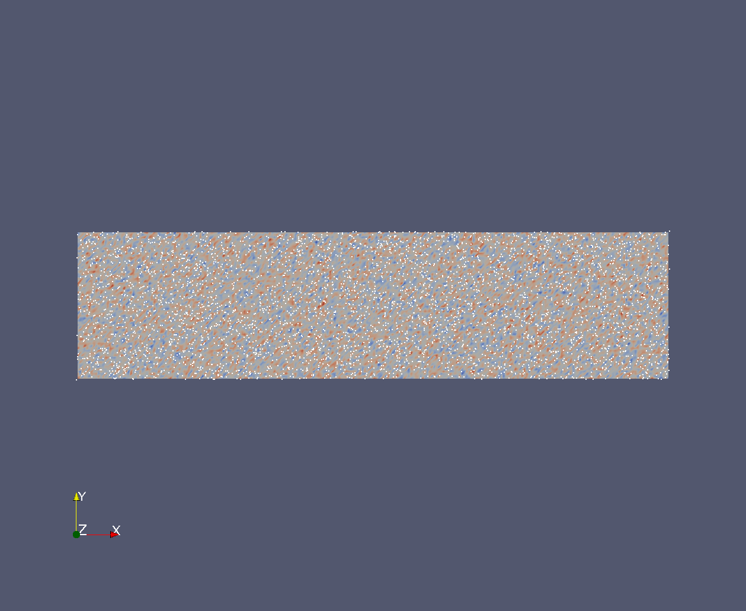
Another idea
Flow is incompressible!
Set T = T(y)

Slide 5
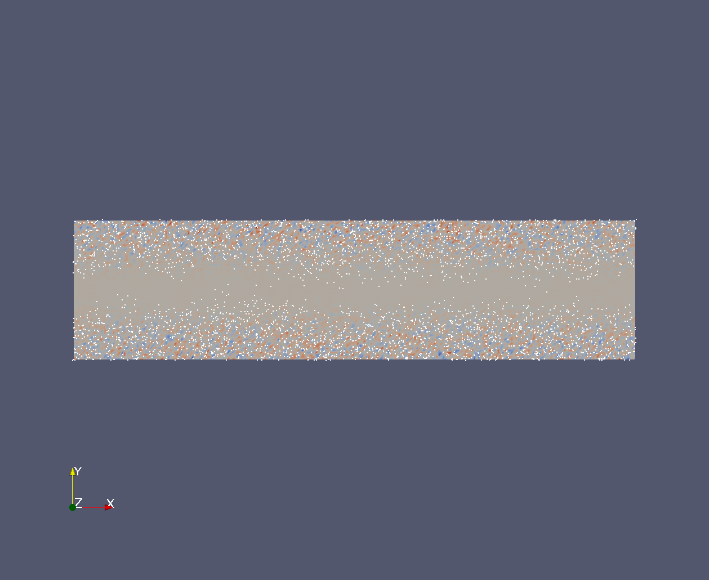
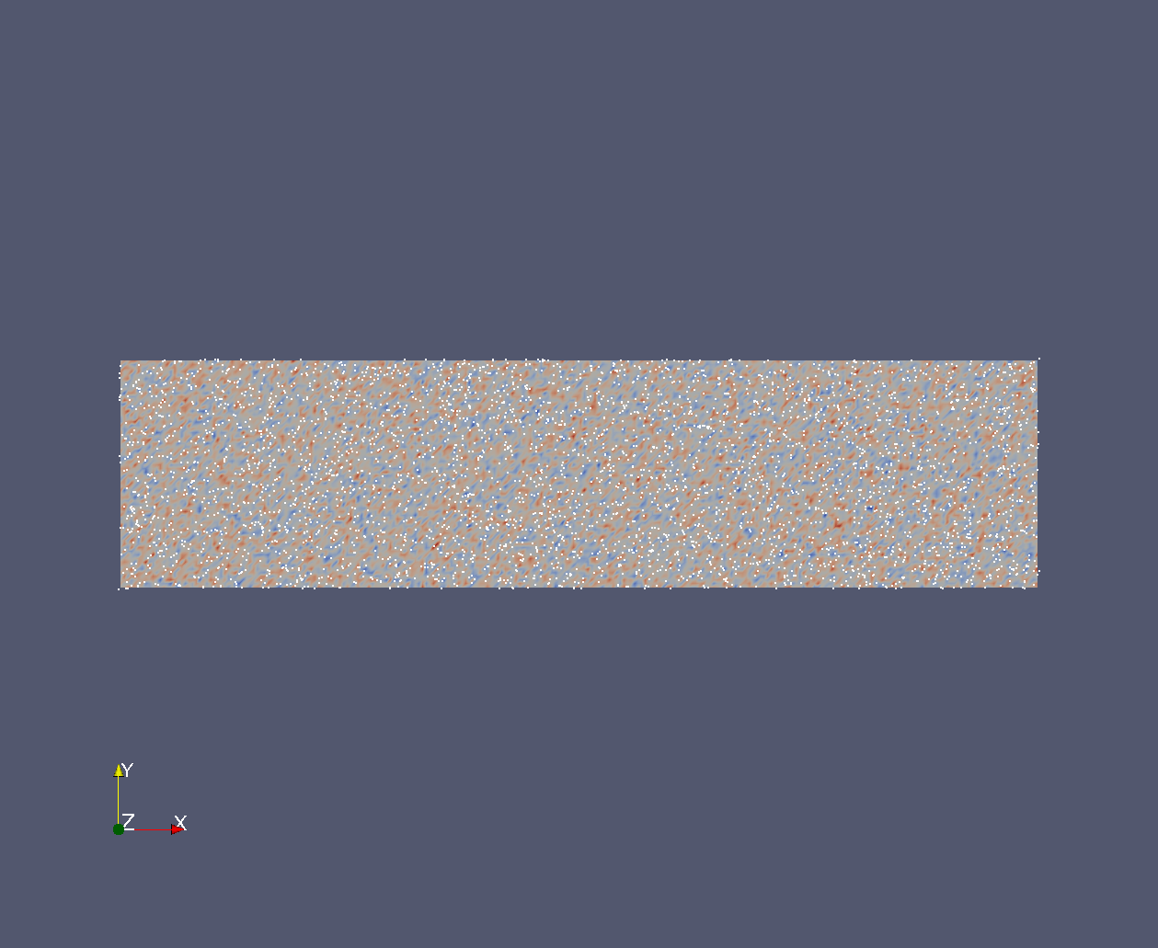
Adding slip

