Slide 1
Intro to AWS

Slide 2
The Cloud
Cloud computing did not come about due to any specific new technology. It is simply a combination of existing tech.
This new paradigm, however, has been revolutionary for IT
Two core enabling technologies are Virtualization and Multi-Tenacy

Slide 3
Multi-tenacy
Multi-tenancy is the sharing of physical IT resources such as CPU, storage, and networking. One of the main reasons that public clouds are affordable.
Virtualization is the technology that allows for the sharing of compute and other resources of a host.

Slide 4
Hypervisors
Xen
* OpenSource
* Used by AWS (originally) and Rackspace Cloud
KVM
* OpenSource
* Used by AWS and Google Cloud
Microsoft Hyper-V
* Microsoft Azure
VMWare ESXi
* Very popular on-prem
Notes:
Hypervisors are special software systems that can emulate physical hardware, allowing for multiple virtual machines to run on a single physical host.

Slide 5
What is "The Cloud"?
“A style of computing in which scalable and elastic IT-enabled capabilities are delivered as a service to external customers using Internet technologies.”
—Gartner Report
Create
$
Delete
On-demand self-service
Broad network access
Resource pooling
Rapid elasticity
Measured service
Notes:
https://www.nist.gov/publications/nist-definition-cloud-computing

Slide 6
Services
Flexibility
Convenient
IaaS
PaaS
SaaS
Kubernetes
Beanstalk
Elastic Container Service
Gmail
S3
VMs
Disk
Network
Notes:
When finding a solution for your use-case, it is best to look for a suitable option from right to left on this diagram. The more managed the solution, as long as it fits your constraints, the less administrative burden to operate.

Slide 7
Cloud Deployment Models
Public - Cloud services made available to the general public
Private - Single-tenant clouds, often located on-prem
Hybrid - Private and Public cloud linked together
Multi - Integration of two or more public cloud providers

Slide 8
The big 3
Amazon Web Services (IaaS 2006)
Large portfolio of services
Google Cloud Platform (PaaS 2008, IaaS 2014)
Massive global network
Microsoft Azure (IaaS 2010)
Good at Microsoft products

Slide 9
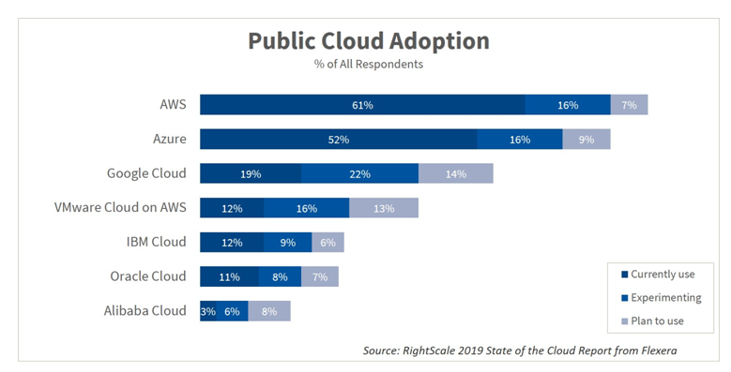

Slide 10
Why the cloud?
Scaling & Efficiency
Pay as you Go (OpEX vs CapEX)
Geo Redundancy and Reliability
Security

Slide 11
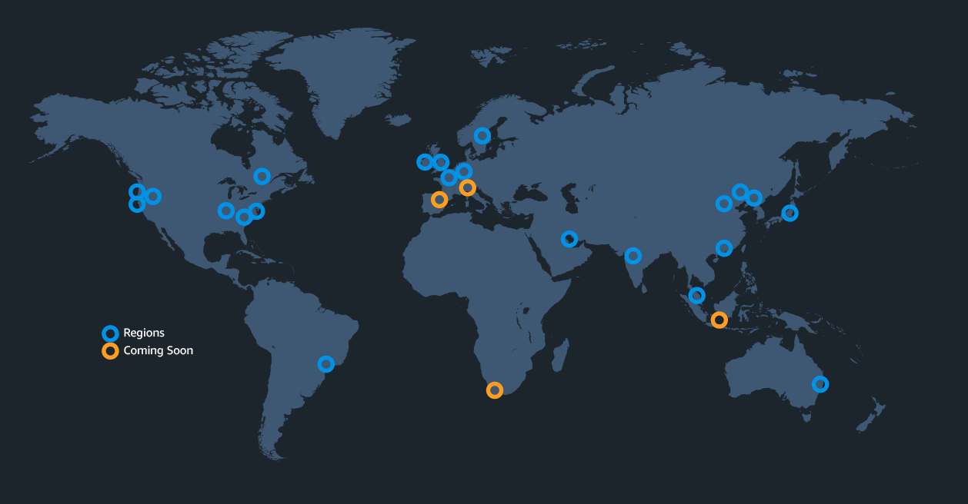
Regions
Notes:
https://aws.amazon.com/what-is-aws/
https://aws.amazon.com/about-aws/global-infrastructure/regions_az/

Slide 12
Availability Zones (fault domains)
Isolated locations within a region, essentially a Datacenter
Each AZ has its own power, cooling, etc
Failures in one zone do not affect another
Region
Availability Zone
Availability Zone
Availability Zone
Notes:
All AZs are physically separate from one another but no further than 100 km apart.

Slide 13
Some AWS Services
IAM - Identity and Access Management
EC2 - Elastic Compute Cloud
S3 - Simple Storage Service
RDS - Relational Database Service
DynamoDB - Managed Document Database
SQS - Simple Queue Service
SNS - Simple Notification Services
Lambda - Functions as a Service
CloudWatch - Cloud logging and monitoring

Slide 14
Interacting with AWS
Web Console - web based GUI
CLI
SDKs
C++, Java, Go, Python, Ruby, Javascript, .NET, Node.js, PHP
Mobile App
Limited functionality

Slide 15
Python SDK example, uploading an object
import boto3
from botocore.exceptions import ClientError
# Upload the file
s3_client = boto3.client('s3')
try:
response = s3_client.upload_file(file_name, bucket, object_name)
except ClientError as e:
logging.error(e)
return False
return True
Notes:
https://aws.amazon.com/sdk-for-python/

Slide 16
Demo
AWS Console
AWS Console

