Slide 1
IAM and EC2

Slide 2

IAM Components
-> Organization
-> Account
-> Users
-> Roles
-> Groups
-> Permissions & Policies
<number>
Notes:
<number>

Slide 3
Users
Root user
- All powerful user created during Account creation
IAM Users
- Created and managed within an Account
Roles
- Identities for non-human users (applications)
<number>
Notes:
<number>

Slide 4
Groups
Best practice is to give permissions to a Group and move users in and out of groups. As opposed to managing individual permissions for each group.
<number>
Notes:
<number>

Slide 5
Policies
Sets of permissions to give to users
Two types:
AWS Managed Policies
Customer Managed Policies
Deny rules take precedence, deny all be default
<number>
Notes:
<number>

Slide 6
Policy Document: Full access to s3
{
"Version": "2012-10-17",
"Statement": [
{
"Effect": "Allow",
"Action": "s3:*",
"Resource": "*"
}
]
}
<number>
Notes:
<number>

Slide 7
Demo
AWS IAM
AWS IAM
<number>

Slide 8
Qwiklab
AWS IAM
AWS IAM
<number>

Slide 9

EC2 (Elastic Compute Cloud)
Allows for creating virtual servers (instances) on Amazon's hardware
Image + Instance Type + Storage = VM
<number>
Notes:
<number>

Slide 10

Amazon Machine Images (AMIs)
Contain the Operating System and additional software
Amazon provided, community, or custom
<number>
Notes:
https://docs.aws.amazon.com/AWSEC2/latest/UserGuide/finding-an-ami.html
<number>

Slide 11



Instance Types
m4.large
m4.xlarge
m4.2xlarge
c5.large
c5.xlarge
c5n.large
c5n.xlarge
r4.large
r4.xlarge
r5.large
t2.nano
t2.micro
...
<number>
Notes:
https://aws.amazon.com/ec2/instance-types/
<number>

Slide 12
Choosing an instance type
F1 (Field Programmable Gate Array) - Geonomics Research, financial analytics, real-time video processing, big data.
I3 (High Speed Storage) - NoSQL DBs, Data Warehousing etc.
G3 (Graphics Intensive) - Video Encoding/ 3D Application Streaming.
H1 (High Disk Throughput) - Map Reduce based workloads, distributed file systems such as HDFS and MapR-FS.
T3 (Lowest Cost, General Purpose) - Web Servers/Small DB's
D2 (Dense Storage) - Fileservers/Data Warehousing/ Hadoop
R5 (Memory Optimized) - Memory Intensive Apps / DB
M5 (General Purpose) - Application Servers
C5 (Compute Optimized) - CPU Intensive Apps/DBs
P3 (Graphics/General Purpose GPU) - Machine Learning, Bitcoin Mining etc.
X1 (Memory Optimized) - SAP HANA/ Apache Spark.
Z1D (High Compute Capacity and a High Memory Footprint) - Ideal for electronic design automation (EDA) and certain relational database workloads with high per-core licensing costs.
A1 (Arm based workloads) - Scale-out workloads such as web servers.
U-6tb1 (Bare metal) - Bare metal capabilities that eliminate virtualization overhead.
<number>
Notes:
https://aws.amazon.com/ec2/instance-types/
Instance Type Pricing: https://aws.amazon.com/ec2/pricing/on-demand/
<number>

Slide 13

Elastic Block Store (EBS)
Additional storage that can be attached to instances
SSD |  | HDD
General Purpose | Provisioned IOPS | Throughput | Cold HDD
1 GiB - 16 TiB | 4 GiB - 16 TiB | 500 GiB - 16 TiB | 500 GiB - 16 TiB
16,000 IOPS | 64,000 IOPS | 500 IOPS | 250 IOPS
<number>
Notes:
https://docs.aws.amazon.com/AWSEC2/latest/UserGuide/ebs-volume-types.html
<number>

Slide 14
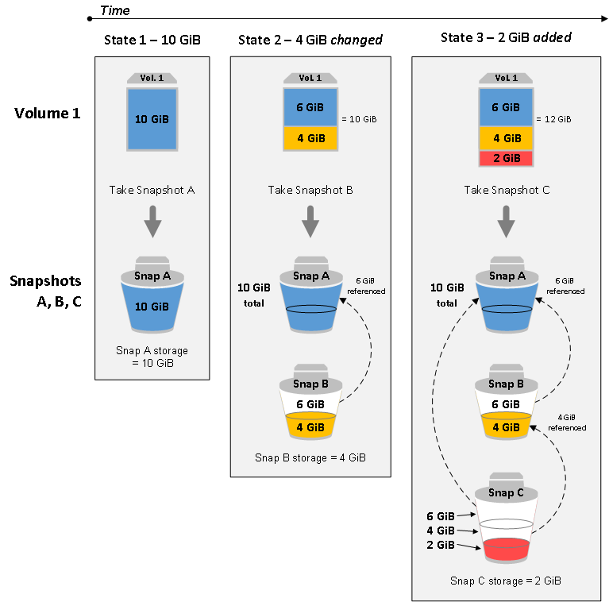
EBS Snapshots
Point in time backups of your volume
Can be turned into custom images
Stored as incremental snapshots
$0.05 /GB month
<number>
Notes:
<number>

Slide 15
Other features of EC2
Tags - Arbitrary key/value pairs for organizing resources
User Data - A script that runs on initial startup
Metadata - Discoverable information about the instance (ip, name, machine type, etc)
keypairs - SSH keypairs automatically copied into the instance to allow connections to the machine
<number>
Notes:
<number>

Slide 16
Paying for EC2 instances
On-Demand
Reserve
Pay-as-you-go
Good for variable requirements
Pay up front
Good for predictable capacity requirements
Spot
Dedicated
Place a bid
Stateless applications that can handle interruption
Reserve a physical host
Single-tenant hardware
<number>
Notes:
https://docs.aws.amazon.com/AWSEC2/latest/UserGuide/instance-purchasing-options.html
Spot instance can be deleted by AWS at any time with a 2 minute warning.
<number>

Slide 17
Lifecycle of an instance
Launch
pending
Reboot
rebooting
running
Stop
stopping
Hibernate
Delete
shutting down
stopped
terminated
Delete
<number>
Notes:
Instances are only billed while in running state
<number>

Slide 18
QwikLab
EC2
EC2
<number>
Notes:
https://www.qwiklabs.com/focuses/8554

Slide 19

Virtual Private Cloud (VPC)
VPCs - Virtual networks for logically isolating resources (such as EC2 Instances)
Security Groups - Virtual firewalls that control traffic for instances
Route Tables - Contains a set of rules, called routes, that are used to determine where network traffic is directed
Internet Gateway - Allows communication between instances in your VPC and the internet.
<number>
Notes:
<number>

Slide 20
QwikLab
Intro to VPC
Intro to VPC
<number>
Notes:
https://www.qwiklabs.com/focuses/8554

Slide 21

Autoscaling Groups
Groups of auto-created EC2 Instances
Autohealing via health checks
Spreads instances across AZs in a single region
Autoscaling based on metrics or a schedule
<number>
Notes:
<number>

Slide 22
Autoscaling components
Launch configuration - information about the EC2 instances to launch
Health checks - rules to determine if an instance is properly operating
Scaling policies - Rules for when to scale the group
<number>
Notes:
<number>

Slide 23

Elastic Load Balancing
Three types: ALB, NLB, Classic
Can be public or private
Load balance across instances in the same region
<number>
Notes:
https://aws.amazon.com/elasticloadbalancing/features/#compare
<number>

Slide 24
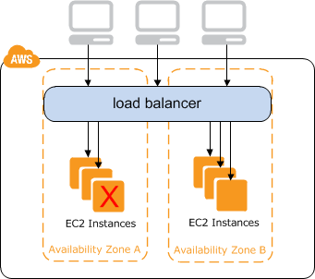
Classic Load Balancer
Legacy load balancer with limited features
Layer 7 load-balancer
Support for sticky sessions with application-generated cookies
Evenly distributes traffic across AZs (not instances)
<number>
Notes:
<number>

Slide 25
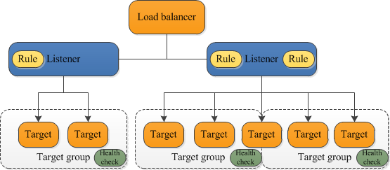
Application Load Balancer
Intelligent routing (host, path, and header based)
Layer 7 load-balancer
Can authenticate users
Supports targets in Lambda, EC2, and ECS
SSL termination
<number>
Notes:
<number>

Slide 26
Network Load Balancer
TCP or UDP on any port
Layer 4 load-balancer
Scale to millions of RPS
Targets can be EC2 or any IP address
<number>
Notes:
<number>

Slide 27
QwikLab
Intro to ELB
Intro to ELB
<number>
Notes:
https://amazon.qwiklabs.com/focuses/390?catalog_rank=%7B%22rank%22%3A2%2C%22num_filters%22%3A0%2C%22has_search%22%3Atrue%7D&parent=catalog&search_id=4411425

Slide 28
Which type of instance is best for running a business critical database 24/7?
1. On-Demand
2. Spot
3. Reserved
<number>
Notes:
<number>

Slide 29
What are the two main components of AWS Autoscaling?
1. Instance Types
2. Elastic Load Balancer
3. Launch Configuration
4. Autoscaling Groups
<number>
Notes:
<number>

