Slide 1
AWS Storage Services

Slide 2
Storage Considerations
Structured/Unstructured
Relational
Latency
Scale: Volume & # of connections
Performance
Durability & Availability
Consistency
Location & Compliance

Slide 3


Unstructured data
Data that has no defined data-model or schema
H4sIAHO2GFkAA+1d627bOBbObz8Fp/nR3UUt62o5BvojdYw26M2IMwEW3UEgy7SsiSRqRcppppjFvME+wO5L7BsuKcqWLMuR49iyp+WH1pEo3sVzPp5Dmh5YX99Bawyjlj21InKyD8iybBoGODETZH/lFGpbAYqmyG1F02TdALJiappyAr7upTYFxJhYE

Slide 4
Structured
{
"Fruits": [
"apple",
"orange"
],
"Veggies": [
"celery",
"squash"
]
}
Veggies
Name
celery
squash
Fruits
Name
apple
orange

Slide 5
Relational Data
Flights
Airports
code | city
DFW | Dallas
CDG | Paris
YYZ | Toronto
origin | destination | departure date
DFW | CDG | 1/20
CDG | YYZ | 1/21
YYZ | CDG | 1/21
Notes:
I want to list all flights by city name. So that means I must look at two sets of data and join them together on a common key. We have two different sets of data that are related.

Slide 6
SQL vs NoSQL
Traditional databases optimize for STORAGE
* In 1980, 2.5GB was 500lb and cost $40k
NoSQL databases optimize for COMPUTE
* Now, 8TB is 0.5 lb and cost $150
Notes:
Back in the day, storage was really expensive. I mean really expensive. In 1980, IBM produced the first gigabyte-capacity disk drive, the 3380. This hard drive weighed over 500 pounds and had a 2.5GB capacity. It cost $40,000. Seagate also produced the first 5.25-inch hard drive in 1980. It had a capacity of 5MB and cost $1,500.
SQL was invented in 1974. Obviously, conserving storage was on the mind. This led to "normalizing" data, the act of minimizing data redundancy/duplication. This put the burden on the compute to reconstruct the data into the request format at query time.
https://www.backblaze.com/blog/wp-content/uploads/2017/07/chart-cost-per-drive-2017.jpg

Slide 7
So instead of this...
SELECT departure_date, a.city
FROM airports AS a
WHERE origin=DFW
JOIN flights AS f
ON (a.code = f.origin)
Airports
Flights
origin | destination | departure_date
DFW | CDG | 1/20
CDG | YYZ | 1/21
YYZ | CDG | 1/21
code | city
DFW | Dallas
CDG | Paris
YYZ | Toronto

Slide 8
I could do this
SELECT departure_date, dest_city WHERE origin=DFW
Flights
origin | destination | dest_city | departure_date
DFW | CDG | Paris | 1/20
CDG | YYZ | Toronto | 1/21
YYZ | CDG | Paris | 1/21

Slide 9
But it would probably look more like this
{
"DFW": [
{
"destination_code": "CDG",
"destination_city": "Paris",
"departure_date": "1/21"
}
]
...
}
lookup "DFW"

Slide 10
What if I want to look up by city name you say? Then store the data differently, this aint SQL.
{
"Dallas": [
{
"destination_code": "CDG",
"destination_city": "Paris",
"departure_date": "1/21"
}
]
...
}
lookup "Dallas"

Slide 11
CAP Theorem
Consistent - Every read receives the most recent write or an error
Available - Every request receives a (non-error) response
Partitioned - The system continues to operate despite an arbitrary number of messages being dropped (or delayed) by the network between nodes
CAP theorem states that in a distributed data store, you can only achieve high availability or consistency.

Slide 12
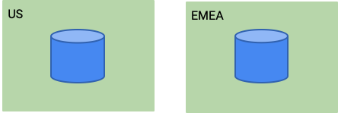
Consistency
Notes:
Eventual Consistency
Success Scenario:
1. user 1 writes "foo=baz" into the US database
2. user 2 reads the data from the EMEA database and gets "foo=bar"
3. the us database replicates the data to EMEA
4. user 2 reads the data from the EMEA database and gets "foo=baz"
Network failure Scenario:
1. user 1 writes "foo=baz" into the US database
2. the US database attempts to replicate the data to EMEA but cannot reach it
3. user 2 reads the data from the EMEA database and gets "foo=bar"
4.user 1 reads the data from the US database and gets "foo=baz"
Strong consistency
Success Scenario:
1. user 1 writes "foo=baz" into the US database
2. the us database replicates the data to EMEA as it writes to itself
4. user 2 reads the data from the EMEA database and gets "foo=baz"
Network failure Scenario:
1. user 1 writes "foo=baz" into the US database
2. the US database attempts to replicate the data to EMEA but cannot reach it
3. the US database returns an error to user 1
4. user 2 reads the data from the EMEA database and gets "foo=bar"
5.user 1 reads the data from the US database and gets "foo=bar"

Slide 13
Unstructured data storage options
EBS
EFS
S3

Slide 14
Block storage vs File Storage
File System
2,7
3
4
Block Storage
HDD
1
2
3
4
1
2
3
4
5
6
7
8
5
6
7
8
Notes:
A filesystem is responsible for managing how and where data is stored on disk.
Just like a set a files in a filing cabinet, a file system keeps track of all of related blocks and groups them with a file name. A file consists of all of the data stored in the relevant blocks arranged in the correct order.
Without a file system, it's like having a giant stack of papers without any filing folders to organize them. It may be a lot faster to just throw papers on your desk but good luck finding anything.

Slide 15
Network attached Block storage
OK!
Write blocks 2, 3, 4
App
Block Storage
HDD
1
2
3
4
5
6
7
8

Slide 16
Network attached Block storage
I need to add data to my yellow file. Block five is empty, write to block 5
OK!
App
Block Storage
HDD
1
2
3
4
Make a new file by writing to empty block 5
5
6
7
8
App

Slide 17
Shared File System
OK! So, additional bits for yellow file can go in 5 and the new file can go on 7 and 8.
I need to add data to my yellow file, put it somewhere please!
App
Shared Filesystem
1
2
3
4
I need to write a new file of X amount of data
5
6
7
8
App

Slide 18

EBS
Network attached block storage for EC2 instances
Therefore, consumes a portion of available bandwidth
Read Write once
SSD |  | HDD
General Purpose | Provisioned IOPS | Throughput | Cold HDD
1 GiB - 16 TiB | 4 GiB - 16 TiB | 500 GiB - 16 TiB | 500 GiB - 16 TiB
16,000 IOPS | 64,000 IOPS | 500 IOPS | 250 IOPS

Slide 19
EBS demo
1. Create VM
2. Add additional volume
3. Make filesystem on volume
4. Mount filesystem

Slide 20
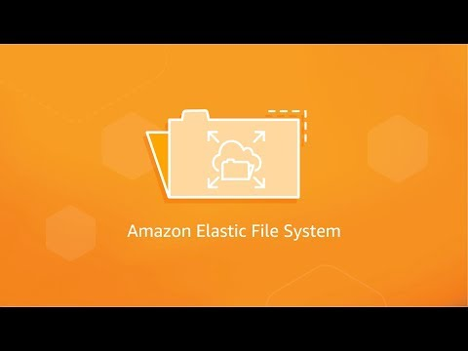
Elastic File System (EFS)
Shrinks and grows as you add/delete files (up to petabytes!)
Two storage classes for files
Standard = single digit ms latency
Infrequent access = double digit
100 MiB/s per TiB throughput
250 MB/s per client
Easy lift-and-shift of existing NFS requirements
Notes:
https://aws.amazon.com/efs/
https://youtu.be/AvgAozsfCrY

Slide 21
EFS demo
1. Create EFS share
2. Boot VM
3. Mount EFS share

Slide 22



S3
Buckets
Objects

Slide 23
S3 is object storage
Use cases:
Website/static content
Backup storage for archival or disaster recovery
Very large amounts of data (exabytes)

Slide 24
S3 is object storage
Objects consist of:
Key - uniquely identifies the object in a bucket
Metadata - contains information such as
Total size of object
Created and Modified dates
Data - The actual BLOB data that is stored

Slide 25
S3 Features
Storage Classes
Event notifications
Versioning
Lifecycle management

Slide 26
Storage Classes
 | Standard | Intelligent-Tiering | Standard-IA | One Zone-IA | Glacier | Glacier Deep Archive
Availability SLA | 99.9% | 99% | 99% | 99% | 99.9% | 99.9%
AZs | >=3 | >=3 | >=3 | 1 | >=3 | >=3
Min charge per object | N/A | N/A | 128KB | 128KB | 40KB | 40KB
Min duration charge | N/A | 30 days | 30 days | 30 days | 90 days | 180 days
Retrieval fee | No | No | Yes, per GB | Yes, per GB | Yes, per GB | Yes, per GB
First byte latency | ms | ms | ms | ms | min or hours | hours
Notes:
Standard
* Intended for data that is frequently accessed (hot data)
*
Intelligent-Tiering
* Data is automatically moved between storage classes based on usage and is billed accordingly
* Intended for data who access patterns change over time
Standard Infrequent Access
* Intended for data accessed less than once a month
One Zone Infrequent Access
* For data accessed less frequently but requires lower latency than other storage classes provide
* lower latency is possible as the data is not replicated across zones, trading redundancy for speed
Glacier
* Intended for "cold storage" of data that is rarely accessed
* Cheap to store with a retreival fee
Glacier Deep Archive
* Intended for "cold storage" of data that is rarely or never accessed
* Cheapest to store with a retreival fee

Slide 27
Event Notifications
S3 can generate notifications on events such as:
Object created
Object Deleted
Restored from Glacier
And can send the notifications to:
SNS topics
SQS queues
Lambda functions
Notes:
https://docs.aws.amazon.com/AmazonS3/latest/dev/notification-content-structure.html

Slide 28
Versioning
Versioning is enabled at the Bucket level and any objects uploaded that already exist with the given name append a new version of the object instead of overriding the object.
Specific versions of an object can be retrieved with the latest being the default returned.
* You pay for the total storage used *

Slide 29
Lifecycle Policy
Set of filters and actions that automatically take effect on objects in a bucket.
Filters include:
Object age/last modified date
Object name
Object tag
Actions include:
Transition (change storage class)
Expiration (delete object)
VersionTransition (change storage class for old versions)
VersionExpiration (delete old versions)

Slide 30
QwikLab
S3
S3

Slide 31




Managed Databases
Build your own DB solution or use a managed one
DB on instance
Amazon SimpleDB
Amazon RDS
DynamoDB

Slide 32
Structured data options (databases)
SimpleDB
RDS
Aurora
DynamoDB

Slide 33
Relational Database Service (RDS)
Fully managed SQL DB solutions on top of EC2.
Pay for allocated instances
Many DB engines available:
MySQL
PostgreSQL
ORACLE
MS SQL Server
Amazon Aurora
Amazon RDS
Notes:
Fully managed means AWS will handle all administrative burden. Including infrastructure provisioning, DB installation, and software patching

Slide 34
RDS security features
Run DB instance in VPC
IAM polices to grant access
Security groups to control client access
SSL support
RDS encryption for at-rest
Finally, any security features of your DB engine

Slide 35
RDS management features
Manual or scheduled backups (snapshots)
Cross-region snapshots for higher redundancy and disaster recovery requirements
Parameter groups for passing configuration to the DB engine
Master-slave for failover or HA masters
Read replicas
Notes:
Examples of DB engine configuration that may be passed via a parameter group:
* Timezone
* Language & Locale

Slide 36
AWS Aurora
Amazons fully-managed, enterprise grade, cloud-native DB
MySQL and PostgreSQL compatible
5x faster than MySQL and 3x faster than PostgreSQL
Automatically grows to up to 64 TB per DB
Point-in-time restores (even without backups!)
Global replication, up to 15 read replicas, sub 30 sec failover
Notes:
Single instance writes

Slide 37
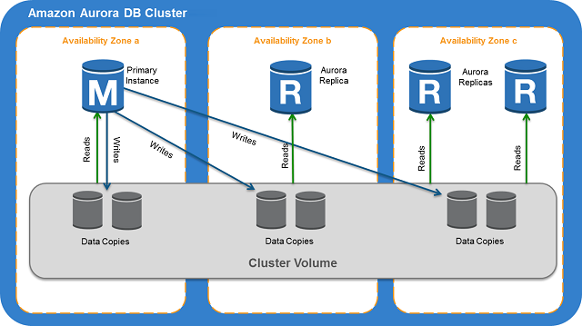
Aurora Architecture

Slide 38
Aurora Serverless (NEW!)
Autoscales automatically as workload changes
Scales to 0 if no activity for 5 minutes
No need to choose instance size
Only works with MySQL 5.6 and Postgres (beta)

Slide 39
QwikLab
RDS
RDS

Slide 40
SimpleDB
Fully-managed, NoSQL DB
Very low cost
Pay for actual usage (no up front provisioning)
Interact via REST API
Highly Available

Slide 41
SimpleDB Data Model
Users
Domain
User 1
User 2
Items
First Name
Middle initial
First Name
Middle initial
Attributes
Values
Bob
J
Alice
C
L
Notes:
You'll notice here that an attribute can have multiple values. Essentially being a list.

Slide 42
SimpleDB Demo - Python SDK
1. Create domain
2. Add item
3. List items
4. Update item
5. Delete domain
Notes:
https://boto3.amazonaws.com/v1/documentation/api/latest/reference/services/sdb.html

Slide 43
DynamoDB
NoSQL, wide-column database
Built to burst up to 20 mil requests per second
Great for many writes and reads
Pay for capacity
RCUs and WCUs
– how many read/write requests can you send per second.
DynamoDB

Slide 44
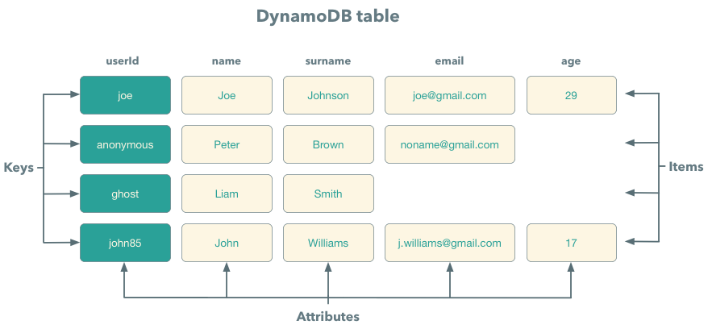
Data Model
Notes:
Excellent post about the detailed data-model of DynamoDB: https://brewing.codes/2017/11/13/dynamo-data-modeling/
Tables ~= tables
items ~= rows
attributes ~= columns

Slide 45
DynamoDB queries
You only interact with a single table (not relational)
3 ways to read items:
Get - Fastest, no processing needed. Look up by key
Query - Fast, filter only on keys and indexes.
Scan - Slow, scan the entire table and filter on any attribute
Optional ConsistentRead parameter, otherwise reads are eventually consistent
For writing data, you provide the entire item. No partial updates. This allows DynamoDB to quickly write the data and not need to look up an existing items location first
Notes:
DynamoDB is designed to be highly performant and makes it difficult to write inefficient queries. By not supporting cross-table relationships, there is no burden for DynamoDB to look up data in multiple tables and perform expensive, time consuming processing to coalesce the results.
When requesting a strongly consistent read, the following may occur:
* HTTP 500 error during network outages or delays
* Strongly consistent reads may be slower
* Requires double the throughput requirement of eventually consistent reads

Slide 46
DynamoDB and SimpleDB comparison
DynamoDB
Large scale, no limits
Pay for capacity
Millions of writes per second
SimpleDB
Hard limit of 10GB
pay for use
<25 writes per second
hella cheap, dead simple

Slide 47
QwikLab
DynamoDB
DynamoDB

