Slide 1
PaaS Services

Slide 2
Agenda
Containers on AWS
Elastic Beanstalk
Lambda Functions
API Gateway
Simple Queue Service
Simple Notification Service

Slide 3
AWS Container services
Elastic Container Registry (ECR) - Store your container images
Elastic Container Service (ECS) - AWS specific container orchestrator
Elastic Kubernetes Service (EKS) - Managed Kubernetes on AWS
Fargate - Run serverless containers
EC2 - Simply run your containers on VMs under you complete control
Notes:
AWS has many different solutions for running and managing docker containers.

Slide 4
Elastic Container Registry (ECR)
Public or private image storage
Pricing is based on image storage
$0.10 per GB-month storage and cost per download
Authenticate via Docker with the `aws ecr get-login` command
Access control via IAM
Image security scanning
Notes:
https://aws.amazon.com/ecr/pricing/

Slide 5
Demo
Pushing an image to ECR
Pushing an image to ECR

Slide 6
Elastic Container Service (ECS)
Deploy clusters
EC2 Linux or Windows auto-scaling groups for application nodes
Services - like a deployment in k8s linked to a load balancer
Tasks - like a pod, it is a definition of multiple containers bundle together, env variables, and ports to expose

Slide 7
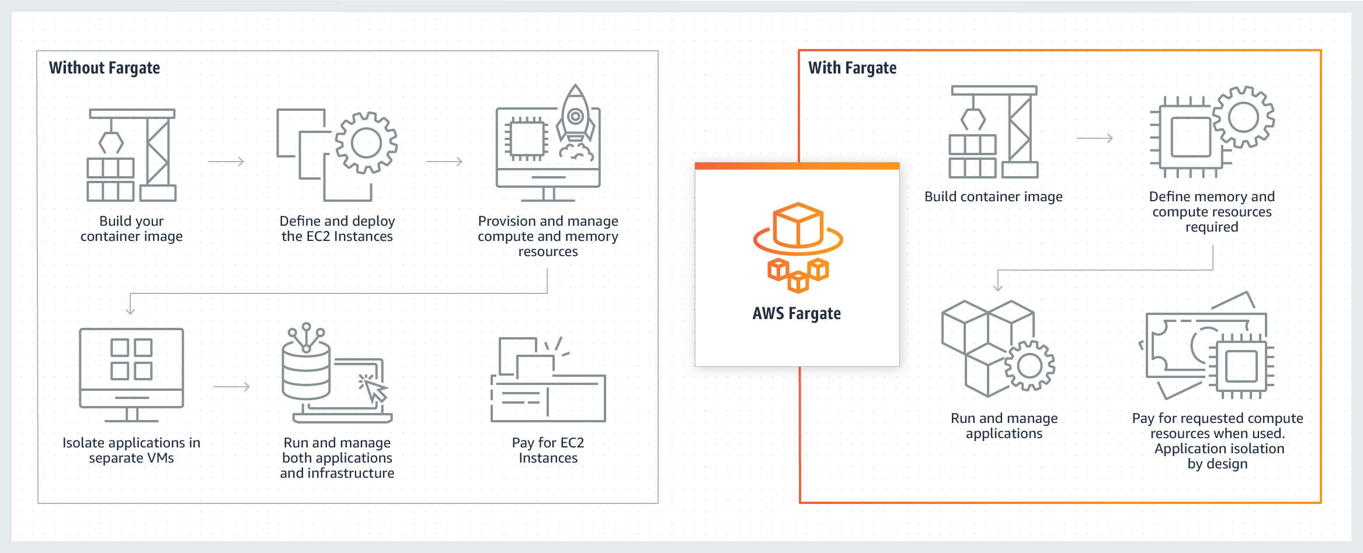
ECS with Fargate
Nodes are hidden, no longer need to even have EC2 worker nodes

Slide 8
Demo
Running an app in ECS
Running an app in ECS

Slide 9
Elastic Kubernetes Service (EKS)
Fully managed k8s control plane, worker nodes managed by autoscaling group
Billed for resources used and cluster management fee ($0.10/hr)

Slide 10
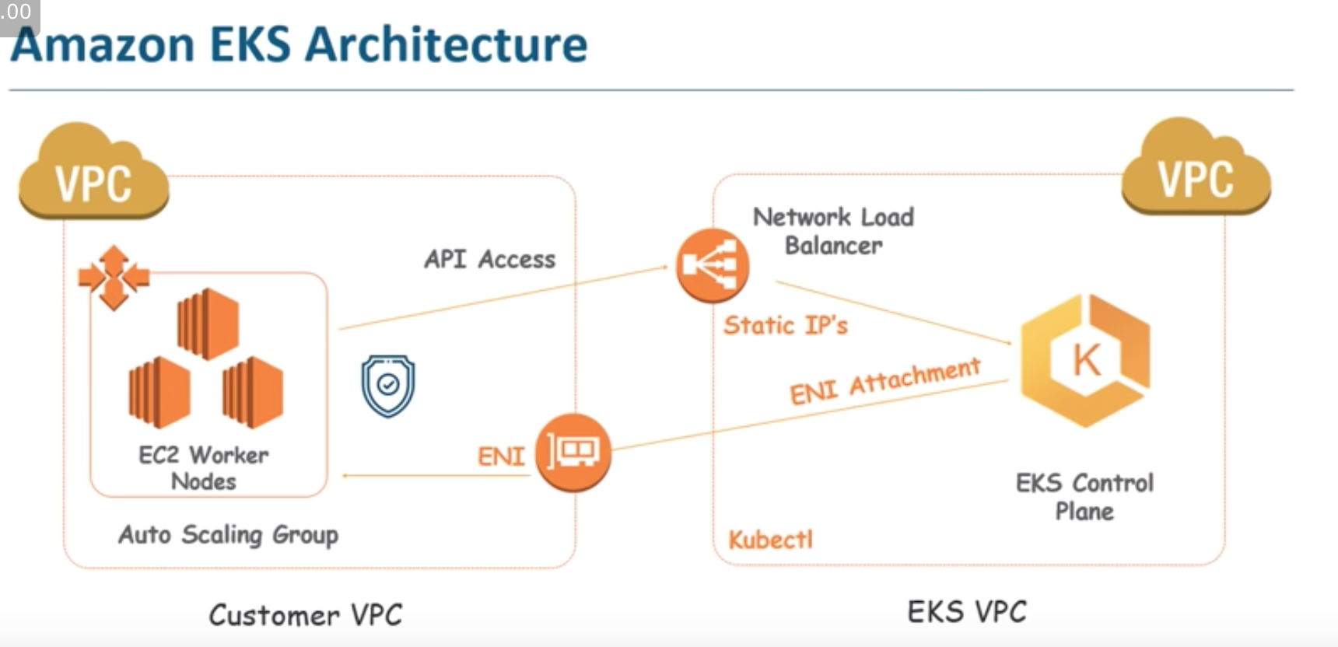

Slide 11

Elastic Beanstalk
PaaS solution for running app
Creates needs EC2 resources automatically
Platforms:
Go, Java, Node.js, PHP, Python, Ruby
Application servers (Tomcat, Passenger, Puma)
Docker containers
Notes:
Beanstalk, in similar fashion to ECS, will create all of the needed infrastructure to run and scale your application. But instead of a containerized application, it just takes your code, builds, and runs it on the chosen platform.

Slide 12
Demo
Running an app with Beanstalk
Running an app with Beanstalk

Slide 13
Amazon Lambda
Functions as a Service! No-ops! Serverless!
No need for long running services if you just have a simple, discrete task to perform
Languages: Go, Ruby, Python, Java, .NET, node.js
Billed per 100ms
Notes:
With Amazon lambda, you have no access to its underlying infrastructure.
https://docs.aws.amazon.com/lambda/latest/dg/lambda-runtimes.html
https://aws.amazon.com/lambda/pricing/

Slide 14
Lambda Use Cases
Simple ETL
Notifications
Website backend logic
Notes:
In addition to this list, Lambda is often used as a mechanism to glue systems together. For example, a mobile app might call a lambda that writes to multiple databases. Another example is a push to a git repository may call a lambda webhook that writes a message in the development teams chat client.

Slide 15
Lambda Functions
Synchronous invocation
$ aws lambda invoke --function-name my-function out --log-type Tail
{
"StatusCode": 200,
"LogResult": "U1RBUlQgUmVxdWVzdElkOiA4N2QwNDRiOC1mMTU0LTExZTgtOGNkYS0yOTc0YzVlNGZiMjEgVmVyc2lvb...",
"ExecutedVersion": "$LATEST"
}
Lambda
...
Execute
...
Success!

Slide 16
Lambda Functions
Asynchronous invocation
$ aws lambda invoke --function-name my-function --invocation-type Event --payload '{ "key": "value" }' response.json
{
"StatusCode": 202
}
Lambda
Got it!
...
Execute
...
Retry on failure
...
Execute
...
Invocation
Records
Done!

Slide 17
Qwiklab
Lambda
Lambda

Slide 18
API Gateway
Allows you to put a REST Api in front of:
Lambdas
EC2 instances
Existing apis
and more!
Automatic features like API metrics such as API calls, latency, and error rates

Slide 19

Simple Queue Service (SQS)
Hosted message queues
Messages are redundantly stored all across underlying
SQS infrastructure
SQS Queue
Component 1
Component 2

Slide 20
Simple Queue Service (SQS)
SQS Queue
Component 1
Component 2
I'm Done. Delete!
AWS

Slide 21
SQS Acknowledgements
SQS Queue
Component 1
Component 2
Component 3
I'm Done! Delete!
Component 3
I'm Done! Delete!
Notes:
If a message is read but not Acknowledged to be done within the "visibility time period" then it may be delivered to another requester.

Slide 22
Simple Queue Service (SQS)
Two types of queues
Standard - best-effort ordering, at least once delivery
max of 120,000 inflight messages
"nearly unlimited" transactions per second
FIFO - first in first out, guaranteed ordering and deliver only once
max of 20,000 inflight messages
3,000 messages per second
Notes:
Standard queues are supported by a highly distributed architecture that allows nearly unlimited throughput
Fifo queues require more work on the backend to keep track of the state of a message in order to guarantee ordering and delivery semantics. Therefore, they cannot scale quite as well.

Slide 23
Demo
SQS
SWS

Slide 24
Simple Notification Service (SNS)
Pub/Sub topics
Allows for multiple publishers, subscriptions, and subscribers
Topic
Message
Subscription
Message
Subscriber
Publisher

Slide 25
Worker Pattern
Publisher
Topic
Subscriber
Message
Subscription
Subscriber
Publisher
Message
Subscriber

Slide 26
Fan-out
Publisher
Topic
Message
Subscriber
Subscription
Publisher
Subscription
Message
Message
Subscriber
Notes:
When you have multiple subscriptions, the message is delivered once for each subscription. This allows you to have one event notify multiple services.

Slide 27
eCommerce Fan-out example
Customer email service
order
Orders
Confirmation Subscription
Website
order
Inventory service
Inventory Subscription
Website
Payments Subscription
order
Order
Payments
service

Slide 28
Lab
Event-driven thumbnail microservice
Event-driven thumbnail microservice

