Slide 1
AWS Additional Services

Slide 2
API Management
Access
Rate-limiting and throttling
Versioning and API Definition
Logging and Monitoring
Caching
REST API

Slide 3

API Gateway
Allows you to put a REST Api in front of:
Lambdas
EC2 instances
Existing apis
and more!
Automatic features like API metrics such as API calls, latency, and error rates

Slide 4
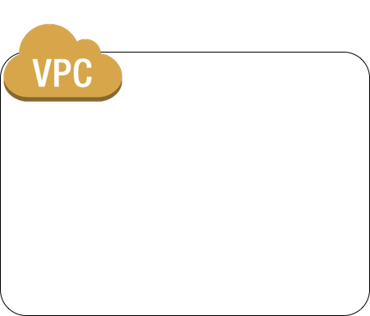



API Gateway
lambdas
All publicly accessible endpoints
ec2 endpoints
Amazon API Gateway
Any AWS service

Slide 5

API Gateway
https://0m73v0kkpg.execute-api.us-east-1.amazonaws.com/Prod/
PetStore API
Pet catalog
/pets
GET
EC2 Instance
POST
/user/login
Login lambda
POST
/user/logout
Logout lambda
POST
Notes:
You may define a single, cohesive api that makes use of multiple microservices.

Slide 6

Processing Flow
API Gateway
ApiAPI
?
Authorize
Check
cache
Throttle
Send to backend
User sends request

Slide 7
API Gateway Steps
1. Create API configuration
2. Deploy API configuration to Stages
Example:
Dev - example.com/dev
Test - example.com/staging
Prod - example.com/prod
3. Manage multiple versions of your API

Slide 8
Access Control
users from a specified AWS account
specified source IP address ranges or CIDR blocks
specific virtual private clouds (VPCs) or VPC endpoints (in any account)
{
"Version": "2012-10-17",
"Statement": [
{
"Effect": "Allow",
"Principal": "*",
"Action": "execute-api:Invoke",
"Resource": "arn:aws:execute-api:region:account-id:*"
},
{
"Effect": "Deny",
"Principal": "*",
"Action": "execute-api:Invoke",
"Resource": "arn:aws:execute-api:region:account-id:*",
"Condition": {
"NotIpAddress": {
"aws:SourceIp": "123.4.5.6/24"
}
}
}
]
}
Notes:
The example policy grants access to the API under the specified account-id in the specified region to any user whose source IP address is in the address block 123.4.5.6/24. The policy denies all access to the API if the user's source IP is not within the range.

Slide 9
Rate limiting/throttling
Control throttling limits per account, stage or stage + resource + method
Server-side throttling limits are applied across all clients. These limit settings exist to prevent your API— and your account — from being overwhelmed by too many requests.
Per-client throttling limits are applied to clients that use API keys associated with your usage policy as client identifier.
If rate limit is reached, HTTP 429 is returned

Slide 10
Available Metrics
Counters:
4XXError
5XXError
CacheHitCount
CacheMissCount
Count - Total # of requests
Gauges
IntegrationLatency - API Gateway to backend
Latency - client to client
Notes:
https://docs.aws.amazon.com/apigateway/latest/developerguide/api-gateway-metrics-and-dimensions.html

Slide 11
Caching
Dedicated cache per stage
Enable caching based on Resource + Method + Parameters
Cache flushing
Clients can bypass the cache with Cache-Control: max-age=0 header

Slide 12
QwikLab
API Gateway
API Gateway
Notes:
https://amazon.qwiklabs.com/focuses/10176?catalog_rank=%7B%22rank%22%3A1%2C%22num_filters%22%3A0%2C%22has_search%22%3Atrue%7D&parent=catalog&search_id=4415042

Slide 13

CloudWatch
Monitors your AWS resources and applications on AWS in real time
Dashboarding
Alerting
Custom metrics
Log aggregation

Slide 14
CloudWatch Gotchas
Metrics are not aggregated across regions
Metric data is kept for 15 months

Slide 15
CloudWatch Constructs
Metrics:
Namespace - Group of metrics for a service Example: aws/ec2
Metric - Represents a vector of measurement
Dimension - key/value pair on a metric used to select subsets of datapoints
Logging:
LogGroups - Example: /aws/lambda/ameade-thumbnail
LogStreams - Sequence of log events from a single emitter of logs
Notes:
https://docs.aws.amazon.com/AmazonCloudWatch/latest/monitoring/aws-services-cloudwatch-metrics.html

Slide 16
Demo
CloudWatch
CloudWatch

