Slide 1
Microservice Architecture
Notes:
Microservices architecture is considered a specific type of service-oriented architecture (SOA). https://en.wikipedia.org/wiki/Service-oriented_architecture
https://en.wikipedia.org/wiki/Microservices

Slide 2
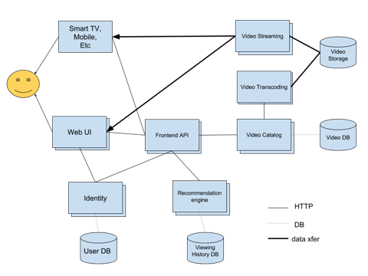
Microservices Example
Video Streaming
Web UI
Video Storage
Smart TV, Mobile Etc.
Video Catalog
Web UI
Video DB
Users
Web UI
Frontend API
Web UI
Recommendation Engine
Web UI
HTTP
Identity
Web UI
DB
data xfer
Viewing History DB
User DB

Slide 3
Benefits
Small is good
Easier to understand, faster to develop, more productive, A/B testing
Faster startup (parallelism in system startup/boot)
Independently developed and deployed versions, modular/replaceable parts
Each microservice can be developed and deployed independently
Modular/replaceable parts reduce "lock in" to a single solution or technology
Improved fault isolation
Limits system impact due to failure (ex: memory leak)
Easier debugging of simpler services
Better reliability/redundancy

Slide 4
Challenges
Distributed design
APIs between services must be well defined and versioned
Distributed transactions are harder to debug
IDEs not geared for it
Testing, deployment, and debugging complexity
Deployment complications
Resource overhead
Multiple "pipelines", potentially asimilar in implementation

Slide 5
Strangler Pattern
Monolith
Monolith
login()
logout()
get_users()
delete_user()
create_user()
suspend_user()
list_videos()
delete_video()
add_video()
open_stream_connection()
encode_video()
serve_ui()
...
list_videos()
delete_video()
add_video()
open_stream_connection()
encode_video()
serve_ui()
...
HTTP
Identity
login()
logout()
get_users()
delete_user()
create_user()
suspend_user()

Slide 6
Until finally ...
Video Streaming
Web UI
Video Storage
Smart TV, Mobile Etc.
Video Catalog
Web UI
Video DB
Users
Web UI
Frontend API
Web UI
Recommendation Engine
Web UI
HTTP
Identity
Web UI
DB
data xfer
Viewing History DB
User DB

Slide 7
Service to Service Communications
Synchronous
RPC
APIs
Asynchronous
Message buses

Slide 8
Message Bus and the Worker Pattern
WebApp
WebApp
Web UI
Web UI
Messages
Worker
Worker
Worker
Worker
Worker
Worker

