Slide 1
Coding Practices

Slide 2
Agenda
Clean Code and Style
Unitesting
Test Driven Development
Pair Programming

Slide 3
Style Guidelines
The Zen of Python (import this)
Pep8 - https://www.python.org/dev/peps/pep-0008/
Google Style Guide - http://google.github.io/styleguide/pyguide.html
Notes:
https://www.amazon.com/Clean-Code-Handbook-Software-Craftsmanship/dp/0132350882

Slide 4
Flake8 & Pylint
$ pip3 install --user flake8 pylint
$pylint weather.py
weather.py:23:2: C0103: Constant name "longitude" doesn't conform to UPPER_CASE naming style (invalid-name)
weather.py:23:13: C0103: Constant name "latitude" doesn't conform to UPPER_CASE naming style (invalid-name)
weather.py:24:2: C0103: Constant name "temp" doesn't conform to UPPER_CASE naming style (invalid-name)
------------------------------------------------------------------
Your code has been rated at 1.11/10 (previous run: 1.11/10, +0.00)
$ flake8
./weather.py:3:1: F401 'argparse' imported but unused
./weather.py:5:20: E225 missing whitespace around operator
./weather.py:11:1: W293 blank line contains whitespace
./weather.py:14:1: E302 expected 2 blank lines, found 1
./weather:15:80: E501 line too long (94 > 79 characters)
https://www.pylint.org/
$ pylint calc.py
https://gitlab.com/pycqa/flake8
$ flake8

Slide 5
Unittesting
Automated tests for individual 'units' of code. Ideally without outside dependencies.
Benefits:
Gives confidence the code does what you think
Gives confidence the code will *continue* to do what you think
Very fast feedback cycle
Results in better, more modular code

Slide 6
Unittest Module
https://docs.python.org/3/library/unittest.html
$ pip3 install --user pytest
=================== test session starts ====================
platform linux -- Python 3.7.4, pytest-5.2.1, py-1.8.0, pluggy-0.13.0
rootdir: /home/alex/
collected 4 items
test_weather.py .... [100%]
==================== 4 passed in 0.14s =====================
import unittest
class SimpleTest(unittest.TestCase):
# Returns True or False.
def test(self):
self.assertTrue(True)

Slide 7
Calc.py example
import unittest
import calc
class TestCalc(unittest.TestCase):
def test_add(self):
expected = 3
result = calc.add(1, 2)
self.assertEqual(result, expected)
def test_add_negative(self):
self.assertEqual(calc.add(-1, 2), 1)
self.assertEqual(calc.add(-1, -2), -3)
def add(a, b):
return a + b

Slide 8
Coverage
$ pip install --user pytest-cov
$ py.test --cov=.
========================== test session starts ==========================
platform darwin -- Python 2.7.10, pytest-4.6.6, py-1.8.0, pluggy-0.13.0
rootdir: /Users/ameade/DI/unittesting/simple
plugins: cov-2.8.1
collected 2 items
test_calc.py .. [100%]
---------- coverage: platform darwin, python 2.7.10-final-0 ----------
Name Stmts Miss Cover
----------------------------------
calc.py 2 0 100%
test_calc.py 10 0 100%
----------------------------------
TOTAL 12 0 100%
======================= 2 passed in 0.03 seconds ========================

Slide 9
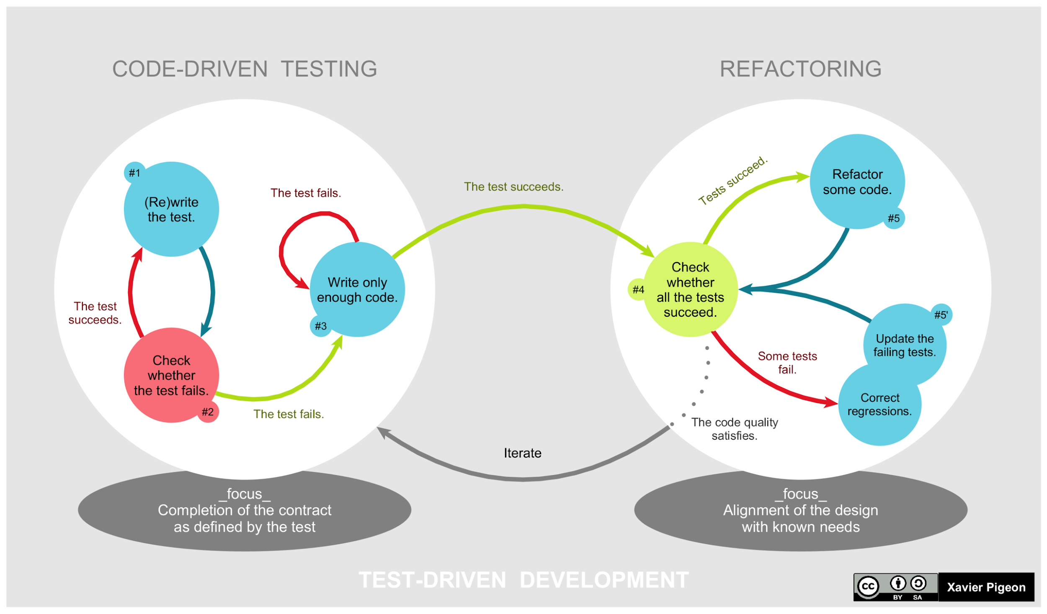
Test Driven Development (TDD)
Notes:
https://en.wikipedia.org/wiki/Test-driven_development

Slide 10
Mocks and Fakes
Unit tests should run very, very fast and only test the specific code they are meant to.
This means external calls to other apis or DBs should be "mocked" and modified to return a predictable result. This can be done by replacing the external call with a mock that returns a set data or a fake that is a simple, fake implementation.

Slide 11
Example Mock
import db
import unittest
import unittest.mock
def mock_get_address(customer_id):
return {"zip": "77777", "city": "nyc"}
class TestGetAddress(unittest.TestCase):
@unittest.mock.patch(db.get_address ', mock_get_address)
def test_get_address(self):
actual = get_address({'id': "1"}
self.assertEqual("nyc, 77777", actual)
def get_address(customer):
address = db.get_address(customer['id'])
return formatAddress(address)

Slide 12

Pair Programming
Notes:
And another video for the skeptics: https://www.youtube.com/watch?v=u_eZ-ae2FY8

