Slide 1
Site Reliability Engineering

Slide 2
Site Reliability Engineering
“Site reliability engineers create a bridge between development and operations by applying a software engineering mindset to system administration topics.”
Notes:
https://en.wikipedia.org/wiki/Site_Reliability_Engineering
Google has been practicing and developing SRE since 2003!
SREs and SRE teams are responsible for the non-functional requirements of a software system. These include availability, latency, performance, efficiency, change management, monitoring, emergency response, and capacity planning.

Slide 3
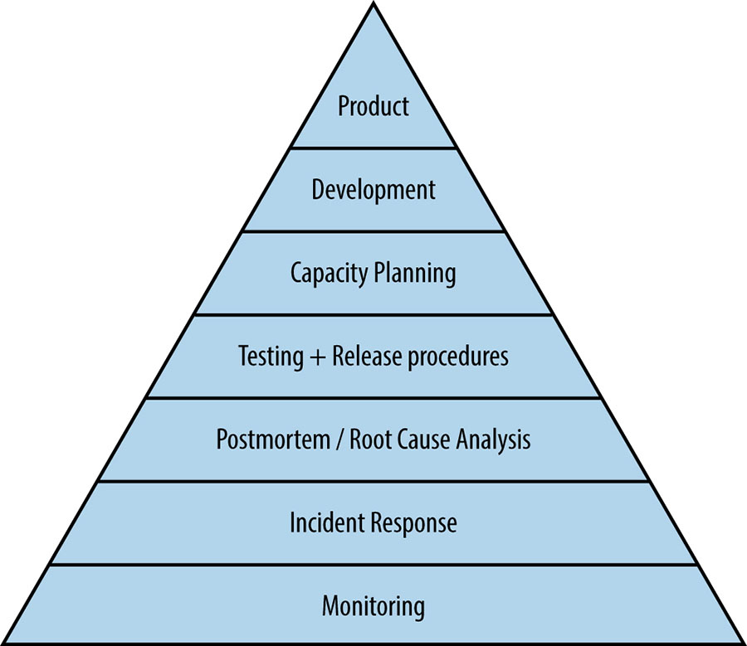
The SRE Triangle

Slide 4
SLIs, SLOs, and SLAs
Service Level Indicator (SLI): An end-user metric representing availability, performance, or correctness
Service Level Objective (SLO): How the service should perform. A threshold representing the point at which the service level is unacceptable.
Service Level Agreement (SLA): A contractual agreement with an customer, usually specifying compensation if a condition is not met. Often less restrictive than an internal SLO.

Slide 5
SLIs, SLOs, and SLAs
Example:
Service Level Indicator: Whether an HTTP response is a system failure (not HTTP 500)
Service Level Objective: 99% of response must be a success
Service Level Agreement: Customer is compensated if less than 95% of responses are a success

Slide 6
SLIs, SLOs, and SLAs
Non technical example:
Service Level Indicator: Total duration of customer being on-hold
Service Level Objective: 90% of on hold wait times must be less than 5 minutes
Service Level Agreement: Customer is offered a discount on services if on-hold times exceed 5 minutes
Notes:
In this example, the company has decided that they can afford to offer a discount to 10% of the callers if necessary. It is cheaper than hiring more call operators to handle peak periods and shoot for higher than 90%.

Slide 7
SLIs, SLOs, and SLAs
Non technical example:
Service Level Indicator: Time it takes between pizza being ordered and delivered
Service Level Objective: 98% of pizza delivery times must be less than 25 minutes
Service Level Agreement: Pizza is free if delivery time exceeds 30 minutes

Slide 8
Error Budgets
Perfection is often unattainable, expensive, and constricting.

Slide 9
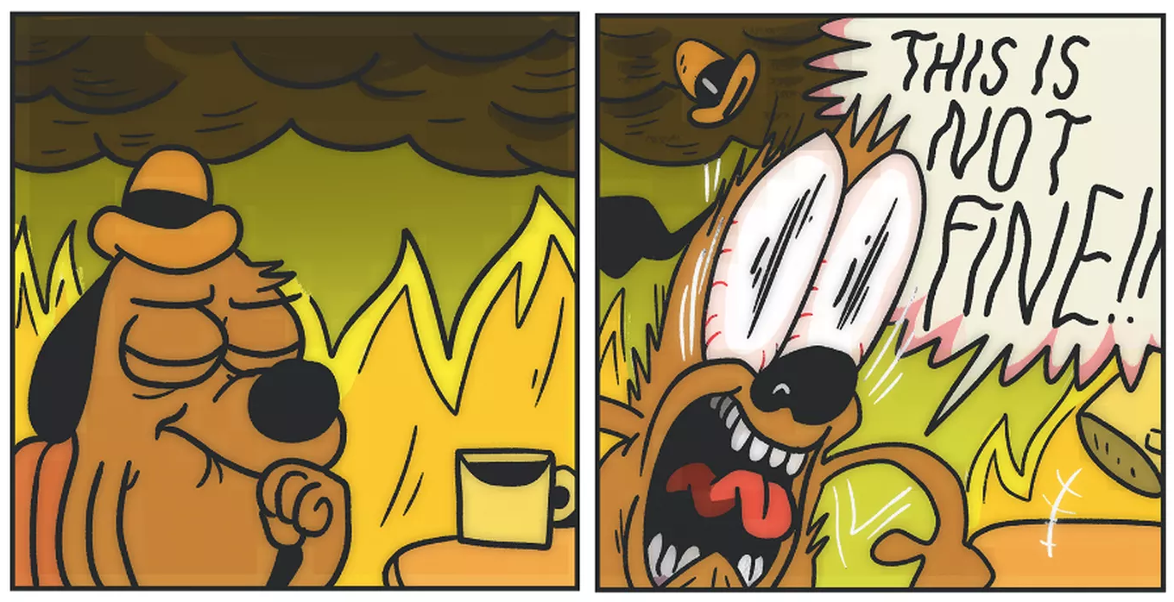
50/50 firefighting
Notes:
SREs spend half their time putting out fires and half their time preventing them.
If a team is overloaded and constantly putting out fires, there are some tactics to improve this:
* Feature freezes
* Embedded SRE (bring in outside engineer to focus on improving processes opposed to helping put out fire)
* Blitzes...bug squashes...automation hackathons

Slide 10
Postmortems
What happened?
Who was affected? By what degree and for how long?
Root Cause?
Mitigations?
Long term fix?
Example: https://landing.google.com/sre/sre-book/chapters/postmortem/
Notes:
At Google, any customer impacting incident requires a post mortem draft within 24 hrs and peer review and finalization within 72 hours. Postmortems may be shared in the future with other teams, through the postmortem mailing list, or as scenarios for new SRE hires to run through.
Postmortem Checklist - https://docs.google.com/document/d/1iaEgF0ICSmKKLG3_BT5VnK80gfOenhhmxVnnUcNSQBE/edit

Slide 11
DevOps vs SRE
Culture
Automation
Lean
Measure
Shared Learning
Notes:
The two disciplines/philosophies originated separately. Some would say SRE is an implementation of devops with a few extra add-ons.

Slide 12
A release engineer deleted a production database during the deployment of a new application version, for the second time. What steps should be attempted first help mitigate this issue
in the future?
1. Fire the release engineer
2. Make it harder to delete a production database (remove permissions from deployment tool)
3. Ensure deployments are automated
4. Tell the team to try harder and better document deployment steps
5. Automatically test database backup and restores

Slide 13
Additional Reading
Free SRE books by Google - https://landing.google.com/sre/books/

