Slide 1
APM and AppDynamics

Slide 2
Module Outline
Application Performance Management
AppDynamics Concepts
Collecting data
Visualization and Dashboarding
Alerting

Slide 3
APM
Application Performance Management is simply the monitoring and management of the performance and availability of software applications.
APM systems often allow monitoring an application from a user perspective while also providing the ability to drill-down into specific requests, calls, and jobs.

Slide 4
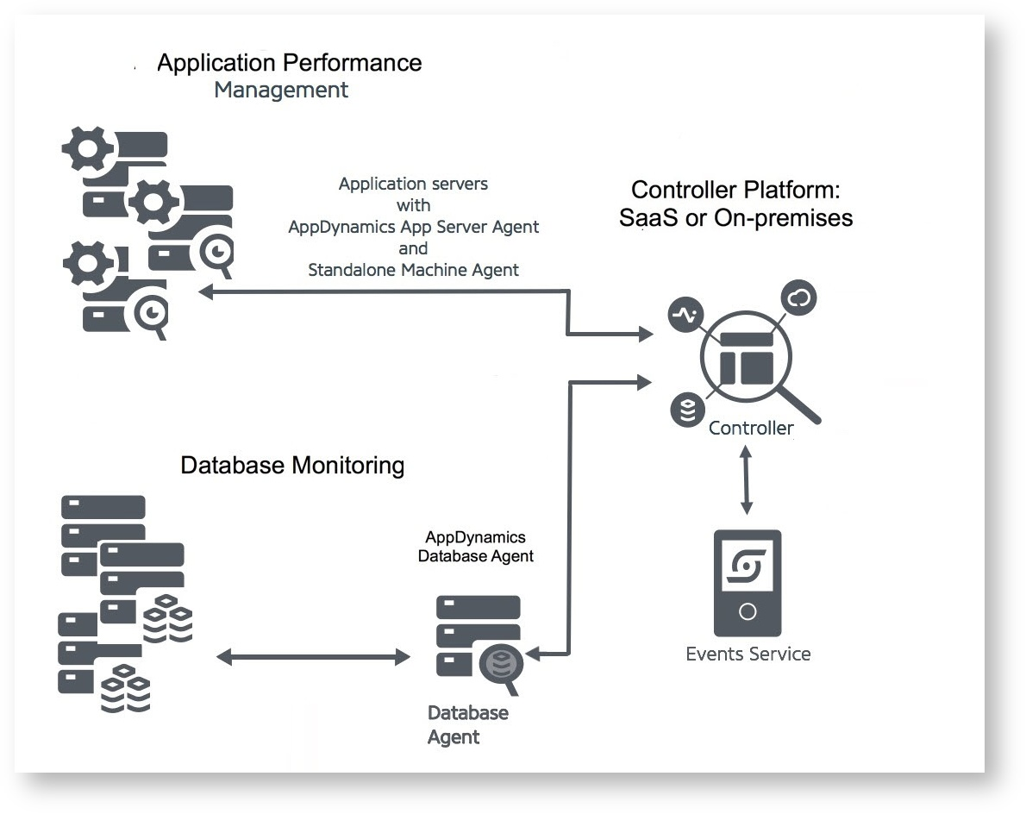

Slide 5
Applications and Tiers
Application:
Top level object in AppD. Contains a set of related services, Business Transactions, and Tiers
Tier:
A group of nodes. Often representing a group of identical, redundant nodes. A logical grouping of a "service" in your application.
There is no interaction among nodes within a single tier
An application agent node cannot belong to more than one tier
Nodes:
May be a server, JVM, or middleware

Slide 6
Business Transactions
A single representation of the flow of a user request, often between multiple services. Intended to represent a "transaction" in the system from the end-user perspective.
An individual request may require calls from the frontend to many backing services and/or databases. AppD agents can tag requests so they can be traced all the way through the system with all calls being grouped together in the UI

Slide 7
Collecting Data
Application Agents:
Java, .NET, PHP, Python, Node.js, AWS Lambda, Apache, C/C++, Golang, etc
Many do not require code changes!
Machine Agents:
Windows, Linux, Solaris, AIX, OSX
Database Agent:
MySQL, MongoDB, MS SQL, Oracle, Postgres, Sybase, IBM DB2, Couchbase
A single agent (running as a java app) can monitor multiple database installations
The DB agent can be clustered for HA
Networking, Browser, Mobile, Etc

Slide 8
Dashboards
Dashboards are comprised of widgets containing graphs, charts, gauges, and tables...and a few others
Dashboard Templates can be created to display the same information for different tiers or nodes
War Rooms are a way to have an interactive view of a dashboard with other folks, intended for troubleshooting incidents

Slide 9
Alerting
Events - Changes in the state of an application from AppDs perspective. Could be health rule violations, anomalies, slow business transactions, code changes, server crashes, errors, etc.
Health Rule - A set of conditions (based off metrics over a time window) defining a critical or warning level issue.
Policies - Can send alerts via multiple channels in the case of a certain event via Actions
Actions - Send emails, notifications to other services, call HTTP endpoints or execute scripts when triggered

