Slide 1
Tales of Defiance to Mind Control in the Modern Age
SESSION 1 PRESENTATION
Tale 1: Dostoevsky's Notes from Underground (1864)
Scott Axelrod
Notes:
Session 1. Order of the session: opening go-round; context for Notes from Underground; Larry Cedar clip 1; concrete homework questions; framing; read the Avery & Riley dialogue; clip 2; abstract questions; course overview pages.
FACILITATION · TIME PLAN (assumes ~90 min; scale if different)
Welcome + opening go-round + roadmap (slides 1–2): 10 min. Context (3–4, 7): 12 min. Clip 1 (5): 3 min. Concrete questions (6): 8 min. Dialogue (8–10): 12 min. Clip 2 (11): 3 min. Abstract questions (12): 27 min. Segue (13–16): 8 min. Buffer: 7 min.
Aim for roughly 45% of the session in discussion. Keep the buffer for discussion overflow, not for lecture.
OPENING GO-ROUND: ~5–7 min
Can everyone see the screen and each other's name tags?
Can I have a volunteer scribe to jot down the words and phrases?
Please state your name and possibly a word or short phrase that stuck with you from the story.
Start with: 'Scott. I am a sick man.'
Don't respond or discuss; just thank each person and move on.
Pay it off later, at slide 6 or 12: 'Three of you said spite. Let's start there.'

Slide 2





What we'll cover
SESSION 1 · TODAY
Context of Notes from Underground
Slides 3–4, PDF 3-5
Clip 1 and Concrete Questions
Slides 5–6, PDF 6-7
A Dialog About Notes
Slides 7–11, PDF 8--12
Abstract Questions
Slide 12, PDF 13-14
Toward 1984: Legacy, Cartoon Summary, Arc, and Lenses
Slides 13–16, PDF 15-18
Notes:
~2 min
A discussion session: short context, a dialogue, then mostly questions.
Main event: slides 6–12.
Questions welcome anytime; the scribe parks anything that would derail us.

Slide 3
Russia under Alexander II, 1855–1881
CONTEXT · NOTES FROM UNDERGROUND
Establishment
Loosens, then cracks down
Disestablishment
Anti-disestablishment?
Establishment shaken
1855
1861
1863
1864
1881
Alexander II takes the throne
Serfs freed; censorship loosened
Chernyshevsky's What Is to Be Done?
Dostoevsky's Notes from Underground
Alexander II assassinated
Autocrat over an empire of serfs
Soon launches the Great Reforms
Reforms make room for radicals
Radicals want more; the government cracks down
Nihilists trust only science and reason
Know your true interest and you'll be good
The Crystal Palace: society designed by reason
We are not piano keys
Against reason claiming totality
Killed by the People's Will
Weeks after Dostoevsky's death
The stone wall ▸
Crystal Palace: from the novella; not in the show
Notes:
~6–8 min · 5 CLICKS, one per period
Don't read every bullet. Land three anchors: 1861 reforms, 1863–64 the debate, 1881 assassination.
'?' on 1864 is deliberate: he opposes the radicals, but Notes doesn't defend the Tsar.
'Shaken', not 'fallen': the autocracy lasts until 1917.
Crystal Palace (1863): novella, not the show. Say it in passing.
ONE check-in: 'Would you want to live in the Crystal Palace? What would you miss?' 2–3 answers.
Optional: after the 1864 click, click the 'The stone wall' button for the quote (novella, not the show). Click the quote to close. Click the button itself; clicking elsewhere moves on.
REF: Chernyshevsky wrote the novel in prison. The Palace is from Vera Pavlovna's Fourth Dream, modeled on London's 1851 hall. Lenin reused the title. 'Nihilist' named via Bazarov in Turgenev's Fathers and Sons (1862).

Slide 4


Two writers, two Siberias, in opposite order
CONTEXT · THE REBUTTAL
Dostoevsky
Chernyshevsky
1849
Joins a utopian-socialist circle
1863
Writes What Is to Be Done? in prison
Punished
Mock execution, Siberia, exile
Punished
Civil execution, Siberia, exile
1864
Writes Notes from Underground
Legacy
Inspires anti-tsarist radicals
Punished first, then writes
Writes first, then is punished
Notes:
~1–2 min · no discussion
Dostoevsky: punished first, then writes.
Chernyshevsky: writes first, then punished.
So Dostoevsky attacks a dream he once partly shared.

Slide 5

Larry Cedar as the Underground Man
CLIP 1 · BACK INTO THE SHOW
"I am a sick man.... I am a spiteful man."
Watch from 1:30
Notes from Underground, one-man show, Garnett translation · youtube.com/watch?v=asp5tqDql0g
Notes:
~3 min · clip from 1:30
Purpose: bring the show back to mind before the questions.
Before: 'Listen for the tone: angry, sad, funny?'
After: no discussion; go straight to the concrete questions.

Slide 6
Concrete questions about the Underground Man
QUESTIONS · FROM THE HOMEWORK
1
What is his situation?
2
How did he get into it?
3
What was his dilemma?
4
What about his personality might have caused him difficulty?
The protagonist is never named; by convention he is called the Underground Man.
Notes:
~8 min · warm-up
Pairs for 2–3 min, then a quick popcorn round.
Use the scribe's list: 'Several of you said ___.'
Deeper points: 'Hold that for after the dialogue.'

Slide 7


"I am a sick man.... I am a spiteful man."
FRAMING · THE UNDERGROUND MAN
2×2
Not piano keys
2 × 2 = 4
No tongue allowed
We'll act against our own interest just to prove we're free.
Watch from 17:58-19:00
"Twice two makes four" is the beginning of death.
In the Crystal Palace you can't even stick out your tongue.
✓ In the show
From the novella; left out of the show
From the novella; left out of the show
The target is not reason itself. It is reason claiming totality.
Notes:
~4 min · SLOW DOWN: the questions build on this
Show vs. novella tags: mention briefly.
Optional clip: 17:58–19:00 (link on slide).
Land the banner: the target is reason claiming totality, not reason itself.
ONE question: 'Is the freedom to act against your own interest worth having?' 2–3 answers.

Slide 8
Not the Keys of a Piano
WARM-UP DIALOGUE · PART 1 OF 3 · READERS: AVERY AND RILEY
AVERY "I am a sick man. I am a spiteful man." That's how Dostoevsky's Notes from Underground begins.
RILEY Not exactly a warm welcome.
AVERY He doesn't want one. He's a retired clerk who has spent forty years in his corner, and he tells us that to be too conscious is an illness.
RILEY An illness? Most of us think knowing ourselves is the cure.
AVERY Not for him. He sees through every motive, including his own, so he can't become anything. Not spiteful, not kind, not a hero, not even an insect.
RILEY So what's he arguing against?
AVERY The confident people who say we only do nasty things because we don't know our own interests. Show us our real advantage, they say, and we'll be good out of sheer necessity.
RILEY That sounds reasonable.
Notes:
~5 min · two volunteers read Avery and Riley
No pause; keep the momentum.
Time marks: 1:30, 6:40, 13:41

Slide 9
Not the Keys of a Piano
WARM-UP DIALOGUE · PART 2 OF 3 · READERS: AVERY AND RILEY
AVERY That's exactly his target. He says what a person wants is simply independent choice, whatever that independence may cost and wherever it may lead.
RILEY Even if the choice is stupid?
AVERY Especially then. A man may choose something stupid just to keep the right to choose it. Otherwise, he says, we'd be nothing but the keys of a piano.
RILEY Press the key, and the note sounds.
AVERY And he asks the reformers a question: how do you know it's even desirable to reform people that way?
RILEY But he's hardly a hero of freedom.
AVERY No, and the second half shows it. He meets Liza, a young woman in a brothel, and gives her a moving speech about the life she could still have. He gives her his address.
RILEY And she comes.
Notes:
~5 min
PAUSE at the end: 'Is he a hero of freedom, or just spiteful?'
2–3 views. Don't resolve: 'Hold that; Part 3 complicates it.'
Time marks: 15:11, 18:29, 19:03

Slide 10
Not the Keys of a Piano
WARM-UP DIALOGUE · PART 3 OF 3 · READERS: AVERY AND RILEY
AVERY She does. And he turns on her. He tells her it was all a game, that power was what he wanted. Then he breaks down and says, "I can't be good."
RILEY So he can stand up to the reformers, but he can't accept one person's kindness.
AVERY He even admits that, for him, loving meant showing his moral superiority.
RILEY And how does he leave us?
AVERY He turns the mirror on us. Give any one of us a little more independence, he says, relax the control, and we'd be begging to be under control again at once.
RILEY That's chilling.
AVERY It's why this is a good place to start thinking about defiance and control. He sees the danger of being managed for our own good. But he also suspects we might want it.
RILEY Then the question is whether we can choose freely without ending up alone in his corner.
AVERY Or whether we'd even notice we'd stopped choosing.
Notes:
~5 min
PAUSE at the end: 'Would we notice we'd stopped choosing?'
Let the silence sit before calling on anyone.
Time marks: 1:21:13, 1:24:03, 1:25:04, 1:29:45

Slide 11

How he leaves us
CLIP 2 · AFTER THE DIALOGUE
Give us a little more independence, relax the control, and we'd be begging to be under control again at once.
Watch from 1:29:45
Avery's paraphrase of the closing pages, from the dialogue
Notes:
~3 min · clip from 1:29:45
After: one-word reactions around the room.
Then: 'Let's take this to the bigger questions.'

Slide 12




Through the lens of human outlier analysis
QUESTIONS · MORE ABSTRACT / SUBJECTIVE
How is the protagonist unusual in the society in which he lives, and how is he trying to influence that society?
THE LENS
Human Outlier Analysis
Foucault, Madness and Civilization (1961): the Age of Reason built institutions to cast radical thinkers out as mad or criminal.
Do we lose something if we dismiss him as mad?
Do you sympathize with the protagonist and his plight? What about the other characters?
Can we usefully separate out the dysfunction from the creative insight?
What does the protagonist see about society that those around him do not see?
A modern reading ▸
These also appear under Tale 1 in the Preface to the course.
Notes:
~27 min · THE MAIN EVENT
Pick 2–3 questions, 8–10 min each. Not all four.
Start from the scribe's list where you can.
Opener: 'Has anyone ever felt like the outlier in a group?'
Anchor: 'Do we lose something if we dismiss him as mad?'
Seed: 'Do you ever want to be managed for your own good?'
Optional: 'A modern reading' button (bottom right) pops out an article quote + Sartre. Click the quote to close.
Hold your view until 2–3 have spoken. 'Say more.' 'Who sees it differently?'

Slide 13
What came after: a literary line and a violent one
SEGUE TO TALE 2 · LEGACY
The literary line: engineering human behavior
1864
1920–21
1932
1949
Notes from Underground
Zamyatin, We
Huxley, Brave New World
Orwell, 1984
Later adopted as a forerunner of existentialism
Glass apartments; citizens reduced to numbers
Lessons whispered before birth
Our next tale
The violent line: from ideas to terror
1866
Karakozov, influenced by Chernyshevsky's novel, tries to kill the Tsar
1872
Dostoevsky's Demons depicts nihilism turning into terror
1881
People's Will assassinates Alexander II
Notes:
~2–3 min · a trailer
The literary line leads to 1984, our next tale. Stop there.
If time: 'Which line of descent surprises you?'

Slide 14
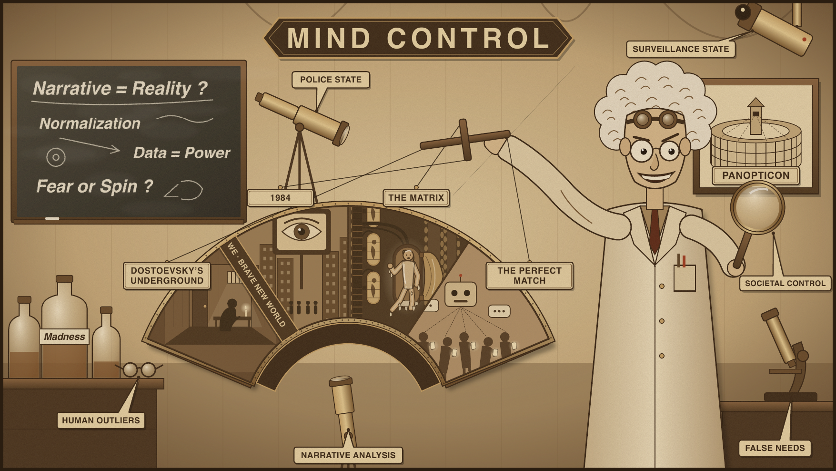
Course overview
SEGUE TO TALE 2 · THE COURSE ARC
Look at modern-age stories where societies impose or offer mind control.
Consider characters who are rebelling.
Ask questions through various lenses.
Notes:
~1 min · overview only, no discussion
Running long? 30 seconds.

Slide 15
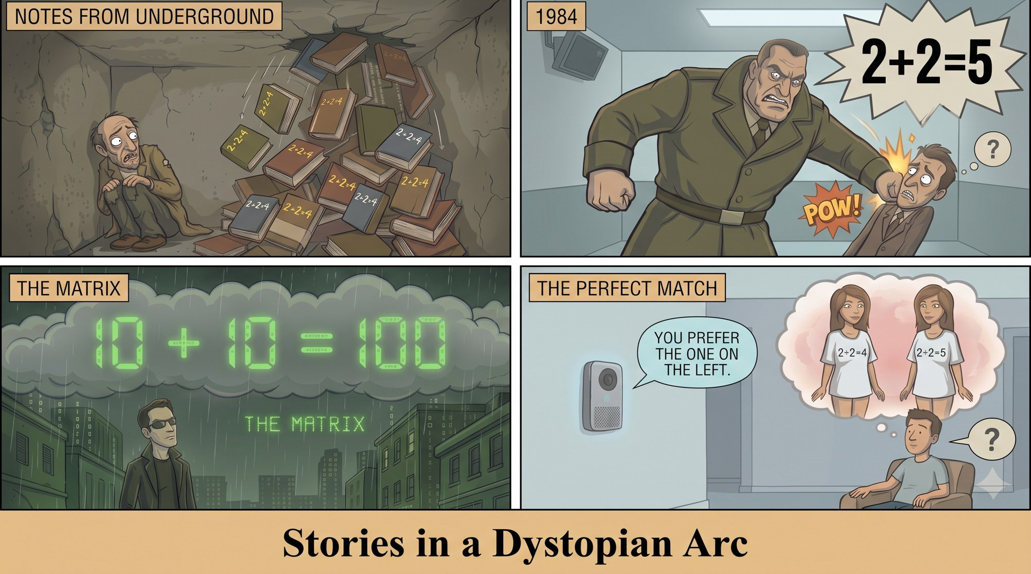
Stories in a dystopian arc
SEGUE TO TALE 2 · THE COURSE ARC
Dostoevsky's Underground Man, isolated and crushed by 2 + 2 = 4 reason.
Winston (1984), pounded by Big Brother to truly believe 2 + 2 = 5.
Neo (The Matrix), perceiving his whole world is a simulation, seeing 2 + 2 = 4 in binary.
Sai (The Perfect Match), nudged by the AI agent Tilly into preferring the beautiful girl in the "2 + 2 = 4" T-shirt.
The 2 + 2 = 4 image comes from the novella. Larry Cedar's show leaves it out, so this panel is our summary of the book, not of the performance.
Notes:
~3 min
Through-line: 2 + 2. Crushed by 4, forced to believe 5, seeing 4 in binary, nudged toward 4.
2 + 2 = 4 is from the novella, not the show (tag on slide).
Optional: 'Which story are you most looking forward to?'

Slide 16
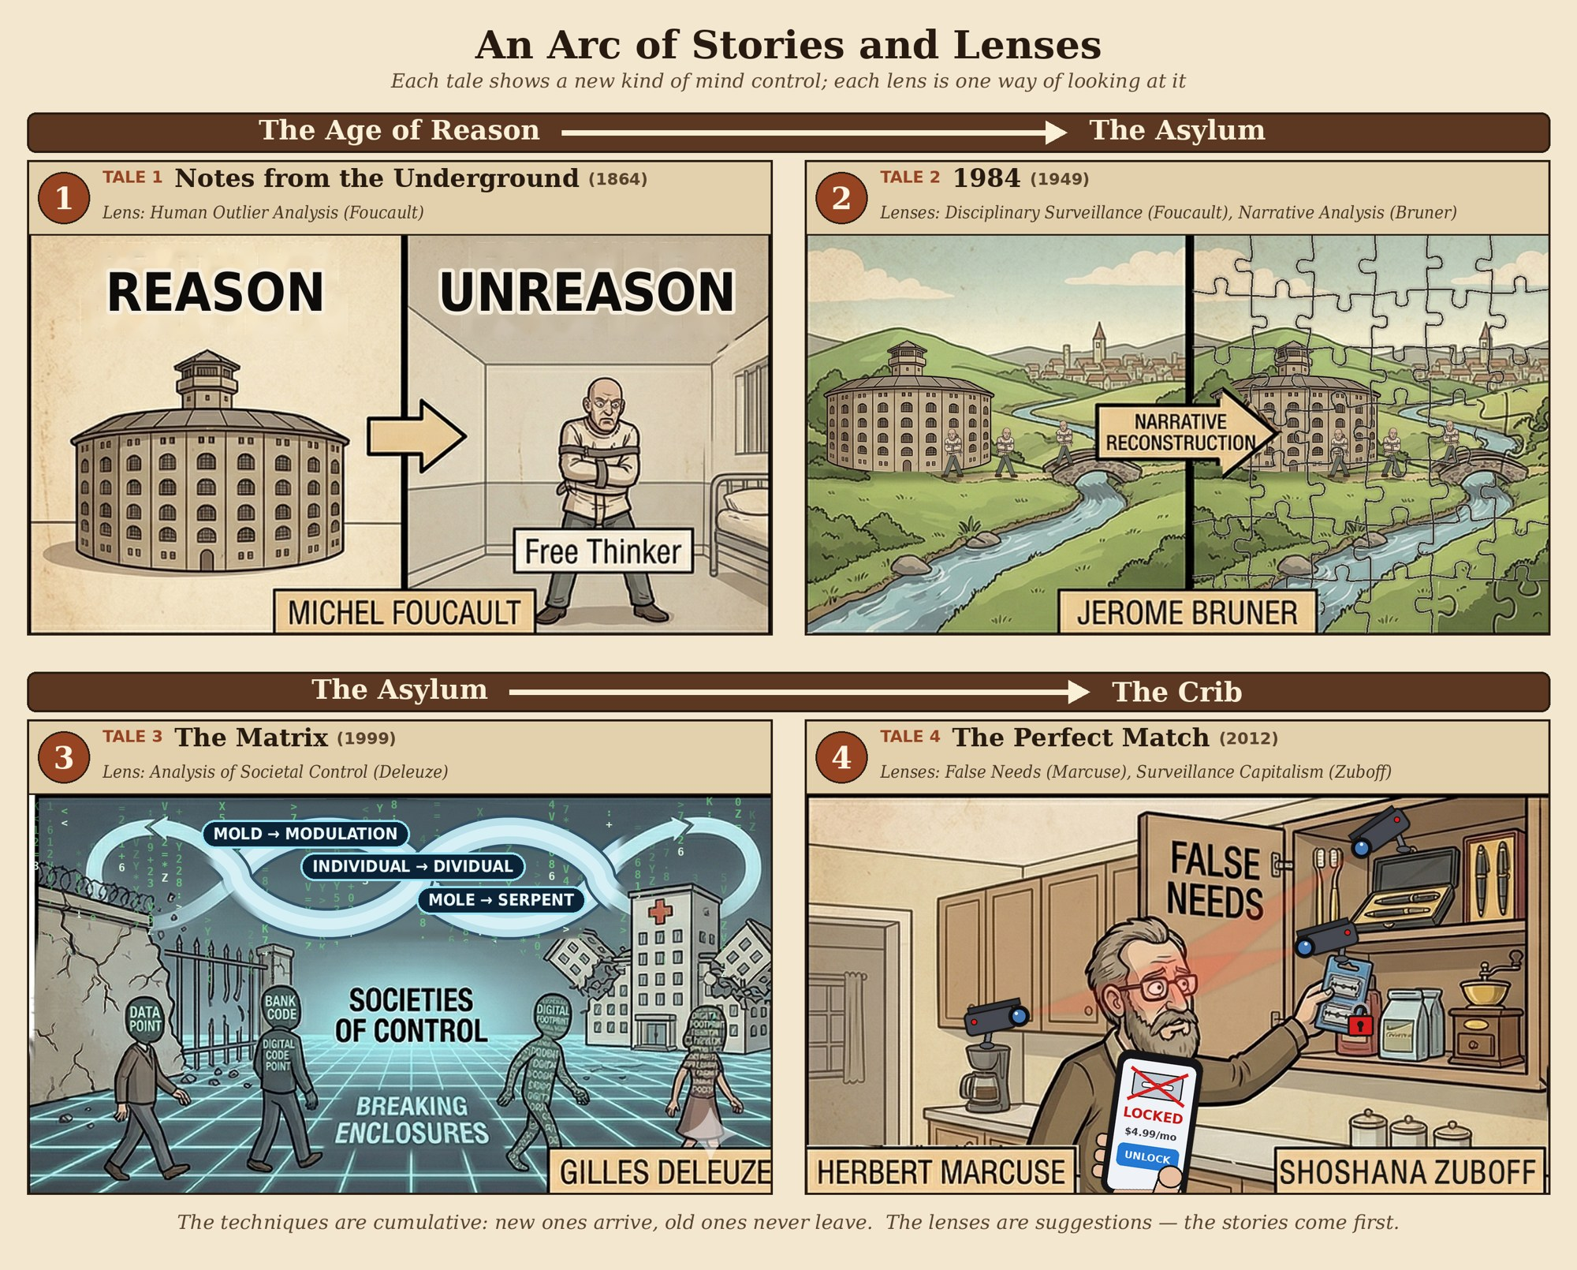
Some lenses
SEGUE TO TALE 2 · THE COURSE ARC
Human Outlier Analysis (Michel Foucault)
  Madness and confinement
  Knowledge and limits of thought
  Panopticism and disciplinary surveillance
Narrative Analysis (Jerome Bruner)
Societal Control (Gilles Deleuze)
  Foucault's "enclosures" (prisons, schools, hospitals) are breaking down.
  We are "dividuals": data points, bank codes, digital footprints tracked in a continuous loop.
  Not a cage, but a network where control is fluid and constant.
False Needs (Herbert Marcuse)
Surveillance Capitalism (Shoshana Zuboff)
Notes:
~2 min
Just name the lenses; they're in the Preface. We've already met Foucault today.
Close: bring one example of control or defiance from your own life next week.

