Slide 1
Tales of Defiance to Mind Control in the Modern Age
SESSION 1 PRESENTATION
Tale 1: Dostoevsky's Notes from Underground (1864)
Scott Axelrod
Notes:
Session 1. Order of the session: context for Notes from Underground; Larry Cedar clip 1; read the Ruth & Dev dialogue; clip 2; homework questions; course overview pages.
FACILITATION · TIME PLAN (assumes ~90 min; scale if different)
Welcome + roadmap (slides 1–2): 3 min. Context (3–7): 12 min. Clip 1 + dialogue (8–11): 15 min. Clip 2 (12): 3 min. QUESTIONS (13–14): 35 min. Segue (15–18): 10 min. Buffer: 12 min.
Aim for roughly 45% of the session in discussion. Keep the buffer for discussion overflow, not for lecture.
Opener: ask 'What stayed with you from the reading?' to learn what students remember and care about.
Set up a 'parking lot' (flip chart or corner of the board) for questions that come up during context; promise to return to them in the discussion.
SOURCE NOTE: Students watched Larry Cedar's one-man show rather than reading the novella. The show is a subset of the text. It omits the Crystal Palace, '2 × 2 = 4', the anthill/ant-heap and 'sticking out your tongue'. Slides 3, 5, 7 and 17 are tagged accordingly. Keep it brief and matter-of-fact.

Slide 2




What we'll cover
SESSION 1 · TODAY
Context of Notes from Underground
Slides 3–7
A Dialog About Notes
Slides 8–12
Concrete and Abstract Questions
Slides 13–14
Toward 1984: Legacy, Cartoon Summary, Arc, and Lenses
Slides 15–18
Notes:
FACILITATION · ~2 min
Say plainly that this is a discussion-weighted session: brief context, a dialogue, then most of our time on the questions.
Invite students to jump in with questions at any point, and note that anything that would derail the flow goes in the parking lot.
Point to slides 13–14 as the main event.

Slide 3
Russia under Alexander II, 1849–1881
CONTEXT · NOTES FROM UNDERGROUND
1849
1861
1863
1866
Dostoevsky's mock execution, then Siberian labor camp and exile
Emancipation of the serfs; censorship loosened
Chernyshevsky's What Is to Be Done? imagines the Crystal Palace
Karakozov tries to assassinate the Tsar
1855
1862
1864
1881
Alexander II takes the throne
Turgenev's Fathers and Sons names the "nihilists"
Dostoevsky answers with Notes from Underground
People's Will kills Alexander II, weeks after Dostoevsky dies
Not to scale. Adapted from DMC Chronology and the Notes from Underground context notes.
Notes:
FACILITATION · ~3 min (reference slide, do NOT walk every date)
Highlight only three anchors: 1861 emancipation; 1863–64 Chernyshevsky and Dostoevsky's reply; 1881 assassination. Say 'the rest is here for reference.'
No questions invited here unless someone asks; park the rest.
SOURCE NOTE: The 1863 Crystal Palace item is background from the novella, not the performance. Mention that in passing, not as a caveat.

Slide 4


A reforming Tsar and the first nihilists
CONTEXT · THE SETTING
Alexander II (r. 1855–1881)
Russian Nihilism
His Great Reforms, above all freeing the serfs in 1861, and looser censorship made room for a radical intelligentsia.
When the reforms didn't satisfy the radicals, his government cracked down.
His reign brought the movement into being, and became its target.
Named through Bazarov, hero of Turgenev's Fathers and Sons (1862).
Less "nothing matters" than "nothing counts except what science can verify."
Out: religion, tradition, art for its own sake, inherited authority. In: materialism, utilitarianism, scientism.
The irony: these nihilists believed passionately in one thing, reason.
Notes:
FACILITATION · ~3 min (combined with slide 5, ~5 min total)
Keep it brisk: reforms made room for radicals; nihilism = faith in reason/science.
Land the irony: the nihilists believed passionately in one thing, reason.
One light check-in: 'Does anyone know where they've met this kind of faith in science or reason before?'

Slide 5
Chernyshevsky's Crystal Palace
CONTEXT · THE DREAM
What Is to Be Done? (1863)
Written while Chernyshevsky was imprisoned in the Peter and Paul Fortress.
Rational egoism
People always act in their own interest. Show them where it truly lies, and they will behave well.
The Crystal Palace
In Vera Pavlovna's Fourth Dream: a glass-and-iron communal paradise, modeled on London's 1851 exhibition hall and Fourier's phalanstery. Society designed by reason, where conflict disappears.
Afterward: a "civil execution" (public degradation), Siberian prison, exile. Lenin later reused the title.
Glass, iron, and everyone finally rational
Heads up: Chernyshevsky's Crystal Palace is in the novella, but not in Larry Cedar's show. The Underground Man argues against it without naming it in the show.
Notes:
FACILITATION · ~3 min
Describe the Crystal Palace quickly: glass, iron, everyone rational, conflict gone.
Single check-in: 'Would you want to live there? What would you miss?' Take 2–3 quick answers only, then move on. Bank the rest of this interest for the discussion segment.
ACKNOWLEDGE (about 20 sec): 'Heads up: the Crystal Palace isn't in Larry Cedar's show. It's in the novella and in Chernyshevsky's book. I'm including it because it's the vision of the future the Underground Man is arguing against. Listen to how Ruth describes it on slide 9: the confident people who say that if we knew our real interest we'd be good.'
DISCUSSION PROMPT: 'He never names who he's arguing with. Who do you think he's talking to?' Let students guess before you name Chernyshevsky and the Palace.
Cut to about 2 min total here, since the Palace is not in the text students saw.

Slide 6


Two writers, two Siberias, in opposite order
CONTEXT · THE REBUTTAL
Dostoevsky
Chernyshevsky
1849
Petrashevsky circle: utopian socialism and banned books
1863
Writes What Is to Be Done? in prison
Punished
Mock execution, hard labor in Siberia, exile in the army
Punished
Civil execution, Siberian prison, exile
1864
Then writes Notes from Underground
Legacy
His novel inspires anti-tsarist radicals
Punished first, then attacks a dream he once partly shared
Writes first, then is punished
Notes:
FACILITATION · ~1–2 min (the quickest slide to gloss over)
Key line: 'Punished first versus writes first.' Dostoevsky attacks a dream he once partly shared; Chernyshevsky writes, then pays.
Say it matters because it shapes who each man is arguing with, then move on. Don't invite discussion here.

Slide 7


"I am a sick man.... I am a spiteful man."
CONTEXT · THE UNDERGROUND MAN
2×2
Not piano keys
2 × 2 = 4
No tongue allowed
People will act against their own interest just to prove they are free, and not keys on a piano.
Watch from 17:58-19:00
"Two times two makes four" is the beginning of death. Twice two makes five can be charming too.
The Crystal Palace is an anthill, a place where you can't even stick out your tongue.
✓ In the show
From the novella; left out of the show
From the novella; left out of the show
The target is not reason itself. It is reason claiming totality: if science can fully predict us, freedom is gone.
Notes:
FACILITATION · ~4 min (SLOW DOWN: this sets up the concepts the questions rely on)
Spend time on 'not piano keys' (in the show). Treat '2 × 2 = 4' and the anthill/'tongue' image as novella material that the show omits.
Emphasize: the target is reason claiming totality, not reason itself.
Ask ONE question: 'Is the freedom to act against your own interest worth having?' Take 2–3 responses. This previews the main discussion.
TAGS ON SLIDE: Piano keys is in the show (about 18:29). '2 × 2 = 4' and the anthill/ant-heap and 'stick out your tongue' images are in the novella, not the performance.
SAY: 'The show kept the piano keys but left out the other two famous images. What do we gain or lose by cutting them?' Treat it as an adaptation choice, but don't claim to know why the adapter cut them.
CLIP: Cue Larry Cedar's show at 17:58 and stop at 19:00 (about 1 minute); this is the piano keys passage in context. Video: youtube.com/watch?v=asp5tqDql0g (start at 17:58).

Slide 8

Larry Cedar as the Underground Man
CLIP 1 · BEFORE THE DIALOGUE
"I am a sick man.... I am a spiteful man."
Watch from 1:30
Notes from Underground, one-man show, Garnett translation · youtube.com/watch?v=asp5tqDql0g
Notes:
Clip 1: https://www.youtube.com/watch?v=asp5tqDql0g&t=90s (opening: "I am a sick man...")
FACILITATION · ~3 min
Before playing: 'Listen for the tone. Is he angry, sad, funny?' After: take 1–2 reactions only.
Remind students they will hear the full text in the dialogue, so this clip is atmosphere, not analysis.

Slide 9
Not the Keys of a Piano
DIALOGUE · PART 1 OF 3 · READERS: RUTH AND DEV
RUTH "I am a sick man. I am a spiteful man." That's how Dostoevsky's Notes from Underground begins.
DEV Not exactly a warm welcome.
RUTH He doesn't want one. He's a retired clerk who has spent forty years in his corner, and he tells us that to be too conscious is an illness.
DEV An illness? Most of us think knowing ourselves is the cure.
RUTH Not for him. He sees through every motive, including his own, so he can't become anything. Not spiteful, not kind, not a hero, not even an insect.
DEV So what's he arguing against?
RUTH The confident people who say we only do nasty things because we don't know our own interests. Show us our real advantage, they say, and we'll be good out of sheer necessity.
DEV That sounds reasonable.
Notes:
Time marks in Larry Cedar's performance (https://www.youtube.com/watch?v=asp5tqDql0g):
RUTH ""I am a sick man. I am a spiteful man." ..." → 1:30
RUTH "He doesn't want one. He's a retired cler..." → 6:40
RUTH "The confident people who say we only do ..." → 13:41
FACILITATION · ~5 min
Recruit two volunteers to read Ruth and Dev (or read it with a student). This keeps the room engaged and varies the voices.
No pause needed in Part 1; keep the momentum.

Slide 10
Not the Keys of a Piano
DIALOGUE · PART 2 OF 3 · READERS: RUTH AND DEV
RUTH That's exactly his target. He says what a person wants is simply independent choice, whatever that independence may cost and wherever it may lead.
DEV Even if the choice is stupid?
RUTH Especially then. A man may choose something stupid just to keep the right to choose it. Otherwise, he says, we'd be nothing but the keys of a piano.
DEV Press the key, and the note sounds.
RUTH And he asks the reformers a question: how do you know it's even desirable to reform people that way?
DEV But he's hardly a hero of freedom.
RUTH No, and the second half shows it. He meets Liza, a young woman in a brothel, and gives her a moving speech about the life she could still have. He gives her his address.
DEV And she comes.
Notes:
Time marks in Larry Cedar's performance (https://www.youtube.com/watch?v=asp5tqDql0g):
RUTH "That's exactly his target. He says what ..." → 15:11
RUTH "Especially then. A man may choose someth..." → 18:29
RUTH "And he asks the reformers a question: ho..." → 19:03
FACILITATION · ~5 min
PAUSE at the end of this part and ask: 'Is he a hero of freedom, or just spiteful?'
Take 2–3 views. Don't resolve it; say 'hold that thought, because Part 3 complicates it.'

Slide 11
Not the Keys of a Piano
DIALOGUE · PART 3 OF 3 · READERS: RUTH AND DEV
RUTH She does. And he turns on her. He tells her it was all a game, that power was what he wanted. Then he breaks down and says, "I can't be good."
DEV So he can stand up to the reformers, but he can't accept one person's kindness.
RUTH He even admits that, for him, loving meant showing his moral superiority.
DEV And how does he leave us?
RUTH He turns the mirror on us. Give any one of us a little more independence, he says, relax the control, and we'd be begging to be under control again at once.
DEV That's chilling.
RUTH It's why this is a good place to start thinking about defiance and control. He sees the danger of being managed for our own good. But he also suspects we might want it.
DEV Then the question is whether we can choose freely without ending up alone in his corner.
RUTH Or whether we'd even notice we'd stopped choosing.
Notes:
Time marks in Larry Cedar's performance (https://www.youtube.com/watch?v=asp5tqDql0g):
RUTH "She does. And he turns on her. He tells ..." → 1:21:13, 1:24:03
RUTH "He even admits that, for him, loving mea..." → 1:25:04
RUTH "He turns the mirror on us. Give any one ..." → 1:29:45
FACILITATION · ~5 min
PAUSE at the end and ask: 'Would we notice we'd stopped choosing?'
This is the bridge into the questions section. Let the silence sit a few seconds before calling on anyone.

Slide 12

How he leaves us
CLIP 2 · AFTER THE DIALOGUE
Give us a little more independence, relax the control, and we'd be begging to be under control again at once.
Watch from 1:29:45
Ruth's paraphrase of the closing pages, from the dialogue
Notes:
Clip 2: https://www.youtube.com/watch?v=asp5tqDql0g&t=5385s
FACILITATION · ~3 min
Play the clip, then ask for one-word reactions around the room, or a quick 'what hit you?'
Then transition: 'Let's take this to your homework questions.'

Slide 13
Concrete questions about the Underground Man
QUESTIONS · FROM THE HOMEWORK
1
What is his situation?
2
How did he get into it?
3
What was his dilemma?
4
What about his personality might have caused him difficulty?
The protagonist is never named; by convention he is called the Underground Man.
Notes:
FACILITATION · ~8 min (warm-up; these are the easy, concrete questions)
Do NOT read all four aloud in order. Use pair-share for 2–3 minutes, then a quick popcorn round (about 5 min) to gather answers.
Goal: build confidence and a shared factual baseline before the harder questions.
If someone raises a deeper point, say 'great, hold that for the next slide.'

Slide 14




Through the lens of human outlier analysis
QUESTIONS · MORE ABSTRACT / SUBJECTIVE
How is the protagonist unusual in the society in which he lives, and how is he trying to influence that society?
THE LENS
Human Outlier Analysis
Foucault, Madness and Civilization (1961): the Age of Reason built institutions to cast radical thinkers out as mad or criminal.
Do we lose something if we dismiss him as mad?
Do you sympathize with the protagonist and his plight? What about the other characters?
Can we usefully separate out the dysfunction from the creative insight?
What does the protagonist see about society that those around him do not see?
These also appear under Tale 1 in the Preface to the course.
Notes:
FACILITATION · ~27 min (the main event; most of the discussion time lives here)
Choose two or three of the four questions rather than covering all; each can take 8–10 minutes.
Opening move, before the abstract questions: 'Has anyone ever felt like the outlier in a group?'
Anchor question: 'Do we lose something if we dismiss him as mad?' (links Foucault to the Underground Man and carries into 1984).
Provocative seed: 'Do you ever want to be managed for your own good?' (ties to the closing line of Clip 2).
Techniques: hold back your own view until 2–3 students have spoken; follow up with 'Say more' or 'Who sees it differently?'; for dominant voices, 'Let's hear from someone who hasn't spoken yet.'

Slide 15
What came after: a literary line and a violent one
SEGUE TO TALE 2 · LEGACY
The literary line: engineering human behavior
1864
1920–21
1932
1949
Notes from Underground
Zamyatin, We
Huxley, Brave New World
Orwell, 1984
Later adopted as a forerunner of existentialism
Glass apartments; citizens reduced to numbers
Lessons whispered before birth
Our next tale
The violent line: from ideas to terror
1866
Karakozov, influenced by Chernyshevsky's novel, tries to kill the Tsar
1872
Dostoevsky's Demons depicts nihilism turning into terror
1881
People's Will assassinates Alexander II
Notes:
FACILITATION · ~3 min (treat as a trailer)
Spend about 2 minutes on the legacy lines, then link 2 × 2 = 4 to 1984 and stop.
One question only if time allows: 'Which of these lines of descent surprises you?'

Slide 16
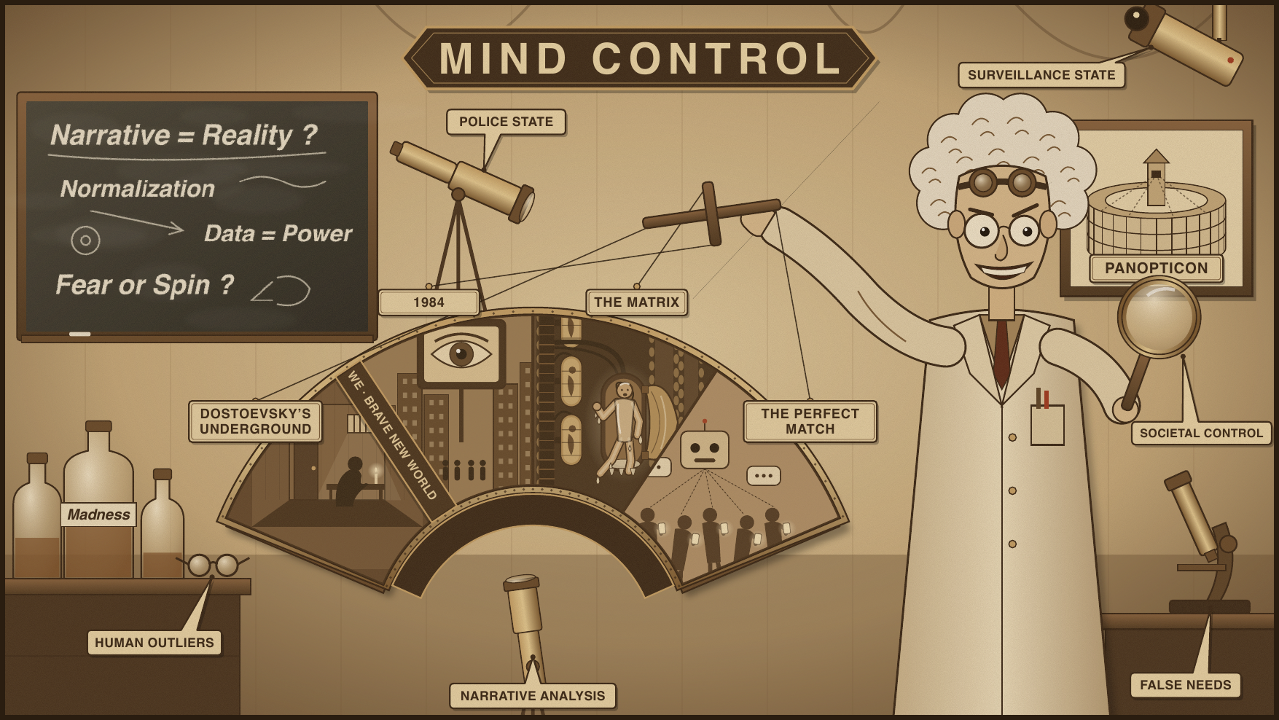
Course overview
SEGUE TO TALE 2 · THE COURSE ARC
Look at modern-age stories where societies impose or offer mind control.
Consider characters who are rebelling.
Ask questions through various lenses.
Notes:
FACILITATION · ~2 min
Quick overview of the course; no discussion needed. If the discussion ran long, shorten to 30 seconds.

Slide 17
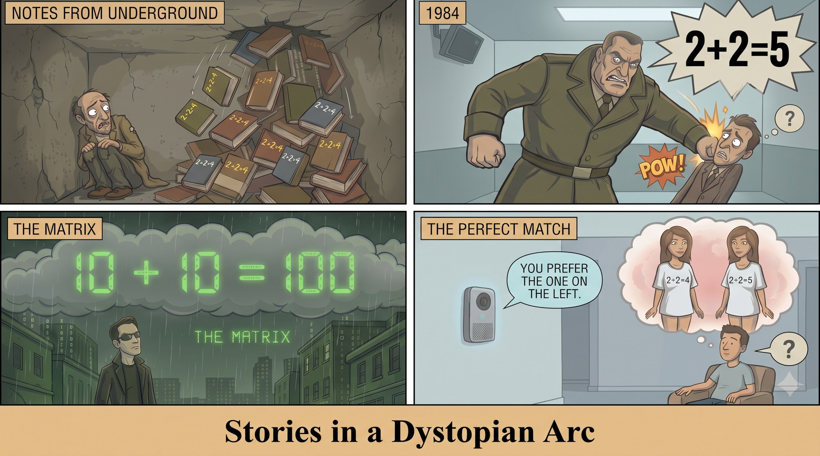
Stories in a dystopian arc
SEGUE TO TALE 2 · THE COURSE ARC
Dostoevsky's Underground Man, isolated and crushed by 2 + 2 = 4 reason.
Winston (1984), pounded by Big Brother to truly believe 2 + 2 = 5.
Neo (The Matrix), perceiving his whole world is a simulation, seeing 2 + 2 = 4 in binary.
Sai (The Perfect Match), nudged by the AI agent Tilly into preferring the beautiful girl in the "2 + 2 = 4" T-shirt.
The 2 + 2 = 4 image comes from the novella. Larry Cedar's show leaves it out, so this panel is our summary of the book, not of the performance.
Notes:
FACILITATION · ~3 min
Use the 2 + 2 motif as the through-line: crushed by 4, forced to believe 5, seeing 4 in binary, nudged toward 4.
Optional hook: 'Which of these four stories are you most looking forward to?'
SOURCE NOTE: '2 + 2 = 4' is from the novella, not from Larry Cedar's show. Say so when you introduce the through-line: 'The show leaves this out, but it's the motif the rest of the course picks up, so I'm bringing it in from the book.'
Optional: ask 'Does the show still make us feel the crushing logic of 2 + 2 = 4 without saying it?'

Slide 18
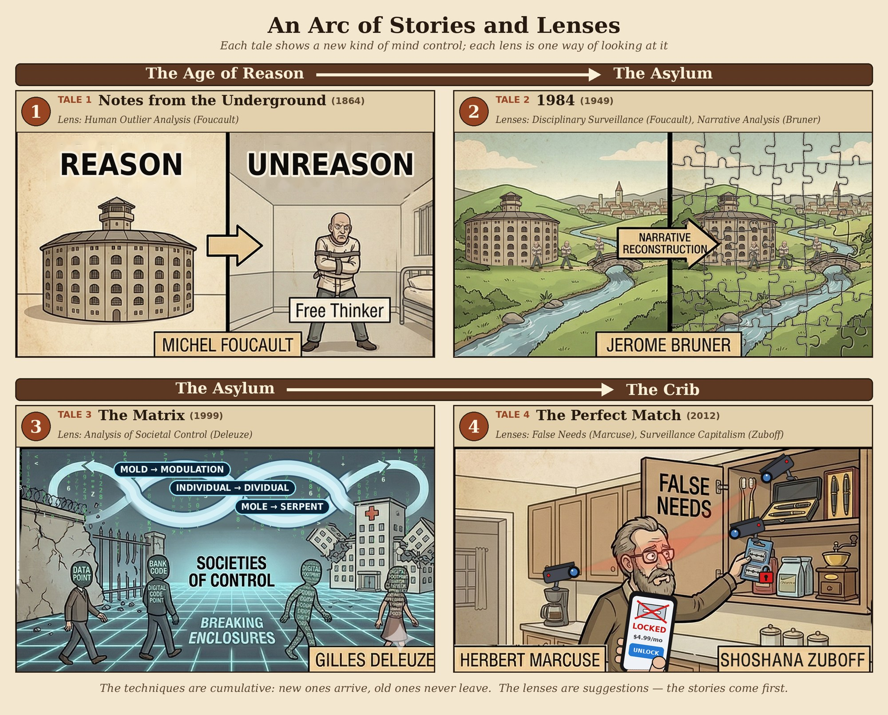
Some lenses
SEGUE TO TALE 2 · THE COURSE ARC
Human Outlier Analysis (Michel Foucault)
  Madness and confinement
  Knowledge and limits of thought
  Panopticism and disciplinary surveillance
Narrative Analysis (Jerome Bruner)
Societal Control (Gilles Deleuze)
  Foucault's "enclosures" (prisons, schools, hospitals) are breaking down.
  We are "dividuals": data points, bank codes, digital footprints tracked in a continuous loop.
  Not a cage, but a network where control is fluid and constant.
False Needs (Herbert Marcuse)
Surveillance Capitalism (Shoshana Zuboff)
Notes:
FACILITATION · ~2 min (coming attractions)
Say these lenses are covered in the Preface; just name them and highlight that we've already met Foucault today.
Close by asking students to bring one example of control or defiance from their own lives to the next session.

