Slide 1
Tales of Defiance to Mind Control in the Modern Age
SESSION 1 PRESENTATION
Tale 1: Dostoevsky's Notes from Underground (1864)
Scott Axelrod
Notes:
Session 1. Order of the session: context for Notes from Underground; Larry Cedar clip 1; read the Ruth & Dev dialogue; clip 2; homework questions; course overview pages.

Slide 2




What we'll cover
SESSION 1 · TODAY
Context of Notes from Underground
Slides 3–8
A Dialog About Notes
Slides 9–13
Concrete and Abstract Questions
Slides 14–15
Cartoon Course Summary, Dystopian Arc, and Lenses
Slides 16–18

Slide 3
Russia under Alexander II, 1849–1881
CONTEXT · NOTES FROM UNDERGROUND
1849
1861
1863
1866
Dostoevsky's mock execution, then Siberian labor camp and exile
Emancipation of the serfs; censorship loosened
Chernyshevsky's What Is to Be Done? imagines the Crystal Palace
Karakozov tries to assassinate the Tsar
1855
1862
1864
1881
Alexander II takes the throne
Turgenev's Fathers and Sons names the "nihilists"
Dostoevsky answers with Notes from Underground
People's Will kills Alexander II, weeks after Dostoevsky dies
Not to scale. Adapted from DMC Chronology and the Notes from Underground context notes.

Slide 4


A reforming Tsar and the first nihilists
CONTEXT · THE SETTING
Alexander II (r. 1855–1881)
Russian Nihilism
His Great Reforms, above all freeing the serfs in 1861, and looser censorship made room for a radical intelligentsia.
When the reforms didn't satisfy the radicals, his government cracked down.
His reign brought the movement into being, and became its target.
Named through Bazarov, hero of Turgenev's Fathers and Sons (1862).
Less "nothing matters" than "nothing counts except what science can verify."
Out: religion, tradition, art for its own sake, inherited authority. In: materialism, utilitarianism, scientism.
The irony: these nihilists believed passionately in one thing, reason.

Slide 5
Chernyshevsky's Crystal Palace
CONTEXT · THE DREAM
What Is to Be Done? (1863)
Written while Chernyshevsky was imprisoned in the Peter and Paul Fortress.
Rational egoism
People always act in their own interest. Show them where it truly lies, and they will behave well.
The Crystal Palace
In Vera Pavlovna's Fourth Dream: a glass-and-iron communal paradise, modeled on London's 1851 exhibition hall and Fourier's phalanstery. Society designed by reason, where conflict disappears.
Afterward: a "civil execution" (public degradation), Siberian prison, exile. Lenin later reused the title.
Glass, iron, and everyone finally rational

Slide 6


Two writers, two Siberias, in opposite order
CONTEXT · THE REBUTTAL
Dostoevsky
Chernyshevsky
1849
Petrashevsky circle: utopian socialism and banned books
1863
Writes What Is to Be Done? in prison
Punished
Mock execution, hard labor in Siberia, exile in the army
Punished
Civil execution, Siberian prison, exile
1864
Then writes Notes from Underground
Legacy
His novel inspires anti-tsarist radicals
Punished first, then attacks a dream he once partly shared
Writes first, then is punished

Slide 7


"I am a sick man.... I am a spiteful man."
CONTEXT · THE UNDERGROUND MAN
2×2
Not piano keys
2 × 2 = 4
No tongue allowed
People will act against their own interest just to prove they are free, and not keys on a piano.
"Two times two makes four" is the beginning of death. Twice two makes five can be charming too.
The Crystal Palace is an anthill, a place where you can't even stick out your tongue.
The target is not reason itself. It is reason claiming totality: if science can fully predict us, freedom is gone.

Slide 8
What came after: a literary line and a violent one
CONTEXT · LEGACY
The literary line: engineering human behavior
1864
1920–21
1932
1949
Notes from Underground
Zamyatin, We
Huxley, Brave New World
Orwell, 1984
Later adopted as a forerunner of existentialism
Glass apartments; citizens reduced to numbers
Lessons whispered before birth
Our next tale
The violent line: from ideas to terror
1866
Karakozov, influenced by Chernyshevsky's novel, tries to kill the Tsar
1872
Dostoevsky's Demons depicts nihilism turning into terror
1881
People's Will assassinates Alexander II

Slide 9

Larry Cedar as the Underground Man
CLIP 1 · BEFORE THE DIALOGUE
"I am a sick man.... I am a spiteful man."
Watch from 1:30
Notes from Underground, one-man show, Garnett translation · youtube.com/watch?v=asp5tqDql0g
Notes:
Clip 1: https://www.youtube.com/watch?v=asp5tqDql0g&t=90s (opening: "I am a sick man...")

Slide 10
Not the Keys of a Piano
DIALOGUE · PART 1 OF 3 · READERS: RUTH AND DEV
RUTH "I am a sick man. I am a spiteful man." That's how Dostoevsky's Notes from Underground begins.
DEV Not exactly a warm welcome.
RUTH He doesn't want one. He's a retired clerk who has spent forty years in his corner, and he tells us that to be too conscious is an illness.
DEV An illness? Most of us think knowing ourselves is the cure.
RUTH Not for him. He sees through every motive, including his own, so he can't become anything. Not spiteful, not kind, not a hero, not even an insect.
DEV So what's he arguing against?
RUTH The confident people who say we only do nasty things because we don't know our own interests. Show us our real advantage, they say, and we'll be good out of sheer necessity.
DEV That sounds reasonable.
Notes:
Time marks in Larry Cedar's performance (https://www.youtube.com/watch?v=asp5tqDql0g):
RUTH ""I am a sick man. I am a spiteful man." ..." → 1:30
RUTH "He doesn't want one. He's a retired cler..." → 6:40
RUTH "The confident people who say we only do ..." → 13:41

Slide 11
Not the Keys of a Piano
DIALOGUE · PART 2 OF 3 · READERS: RUTH AND DEV
RUTH That's exactly his target. He says what a person wants is simply independent choice, whatever that independence may cost and wherever it may lead.
DEV Even if the choice is stupid?
RUTH Especially then. A man may choose something stupid just to keep the right to choose it. Otherwise, he says, we'd be nothing but the keys of a piano.
DEV Press the key, and the note sounds.
RUTH And he asks the reformers a question: how do you know it's even desirable to reform people that way?
DEV But he's hardly a hero of freedom.
RUTH No, and the second half shows it. He meets Liza, a young woman in a brothel, and gives her a moving speech about the life she could still have. He gives her his address.
DEV And she comes.
Notes:
Time marks in Larry Cedar's performance (https://www.youtube.com/watch?v=asp5tqDql0g):
RUTH "That's exactly his target. He says what ..." → 15:11
RUTH "Especially then. A man may choose someth..." → 18:29
RUTH "And he asks the reformers a question: ho..." → 19:03

Slide 12
Not the Keys of a Piano
DIALOGUE · PART 3 OF 3 · READERS: RUTH AND DEV
RUTH She does. And he turns on her. He tells her it was all a game, that power was what he wanted. Then he breaks down and says, "I can't be good."
DEV So he can stand up to the reformers, but he can't accept one person's kindness.
RUTH He even admits that, for him, loving meant showing his moral superiority.
DEV And how does he leave us?
RUTH He turns the mirror on us. Give any one of us a little more independence, he says, relax the control, and we'd be begging to be under control again at once.
DEV That's chilling.
RUTH It's why this is a good place to start thinking about defiance and control. He sees the danger of being managed for our own good. But he also suspects we might want it.
DEV Then the question is whether we can choose freely without ending up alone in his corner.
RUTH Or whether we'd even notice we'd stopped choosing.
Notes:
Time marks in Larry Cedar's performance (https://www.youtube.com/watch?v=asp5tqDql0g):
RUTH "She does. And he turns on her. He tells ..." → 1:21:13, 1:24:03
RUTH "He even admits that, for him, loving mea..." → 1:25:04
RUTH "He turns the mirror on us. Give any one ..." → 1:29:45

Slide 13

How he leaves us
CLIP 2 · AFTER THE DIALOGUE
Give us a little more independence, relax the control, and we'd be begging to be under control again at once.
Watch from 1:29:45
Ruth's paraphrase of the closing pages, from the dialogue
Notes:
Clip 2: https://www.youtube.com/watch?v=asp5tqDql0g&t=5385s

Slide 14
Concrete questions about the Underground Man
QUESTIONS · FROM THE HOMEWORK
1
What is his situation?
2
How did he get into it?
3
What was his dilemma?
4
What about his personality might have caused him difficulty?
The protagonist is never named; by convention he is called the Underground Man.

Slide 15



Through the lens of human outlier analysis
QUESTIONS · MORE ABSTRACT / SUBJECTIVE
How is the protagonist unusual in the society in which he lives, and how is he trying to influence that society?
THE LENS
Human Outlier Analysis
Foucault, Madness and Civilization (1961): the Age of Reason built institutions to cast radical thinkers out as mad or criminal.
Do we lose something if we dismiss him as mad?
Do you sympathize with the protagonist and his plight? What about the other characters?
Can we usefully separate out the dysfunction from the creative insight?
What does the protagonist see about society that those around him do not see?
These also appear under Tale 1 in the Preface to the course.

Slide 16
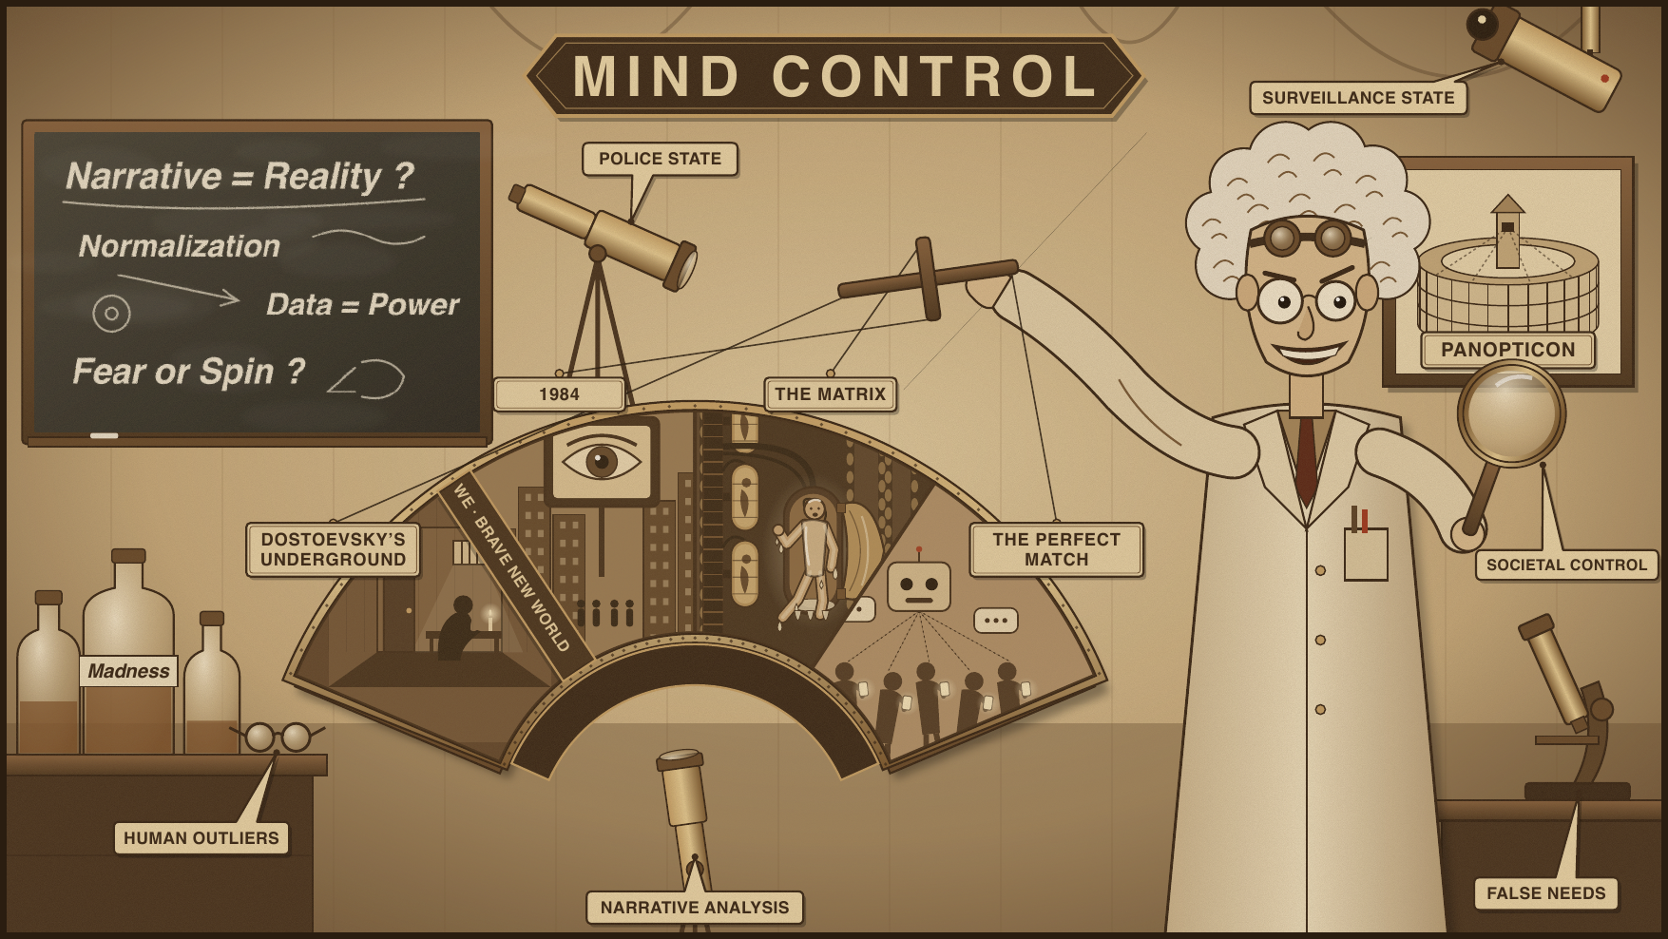
Course overview
SESSION 1 PRESENTATION
Look at modern-age stories where societies impose or offer mind control.
Consider characters who are rebelling.
Ask questions through various lenses.

Slide 17
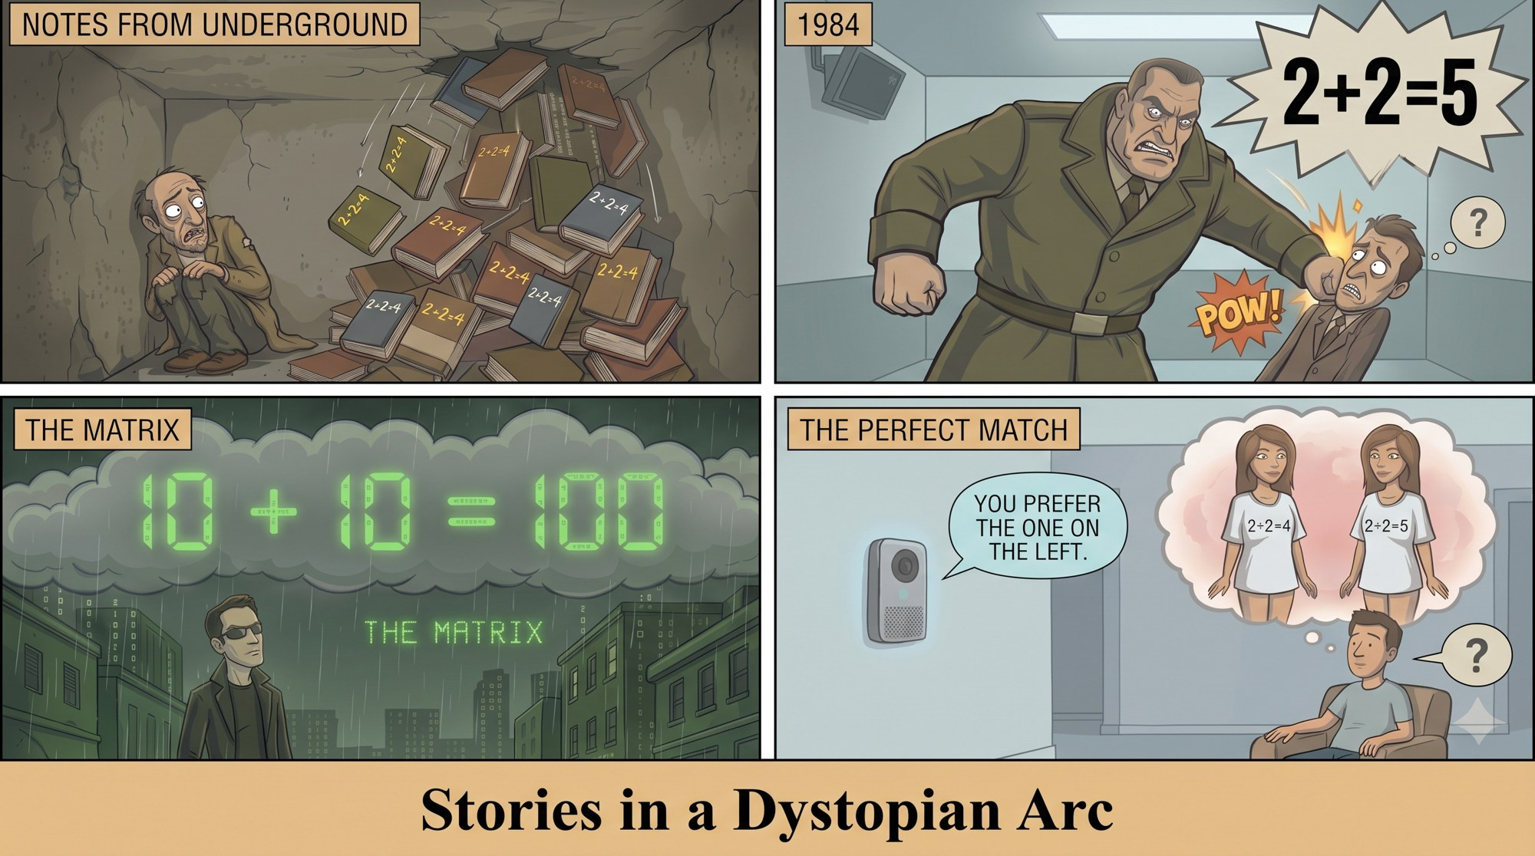
Stories in a dystopian arc
SESSION 1 PRESENTATION
Dostoevsky's Underground Man, isolated and crushed by 2 + 2 = 4 reason.
Winston (1984), pounded by Big Brother to truly believe 2 + 2 = 5.
Neo (The Matrix), perceiving his whole world is a simulation, seeing 2 + 2 = 4 in binary.
Sai (The Perfect Match), nudged by the AI agent Tilly into preferring the beautiful girl in the "2 + 2 = 4" T-shirt.

Slide 18
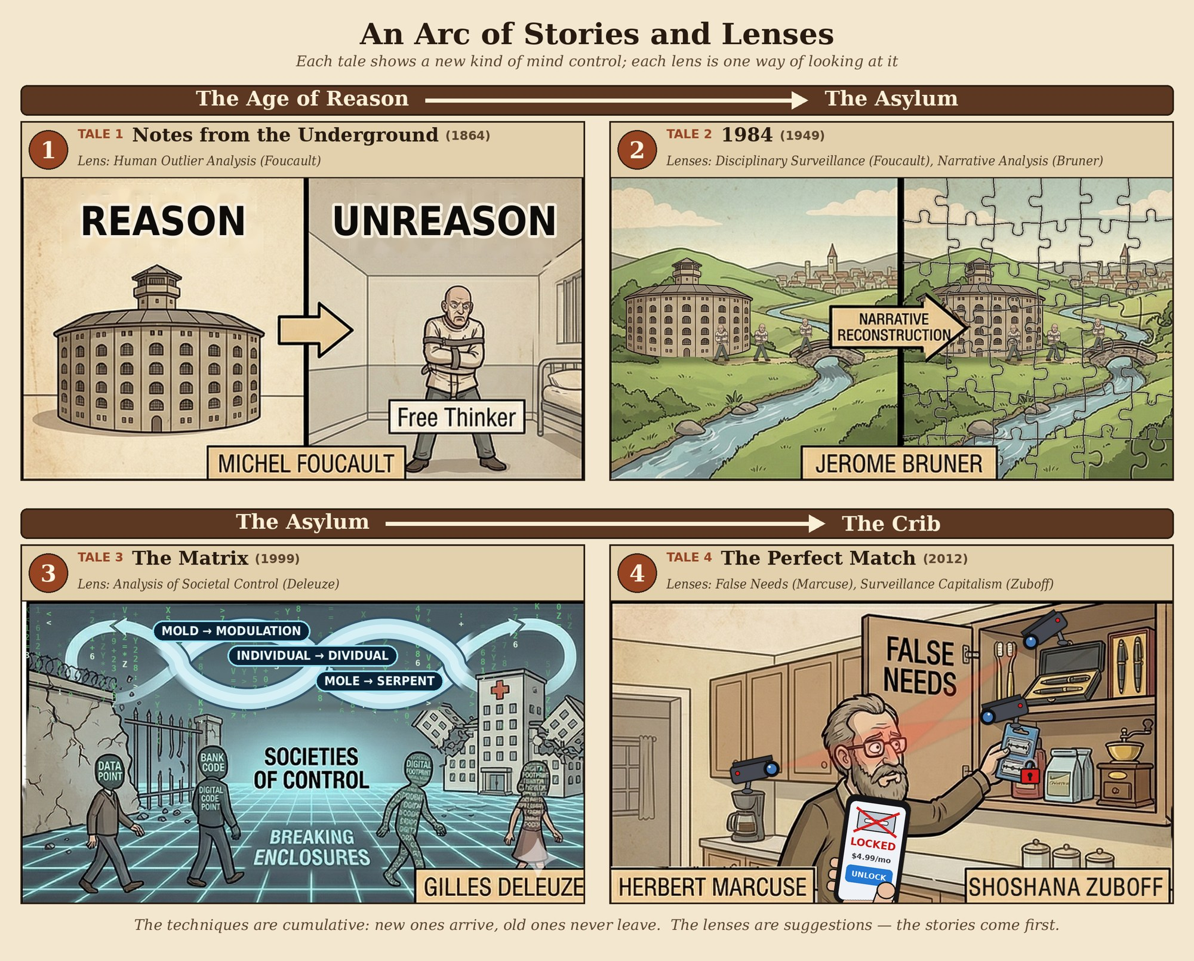
Some lenses
SESSION 1 PRESENTATION
Human Outlier Analysis (Michel Foucault)
  Madness and confinement
  Knowledge and limits of thought
  Panopticism and disciplinary surveillance
Narrative Analysis (Jerome Bruner)
Societal Control (Gilles Deleuze)
  Foucault's "enclosures" (prisons, schools, hospitals) are breaking down.
  We are "dividuals": data points, bank codes, digital footprints tracked in a continuous loop.
  Not a cage, but a network where control is fluid and constant.
False Needs (Herbert Marcuse)
Surveillance Capitalism (Shoshana Zuboff)

