Slide 1
Identifying subclasses of pitches and optimal pitch permutations for starting pitchers in Major League Baseball
Sebastian Kirkpatrick

Slide 2
Motivations
STAT 488: Multivariate Analysis
“Using Clustering to Find Pitch Subtypes and Effective Pairings” (Eno Sarris)
Cluster Identification
What’s New?
2023 Data
Isolate the Value of Each Permutation

Slide 3
Horizontal Break
Release Speed
K-Means Clustering
Vertical Break

Slide 4
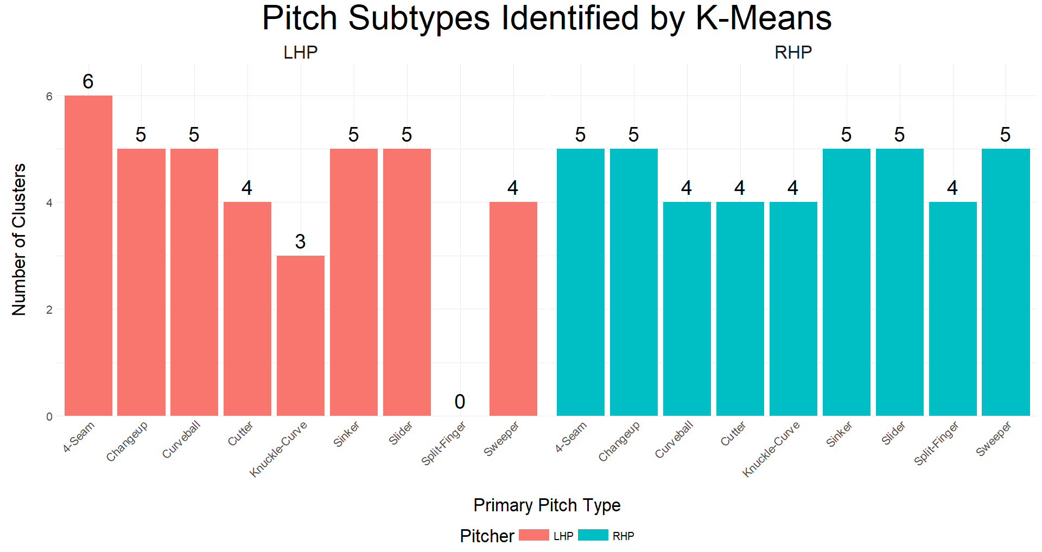

Slide 5
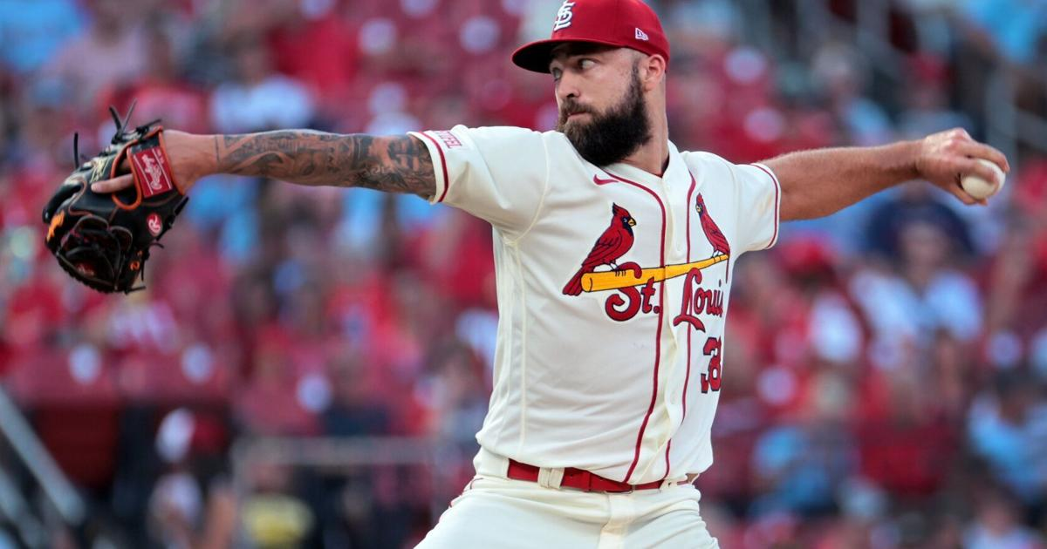

Slide 6
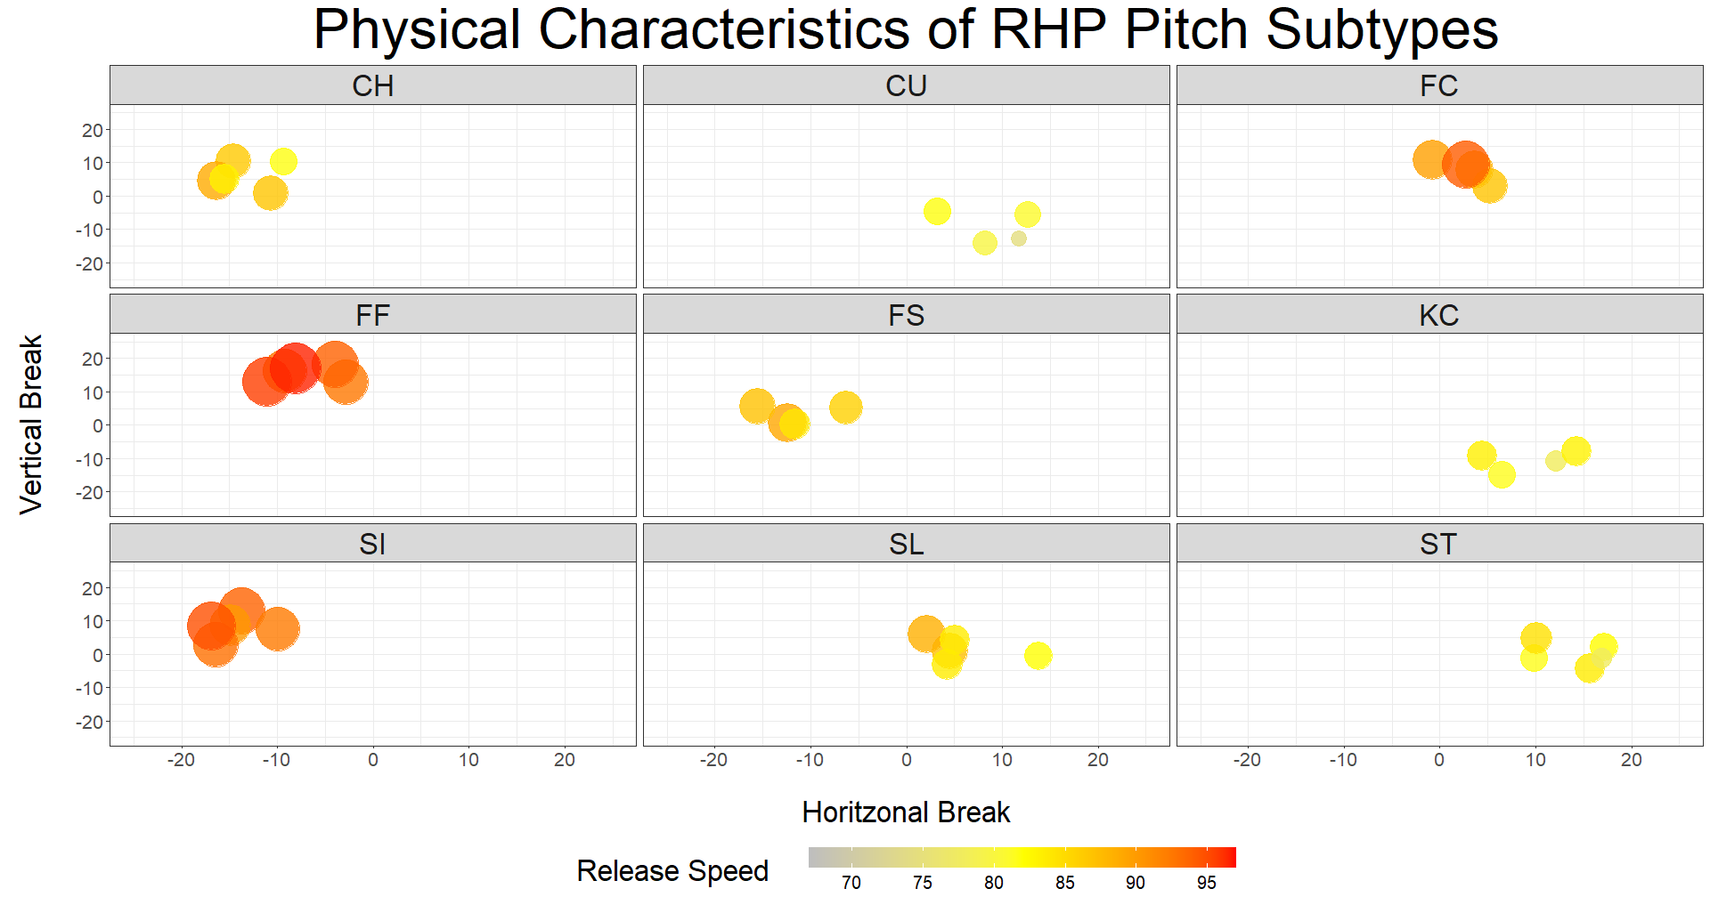

Slide 7
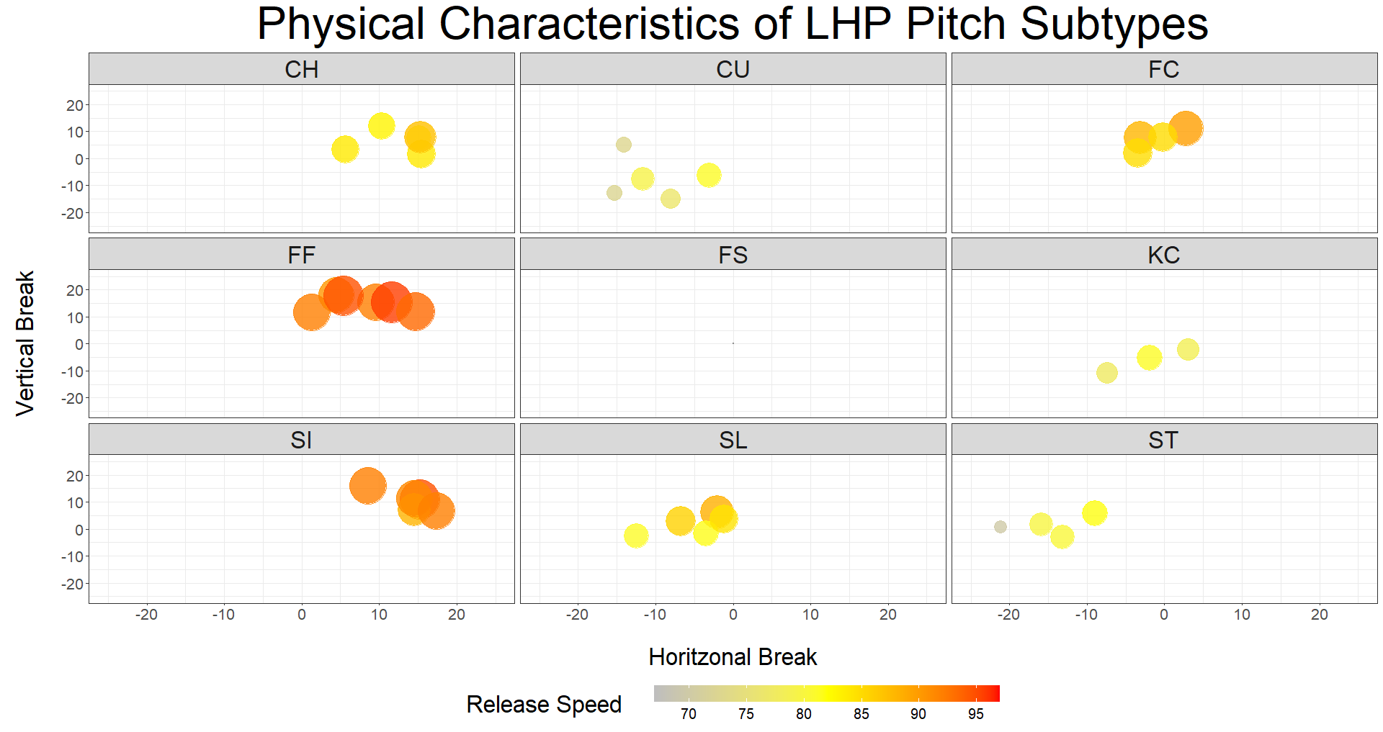


Slide 8
Modeling
Mixed Effects Linear Model
2 Sequential Models
Primary Pitch Type
Pitch Subtype (Clusters)
Separate Models for RHP & LHP
Response: Out-Value

Slide 9
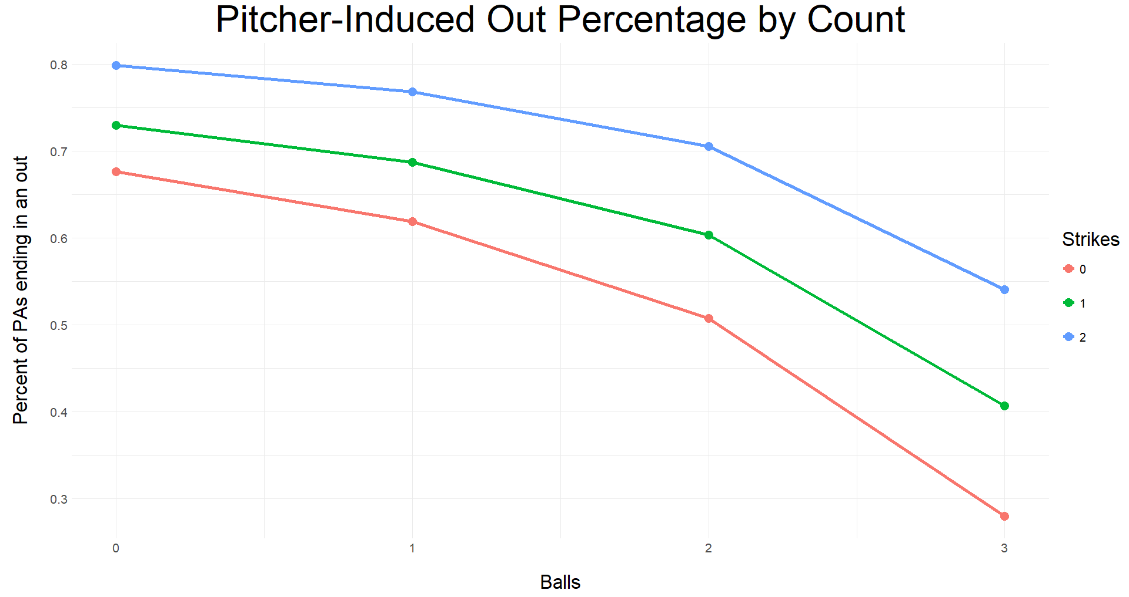

Slide 10
Modeling
Mixed Effects Linear Model
2 Sequential Models
Primary Pitch Type
Pitch Subtype (Clusters)
Separate Models for RHP & LHP
Response: Out-Value
Goal: Identify Pitch Permutation’s Relationship to Out-Value

Slide 11
RHP
Results

Slide 12
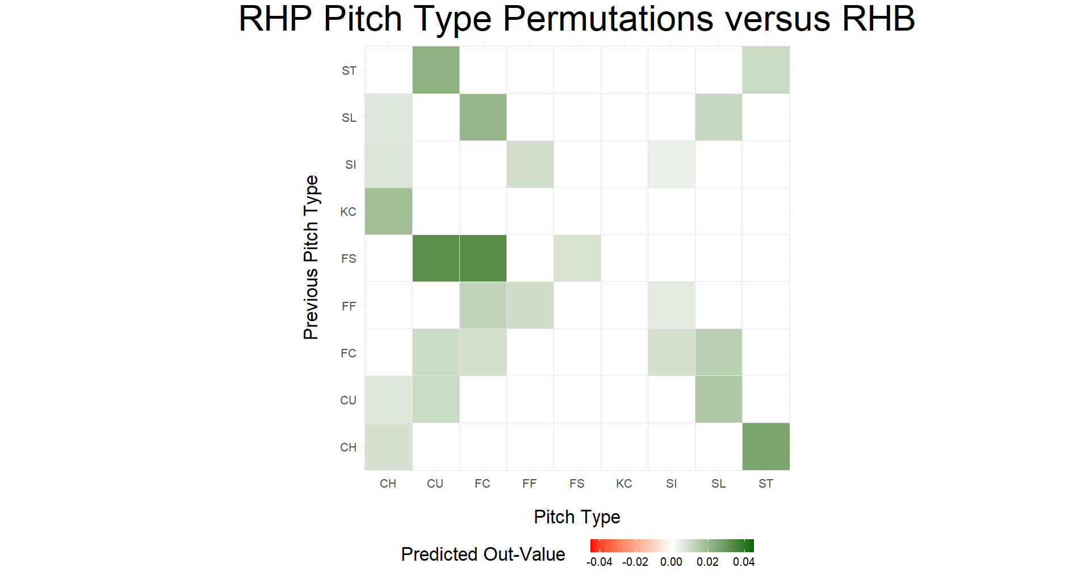

Slide 13
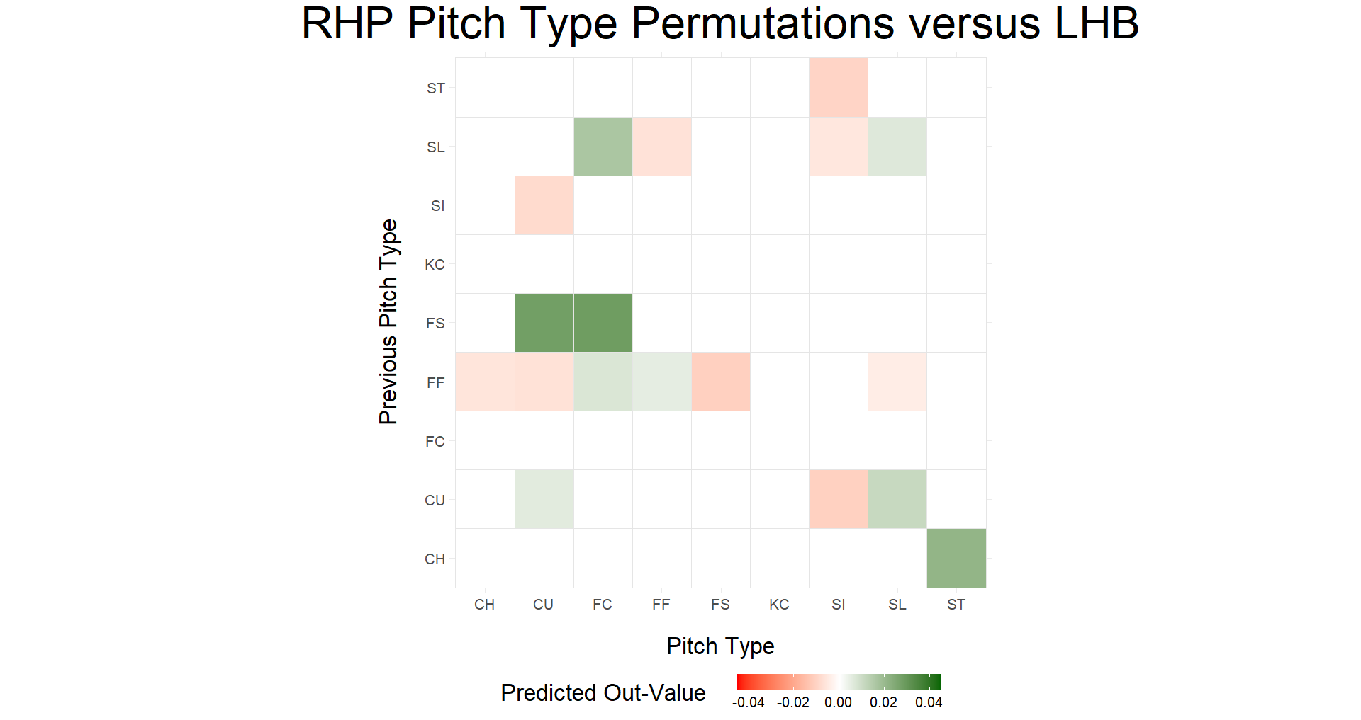

Slide 14
Previous Subtype | Release Speed | Vertical Break | Horizontal Break
FF1 | 92.44 | 12.78 | -2.84
FF2 | 93.86 | 18.24 | -3.95
FF3 | 92.42 | 16.13 | -9.18
FF4 | 95.57 | 12.92 | -11.04
FF5 | 96.49 | 16.99 | -9.07
Subtype | Release Speed | Vertical Break | Horizontal Break
FC1 | 88.49 | 7.97 | 3.54
FC2 | 86.83 | 3.02 | 5.26
FC3 | 89.64 | 10.80 | -0.80
FC4 | 94.19 | 9.21 | 2.71

Slide 15
Previous Subtype | Release Speed | Vertical Break | Horizontal Break
FF1 | 92.44 | 12.78 | -2.84
FF2 | 93.86 | 18.24 | -3.95
FF3 | 92.42 | 16.13 | -9.18
FF4 | 95.57 | 12.92 | -11.04
FF5 | 96.49 | 16.99 | -9.07
Subtype | Release Speed | Vertical Break | Horizontal Break
FC1 | 88.49 | 7.97 | 3.54
FC2 | 86.83 | 3.02 | 5.26
FC3 | 89.64 | 10.80 | -0.80
FC4 | 94.19 | 9.21 | 2.71

Slide 16

Previous Subtype | Release Speed | Vertical Break | Horizontal Break
FF1 | 92.44 | 12.78 | -2.84
FF2 | 93.86 | 18.24 | -3.95
FF3 | 92.42 | 16.13 | -9.18
FF4 | 95.57 | 12.92 | -11.04
FF5 | 96.49 | 16.99 | -9.07
Subtype | Release Speed | Vertical Break | Horizontal Break
FC1 | 88.49 | 7.97 | 3.54
FC2 | 86.83 | 3.02 | 5.26
FC3 | 89.64 | 10.80 | -0.80
FC4 | 94.19 | 9.21 | 2.71

Slide 17
LHP
Results

Slide 18
Previous Subtype | Release Speed | Vertical Break | Horizontal Break
SL1 | 88.40 | 6.22 | -2.08
SL2 | 81.59 | -1.58 | -3.51
SL3 | 81.09 | -2.44 | -12.47
SL4 | 85.67 | 2.79 | -6.73
SL5 | 84.26 | 3.61 | -1.14
Subtype | Release Speed | Vertical Break | Horizontal Break
SL1 | 88.40 | 6.22 | -2.08
SL2 | 81.59 | -1.58 | -3.51
SL3 | 81.09 | -2.44 | -12.47
SL4 | 85.67 | 2.79 | -6.73
SL5 | 84.26 | 3.61 | -1.14

Slide 19

Previous Subtype | Release Speed | Vertical Break | Horizontal Break
SL1 | 88.40 | 6.22 | -2.08
SL2 | 81.59 | -1.58 | -3.51
SL3 | 81.09 | -2.44 | -12.47
SL4 | 85.67 | 2.79 | -6.73
SL5 | 84.26 | 3.61 | -1.14
Subtype | Release Speed | Vertical Break | Horizontal Break
SL1 | 88.40 | 6.22 | -2.08
SL2 | 81.59 | -1.58 | -3.51
SL3 | 81.09 | -2.44 | -12.47
SL4 | 85.67 | 2.79 | -6.73
SL5 | 84.26 | 3.61 | -1.14

Slide 20
What’s Next?
Add More Data
2024 season, past seasons?
Ignore Primary Pitch Types
Fixes a lot of “not enough data” issues
Better Clustering
More variables
Explore other clustering methods

Slide 21
Acknowledgements
Co-Authors: Mena Whalen and Gregory J. Matthews (Loyola University Chicago)
Shout-Out: Quang Nguyen (Carnegie Mellon University) - @qntkhvn

Slide 22
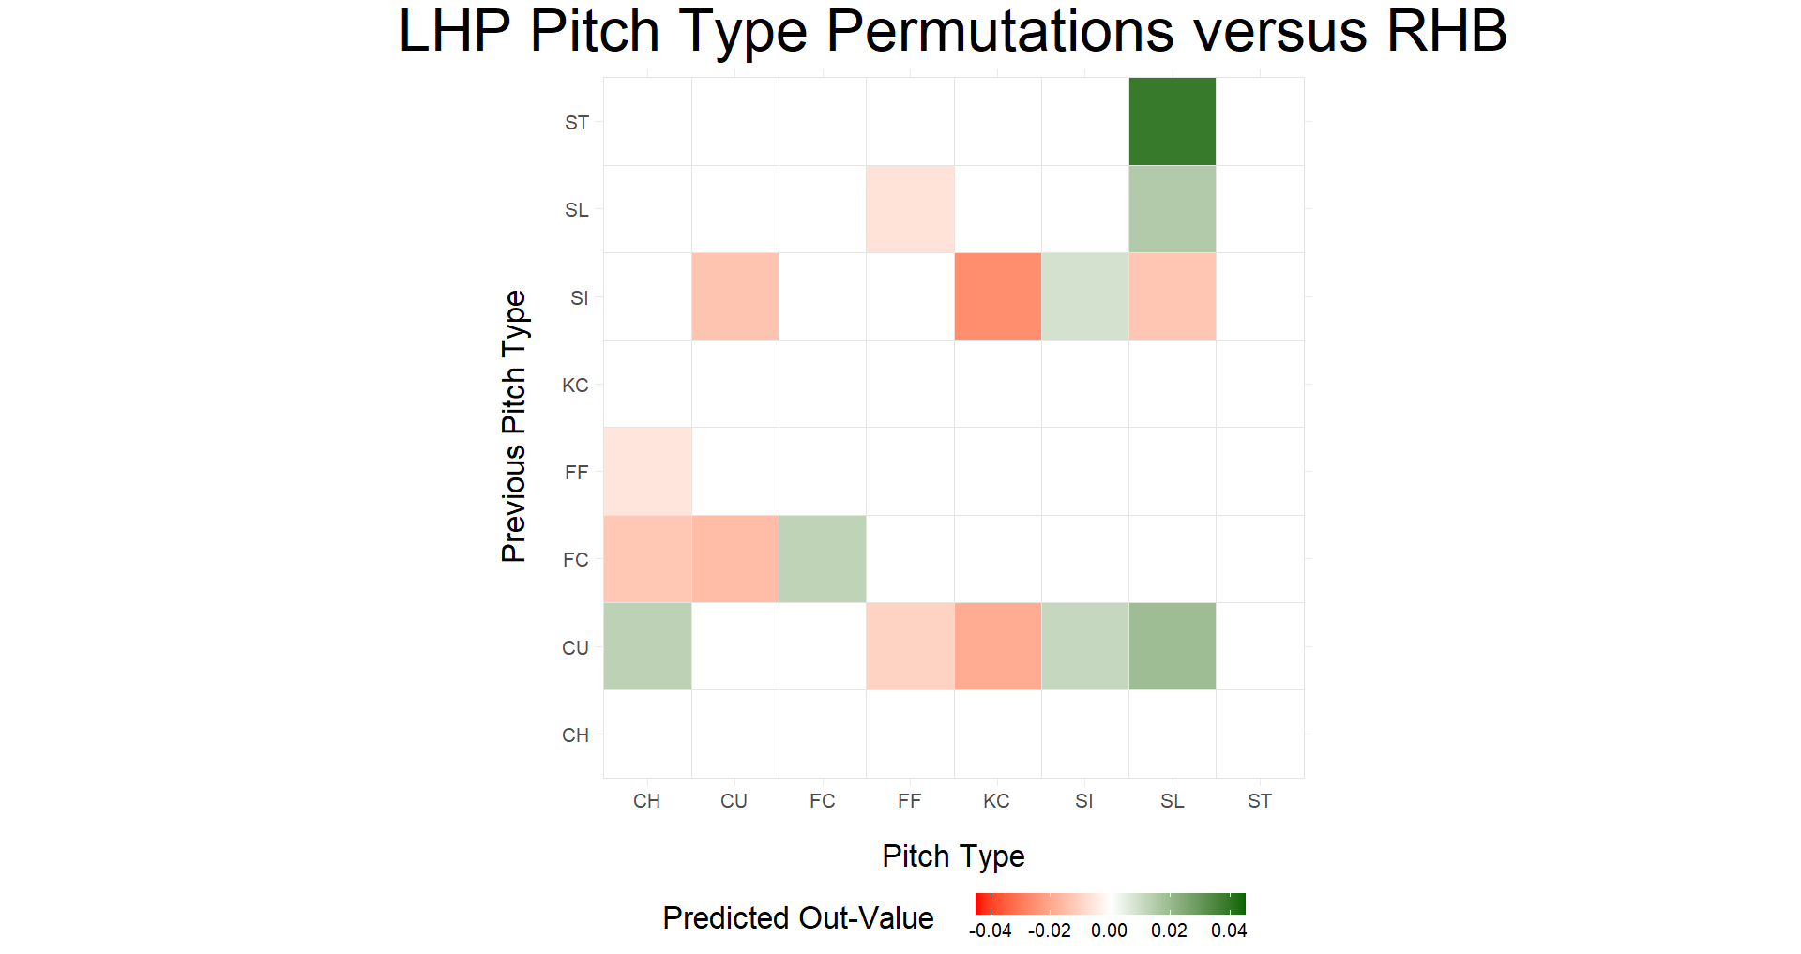

Slide 23
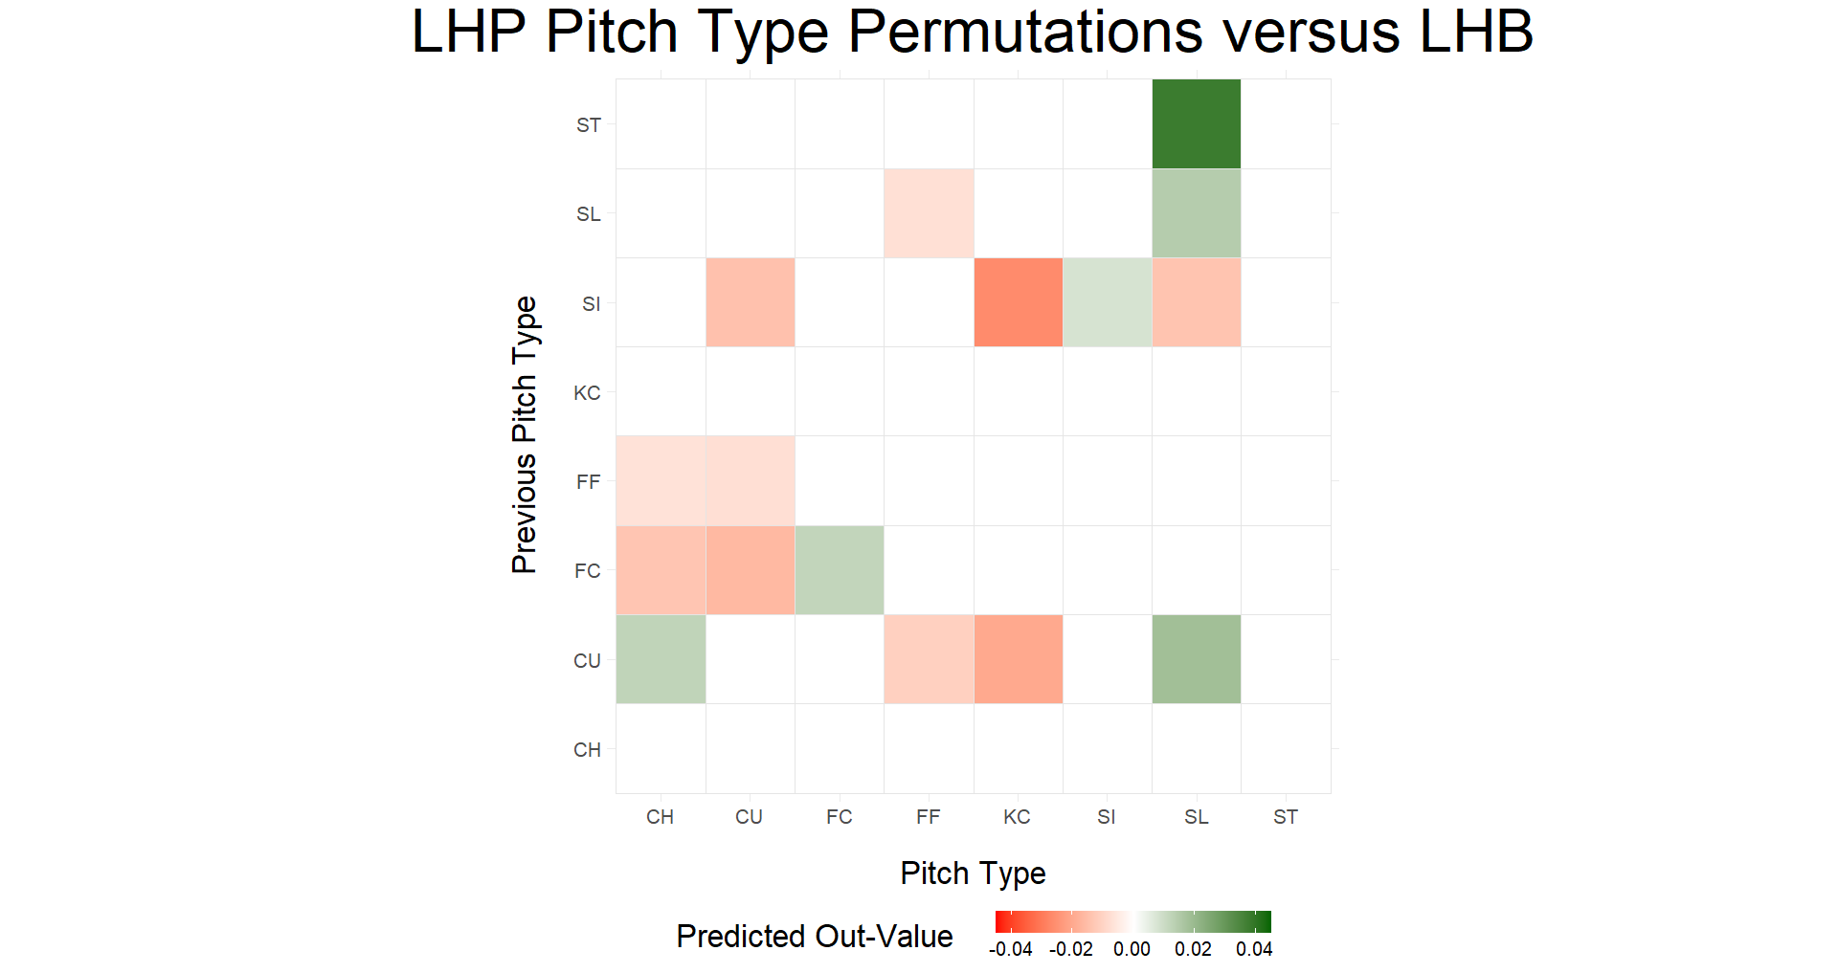

Slide 24
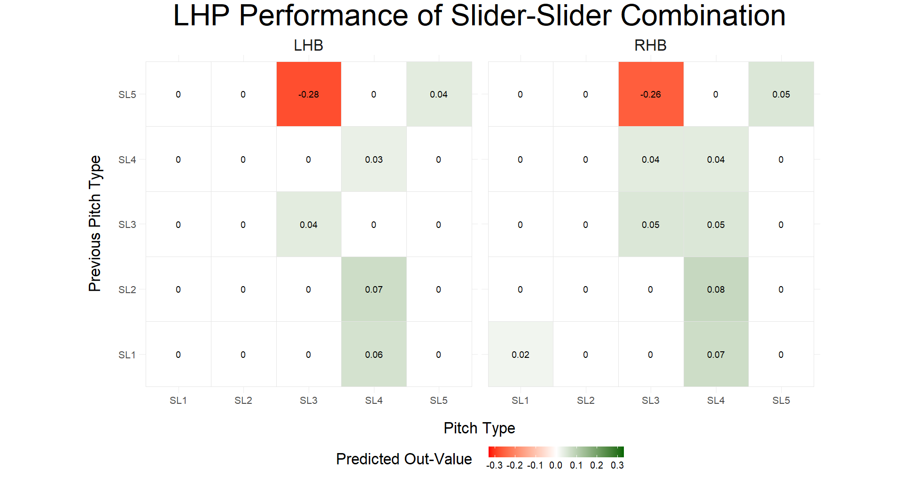

Slide 25
Previous Subtype | Release Speed | Vertical Break | Horizontal Break
SL1 | 88.40 | 6.22 | -2.08
SL2 | 81.59 | -1.58 | -3.51
SL3 | 81.09 | -2.44 | -12.47
SL4 | 85.67 | 2.79 | -6.73
SL5 | 84.26 | 3.61 | -1.14
Subtype | Release Speed | Vertical Break | Horizontal Break
SL1 | 88.40 | 6.22 | -2.08
SL2 | 81.59 | -1.58 | -3.51
SL3 | 81.09 | -2.44 | -12.47
SL4 | 85.67 | 2.79 | -6.73
SL5 | 84.26 | 3.61 | -1.14

Slide 26
Previous Subtype | Release Speed | Vertical Break | Horizontal Break
SL1 | 88.40 | 6.22 | -2.08
SL2 | 81.59 | -1.58 | -3.51
SL3 | 81.09 | -2.44 | -12.47
SL4 | 85.67 | 2.79 | -6.73
SL5 | 84.26 | 3.61 | -1.14
Subtype | Release Speed | Vertical Break | Horizontal Break
SL1 | 88.40 | 6.22 | -2.08
SL2 | 81.59 | -1.58 | -3.51
SL3 | 81.09 | -2.44 | -12.47
SL4 | 85.67 | 2.79 | -6.73
SL5 | 84.26 | 3.61 | -1.14

Slide 27
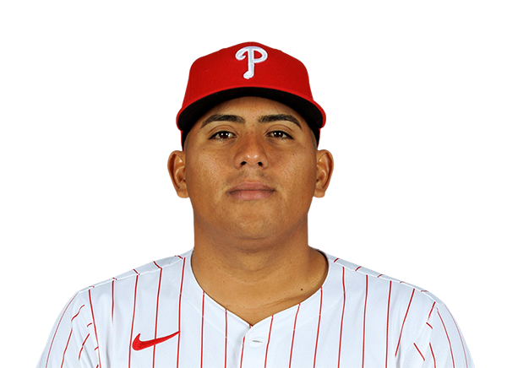
Previous Subtype | Release Speed | Vertical Break | Horizontal Break
SL1 | 88.40 | 6.22 | -2.08
SL2 | 81.59 | -1.58 | -3.51
SL3 | 81.09 | -2.44 | -12.47
SL4 | 85.67 | 2.79 | -6.73
SL5 | 84.26 | 3.61 | -1.14
Subtype | Release Speed | Vertical Break | Horizontal Break
SL1 | 88.40 | 6.22 | -2.08
SL2 | 81.59 | -1.58 | -3.51
SL3 | 81.09 | -2.44 | -12.47
SL4 | 85.67 | 2.79 | -6.73
SL5 | 84.26 | 3.61 | -1.14

Slide 28
Previous Subtype | Release Speed | Vertical Break | Horizontal Break
SL1 | 88.40 | 6.22 | -2.08
SL2 | 81.59 | -1.58 | -3.51
SL3 | 81.09 | -2.44 | -12.47
SL4 | 85.67 | 2.79 | -6.73
SL5 | 84.26 | 3.61 | -1.14
Subtype | Release Speed | Vertical Break | Horizontal Break
SL1 | 88.40 | 6.22 | -2.08
SL2 | 81.59 | -1.58 | -3.51
SL3 | 81.09 | -2.44 | -12.47
SL4 | 85.67 | 2.79 | -6.73
SL5 | 84.26 | 3.61 | -1.14

Slide 29

Previous Subtype | Release Speed | Vertical Break | Horizontal Break
SL1 | 88.40 | 6.22 | -2.08
SL2 | 81.59 | -1.58 | -3.51
SL3 | 81.09 | -2.44 | -12.47
SL4 | 85.67 | 2.79 | -6.73
SL5 | 84.26 | 3.61 | -1.14
Subtype | Release Speed | Vertical Break | Horizontal Break
SL1 | 88.40 | 6.22 | -2.08
SL2 | 81.59 | -1.58 | -3.51
SL3 | 81.09 | -2.44 | -12.47
SL4 | 85.67 | 2.79 | -6.73
SL5 | 84.26 | 3.61 | -1.14

