Slide 1
Identifying subclasses of pitches and optimal pitch permutations for starting pitchers in Major League Baseball
Sebastian Kirkpatrick

Slide 2
Horizontal Break:
The induced horizontal movement due to spin and drag, measured in inches from the perspective
of the catcher
Release Speed: Out-of-hand velocity, measured in MPH
K-Means Clustering
Vertical Break:
The induced vertical movement due to spin and drag, measured in inches from the perspective
of the catcher

Slide 3
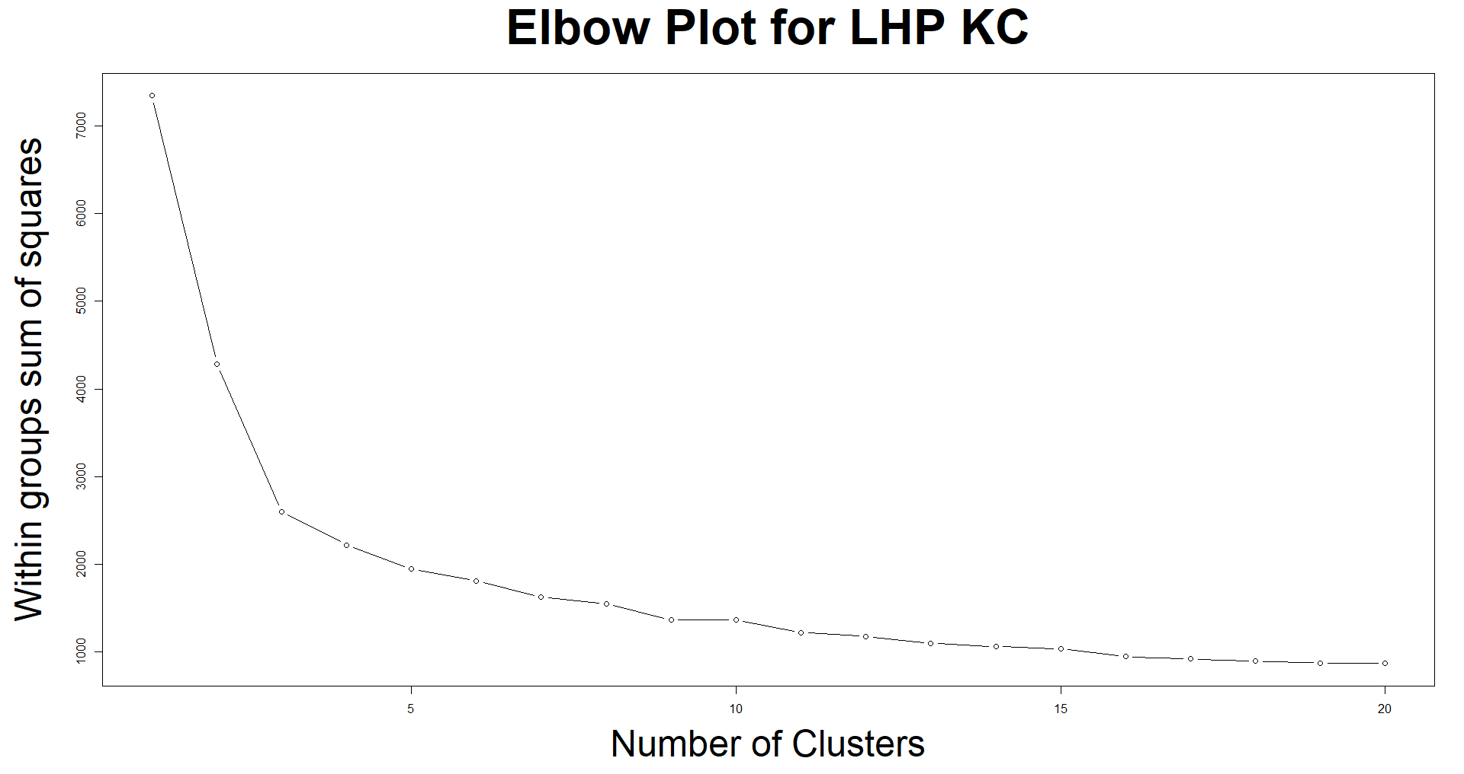
O

Slide 4
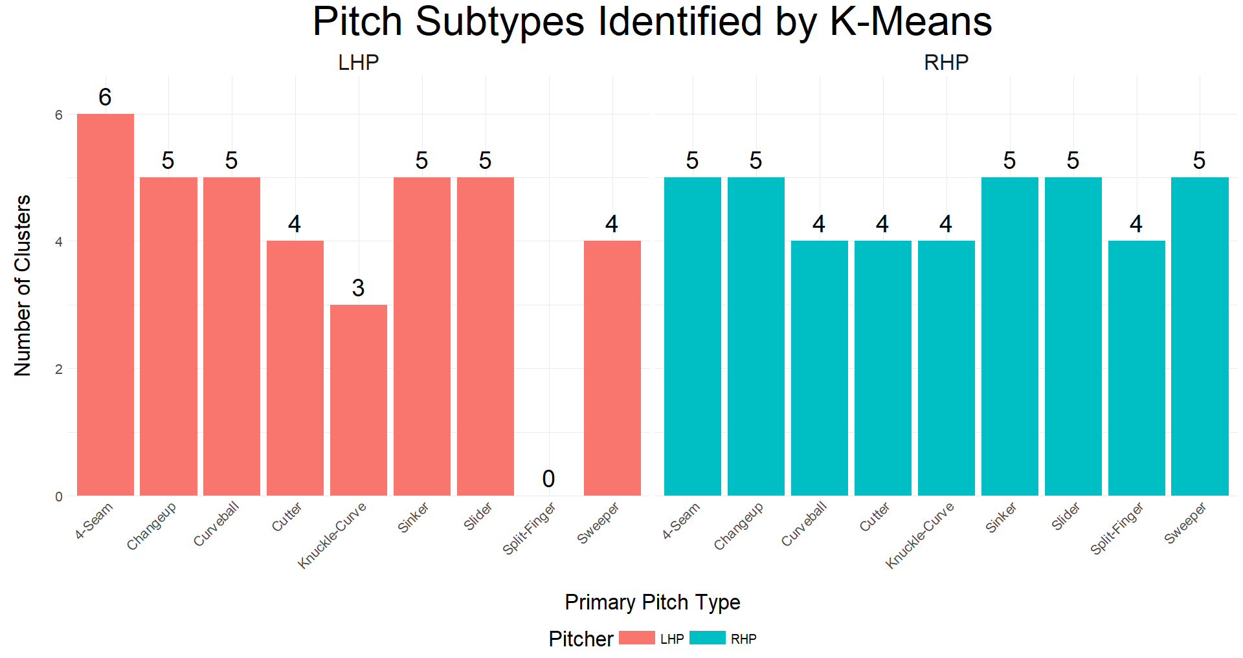

Slide 5


Slide 6
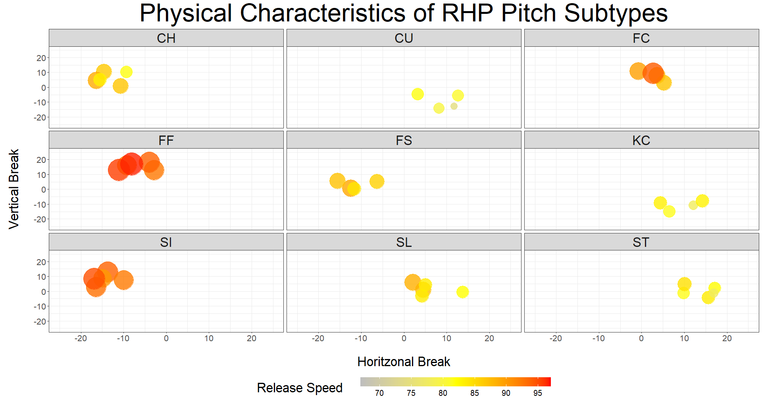

Slide 7
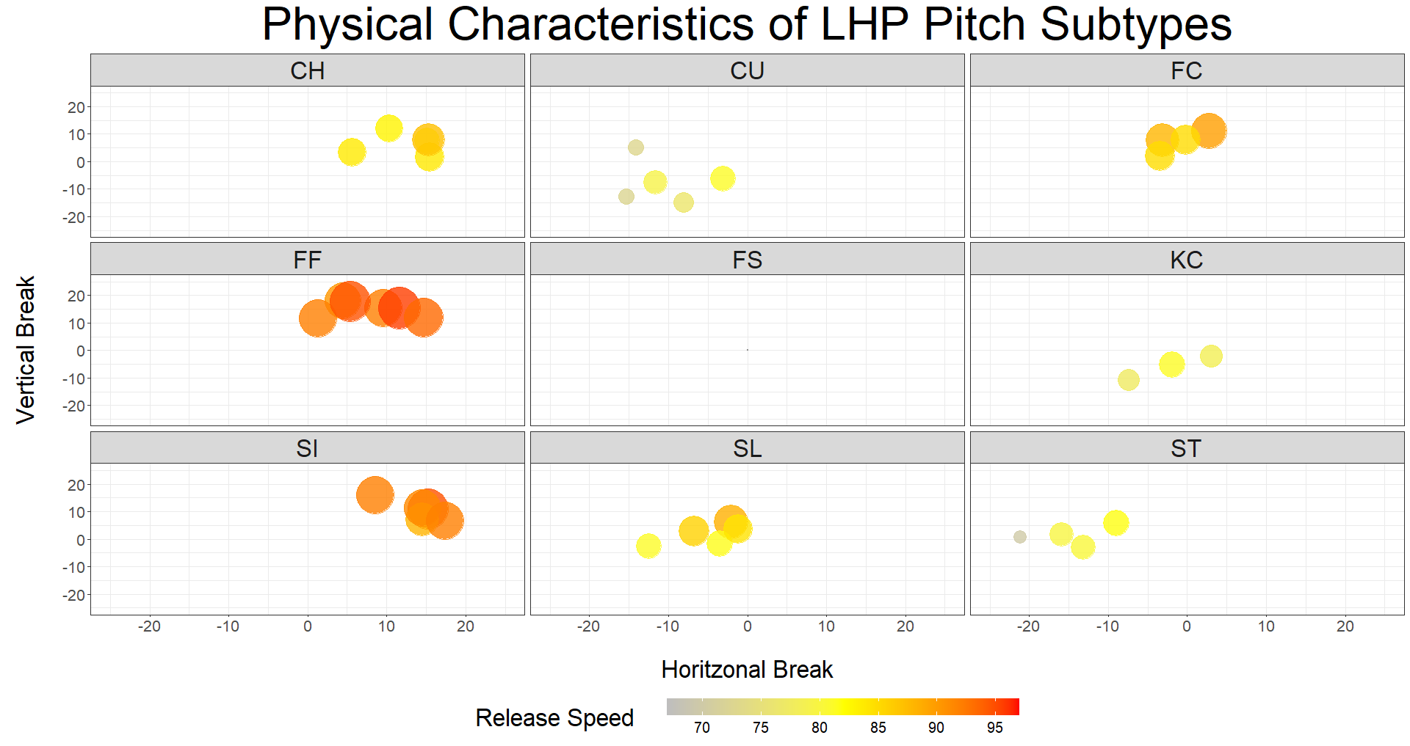


Slide 8
Performance Mixed-Effects Model
Fixed Effects:
Pitch Type
Previous Pitch Type
Batter Handedness
Runners on Base
Count Impact
Interaction between Pitch Type and Previous Pitch Type
Random Effects:
Batter
Pitcher
Stadium
Catcher

Slide 9
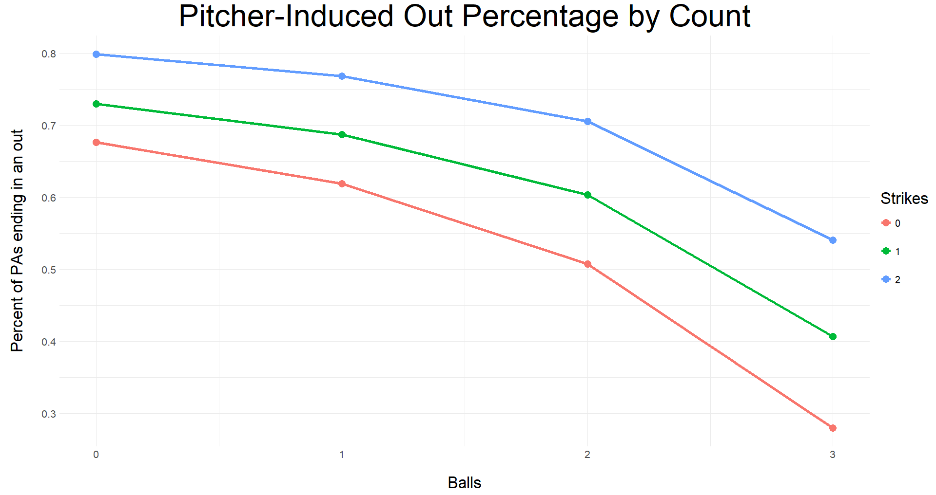

Slide 10
RHP
Results

Slide 11
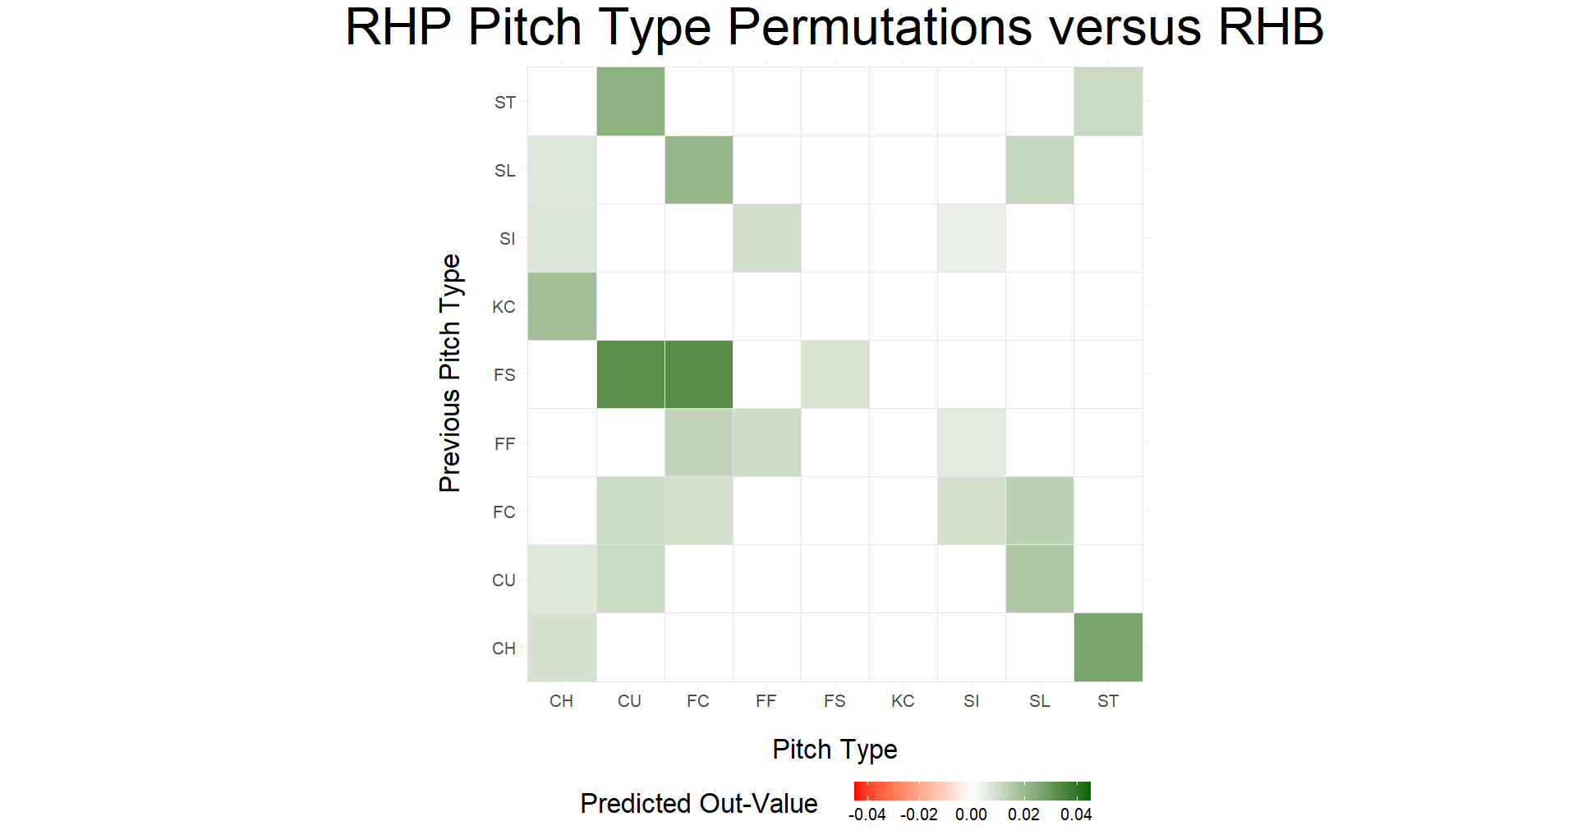

Slide 12
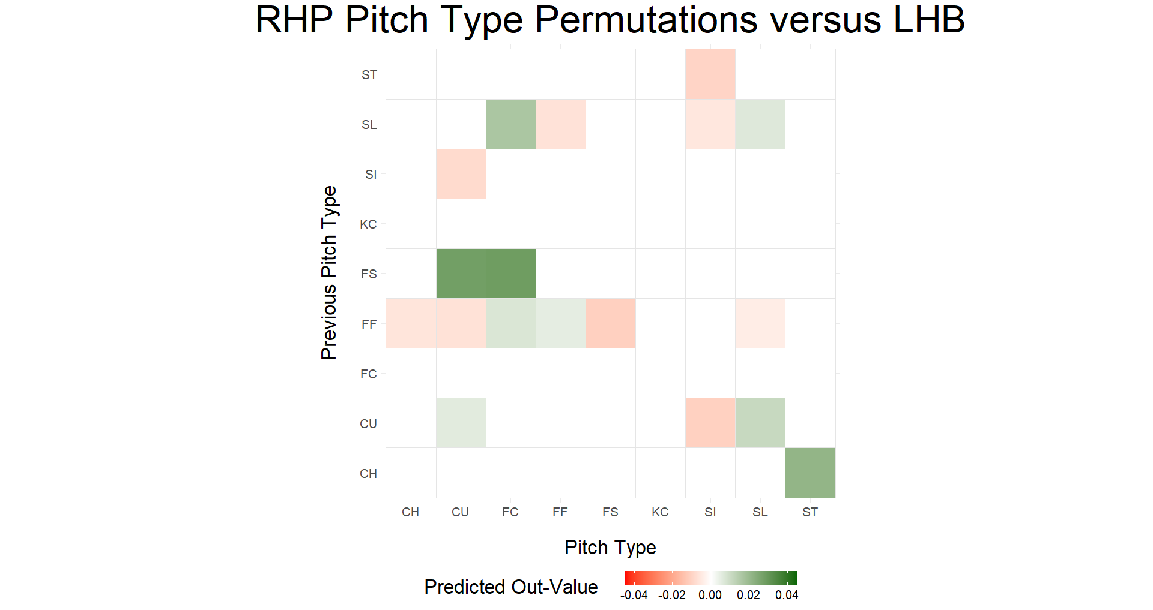

Slide 13
Previous Subtype | Release Speed | Vertical Break | Horizontal Break
FF1 | 92.44 | 12.78 | -2.84
FF2 | 93.86 | 18.24 | -3.95
FF3 | 92.42 | 16.13 | -9.18
FF4 | 95.57 | 12.92 | -11.04
FF5 | 96.49 | 16.99 | -9.07
Subtype | Release Speed | Vertical Break | Horizontal Break
FC1 | 88.49 | 7.97 | 3.54
FC2 | 86.83 | 3.02 | 5.26
FC3 | 89.64 | 10.80 | -0.80
FC4 | 94.19 | 9.21 | 2.71

Slide 14
Previous Subtype | Release Speed | Vertical Break | Horizontal Break
FF1 | 92.44 | 12.78 | -2.84
FF2 | 93.86 | 18.24 | -3.95
FF3 | 92.42 | 16.13 | -9.18
FF4 | 95.57 | 12.92 | -11.04
FF5 | 96.49 | 16.99 | -9.07
Subtype | Release Speed | Vertical Break | Horizontal Break
FC1 | 88.49 | 7.97 | 3.54
FC2 | 86.83 | 3.02 | 5.26
FC3 | 89.64 | 10.80 | -0.80
FC4 | 94.19 | 9.21 | 2.71

Slide 15

Previous Subtype | Release Speed | Vertical Break | Horizontal Break
FF1 | 92.44 | 12.78 | -2.84
FF2 | 93.86 | 18.24 | -3.95
FF3 | 92.42 | 16.13 | -9.18
FF4 | 95.57 | 12.92 | -11.04
FF5 | 96.49 | 16.99 | -9.07
Subtype | Release Speed | Vertical Break | Horizontal Break
FC1 | 88.49 | 7.97 | 3.54
FC2 | 86.83 | 3.02 | 5.26
FC3 | 89.64 | 10.80 | -0.80
FC4 | 94.19 | 9.21 | 2.71

Slide 16
LHP
Results

Slide 17
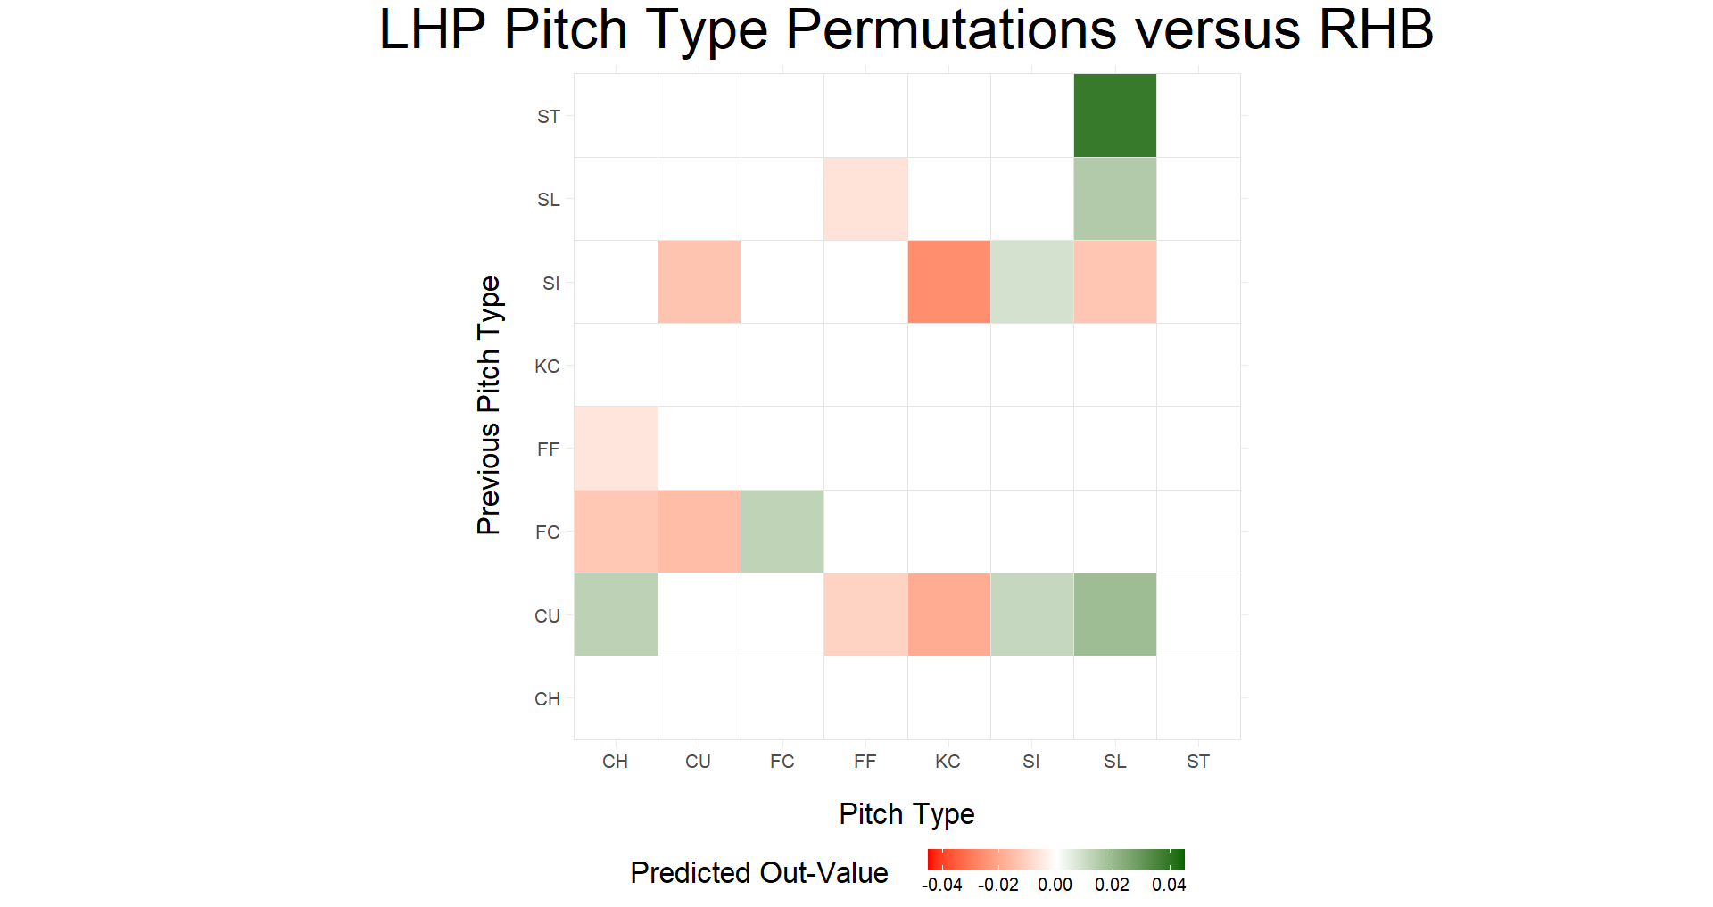

Slide 18
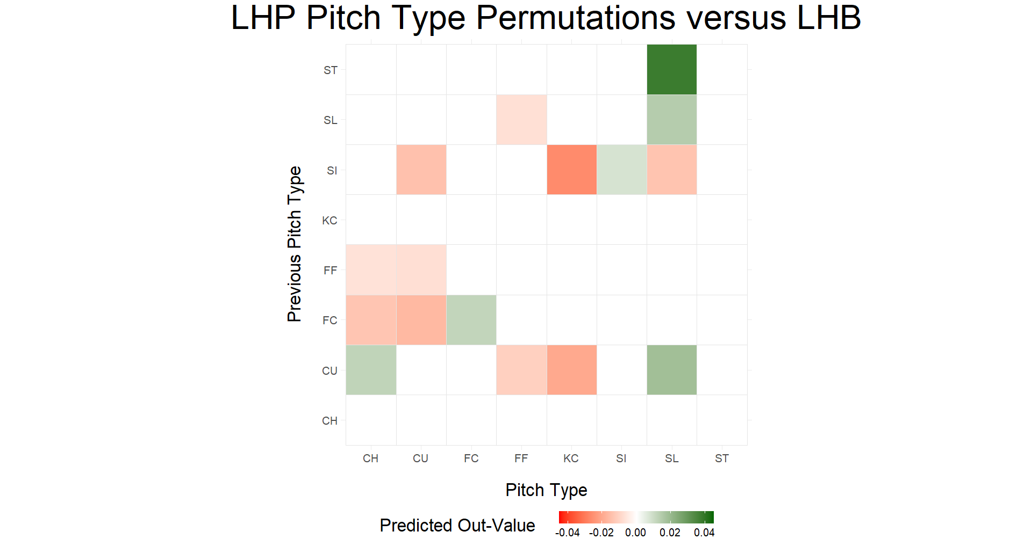

Slide 19
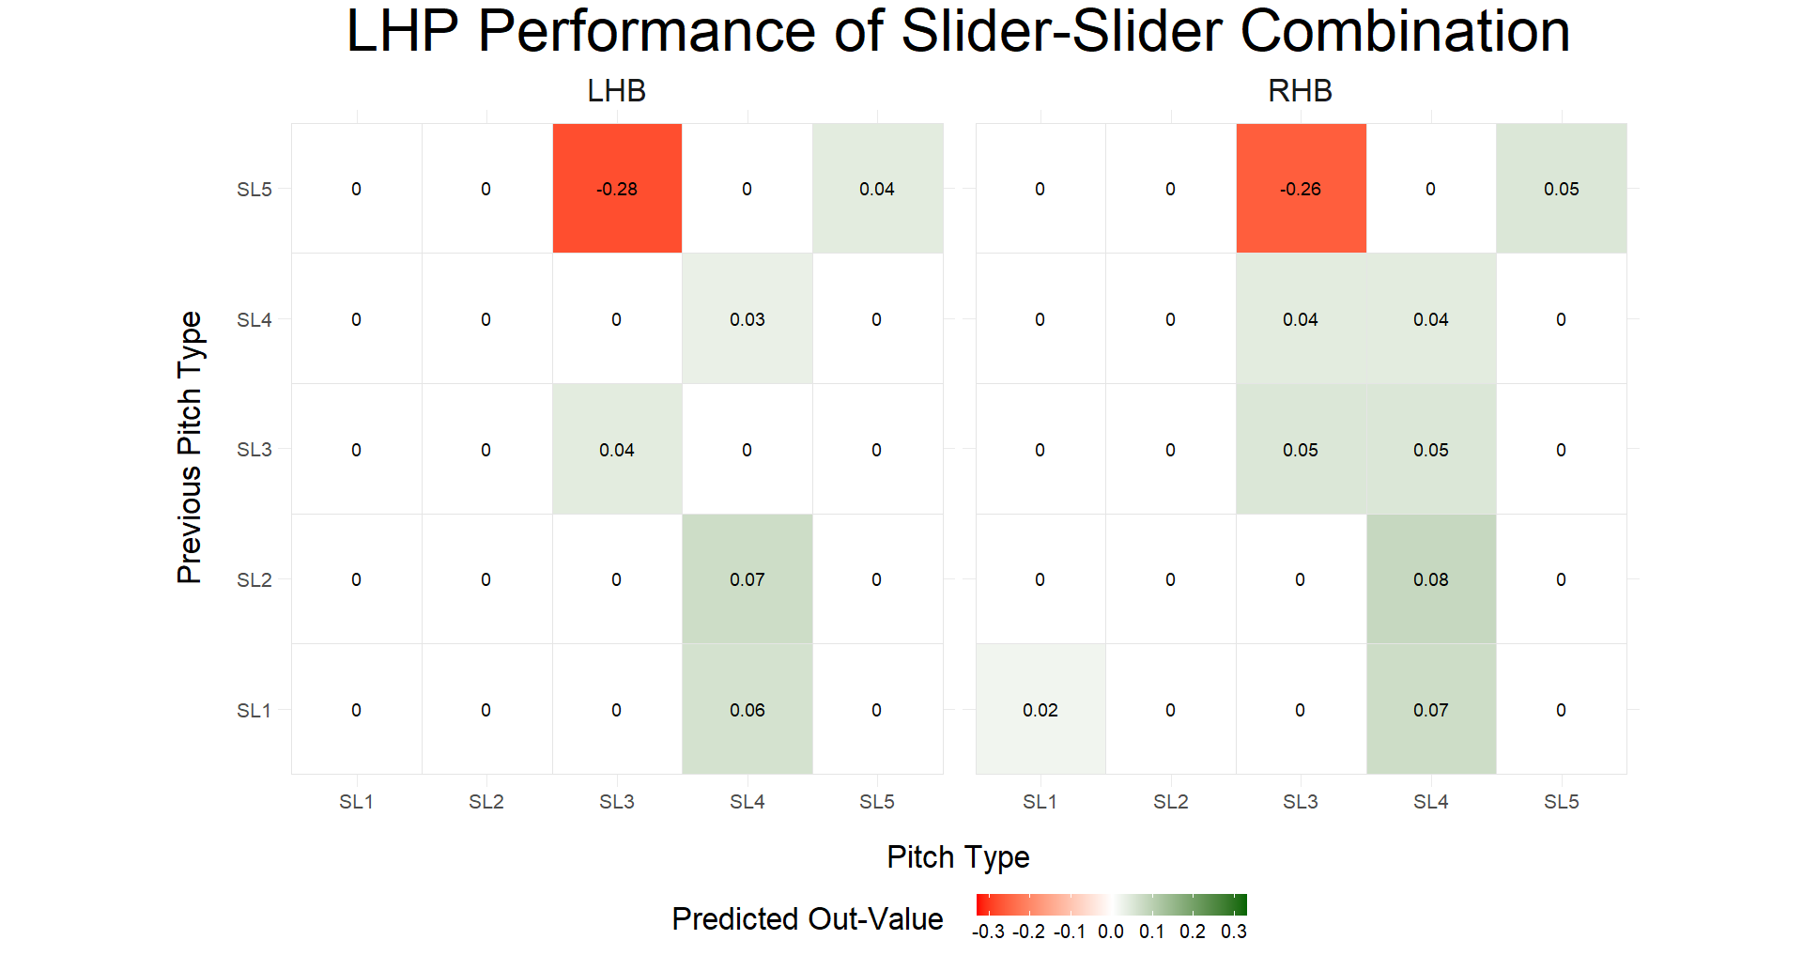

Slide 20
Previous Subtype | Release Speed | Vertical Break | Horizontal Break
SL1 | 88.40 | 6.22 | -2.08
SL2 | 81.59 | -1.58 | -3.51
SL3 | 81.09 | -2.44 | -12.47
SL4 | 85.67 | 2.79 | -6.73
SL5 | 84.26 | 3.61 | -1.14
Subtype | Release Speed | Vertical Break | Horizontal Break
SL1 | 88.40 | 6.22 | -2.08
SL2 | 81.59 | -1.58 | -3.51
SL3 | 81.09 | -2.44 | -12.47
SL4 | 85.67 | 2.79 | -6.73
SL5 | 84.26 | 3.61 | -1.14

Slide 21
Previous Subtype | Release Speed | Vertical Break | Horizontal Break
SL1 | 88.40 | 6.22 | -2.08
SL2 | 81.59 | -1.58 | -3.51
SL3 | 81.09 | -2.44 | -12.47
SL4 | 85.67 | 2.79 | -6.73
SL5 | 84.26 | 3.61 | -1.14
Subtype | Release Speed | Vertical Break | Horizontal Break
SL1 | 88.40 | 6.22 | -2.08
SL2 | 81.59 | -1.58 | -3.51
SL3 | 81.09 | -2.44 | -12.47
SL4 | 85.67 | 2.79 | -6.73
SL5 | 84.26 | 3.61 | -1.14

Slide 22
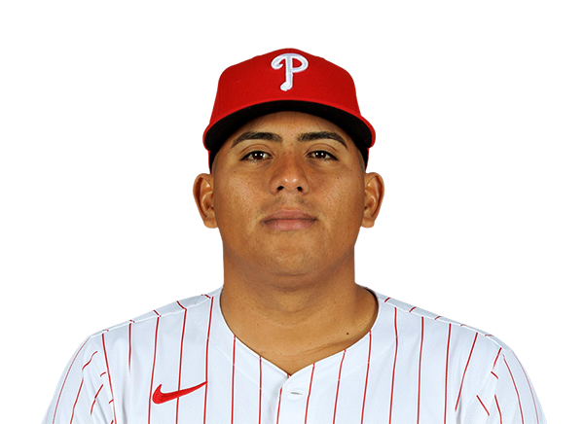
Previous Subtype | Release Speed | Vertical Break | Horizontal Break
SL1 | 88.40 | 6.22 | -2.08
SL2 | 81.59 | -1.58 | -3.51
SL3 | 81.09 | -2.44 | -12.47
SL4 | 85.67 | 2.79 | -6.73
SL5 | 84.26 | 3.61 | -1.14
Subtype | Release Speed | Vertical Break | Horizontal Break
SL1 | 88.40 | 6.22 | -2.08
SL2 | 81.59 | -1.58 | -3.51
SL3 | 81.09 | -2.44 | -12.47
SL4 | 85.67 | 2.79 | -6.73
SL5 | 84.26 | 3.61 | -1.14

Slide 23
Previous Subtype | Release Speed | Vertical Break | Horizontal Break
SL1 | 88.40 | 6.22 | -2.08
SL2 | 81.59 | -1.58 | -3.51
SL3 | 81.09 | -2.44 | -12.47
SL4 | 85.67 | 2.79 | -6.73
SL5 | 84.26 | 3.61 | -1.14
Subtype | Release Speed | Vertical Break | Horizontal Break
SL1 | 88.40 | 6.22 | -2.08
SL2 | 81.59 | -1.58 | -3.51
SL3 | 81.09 | -2.44 | -12.47
SL4 | 85.67 | 2.79 | -6.73
SL5 | 84.26 | 3.61 | -1.14

Slide 24

Previous Subtype | Release Speed | Vertical Break | Horizontal Break
SL1 | 88.40 | 6.22 | -2.08
SL2 | 81.59 | -1.58 | -3.51
SL3 | 81.09 | -2.44 | -12.47
SL4 | 85.67 | 2.79 | -6.73
SL5 | 84.26 | 3.61 | -1.14
Subtype | Release Speed | Vertical Break | Horizontal Break
SL1 | 88.40 | 6.22 | -2.08
SL2 | 81.59 | -1.58 | -3.51
SL3 | 81.09 | -2.44 | -12.47
SL4 | 85.67 | 2.79 | -6.73
SL5 | 84.26 | 3.61 | -1.14

Slide 25
Previous Subtype | Release Speed | Vertical Break | Horizontal Break
SL1 | 88.40 | 6.22 | -2.08
SL2 | 81.59 | -1.58 | -3.51
SL3 | 81.09 | -2.44 | -12.47
SL4 | 85.67 | 2.79 | -6.73
SL5 | 84.26 | 3.61 | -1.14
Subtype | Release Speed | Vertical Break | Horizontal Break
SL1 | 88.40 | 6.22 | -2.08
SL2 | 81.59 | -1.58 | -3.51
SL3 | 81.09 | -2.44 | -12.47
SL4 | 85.67 | 2.79 | -6.73
SL5 | 84.26 | 3.61 | -1.14

Slide 26

Previous Subtype | Release Speed | Vertical Break | Horizontal Break
SL1 | 88.40 | 6.22 | -2.08
SL2 | 81.59 | -1.58 | -3.51
SL3 | 81.09 | -2.44 | -12.47
SL4 | 85.67 | 2.79 | -6.73
SL5 | 84.26 | 3.61 | -1.14
Subtype | Release Speed | Vertical Break | Horizontal Break
SL1 | 88.40 | 6.22 | -2.08
SL2 | 81.59 | -1.58 | -3.51
SL3 | 81.09 | -2.44 | -12.47
SL4 | 85.67 | 2.79 | -6.73
SL5 | 84.26 | 3.61 | -1.14

Slide 27
What’s Next?
Add More Data
2024 season, past seasons?
Ignore Primary Pitch Types
Fixes a lot of “not enough data” issues
Get Better Clusters
Classifying variables
Cluster selection
Tie Back To My Initial Goal: Pitcher Development

Slide 28
Acknowledgements
Co-Authors: Mena Whalen and Gregory Matthews (Loyola University Chicago)
Shout-Out: Quang Nguyen (Carnegie Mellon University)

