Slide 1
Introduction to gene expression (RNAseq)
Sébastien Renaut
UdeM (CSBQ)
R symposium – April 24-25th 2017

Slide 2
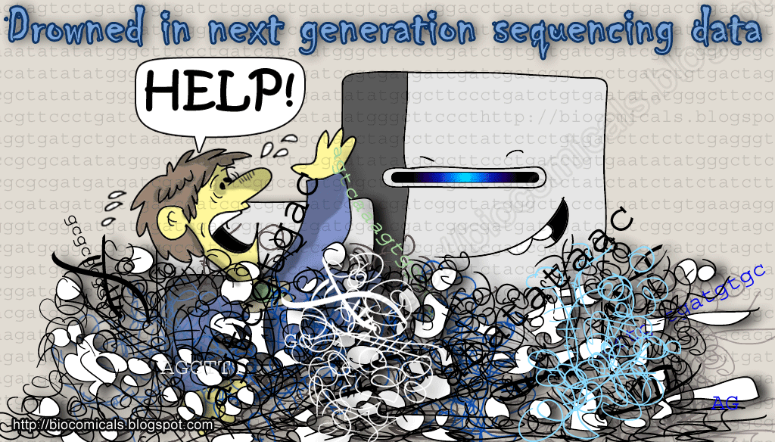
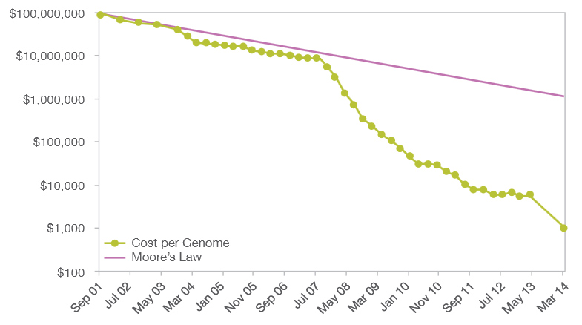
The data deluge!
Sunflowers
The genomic landscape of species divergence
How does geography of speciation influence genomic divergence?
The repeatability of genomic divergence
Do the same genes / genomic regions underlie independent adaptation?
The consequences of domestication
http://www.futuretimeline.net/blog/2014/01/16.htm#.VMaNOnDF-5I

Slide 3
dwdwd
dwdw

Slide 4
Outline
1. Introduction + historical perspective
2. High throughput Sequencing
3. RNAseq
4. Getting our hands “dirty”
Rnaseq transcriptome analysis in R

Slide 5
Some tales of caution before we get started…
I am not:
An R guru / statistician
But I am :
An “R user/fan”
very familiar with High Throughput Sequencing, RNAseq (gene expression and genetic differentiation studies)
Not tied to a model system
Likely to leave at any time…

Slide 6
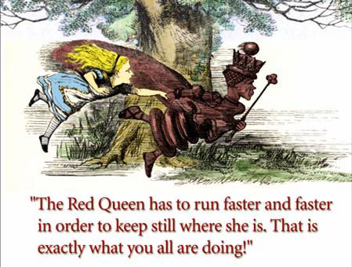
Some tales of caution before we get started…
Also :
There are several approaches to solving these problems.
Approaches changes constantly…
Always more (better?) data!

Slide 7
Introduction-1
Why did High Throughput methods arise around 2005?
1) Large (human) genome projects optimized classic (Sanger) methods to the maximum
Sanger: max output / run = 1000 bp X 384
2) Technological progress
optics (CCD), biochemical, hardware, software
3) Given sequenced (reference) genomes available, working with small fragments was easier
Alignment vs. assembly problem
4) Leverage NGS development resources for different purposes than solely genome sequencing
Gene expression, SNP, chip-seq, etc…

Slide 8
Introduction-2
How are High Throughput methods different than classic (Sanger) sequencing?
Short (30-500 bp) sequences
Parallelism of sequencing (10e6-10e9 sequences)
Heavy use of bioinformatics
Curate (clean) sequencing data
Short sequences
multiplexing (requires DNA barcodes)

Slide 9
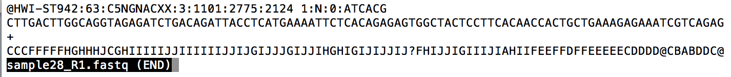
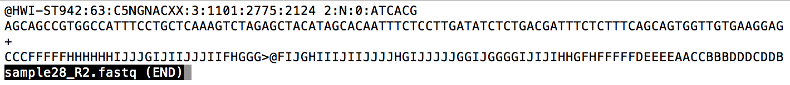
High Throughput Sequencing
Illumina paired-end sequencing
Most popular (>90% of all sequencing)
.fastq files
ACTCTG--------------------------ACTGTCC
Read1: 100bp
Read2: 100bp
http://en.wikipedia.org/wiki/FASTQ_format

Slide 10
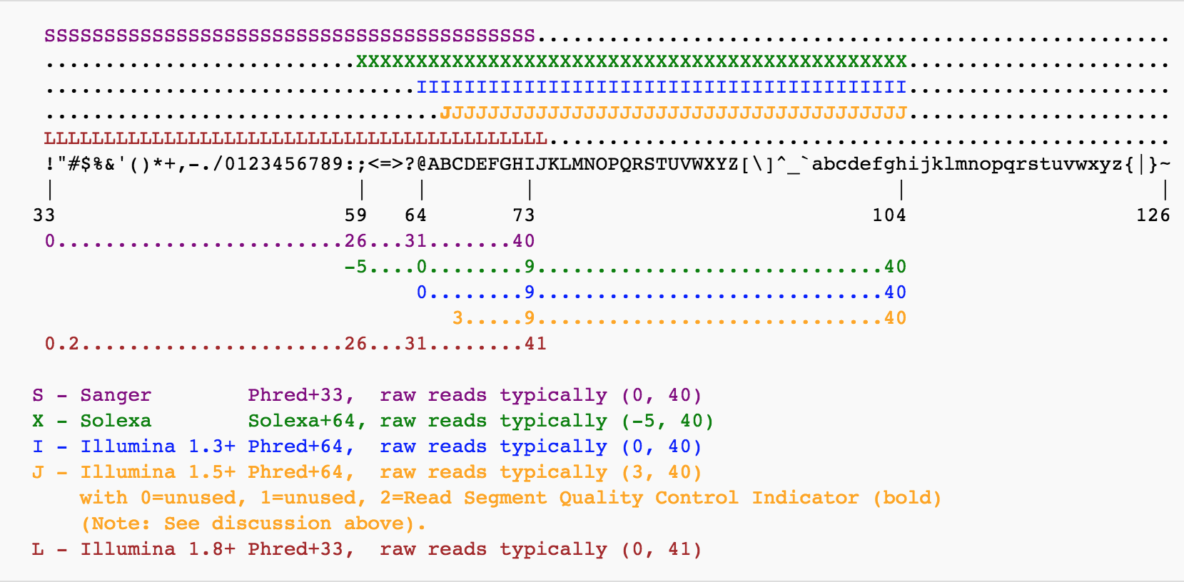
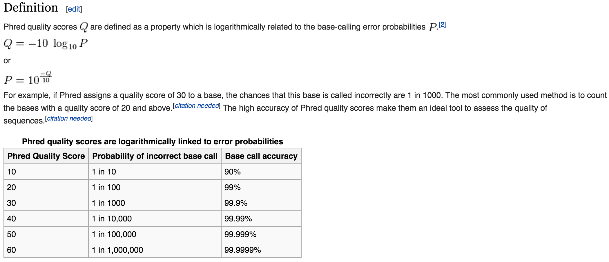
High Throughput Sequencing
Quality score
Phred score
http://en.wikipedia.org/wiki/FASTQ_format
http://en.wikipedia.org/wiki/Phred_quality_score

Slide 11
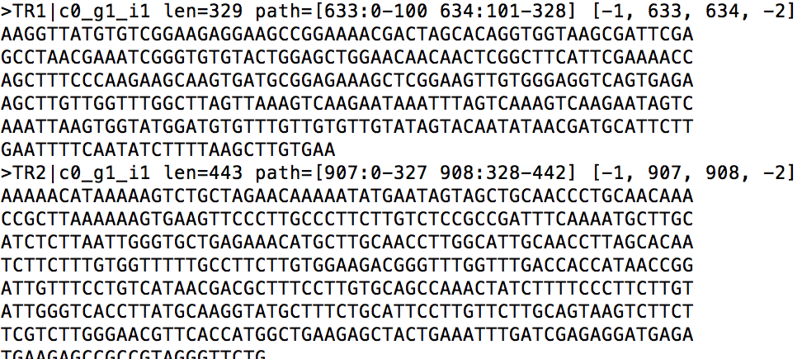
.fasta file

Slide 12


Gene expression
DNA ➔ RNA➔ protein ➔ or
~3 % of the genome codes from a protein.
Transcriptome: collection of RNA expressed at a given time in a given cell

Slide 13
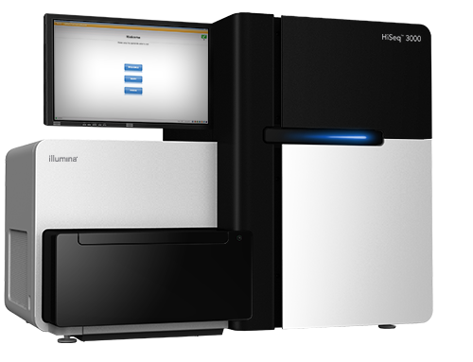
RNAseq (Transcriptome sequencing)
Isolate RNA from a sample
RNA ➔ cDNA
Barcode samples, pool and sequence
Get lots of sequences back (but few samples)
Analyse or …

Slide 14
Analyse RNAseq data
(0. generate a reference de novo)
1. Align reads against a reference
2. Calculate number reads aligned per gene / per individual
3. Identify differentially expressed genes (DEG)
4. What are the DEG? (annotations, Gene ontology)

Slide 15
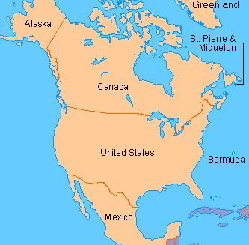

Lets look at some data now!
Common sunflower (Helianthus annuus)
North – South populations
8 individual (4 North, 4 South)
Isolate and sequence RNA from growing tissue (leaf /flower buds)
1,000 genes (transcriptome)
~15,000-20,000 sequences per individual

Slide 16
You will need:
Several R packages from:
Bioconductor:
source("https://bioconductor.org/biocLite.R"); biocLite("edgeR”); library(edgeR)
DESeq2
marray
goseq
GO.db
qvalue
CRAN:
install.packages(“gplots”); library(gplots)

Slide 17
You will need:
Data
http://sebastien.renaut.com/rnaseq_workshop/results/idxstats
Some reference files
http://sebastien.renaut.com/rnaseq_workshop/references.tar.gz
R script
http://sebastien.renaut.com/rnaseq_workshop/Rcode/rnaseq.html

Slide 19
RNASeq : genetic differences
Identify genetic differences among samples
Samtools will identify variable sites

Slide 20
Genetic differences (diversity) among populations (e.g. Fst)
hierfstat
Phylogenetics (e.g. build trees)
ape
Population structure
Eg. STRUCTURE

