Slide 1
Crime Police
Strategy Controls
in
Chicago

Slide 2
Introduction
Crime in Chicago has been tracked by the Chicago Police Department's Bureau of Records since the beginning of the 20th century. The city's overall crime rate, especially the violent crime rate, is higher than the US average. Chicago was responsible for nearly half of 2016's increase in homicides in the US, though the nation's crime rates remain near historic lows. The reasons for the higher numbers in Chicago remain unclear. An article in The Atlantic detailed how researchers and analysts had come to no real consensus on the cause for the violence.

Slide 3
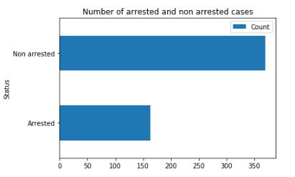
In the following image, as we can see, it is a good proportion of total arrested based in total cases (lot of them are minus crimes).

Slide 4
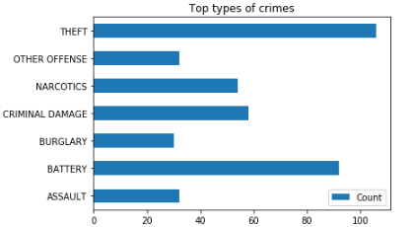
The more repetitive crimes are theft, criminal damage, battery and narcotics also there is important to keep in mind that assault it’s a non minor crime and it will be included in the geospital analysis

Slide 5
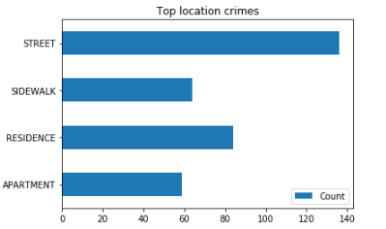
Also, big part of them are in the street / sidewalk, wich evidences the necessity of more police controls in the street.

Slide 6
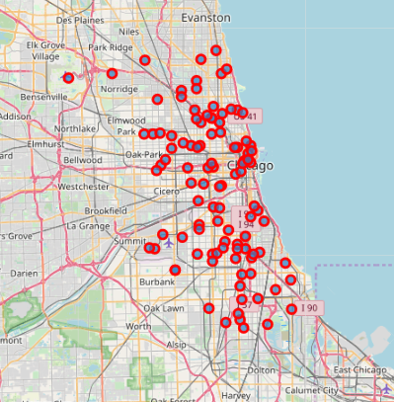
As the image shows, theft crime doesn’t follow a patter, it is randomly situated in the centre of city street wich evidence that the best way to prevent it its highy impact police monitoring in the streets, also, theft it’s the most common crime in Chicago city as we have seen before.

Slide 7
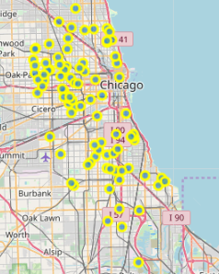
In battery crime cases, it mays follow a pattern in oak park and cicero zones for most cases, and such a few oters in the south of main zone. The best way to prevent this crime is installing police controls in the focus zones

Slide 8
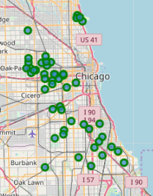
For narco crime cases, it mays follow a pattern in oak park and cicero zones for most cases, and such a few oters in the south of main zone with some outliers. But it seems follows the same pattern as battery crimes. The best way to prevent this crime is installing police controls in the focus zones.

Slide 9
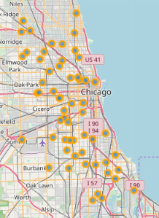
As the map shows, criminal damage crime is a crime highly randomly distributed as theft, the best way to prevent it is random highly impact police monitoring in the streets.

Slide 10
Conclusion
The most relevant crimes are theft, battery, narcotics and criminal damage, each one have their own best way to prevent it… in some cases the way match each other as battery and narcotics cases. My professional recommendation is that set points of anti narcotic police on Cicero and Oak-Park in company with a same proportion of oficials to prevent most cases of narcotics and battery crimes. For theft and criminal damage crimes the pololice MUST incarese the monitoring in the streets because there are highly random distributed in the city.

