Slide 1

A Machine Learning-Integrated Dashboard for DNS Traffic Monitoring and Anomaly Detection
Ali Khan CS 656
Sebastian Skubisz Professor Moshiur Rahman

Slide 2

INTRODUCTION
Evolving cyber threats exploit DNS for malicious activities such as phishing, malware, and command-and-control
Traditional DNS monitoring methods lack sophistication for modern cyber attacks.
Objective: Develop a data-driven dashboard integrating ML-based anomaly detection.

Slide 3

Reason For Choosing This Topic
Anomaly detection is crucial across diverse fields like finance, networking, and healthcare, where identifying irregularities can prevent fraud, optimize systems, and save lives.
Manual analysis and static rules are not sufficient or sophisticated enough to analyse the ever evolving landscape of cyber attacks
We believe using machine learning is a more sophisticated approach to monitoring DNS traffic as well as mitigating cyber attacks
Machine learning can help us look for anomalies in a more efficient manner

Slide 4
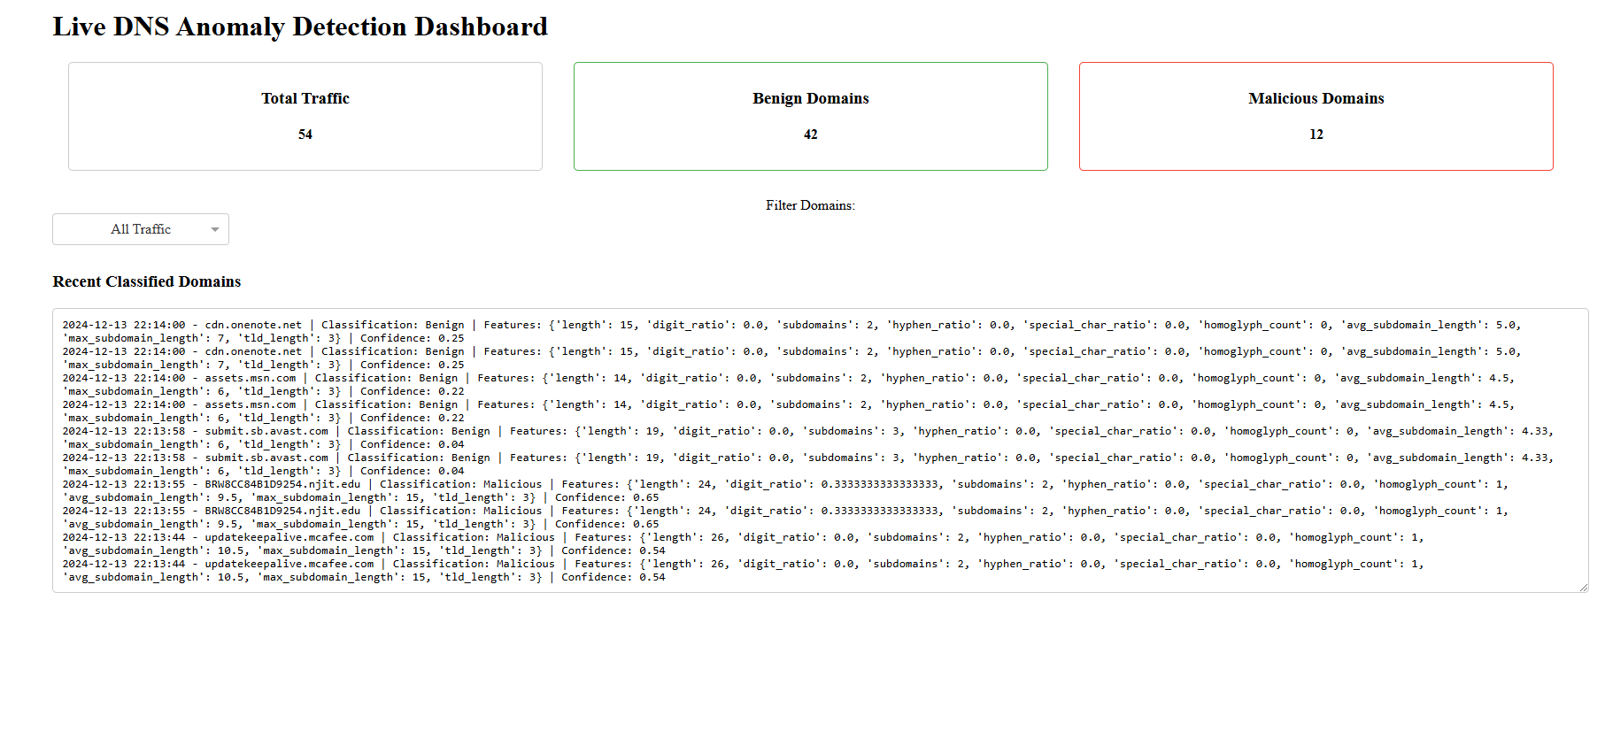
Research and Methodology
Dashboard: Python-based dashboard for real-time DNS monitoring.
Filters by benign/malicious traffic with dynamic updates.
ML Models:
Supervised:
Neural Network: High accuracy, trained on balanced datasets with RFE optimization.
Random Forest: Reliable with feature importance insights.
XGBoost: Focused on improving performance for imbalanced data.
KNN: Baseline model with limited scalability for high-dimensional data.
Unsupervised
Isolation Forest: Flags anomalies by identifying outliers in feature space.
Local Outlier Factor (LOF): Detects density-based irregularities.
Autoencoder: Identifies anomalies with high reconstruction errors.

Slide 5

Dataset Explanation
Benign Domains: Public datasets like Alexa's top websites.
Malicious Domains: Sources like ViriBack and PhishTank.
Features Extracted: Domain length, subdomains,special characters, and digit ratios.
Dataset imbalance addressed using SMOTE for balanced training.

Slide 6

Recorded Demonstration

Slide 7
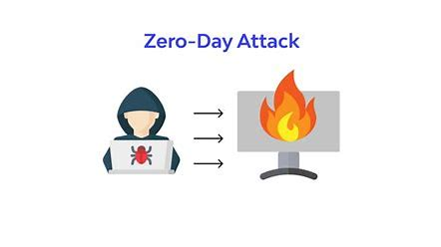
Future Scope
Continuously train models on new malicious data to stay updated and accurate.
Try to handle zero-day threats with real-time data processing.
Use adaptive models to manage evolving traffic patterns.
Enable continuous learning to tackle emerging cyber threats.
Combat malicious domain generation algorithms effectively.
Enhance visuals, like threat maps, for clearer insights and rapid response.

Slide 8

Conclusion
Machine learning enhances DNS monitoring and anomaly detection.
Anomaly detection is essential for identifying irregularities across industries, enhancing security, decision-making, and efficiency.
While challenges like imbalanced data, false alarms, and scalability remain, advancements in deep learning, Explainable AI, and edge computing promise to improve adaptability and real-time detection.
Mastering these techniques ensures robust data analysis and proactive problem-solving.

Slide 9

THANK YOU FOR LISTENING

Slide 10
References
DataCamp, "An Introduction to Anomaly Detection," [Online]. Available: https://www.datacamp.com/tutorial/introduction-to-anomaly-detection. [Accessed: Dec. 13, 2024].
GeeksforGeeks, "Anomaly Detection using R," [Online]. Available: https://www.geeksforgeeks.org/anomaly-detection-using-r/. [Accessed: Dec. 13, 2024].
Y. Jin, K. Kakoi, N. Yamai, N. Kitagawa, and M. Tomoishi, "A Client Based Anomaly Traffic Detection and Blocking Mechanism by Monitoring DNS Name Resolution with User Alerting Feature," 2018 International Conference on Cyberworlds (CW), Singapore, 2018, pp. 351-356, doi: 10.1109/CW.2018.00070.
Z. Wang and M. Zhang, "The Research of DNS Anomaly Detection Based on the Method of Similarity and Entropy," 2010 International Conference on Intelligent Computation Technology and Automation, Changsha, China, 2010, pp. 905-909, doi: 10.1109/ICICTA.2010.442.

