Slide 1
Nordbolt diligence
Scope and investment decision

Slide 2
Scope B answers the bid question for €320k
1
Nordbolt earns a 14.6% margin
Revenue is €212m and EBITDA is €31m.
2
Price explains most of the earnings gain
Price added €6.5m of the €7m EBITDA increase.
3
Scope B fits the four-week deadline
25 interviews test price risk. Scope C adds a week and €90k.
Approve scope B on 9 October
7 October 2026
‹#›

Slide 3
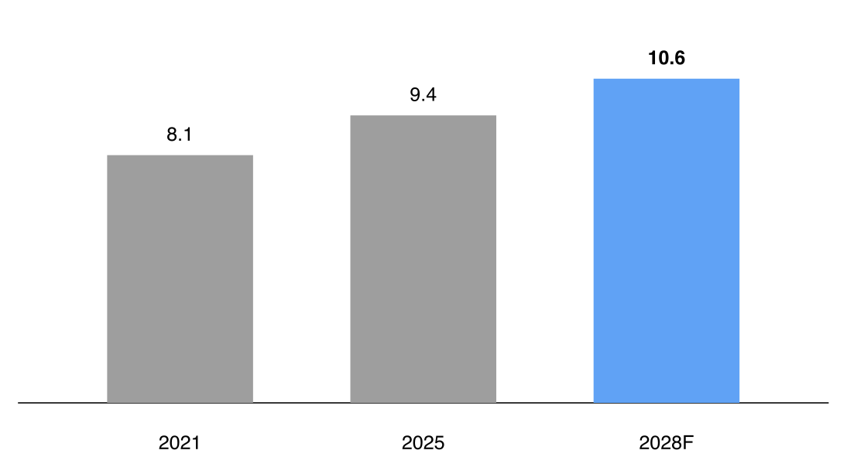
Nordbolt holds 2.3% of a growing market
European fastener market (EUR bn)
2.3%
Nordbolt market share
Position
Sixth in Europe
2028 estimate is a forecast
Source: Fictional audit fixture
7 October 2026
‹#›

Slide 4
Price explains most of the €7m EBITDA gain
€24m
+€6.5m
+€3.2m
+€1.4m
€31m
−€4.1m
2023
Price
Volume
Materials
OpEx
2025
Source: Fictional audit fixture
7 October 2026
‹#›

Slide 5
Scope B tests price risk within four weeks
Scope B
Scope C
25 customer interviews
25 interviews plus survey
€320k fee
€410k fee
4 weeks
5 weeks
Tests price risk before bid
Adds channel evidence
7 October 2026
‹#›

Slide 6
Scope B costs €320k across eight activities
Activity | Days | Fee (€k)
Data room | 5 | 30
Market sizing | 8 | 50
Competition | 6 | 40
Interview design | 4 | 25
Interviews | 14 | 90
Synthesis | 5 | 35
Risk report | 4 | 30
IC pack | 3 | 20
Source: Fictional audit fixture
7 October 2026
‹#›

Slide 7
The investment committee pack arrives in week 4
Market model
Interviews
Synthesis
IC pack
Week 1
Data room and market sizing
Week 2
25 customers
Week 3
Price and volume risks
Week 4
Red flags and bid implications
In parallel
Weekly partner review
7 October 2026
‹#›

Slide 8
Approval starts the four-week diligence
Action
Owner
Date
01
Confirm scope B
CFO
9 Oct 2026
02
Sign engagement letter
Partner
12 Oct 2026
Decisions requested
Approve the €320k scope B fee
7 October 2026
‹#›

