Slide 1
Wirtschaftsausblick MENA – April 2021
Leben mit Schulden: Wie Institutionen einen Weg zur Erholung im Nahen Osten und in Nordafrika ebnen können
Notes:
Thank you very much Roberta, for the very kind introduction. Good morning, good afternoon, and good evening.
This is my great honor and pleasure to be here, jointly with Ha, on behalf of the MENA Economic Update team, to present to you our semi-annual flagship report MENA Economic Update, April 2021.
Please allow me to start with a big thank you to the team.

Slide 2







Autoren
Roberta Gatti
Chefökonomin, Naher Osten und Nordafrika, Weltbank
DANIEL LEDERMAN
Stellvertretender Chefökonom, Naher Osten und Nordafrika, Weltbank
ha minh nguyenLeitender Ökonom, Büro des Chefökonomen, Naher Osten und Nordafrika, Weltbank
Asif IslamLeitender Ökonom, Büro des Chefökonomen, Naher Osten und Nordafrika, Weltbank
rachel yuting fanÖkonomin, Büro des Chefökonomen, Naher Osten und Nordafrika, Weltbank
Claudio RojasBerater, Büro des Chefökonomen, Naher Osten und Nordafrika, Weltbank
Sultan AlturkiBerater, Büro des Chefökonomen, Naher Osten und Nordafrika, Weltbank
Notes:
We want to thank the team, Roberta, Daniel, Ha, Asif, Claudio, Sultan, for their incredibly hard work in this production.
Thank Daniel for his intellectual leadership.
We want to thank Roberta, our chief economist, for her push for the institutions and transparency angle

Slide 3
Wichtigste Ergebnisse
The Middle East and North Africa (MENA) region is still in crisis
MENA countries face a balancing act between short-term needs and long-run risks of public debt
Tough choices: public expenditure priorities depend on the phase of the recovery
Sunlight can help! Transparency can help chart a path to lasting recovery for MENA
Notes:
You can probably already see from the title: Living with debt: how institutions can chart a path to recovery in the middle east and north Africa
that this edition includes not only an update of the Economic Situation of the region, but also some reflections of the role of fiscal policy.
Here is our main findings of the report:
One year ago, the first cases of COVID-19 hit the MENA region. One year later, the region remains in a crisis.
The pandemic is forcing economies in the MENA region to borrow a lot. While addressing the immediate concerns of the disaster relief, MENA countries need to be aware of the tension between short-term needs and long-run risks of public debt, and a balancing act between the two would be essential.
Thus countries are facing touch choices, and public expenditure priorities depend on the phase of the recovery.
We want to emphasis that, in every stage of the recovery, transparency can help chart a path to lasting recovery for MENA.
Borrowing a sentence from our president David Malpass, sunlight is truly the best remedy.

Slide 4
Eine Region weiterhin in der Krise: Langanhaltende Verluste beim BIP
Bis 2021 wird die regionale Wirtschaft voraussichtlich 7,2 Prozentpunkte unter dem BIP-Niveau ohne Pandemie liegen, was 227 Milliarden Dollar entspricht; das Pro-Kopf-BIP (ein Indikator für den Entwicklungsstand, der die Armut bestimmt) wird immer noch um rund 5 % niedriger sein als das Niveau von 2019
Notes:
MENA is still in crisis from an economic point of view.
The LHS panel is a comparison of growth in GDP levels. And the RHS is a comparison of growth in GDP per capita levels.
In both charts, the dotted lines represent the forecasts in a no-pandemic world, which is represented by MPO forecast in October 2019.
And the solid lines represent the latest forecast, one year into the pandemic, which is represented by MPO forecast in April 2021.
By end of 2021 GDP level will be 7.2 percentage points below where it was predicted to be in a no-pandemic world. This gap of 7.2 percentage points is equivalent to 227 billion dollars.
This drop results from a GDP contraction in 2020, compared to a positive growth predicted before pandemic. Add up to that, a slower forecasted growth for 2021.
This counterfactual comparison is even sharper if we look at GDP per capita levels, which is a better measure for living standards.
By the end of 2021, GDP per capita level will be 7 percentage points below where it was predicted to be in a no-pandemic world. More importantly, even with the positive growth in 2021, by end of 2021, the level of GDP per capita will still be 5% lower than its level back in 2019.

Slide 5
Eine Region weiterhin in der Krise: Verluste beim Pro-Kopf-BIP
Verluste bis 2021:
MENA: 7,0 %
GCC: 7,3 %
Ölexporteure mittleren Einkommens: 4,6 %
Ölimporteure mittleren Einkommens: 8,6 %
Quelle: Weltbank, Macro and Poverty Outlook (April 2021 und Oktober 2019) und Berechnungen der Weltbank-Mitarbeiter.
Hinweis: Die gepunkteten Linien zeigen das prognostizierte Pro-Kopf-BIP im kontrafaktischen Fall ohne Pandemie (auf Grundlage der Pro-Kopf-BIP-Prognosen vom Oktober 2019). Die durchgezogenen Linien zeigen das prognostizierte Pro-Kopf-BIP im Fall der Pandemie (auf Grundlage der Pro-Kopf-BIP-Prognosen vom April 2021).
Notes:
If we zoom in the loss in terms of GDP per capita, by decomposing MENA into three countries groups, then the biggest loss, compared to pre-pandemic forecast, would come from Developing oil importers (represented by red lines), followed by GCC (Gulf Cooperation Council countries, represented by blue lines), and other oil exporters (represented by gold lines).
Again, in both charts, the dotted lines represent the forecasts in a no-pandemic world, which is represented by MPO forecast in October 2019.
And the solid lines represent the latest forecast, one year into the pandemic, which is represented by MPO forecast in April 2021.
The region’s oil importing countries entered 2020 with the highest public debt. By the end of 2021, their GDP per capita will be 8.6 percentage points below where it could have been in a no-pandemic world, comparing the red dotted line and the red solid line.
This drop results from a GDP per capita contraction in 2020 and a slight recovery in 2021, compared to a 3% growth in both years in a no-pandemic world.
Last but not least from this chart, none of the country groups can return to its 2019 level by the end of 2021.

Slide 6
Eine Region weiterhin in der Krise: Konservative Schätzungen von Millionen neuer Armer
14,2 Millionen
Notes:
Because of that, poverty is rising in the region.
In this chart, the black line represent the estimated headcount of poverty (i.e. those making less than $5.50 per day) in a no-pandemic world. And the redline is the estimated poverty headcount based on latest GDP forecasts.
The number of poor people in the region is expected to increase from 176 million in 2019 to 192 million people by the end of 2021. This is an extra 14 million people falling into poverty following the pandemic, all of whom wouldn’t have been in poverty if not hit by the pandemic.
Noted that this forecast provides only a lower threshold, because it assumes that every household is equally affected. Unfortunately, the effect of Covid‐19 is not equal to the population, and the poorer side of the population suffers most from the pandemic.

Slide 7
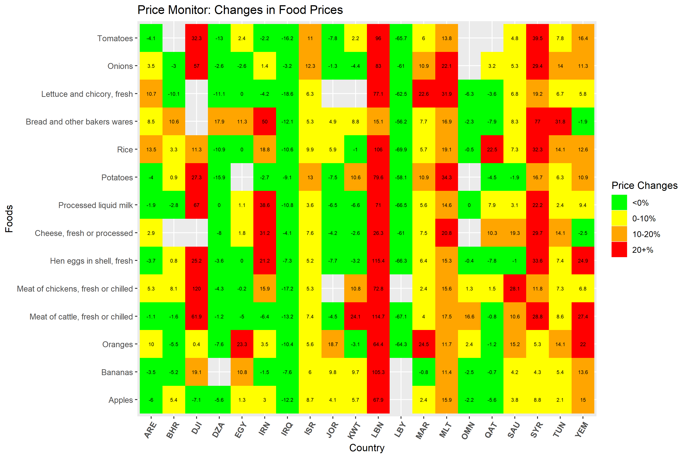
Eine Region weiterhin in der Krise: Regressive Nahrungsmittelpreis-InflationFeb. 2020 – März 2021
Notes:
One of the many aspects where inequality is in the rise, lies in the food price inflation.
In this chart, the horizonal axis represents countries in the MENA region, and the vertical axis represent different foods, such as rice, bread, tomatoes, etc. So each little square represent one food in one country. If the price is red, that means the food price is more than 20% compared to a year ago.
The country that’s most worrisome in this chart is Lebanon, where prices are almost all more than 20% more expensive, compared to a year ago, and some are more than 100% more expensive.
Syria, Yemen, Djibouti, Iran are also on the hot spot. Even in Morocco, prices for fruits and vegetables (oranges; lettuce) are more than 20% higher compared to a year ago.

Slide 8
Der Balanceakt der steigenden öffentlichen Verschuldung
Der Balanceakt ist bei den ölimportierenden Volkswirtschaften mittleren Einkommens der MENA-Region am schwierigsten.
Quelle: Weltbank, Macro and Poverty Outlook (April 2021)
Hinweis: Die Ländergruppen werden durch den Medianwert der Gruppe dargestellt. Die Balken zeigen die mittlere Verschuldung der MENA-Ländergruppen. Die Rauten zeigen die mittlere Verschuldung der entsprechenden Einkommensgruppen weltweit. Für die MENA-Länder mit niedrigem Einkommen (Jemen und Syrien) liegen in der Regel keine Schuldendaten vor. Die Gruppe mit hohem Einkommen im MPO beschränkt sich ausschließlich auf von der Weltbank erfasste Länder.
Notes:
With MENA remains in the crisis, countries are walking the tight rope of rising public debt.
The blue bars in this chart represent median public debt for each of the MENA country groups, the three bars on the left represent situations in 2019, and the three bars on the right represent median public debt in 2020.
The yellow diamonds represent world median public debt of the corresponding income group. MENA high income countries (i.e. GCC) are compared with world median of high-income countries, and MENA Middle-income oil exporters and oil importers are compared with world median of middle-income countries.
We could already see a global increase in public debt, when all three yellow diamonds moved higher in 2020 compared to 2019.
And MENA is no exception. Most worrisome are MENA oil importers that are highlighted with a red box, who entered 2020 with highest public debt.
During the pandemic, public debt in middle-income oil importers have increased from 72 to almost 90, high above the debt level of a typical world middle-income country.
MENA middle-income oil exporters had also accumulated debt, and have passed its peers in the middle income group.
For these countries, making decision about fiscal expenditure would be walking the tight rope.
My colleague Ha, will walk you through the details of this tight rope. ☺
-----------------------------------------------------------------------------------------------------
Debt/GDP is rising because of a combinations of factors:
--negative GDP growth in majority of countries, but most notably, Iraq (-11.9% in 2020); Tunisia (-8.8%); Morocco (-7%). Three exceptions (Iran: 1.7%; Egypt: 3.6% and Djibouti: 0.5%).
and rising debt. This in turn is due to:
primary deficits, which were the driving force in many oil exporters, largest in Libya (45% of GDP in 2020), but also GCC countries (e.g. Kuwait 25%, Oman: 14%; Bahrain: 12%).
a. Primary deficits were mainly due to drop in revenues: for oil exporters (Iraq: -41% drop in real revenue in 2020 compared to 2019; Lybia (-60%); UAE (-31%); Kuwait (-29%) and other GCC countries with similar magnitude); but also for oil importers, e.g., Tunisia (-6.1%); Morocco (-6.9%)
b. and in some cases, large countercyclical increases in spending, e.g., in Tunisia (real primary expenditure in 2020 was up 13% compared to 2019), Morocco (+7%). Note that many others also put together stimulus packages as well (e.g. Bahrain 4% of GDP and then partially extended; UAE: ~3% of GDP; Saudi Arabia: ~3% of GDP) although their primary expenditure did not increase as much as Tunisia and Morocco.
For example, the fiscal packages for Tunisia put together were around 2.3% of GDP (announced in March 2020 covering both 2020 and 2021), consists a combination of transfers, support to firms and sectors such as tourism in the form of interest rate subsidy and support to unemployed and self-employed (IMF)
Morocco created a special fund in early 2020 (3% of GDP) for health spending, defer social contribution, unemployment support, tax deferral, also support to informal workers (IMF).
By comparison, high income country like the US, the combined fiscal packages were much larger (11%+4% and most recent in 2021, 9% ~25% of GDP); Germany (20% of GDP as of December 2020); Japan (42% as of Dec 2020); Australia (16%) (https://time.com/5923840/us-pandemic-relief-bill-december/)
Other middle-income countries’ fiscal packages are usually <10% (Mexico ~1%; China: 5% of GDP; India: 8%; Brazil: 10%; Vietnam: 3.6%; Indonesia: 3.8%). On average, emerging markets and middle-income economies’ (EMMIEs) deployed all instruments for the fiscal response, with about 3.4 percent of GDP in expenditure and revenue measures and 2.5 percent of GDP in support through other instruments.
2. Interest payments
In some countries (Egypt), interest payments were around 10% of GDP in 2020. However, note that debt-GDP ratio in Egypt slightly declined (from 90% in 2019 to 87.5% in 2020), due to positive growth and primary balance.
These increases in public debt overlay on already worryingly high debt levels in MIC oil importers (for 2019 LB: 171% +; TN: 72% +; Egypt 90% flat; JO: 97% +) --- the MIC oil exporter IRAQ from 48% to 69%, Lybia from 49% to 137% (two factors: GDP drop 30%, and primary deficits (45% of GDP) due to drop in oil exports and oil revenue.

Slide 9
Dieser Bericht
A Region Still In Crisis: Quantifies the socio-economic pain
Walking the Debt Tightrope: Articulates the tensions between immediate socio-economic needs and long-run risks in a region that already had high levels of debt in 2019
Tough Choices ahead: Discusses priorities during the pandemic, after the pandemic, and beyond
Sunlight Can Help: Highlights the role of institutions, especially transparency, in charting a path to recovery for the Middle East and North Africa

Slide 10
Der Balanceakt der Verschuldung:Spannung zwischen kurzfristigem Bedarf und langfristigen Kosten der öffentlichen Verschuldung
Langfristige Risiken
Verdrängung privater Investitionen (mit steigenden Zinssätzen)
Verdrängung öffentlicher Investitionen mit steigenden Zinszahlungen
Makroökonomische Anfälligkeit, Refinanzierungsrisiko und Wahrscheinlichkeit kostspieliger Schuldenkrisen
Kurzfristiger Bedarf
Katastrophenhilfe: Unterstützung von Unternehmen und Haushalten
Ausgaben für das öffentliche Gesundheitswesen
Notes:
Positive:
Disaster Relief: Support firms and households
Public Health Spending
Negative:
Crowding out of private investment (as interest rates rise)
Crowding out of public investment as interest payments rise
Macroeconomic vulnerability, rollover risk and likelihood of costly debt crises

Slide 11
Der Balanceakt der Verschuldung – Kurzfristiger Bedarf der öffentlichen Verschuldung: Lehren aus der Katastrophenhilfe
Historische Belege:
Während und unmittelbar nach Katastrophen wächst die Verschuldung in Katastrophenökonomien schneller (2 %) als in der Kontrollgruppe (Ökonomie-Jahre ohne Katastrophen)
Das Wachstum bricht während der Katastrophe ein, erholt sich aber im Anschluss im Vergleich zur Kontrollgruppe.
Notes:
Evidence is based on over 300 episodes of severe natural disasters, with estimated reconstruction needs of at least 1% of GDP. The data cover episodes of natural disasters during 1960-2019. Sample is limited to developing economies.

Slide 12
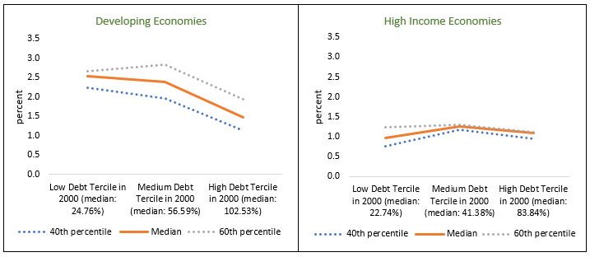
Der Balanceakt der Verschuldung: Langfristige Risiken der öffentlichen VerschuldungZusammenhang zwischen hoher öffentlicher Verschuldung und niedrigem Wachstum im Zeitraum 2000–2019
Mittleres jährliches Pro-Kopf-Wachstum im Zeitraum 2000–2019 nach Ländern, geordnet nach der Verschuldung des Zentralstaats im Jahr 2000

Slide 13
Prioritäten während der Pandemie:Öffentliche Ausgaben für Katastrophenhilfe und öffentliches Gesundheitswesen
Während der Pandemie: Katastrophenhilfe, Unterstützung von Haushalten und Unternehmen
Die Stimulierung der Gesamtnachfrage könnte nur geringe Auswirkungen auf das BIP haben (der „fiskalische Multiplikator“), wenn das Risiko von Covid-19 bestehen bleibt
Investitionen in das öffentliche Gesundheitswesen, um Leben zu retten und langfristige Gewinne zu erzielen
Krankheitsüberwachung und Datentransparenz
Tests und Kontaktnachverfolgung
Impfkampagnen
Kann zudem die wirtschaftlichen Kosten der Pandemie senken
Partielle Korrelation zwischen Testpositivitätsraten und BIP-Abwärtskorrektur
Quellen: IWF, World Economic Outlook; Worldometer; Johns Hopkins University; Weltbank, World Development Indicators; und Berechnungen der Weltbank-Mitarbeiter.
Hinweis: Die Abbildung zeigt die partielle Korrelation zwischen den Wachstumsanpassungen 2020 zwischen Oktober 2020 und Oktober 2019 und der Covid-19-Positivitätsrate (Stand Dezember 2020). Die Positivitätsrate ist die Zahl der Covid-19-Fälle als Prozentsatz der Gesamtzahl der Tests. Weitere erklärende Variablen umfassen den Logarithmus des Pro-Kopf-BIP im Jahr 2019 (in US-Dollar), den gesamten Handelswert am BIP im Jahr 2019 (in Prozent), die Tage seit dem ersten positiven Fall bis zum 30. November 2020 sowie den Tourismus als Prozentsatz der Exporte im Jahr 2018.

Slide 14
Prioritäten, während die Pandemie abklingt
Faktoren, die den Bedarf und die Wirksamkeit traditioneller fiskalischer Konjunkturmaßnahmen verringern | Potenzieller Nutzen (gezielter) Konjunkturmaßnahmen – Heilung wirtschaftlicher Narben
„Nachholbedarf“ kann das BIP ohne fiskalische Konjunkturmaßnahmen steigern Wenn die Verbraucher (z. B. ausländische Touristen) glauben, dass die Pandemie vorbei ist Hohe Verschuldung wurde mit niedrigen Fiskalmultiplikatoren in Verbindung gebracht (Huidrom et al., 2020)Der Fiskalmultiplikator öffentlicher Investitionen ist niedrig, wenn die Regierungsführung schwach ist (Izquierdo et al., 2019) If consumers (e.g., foreign tourists) believe that the pandemic is over High debt has been associated with low fiscal multipliers (Huidrom et al., 2020) Fiscal multiplier of public investment is low when governance is poor (Izquierdo et al., 2019) | Finanzielle Beschränkungen verhindern den Wiedereinstieg von Unternehmen Vernarbung untätiger Arbeitskräfte, insbesondere junger Menschen, die in den Arbeitsmarkt eintreten Unterstützung von Schulen zur Rückgewinnung verlorenen Humankapitals Scarring of idled workers, particularly the young entering the labor force Support schools to recover lost human capital
Notes:
Pent-up demand: demand for goods and services are unusually strong

Slide 15
Abfederung der Kosten der öffentlichen Verschuldung nach der Pandemie
Refinanzierung fällig werdender Schulden zu günstigeren Konditionen durch eine verbesserte Transparenz der Schuldenberichterstattung
Verbesserung der Institutionen: Verschuldete Länder geraten eher in kostspielige Phasen der Schuldennot, wenn sie ein geringes Wachstum und eine schwache Regierungsführung aufweisen.

Slide 16
Gute Regierungsführung kann helfen: Belege aus Episoden der Schuldennot
Hinweis: Kontrollgruppe = Entwicklungsländer ohne Episoden von Schuldennot (Umschuldung)
Notes:
Episodes of debt distress = episodes of debt restructuring, both “pre-emptive” and “defaults”.

Slide 17
Einen Weg zu einer dauerhaften Erholung ebnen:Transparenz hilft!
During the pandemic
Reduce costs, accelerate recovery
Public health surveillance and transparency can reduce costs of the pandemic.
As the pandemic subsides
Raise investment’s impact
After the pandemic
Reduce costs, reduce risk
Transparency can reduce borrowing costs. Good governance can reduce the risks of debt distress.
Transparency in public investment decisions can raise its impact on economic activity (GDP)
Public health surveillance and transparency can accelerate the post-pandemic rebound (e.g., tourism; hospitality industries).

Slide 18
VIELEN DANK!

Slide 19
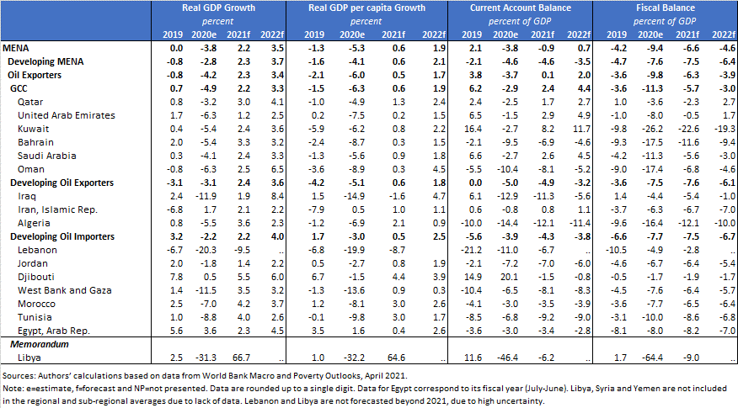
Anhang Tabelle B1: Prognosen der Weltbank zu Wachstum, Leistungsbilanz und Staatshaushalt

Slide 20
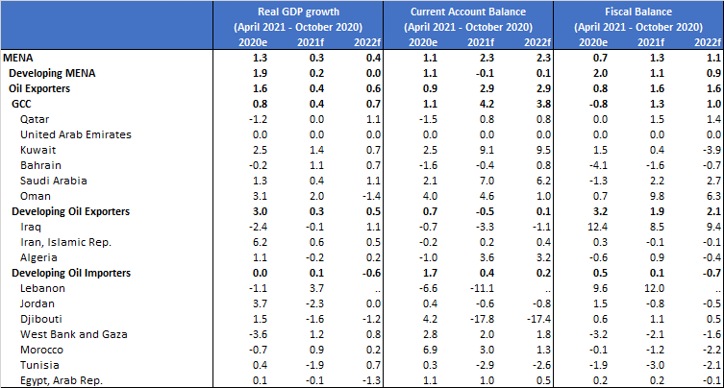
Anhang Tabelle B2 Teil B (zwischen April 2021 und Oktober 2020):

Slide 21
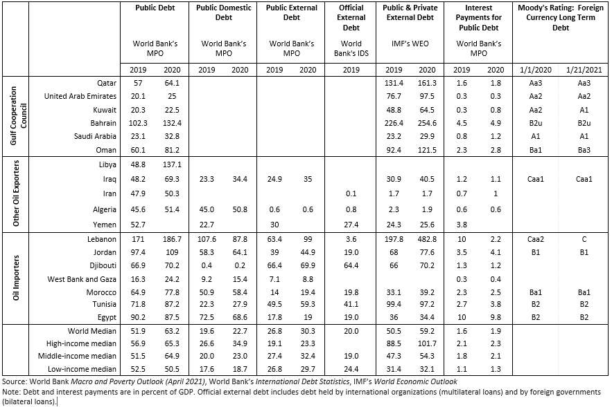
Anhang Tabelle B3: Überblick über die Verschuldung der MENA-Region

Slide 22
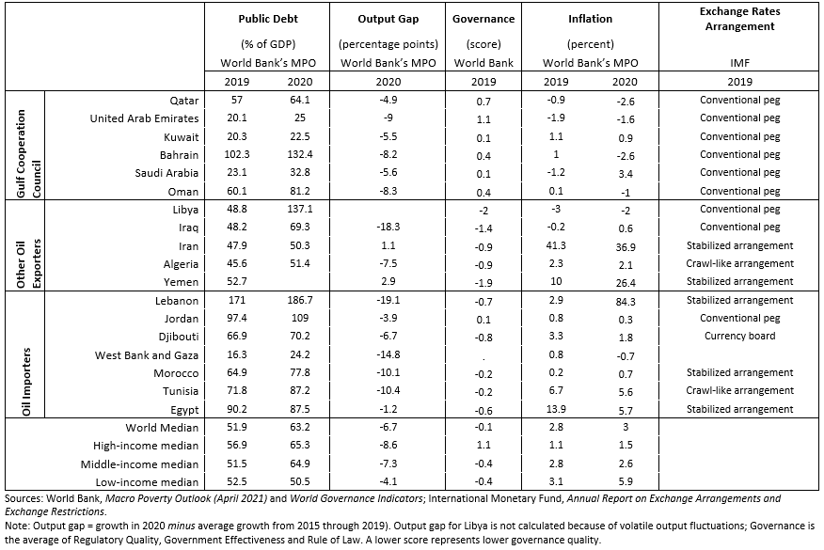
Anhang Tabelle B4: Merkmale der Volkswirtschaften der MENA-Region

