Slide 1
Mise à jour économique MENA – avril 2021
Vivre avec la dette : comment les institutions peuvent tracer une voie vers la reprise au Moyen-Orient et en Afrique du Nord
Notes:
Thank you very much Roberta, for the very kind introduction. Good morning, good afternoon, and good evening.
This is my great honor and pleasure to be here, jointly with Ha, on behalf of the MENA Economic Update team, to present to you our semi-annual flagship report MENA Economic Update, April 2021.
Please allow me to start with a big thank you to the team.

Slide 2





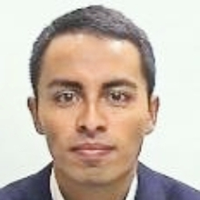

Auteurs
Roberta Gatti
Économiste en chef, Moyen-Orient et Afrique du Nord, Banque mondiale
DANIEL LEDERMAN
Économiste en chef adjoint, Moyen-Orient et Afrique du Nord, Banque mondiale
ha minh nguyenÉconomiste principal, Bureau de l’économiste en chef, Moyen-Orient et Afrique du Nord, Banque mondiale
Asif IslamÉconomiste principal, Bureau de l’économiste en chef, Moyen-Orient et Afrique du Nord, Banque mondiale
rachel yuting fanÉconomiste, Bureau de l’économiste en chef, Moyen-Orient et Afrique du Nord, Banque mondiale
Claudio RojasConsultant, Bureau de l’économiste en chef, Moyen-Orient et Afrique du Nord, Banque mondiale
Sultan AlturkiConsultant, Bureau de l’économiste en chef, Moyen-Orient et Afrique du Nord, Banque mondiale
Notes:
We want to thank the team, Roberta, Daniel, Ha, Asif, Claudio, Sultan, for their incredibly hard work in this production.
Thank Daniel for his intellectual leadership.
We want to thank Roberta, our chief economist, for her push for the institutions and transparency angle

Slide 3
Principales conclusions
The Middle East and North Africa (MENA) region is still in crisis
MENA countries face a balancing act between short-term needs and long-run risks of public debt
Tough choices: public expenditure priorities depend on the phase of the recovery
Sunlight can help! Transparency can help chart a path to lasting recovery for MENA
Notes:
You can probably already see from the title: Living with debt: how institutions can chart a path to recovery in the middle east and north Africa
that this edition includes not only an update of the Economic Situation of the region, but also some reflections of the role of fiscal policy.
Here is our main findings of the report:
One year ago, the first cases of COVID-19 hit the MENA region. One year later, the region remains in a crisis.
The pandemic is forcing economies in the MENA region to borrow a lot. While addressing the immediate concerns of the disaster relief, MENA countries need to be aware of the tension between short-term needs and long-run risks of public debt, and a balancing act between the two would be essential.
Thus countries are facing touch choices, and public expenditure priorities depend on the phase of the recovery.
We want to emphasis that, in every stage of the recovery, transparency can help chart a path to lasting recovery for MENA.
Borrowing a sentence from our president David Malpass, sunlight is truly the best remedy.

Slide 4
Une région toujours en crise : pertes durables de PIB
D’ici 2021, l’économie régionale devrait se situer 7,2 points de pourcentage en dessous du niveau de PIB « sans pandémie », soit l’équivalent de 227 milliards de dollars ; le PIB par habitant (un indicateur du niveau de développement qui détermine la pauvreté) restera encore inférieur d’environ 5 % au niveau de 2019
Notes:
MENA is still in crisis from an economic point of view.
The LHS panel is a comparison of growth in GDP levels. And the RHS is a comparison of growth in GDP per capita levels.
In both charts, the dotted lines represent the forecasts in a no-pandemic world, which is represented by MPO forecast in October 2019.
And the solid lines represent the latest forecast, one year into the pandemic, which is represented by MPO forecast in April 2021.
By end of 2021 GDP level will be 7.2 percentage points below where it was predicted to be in a no-pandemic world. This gap of 7.2 percentage points is equivalent to 227 billion dollars.
This drop results from a GDP contraction in 2020, compared to a positive growth predicted before pandemic. Add up to that, a slower forecasted growth for 2021.
This counterfactual comparison is even sharper if we look at GDP per capita levels, which is a better measure for living standards.
By the end of 2021, GDP per capita level will be 7 percentage points below where it was predicted to be in a no-pandemic world. More importantly, even with the positive growth in 2021, by end of 2021, the level of GDP per capita will still be 5% lower than its level back in 2019.

Slide 5
Une région toujours en crise : pertes de PIB par habitant
Pertes d’ici 2021 :
MENA : 7,0 %
CCG : 7,3 %
Exportateurs de pétrole à revenu intermédiaire : 4,6 %
Importateurs de pétrole à revenu intermédiaire : 8,6 %
Source : Banque mondiale, Macro and Poverty Outlook (avril 2021 et octobre 2019) et calculs des services de la Banque mondiale.
Note : Les lignes pointillées indiquent les niveaux prévus de PIB par habitant dans le cas contrefactuel d’absence de pandémie (sur la base des prévisions de PIB par habitant d’octobre 2019). Les lignes continues indiquent les niveaux prévus de PIB par habitant dans le cas de la pandémie (sur la base des prévisions de PIB par habitant d’avril 2021).
Notes:
If we zoom in the loss in terms of GDP per capita, by decomposing MENA into three countries groups, then the biggest loss, compared to pre-pandemic forecast, would come from Developing oil importers (represented by red lines), followed by GCC (Gulf Cooperation Council countries, represented by blue lines), and other oil exporters (represented by gold lines).
Again, in both charts, the dotted lines represent the forecasts in a no-pandemic world, which is represented by MPO forecast in October 2019.
And the solid lines represent the latest forecast, one year into the pandemic, which is represented by MPO forecast in April 2021.
The region’s oil importing countries entered 2020 with the highest public debt. By the end of 2021, their GDP per capita will be 8.6 percentage points below where it could have been in a no-pandemic world, comparing the red dotted line and the red solid line.
This drop results from a GDP per capita contraction in 2020 and a slight recovery in 2021, compared to a 3% growth in both years in a no-pandemic world.
Last but not least from this chart, none of the country groups can return to its 2019 level by the end of 2021.

Slide 6
Une région toujours en crise : estimations prudentes de millions de nouveaux pauvres
14,2 millions
Notes:
Because of that, poverty is rising in the region.
In this chart, the black line represent the estimated headcount of poverty (i.e. those making less than $5.50 per day) in a no-pandemic world. And the redline is the estimated poverty headcount based on latest GDP forecasts.
The number of poor people in the region is expected to increase from 176 million in 2019 to 192 million people by the end of 2021. This is an extra 14 million people falling into poverty following the pandemic, all of whom wouldn’t have been in poverty if not hit by the pandemic.
Noted that this forecast provides only a lower threshold, because it assumes that every household is equally affected. Unfortunately, the effect of Covid‐19 is not equal to the population, and the poorer side of the population suffers most from the pandemic.

Slide 7
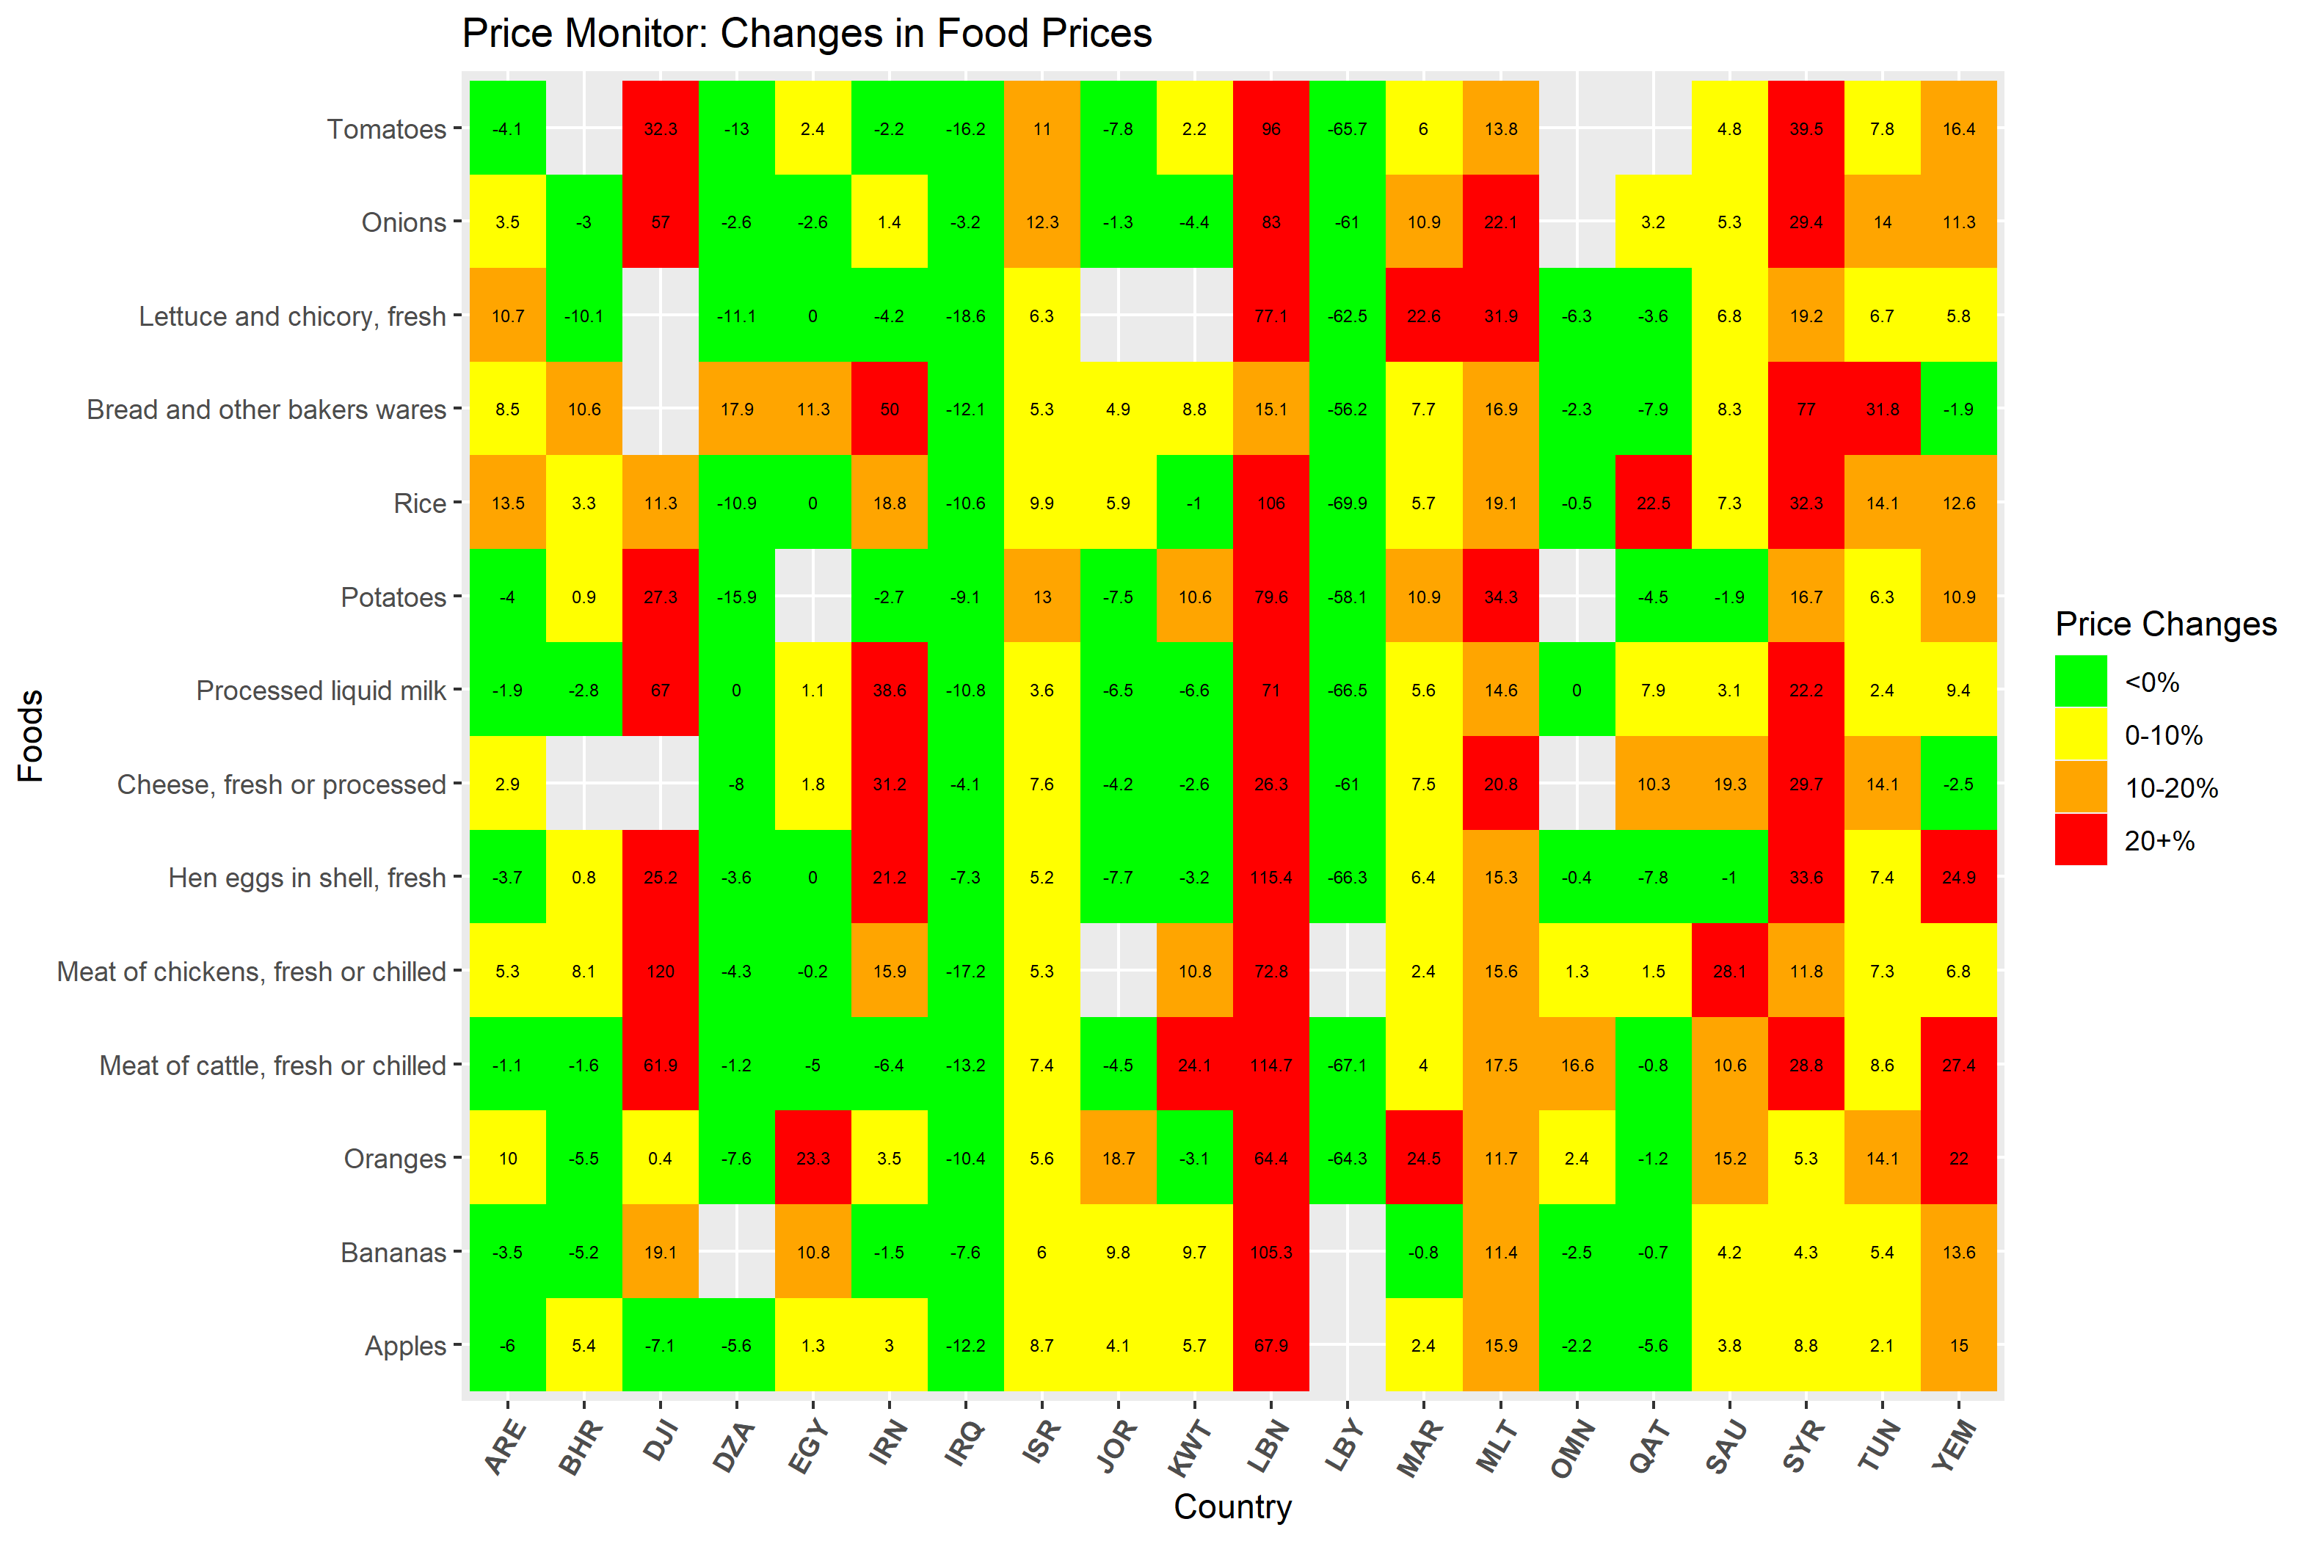
Une région toujours en crise : inflation régressive des prix alimentairesfévr. 2020 – mars 2021
Notes:
One of the many aspects where inequality is in the rise, lies in the food price inflation.
In this chart, the horizonal axis represents countries in the MENA region, and the vertical axis represent different foods, such as rice, bread, tomatoes, etc. So each little square represent one food in one country. If the price is red, that means the food price is more than 20% compared to a year ago.
The country that’s most worrisome in this chart is Lebanon, where prices are almost all more than 20% more expensive, compared to a year ago, and some are more than 100% more expensive.
Syria, Yemen, Djibouti, Iran are also on the hot spot. Even in Morocco, prices for fruits and vegetables (oranges; lettuce) are more than 20% higher compared to a year ago.

Slide 8
L’exercice d’équilibre face à la hausse de la dette publique
L’exercice d’équilibre est le plus difficile parmi les économies importatrices de pétrole à revenu intermédiaire de la région MENA.
Source : Banque mondiale, Macro and Poverty Outlook (avril 2021)
Note : Les groupes de pays sont représentés par l’observation médiane du groupe. Les barres indiquent la dette médiane des groupes de pays MENA. Les losanges indiquent la dette médiane des groupes de revenu correspondants à l’échelle mondiale. Les données sur la dette ne sont généralement pas disponibles pour les pays MENA à faible revenu (Yémen et Syrie). Dans le MPO, le groupe à revenu élevé se limite aux seuls pays couverts par la Banque mondiale.
Notes:
With MENA remains in the crisis, countries are walking the tight rope of rising public debt.
The blue bars in this chart represent median public debt for each of the MENA country groups, the three bars on the left represent situations in 2019, and the three bars on the right represent median public debt in 2020.
The yellow diamonds represent world median public debt of the corresponding income group. MENA high income countries (i.e. GCC) are compared with world median of high-income countries, and MENA Middle-income oil exporters and oil importers are compared with world median of middle-income countries.
We could already see a global increase in public debt, when all three yellow diamonds moved higher in 2020 compared to 2019.
And MENA is no exception. Most worrisome are MENA oil importers that are highlighted with a red box, who entered 2020 with highest public debt.
During the pandemic, public debt in middle-income oil importers have increased from 72 to almost 90, high above the debt level of a typical world middle-income country.
MENA middle-income oil exporters had also accumulated debt, and have passed its peers in the middle income group.
For these countries, making decision about fiscal expenditure would be walking the tight rope.
My colleague Ha, will walk you through the details of this tight rope. ☺
-----------------------------------------------------------------------------------------------------
Debt/GDP is rising because of a combinations of factors:
--negative GDP growth in majority of countries, but most notably, Iraq (-11.9% in 2020); Tunisia (-8.8%); Morocco (-7%). Three exceptions (Iran: 1.7%; Egypt: 3.6% and Djibouti: 0.5%).
and rising debt. This in turn is due to:
primary deficits, which were the driving force in many oil exporters, largest in Libya (45% of GDP in 2020), but also GCC countries (e.g. Kuwait 25%, Oman: 14%; Bahrain: 12%).
a. Primary deficits were mainly due to drop in revenues: for oil exporters (Iraq: -41% drop in real revenue in 2020 compared to 2019; Lybia (-60%); UAE (-31%); Kuwait (-29%) and other GCC countries with similar magnitude); but also for oil importers, e.g., Tunisia (-6.1%); Morocco (-6.9%)
b. and in some cases, large countercyclical increases in spending, e.g., in Tunisia (real primary expenditure in 2020 was up 13% compared to 2019), Morocco (+7%). Note that many others also put together stimulus packages as well (e.g. Bahrain 4% of GDP and then partially extended; UAE: ~3% of GDP; Saudi Arabia: ~3% of GDP) although their primary expenditure did not increase as much as Tunisia and Morocco.
For example, the fiscal packages for Tunisia put together were around 2.3% of GDP (announced in March 2020 covering both 2020 and 2021), consists a combination of transfers, support to firms and sectors such as tourism in the form of interest rate subsidy and support to unemployed and self-employed (IMF)
Morocco created a special fund in early 2020 (3% of GDP) for health spending, defer social contribution, unemployment support, tax deferral, also support to informal workers (IMF).
By comparison, high income country like the US, the combined fiscal packages were much larger (11%+4% and most recent in 2021, 9% ~25% of GDP); Germany (20% of GDP as of December 2020); Japan (42% as of Dec 2020); Australia (16%) (https://time.com/5923840/us-pandemic-relief-bill-december/)
Other middle-income countries’ fiscal packages are usually <10% (Mexico ~1%; China: 5% of GDP; India: 8%; Brazil: 10%; Vietnam: 3.6%; Indonesia: 3.8%). On average, emerging markets and middle-income economies’ (EMMIEs) deployed all instruments for the fiscal response, with about 3.4 percent of GDP in expenditure and revenue measures and 2.5 percent of GDP in support through other instruments.
2. Interest payments
In some countries (Egypt), interest payments were around 10% of GDP in 2020. However, note that debt-GDP ratio in Egypt slightly declined (from 90% in 2019 to 87.5% in 2020), due to positive growth and primary balance.
These increases in public debt overlay on already worryingly high debt levels in MIC oil importers (for 2019 LB: 171% +; TN: 72% +; Egypt 90% flat; JO: 97% +) --- the MIC oil exporter IRAQ from 48% to 69%, Lybia from 49% to 137% (two factors: GDP drop 30%, and primary deficits (45% of GDP) due to drop in oil exports and oil revenue.

Slide 9
Ce rapport
A Region Still In Crisis: Quantifies the socio-economic pain
Walking the Debt Tightrope: Articulates the tensions between immediate socio-economic needs and long-run risks in a region that already had high levels of debt in 2019
Tough Choices ahead: Discusses priorities during the pandemic, after the pandemic, and beyond
Sunlight Can Help: Highlights the role of institutions, especially transparency, in charting a path to recovery for the Middle East and North Africa

Slide 10
L’exercice d’équilibre de la dette :tension entre les besoins à court terme et les coûts à long terme de la dette publique
Risques à long terme
Éviction de l’investissement privé (à mesure que les taux d’intérêt augmentent)
Éviction de l’investissement public à mesure que les paiements d’intérêts augmentent
Vulnérabilité macroéconomique, risque de refinancement et probabilité de crises de la dette coûteuses
Besoins à court terme
Aide en cas de catastrophe : soutien aux entreprises et aux ménages
Dépenses de santé publique
Notes:
Positive:
Disaster Relief: Support firms and households
Public Health Spending
Negative:
Crowding out of private investment (as interest rates rise)
Crowding out of public investment as interest payments rise
Macroeconomic vulnerability, rollover risk and likelihood of costly debt crises

Slide 11
L’exercice d’équilibre de la dette – Besoins à court terme de la dette publique : enseignements tirés de l’aide en cas de catastrophe
Données historiques :
Pendant et immédiatement après les catastrophes, la dette croît plus vite (2 %) dans les économies touchées que dans le groupe témoin (années-économies sans catastrophe)
La croissance chute pendant la catastrophe mais se redresse par la suite par rapport au groupe témoin.
Notes:
Evidence is based on over 300 episodes of severe natural disasters, with estimated reconstruction needs of at least 1% of GDP. The data cover episodes of natural disasters during 1960-2019. Sample is limited to developing economies.

Slide 12
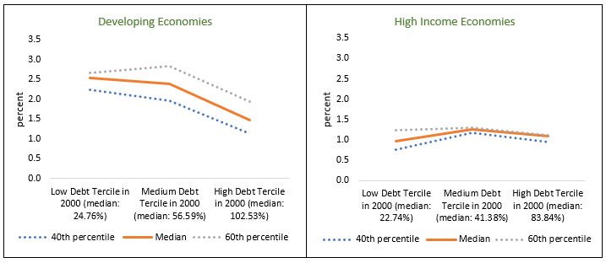
L’exercice d’équilibre de la dette : risques à long terme de la dette publiqueAssociation entre une dette publique élevée et une faible croissance sur la période 2000-2019
Croissance annuelle médiane par habitant sur la période 2000-2019 selon les pays classés par dette de l’administration centrale en 2000

Slide 13
Priorités pendant la pandémie :dépenses publiques pour l’aide en cas de catastrophe et la santé publique
Pendant la pandémie : aide en cas de catastrophe, soutien aux ménages et aux entreprises
La stimulation de la demande globale pourrait avoir peu d’effet sur le PIB (le « multiplicateur budgétaire ») si le risque de Covid-19 persiste
Investir dans la santé publique pour sauver des vies et générer des gains à long terme
Surveillance des maladies et transparence des données
Dépistage et recherche des contacts
Campagnes de vaccination
Peut aussi réduire les coûts économiques de la pandémie
Corrélation partielle entre les taux de positivité des tests et la révision à la baisse du PIB
Sources : FMI, World Economic Outlook ; Worldometer ; Johns Hopkins University ; Banque mondiale, World Development Indicators ; et calculs des services de la Banque mondiale.
Note : La figure montre la corrélation partielle entre les ajustements de croissance pour 2020 entre octobre 2020 et octobre 2019 et le taux de positivité au Covid-19 (au mois de décembre 2020). Le taux de positivité correspond au nombre de cas de Covid-19 en pourcentage du nombre total de tests. Les autres variables explicatives comprennent le logarithme du PIB par habitant en 2019 (en dollars américains), la valeur totale des échanges commerciaux dans le PIB en 2019 (en pourcentage), le nombre de jours écoulés depuis le premier cas positif jusqu’au 30 novembre 2020, et le tourisme en pourcentage des exportations en 2018.

Slide 14
Priorités à mesure que la pandémie s’atténue
Facteurs qui réduisent le besoin et l'efficacité des mesures de relance budgétaire traditionnelles | Avantages potentiels d'une relance (ciblée) – cicatrisation des séquelles économiques
La « demande refoulée » peut accroître le PIB sans relance budgétaire Si les consommateurs (par ex. les touristes étrangers) estiment que la pandémie est terminée Un endettement élevé a été associé à de faibles multiplicateurs budgétaires (Huidrom et al., 2020)Le multiplicateur budgétaire de l'investissement public est faible lorsque la gouvernance est défaillante (Izquierdo et al., 2019) If consumers (e.g., foreign tourists) believe that the pandemic is over High debt has been associated with low fiscal multipliers (Huidrom et al., 2020) Fiscal multiplier of public investment is low when governance is poor (Izquierdo et al., 2019) | Les contraintes financières empêchent la réinsertion des entreprises Séquelles des travailleurs inactifs, en particulier les jeunes entrant sur le marché du travail Soutenir les écoles pour récupérer le capital humain perdu Scarring of idled workers, particularly the young entering the labor force Support schools to recover lost human capital
Notes:
Pent-up demand: demand for goods and services are unusually strong

Slide 15
Atténuer les coûts de la dette publique après la pandémie
Refinancer la dette arrivant à échéance à des conditions plus favorables en améliorant la transparence de la communication sur la dette
Améliorer les institutions : les pays endettés sont plus susceptibles d’entrer dans des périodes coûteuses de surendettement lorsqu’ils connaissent une faible croissance et une gouvernance défaillante.

Slide 16
Une bonne gouvernance peut aider : données issues d’épisodes de surendettement
Note : Groupe témoin = pays en développement sans épisodes de surendettement (restructuration de la dette)
Notes:
Episodes of debt distress = episodes of debt restructuring, both “pre-emptive” and “defaults”.

Slide 17
Tracer une voie vers une reprise durable :la transparence peut aider !
During the pandemic
Reduce costs, accelerate recovery
Public health surveillance and transparency can reduce costs of the pandemic.
As the pandemic subsides
Raise investment’s impact
After the pandemic
Reduce costs, reduce risk
Transparency can reduce borrowing costs. Good governance can reduce the risks of debt distress.
Transparency in public investment decisions can raise its impact on economic activity (GDP)
Public health surveillance and transparency can accelerate the post-pandemic rebound (e.g., tourism; hospitality industries).

Slide 18
MERCI !

Slide 19
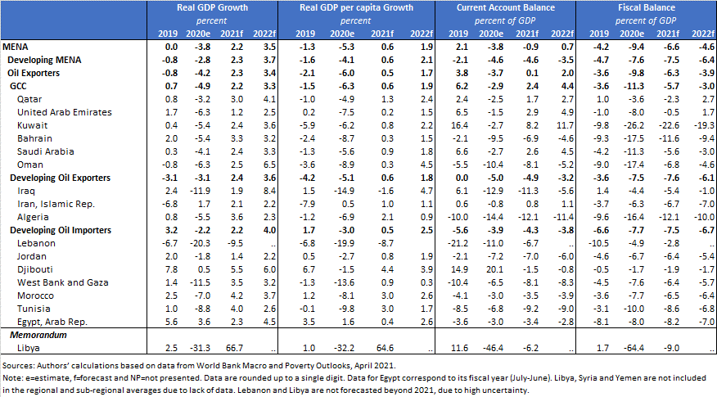
Annexe Tableau B1 : prévisions de la Banque mondiale en matière de croissance, de compte courant et de comptes budgétaires

Slide 20
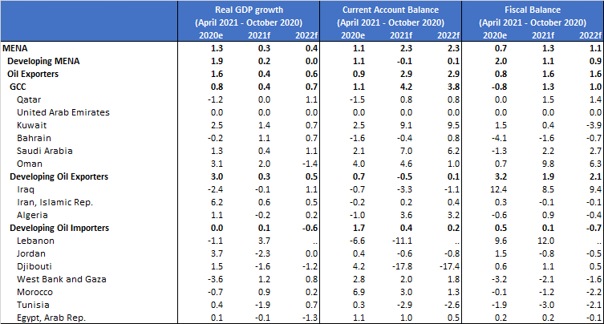
Annexe Tableau B2 Volet B (entre avril 2021 et octobre 2020) :

Slide 21
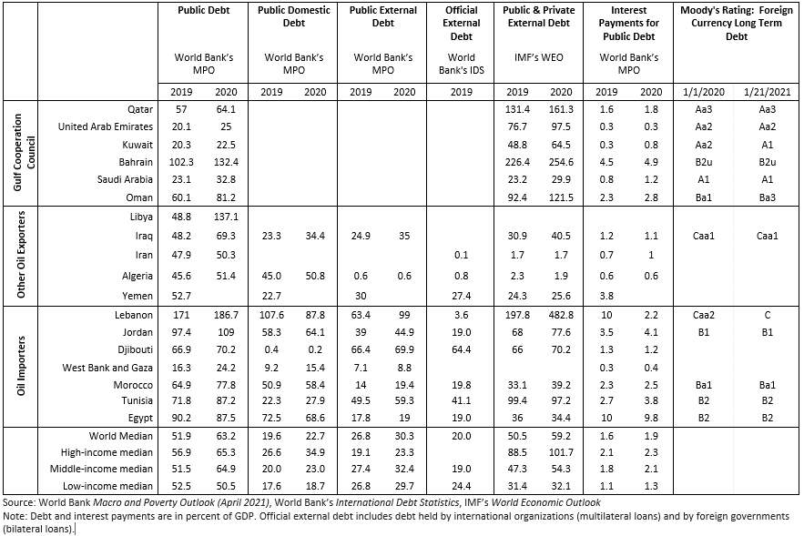
Annexe Tableau B3 : aperçu de la dette de la région MENA

Slide 22
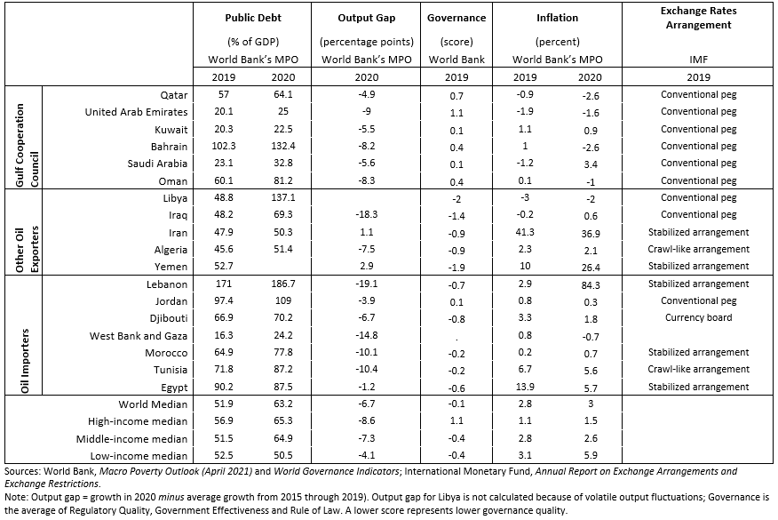
Annexe Tableau B4 : caractéristiques des économies de la région MENA

