Slide 1
OECD ECONOMIC OUTLOOK
Better, but not good enough
Catherine L. Mann
OECD Chief Economist
7 June 2017 Paris
www.oecd.org/economy/economicoutlook.htm
ECOSCOPE blog: oecdecoscope.wordpress.com

Slide 2
Key messages
Global growth expected to pick-up modestly with upside risks
More needs to be done to share the gains from structural trends and trade
An integrated policy approach is needed to make globalisation work for all
Changes to technology, consumer preferences and trade are occurring simultaneously
A more level playing field for the international system
Confidence is increasing and investment and trade are picking up from low levels
Signs of rising demand for high-tech goods and investment to upgrade capital
Domestic reforms to boost competition, job creation, skills and innovation
Productivity and wage growth remain subdued; financial stability risks persist
Job losses from shifts in activity are concentrated in manufacturing and specific regions
Growth is broad based; recovery in commodity producers helps the modest global upturn
Headline employment indicators are improving but labour markets have not recovered
Financial risks from high and rising credit growth, house price increases, interest rate gaps
Targeted policies to help people who are left behind seize new opportunities

Slide 3
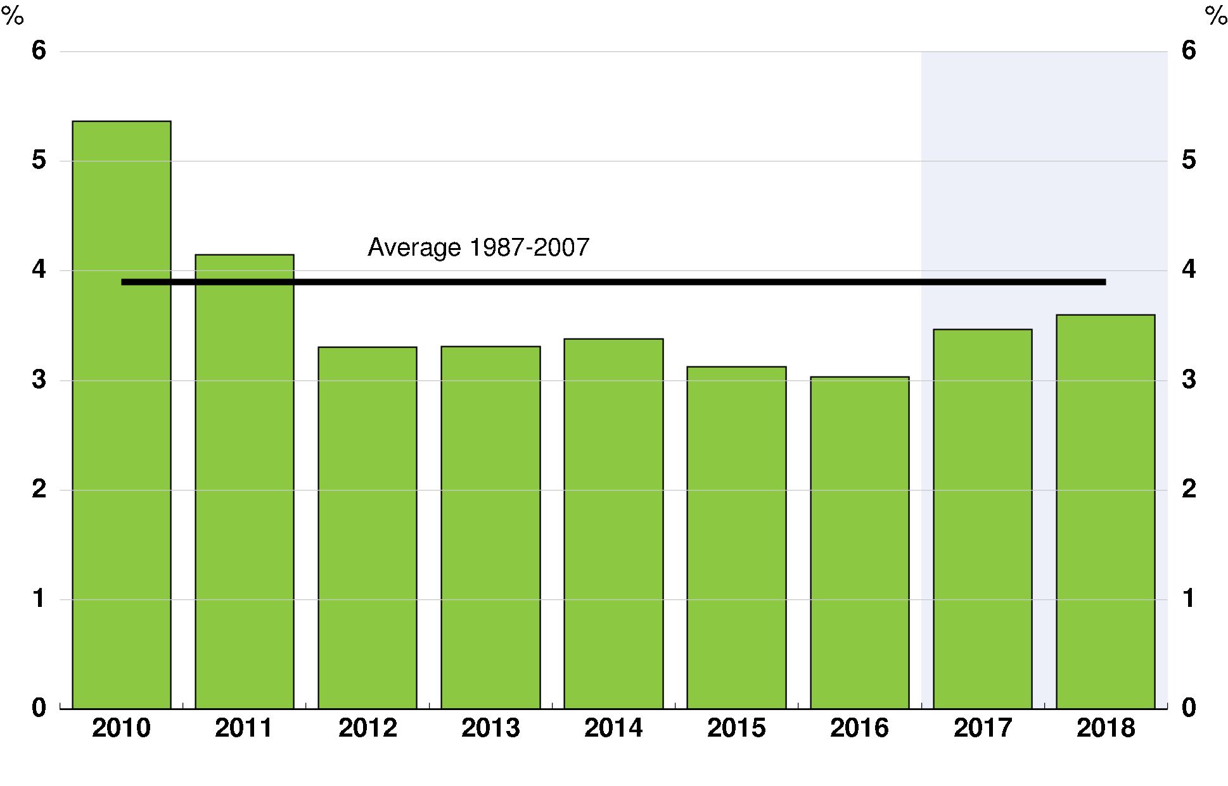
Global GDP growth should pick up modestly
but remains below historical norms
Global GDP growth
Source: OECD June 2017 Economic Outlook database.

Slide 4
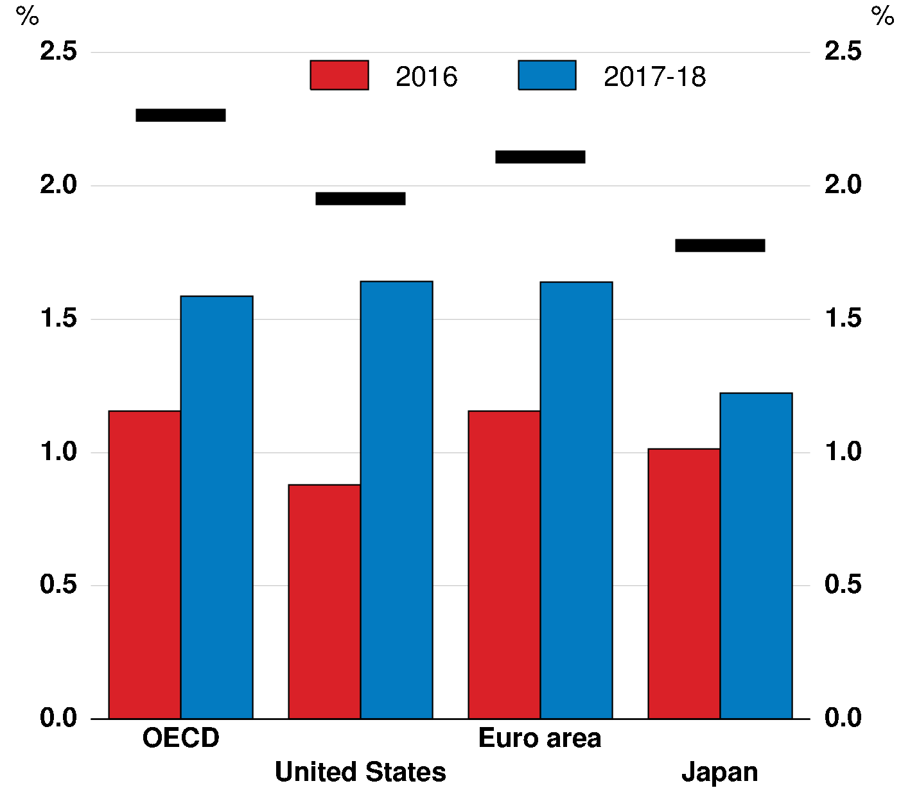
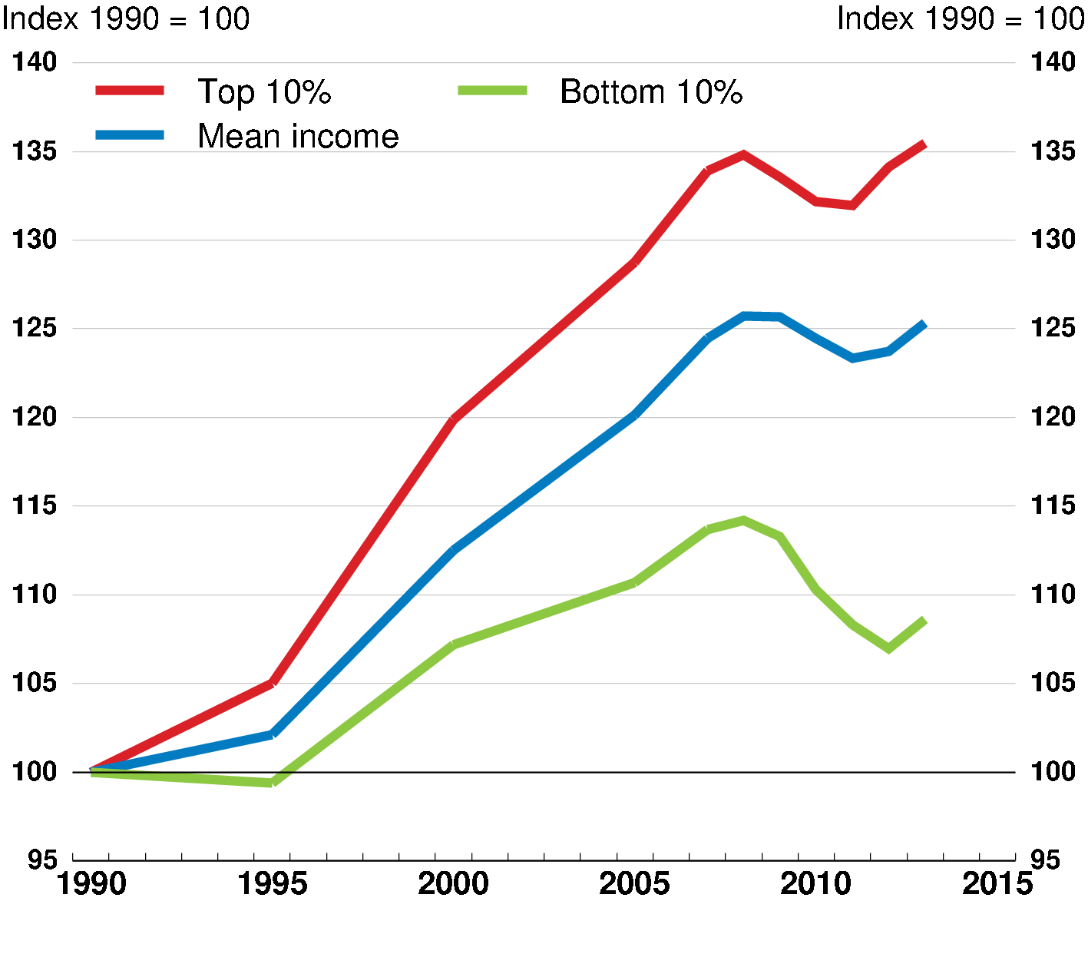
GDP growth per person is below history
and income inequality continues to rise
GDP growth per person
Horizontal lines are averages for 1987-2007
Income inequality is rising in the OECD Real household disposable income, total population
Note: RHS is the unweighted average of 17 OECD countries.
Source: OECD June 2017 Economic Outlook database; and OECD Income Distribution database.

Slide 5
OECD Economic Outlook Projections
Real GDP growth
Year-on-year, %
Note: Difference in percentage points based on rounded figures.
1. With growth in Ireland in 2015 computed using gross value added at constant prices excluding foreign-owned multinational enterprise dominated sectors.
2. Fiscal years starting in April.

Slide 6
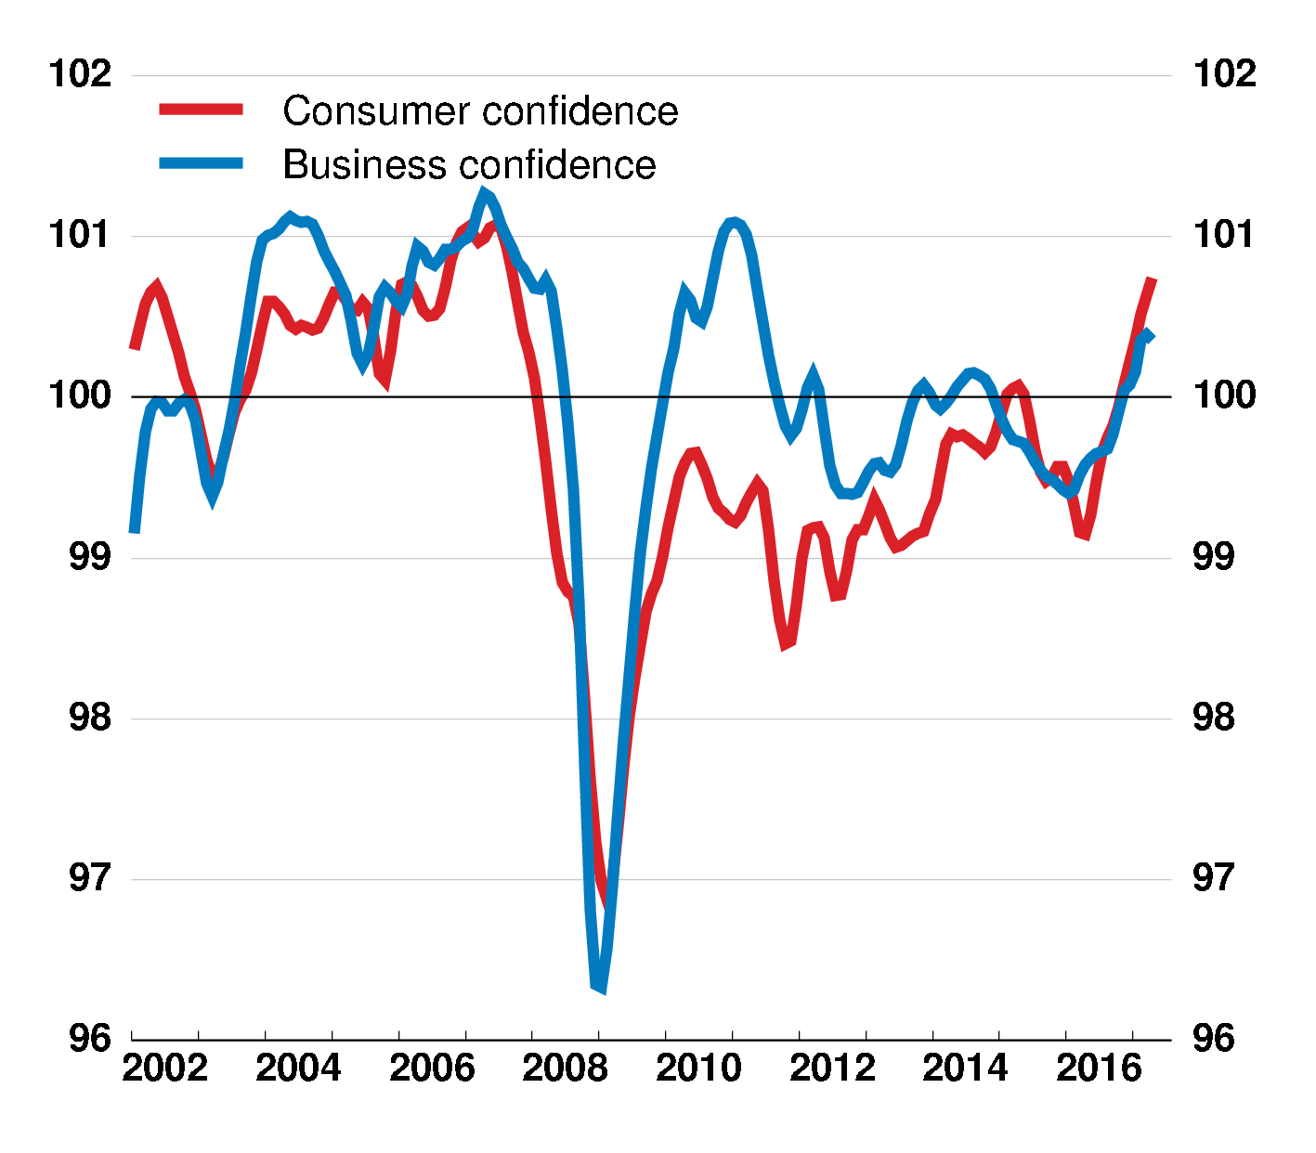
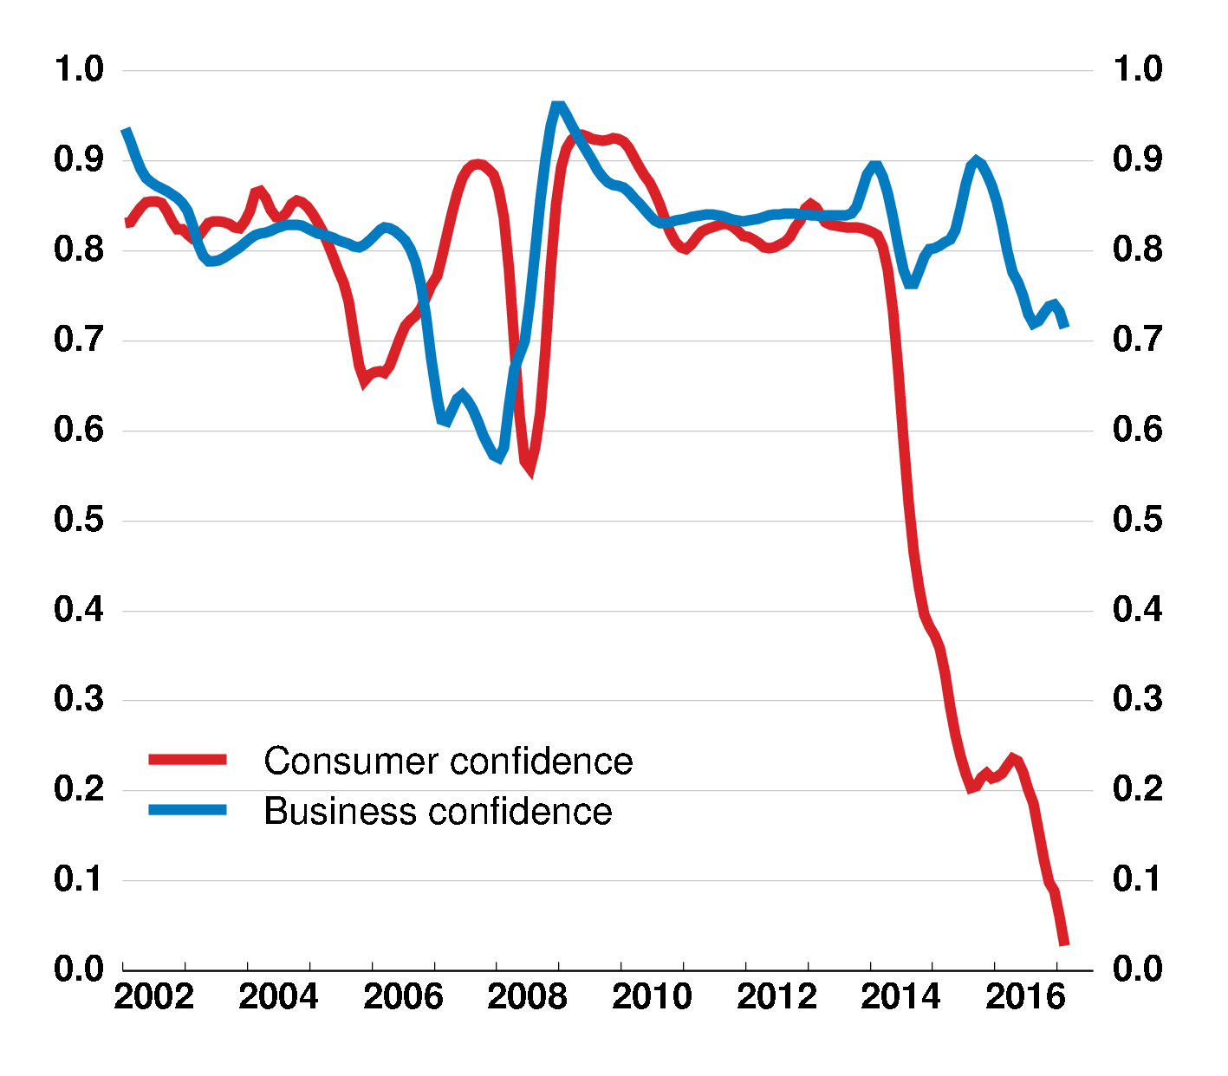
Confidence indicators point to pick-up, but they have become less reliable
Consumer and business confidence OECD and BRIICS, Index
Performance of confidence indicators
OECD and BRIICS, 5-year correlation with activity
Note: Confidence indices are GDP PPP weighted averages of individual country standardised series where long-term average = 100. Consumer confidence correlation with global retail sales growth and business confidence with global industrial production growth.
Source: OECD Main Economic Indicators database; and OECD calculations.

Slide 7
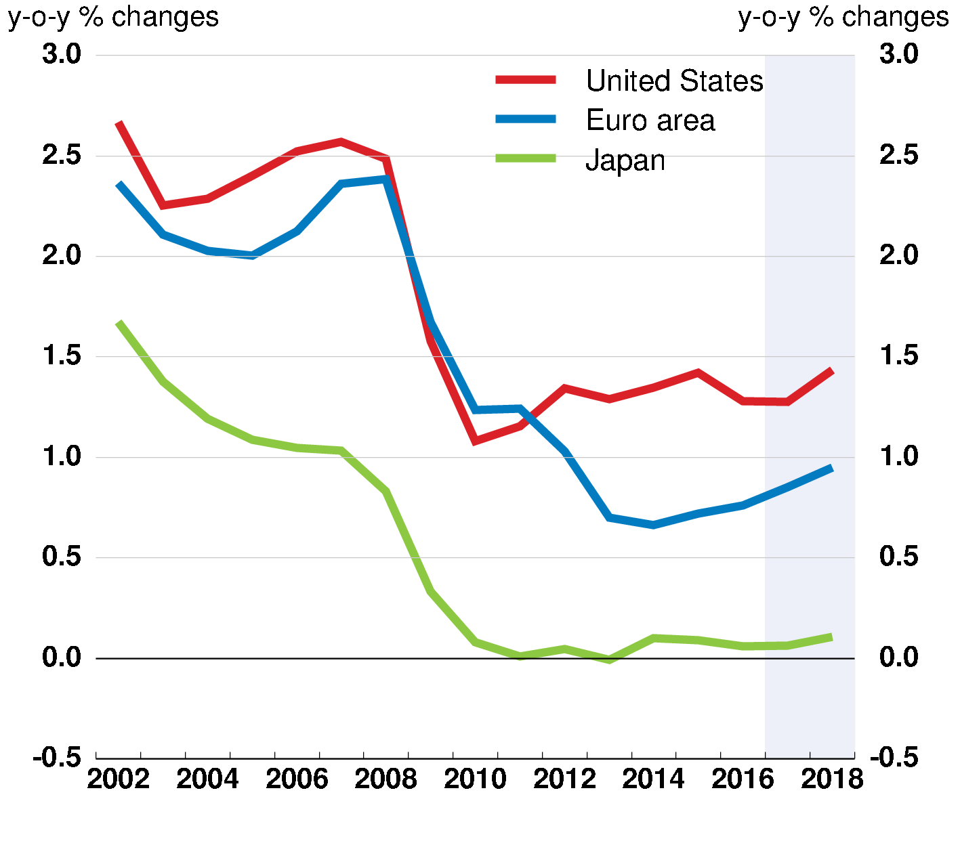
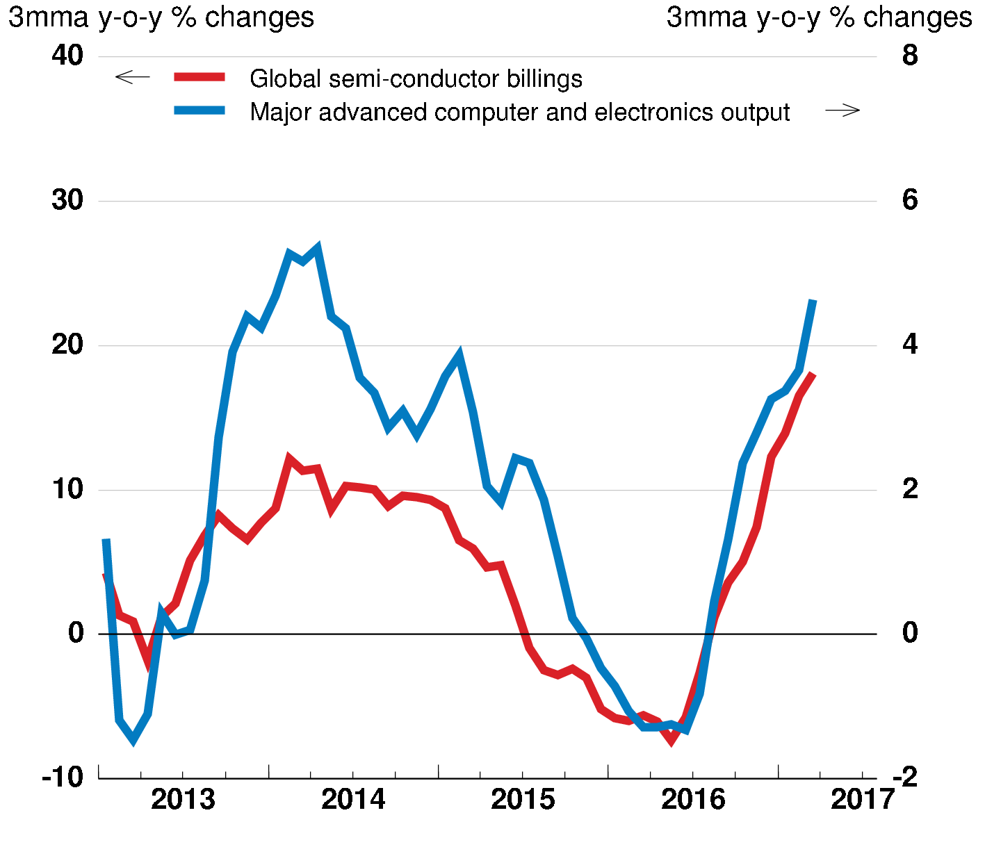
Investment is increasing but capital stock is old Potential upside from technology upgrading
Productive capital stock growth
High tech products
Note: Global semi-conductor billings in nominal US dollars. Major advanced computer and electronics output is a weighted average of production of computer and electronic products for the United States, output of computer, electronic and optical products for Germany, and production of information and communications electronics equipment plus electronic parts and devices for Japan. Source: OECD June 2017 Economic Outlook database; World Semi-Conductor Statistics; Eurostat; Board of Governors of the Federal Reserve System; Japan Ministry of Economy, Trade and Industry; and OECD calculations.

Slide 8
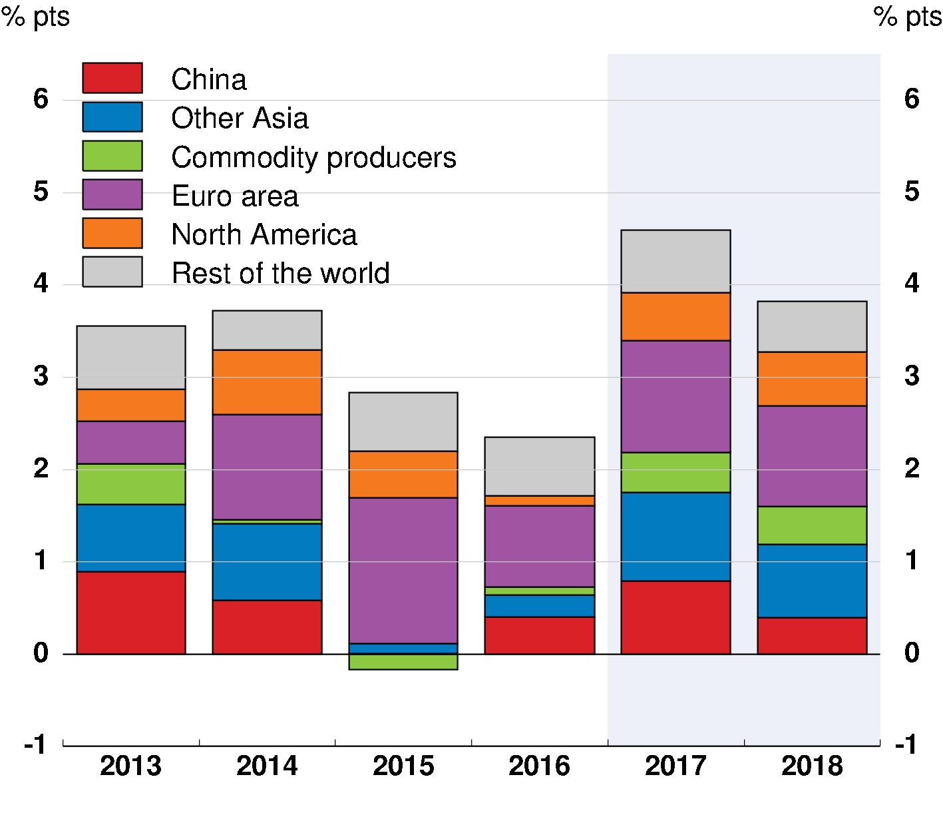
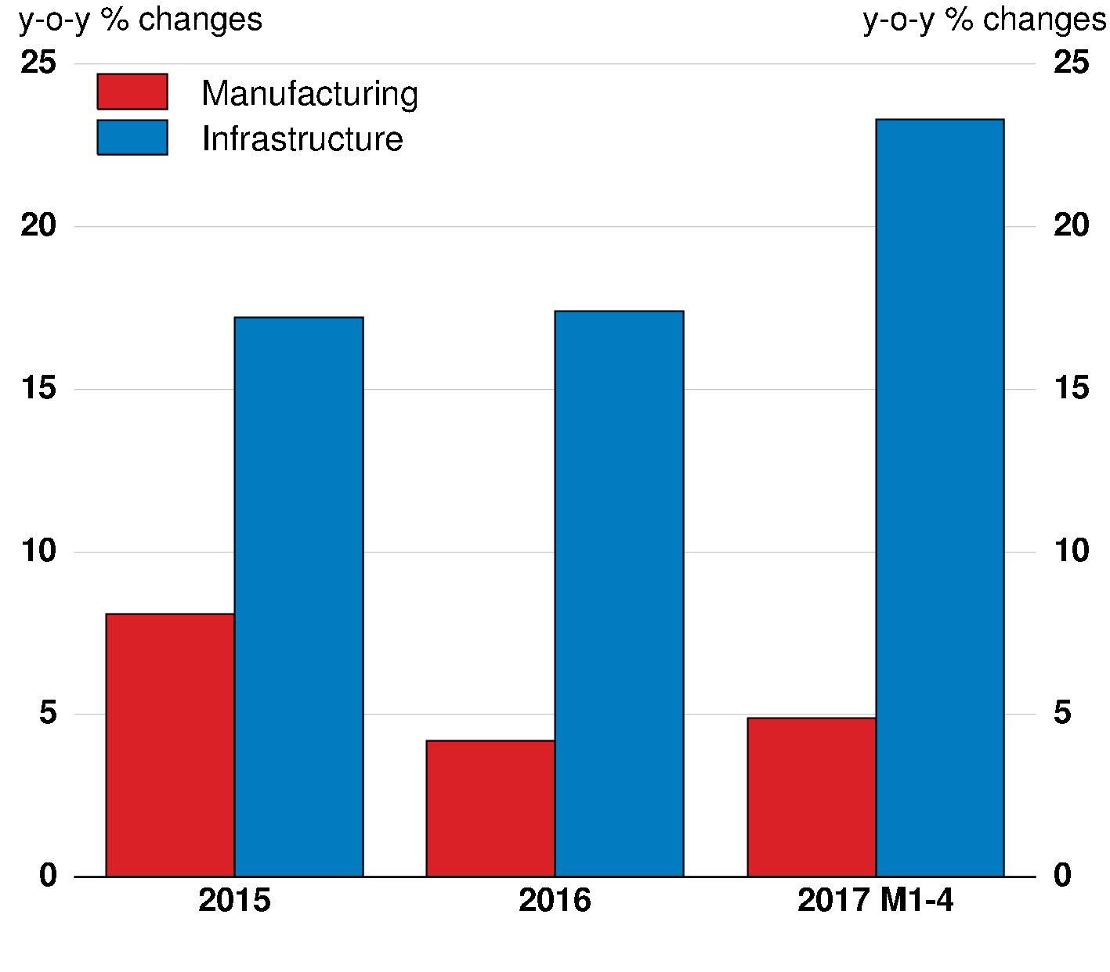
Global trade has recovered recently with important support from stimulus in China
Contributions to world trade growth
China nominal fixed asset investment
Note: Commodity producers includes Argentina, Australia, Brazil, Chile, Colombia, Norway, New Zealand, Russia, Saudi Arabia, South Africa and other oil producing countries. Source: OECD June 2017 Economic Outlook database; and National Bureau of Statistics of China.

Slide 9
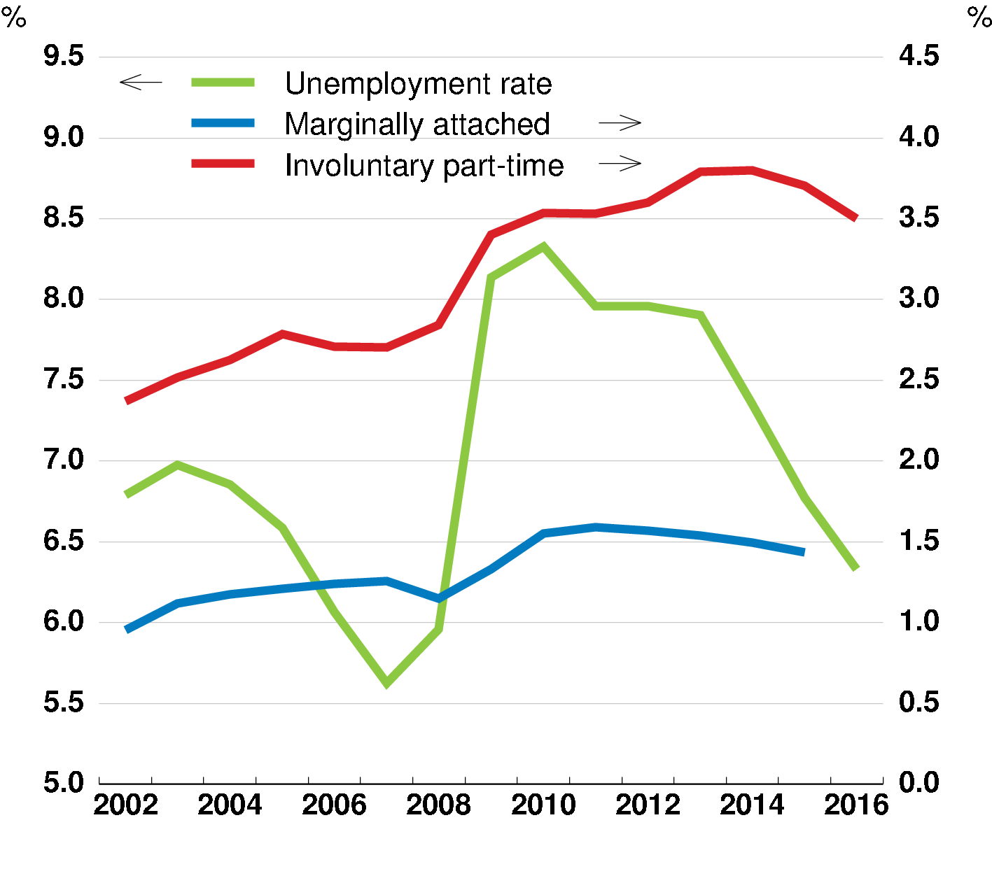
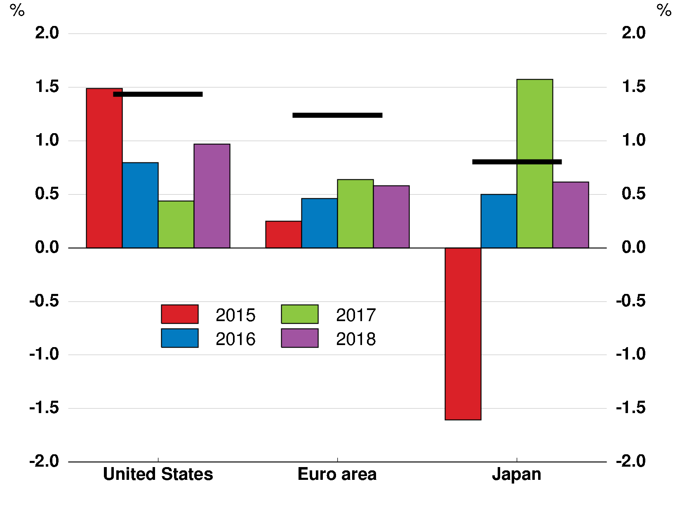
Labour market recovery is incomplete and real wage growth remains sluggish
Unemployment and underemployment OECD, share of labour force
Real wage growth
Horizontal lines are averages for 1987-2007
Note: Real wages measured as labour compensation per employee adjusted for the GDP deflator. Source: OECD June 2017 Economic Outlook database; OECD Employment database; US Bureau of Labor Statistics; Eurostat; and Japan Statistics Bureau.

Slide 10
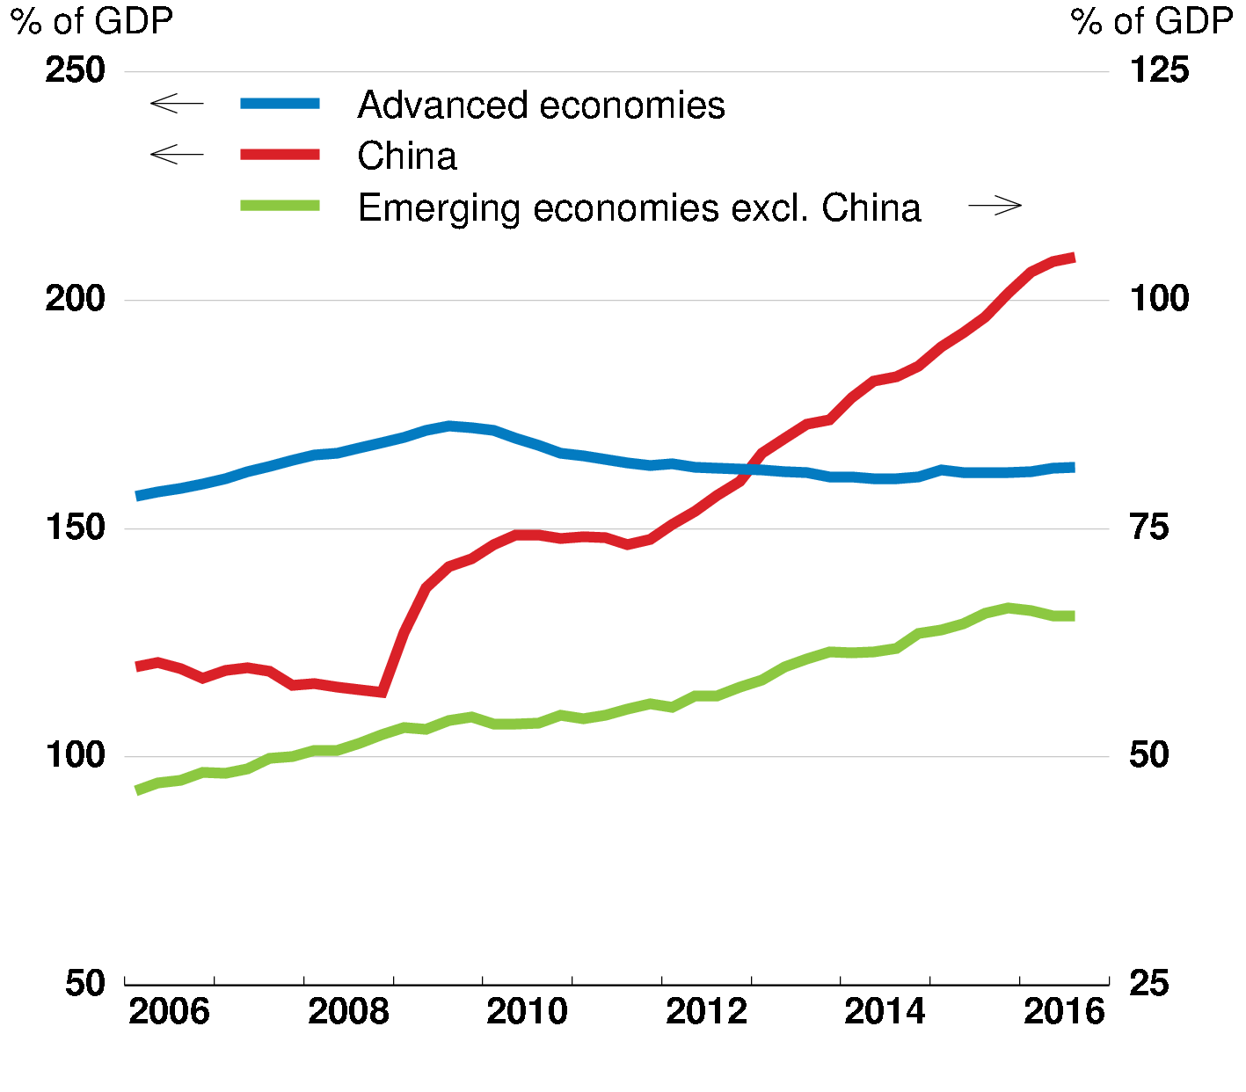
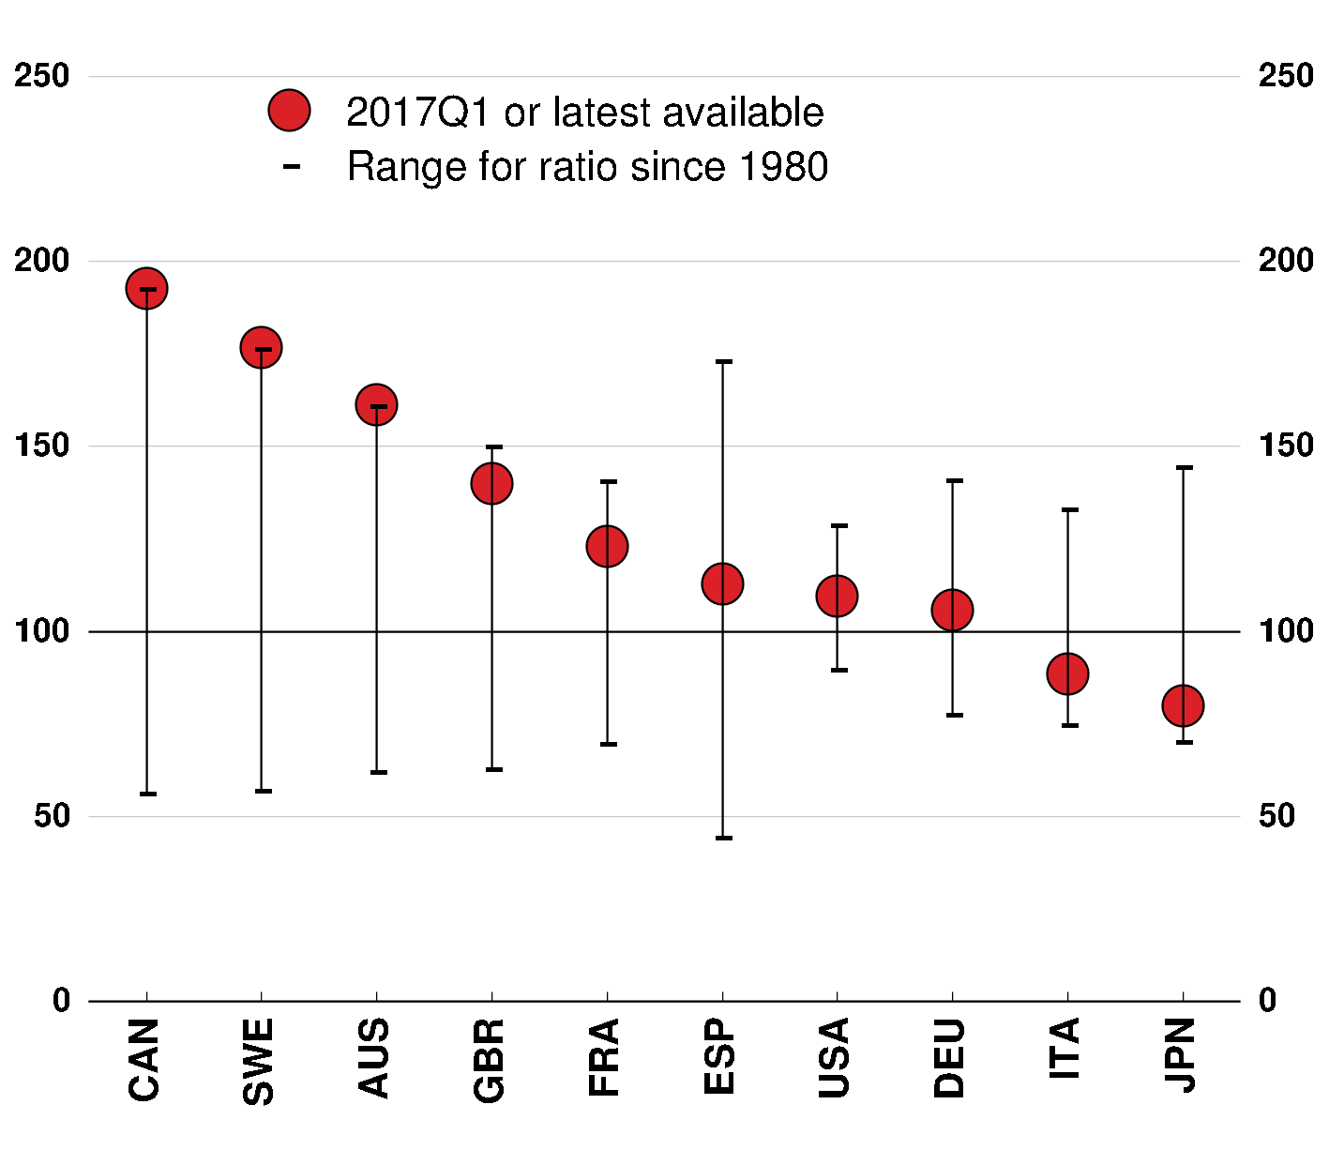
Rising private credit in EMEs and housing market risks in advanced economies
Private non-financial sector credit
House price-to-rent ratio
Average since 1980 = 100
Note: EMEs excluding China is an unweighted average of ratios for Argentina, Brazil, Colombia, India, Indonesia, Mexico, Russia, Malaysia, South Africa and Turkey. Source: BIS; OECD Analytical House Price database; and OECD calculations.

Slide 11
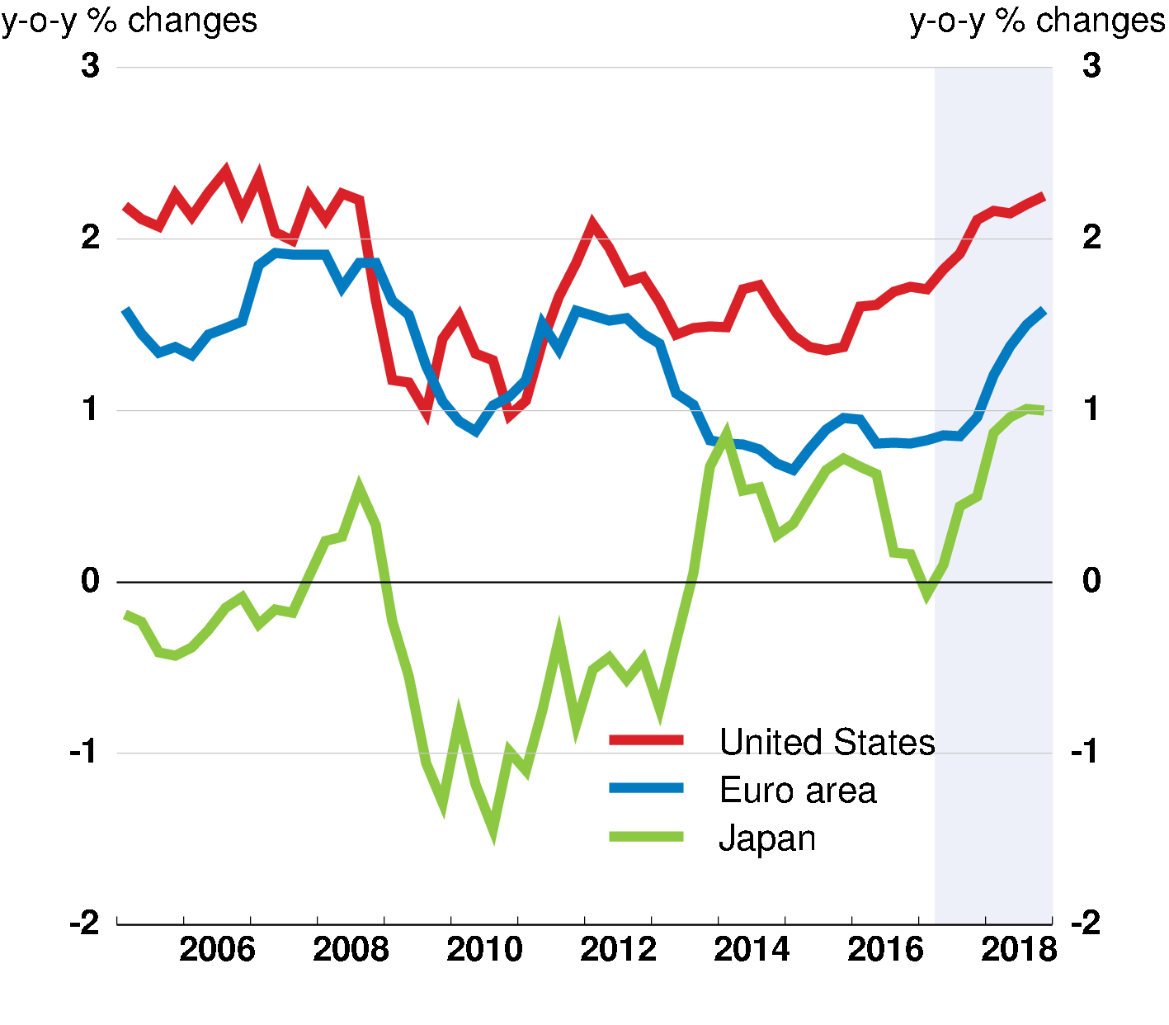
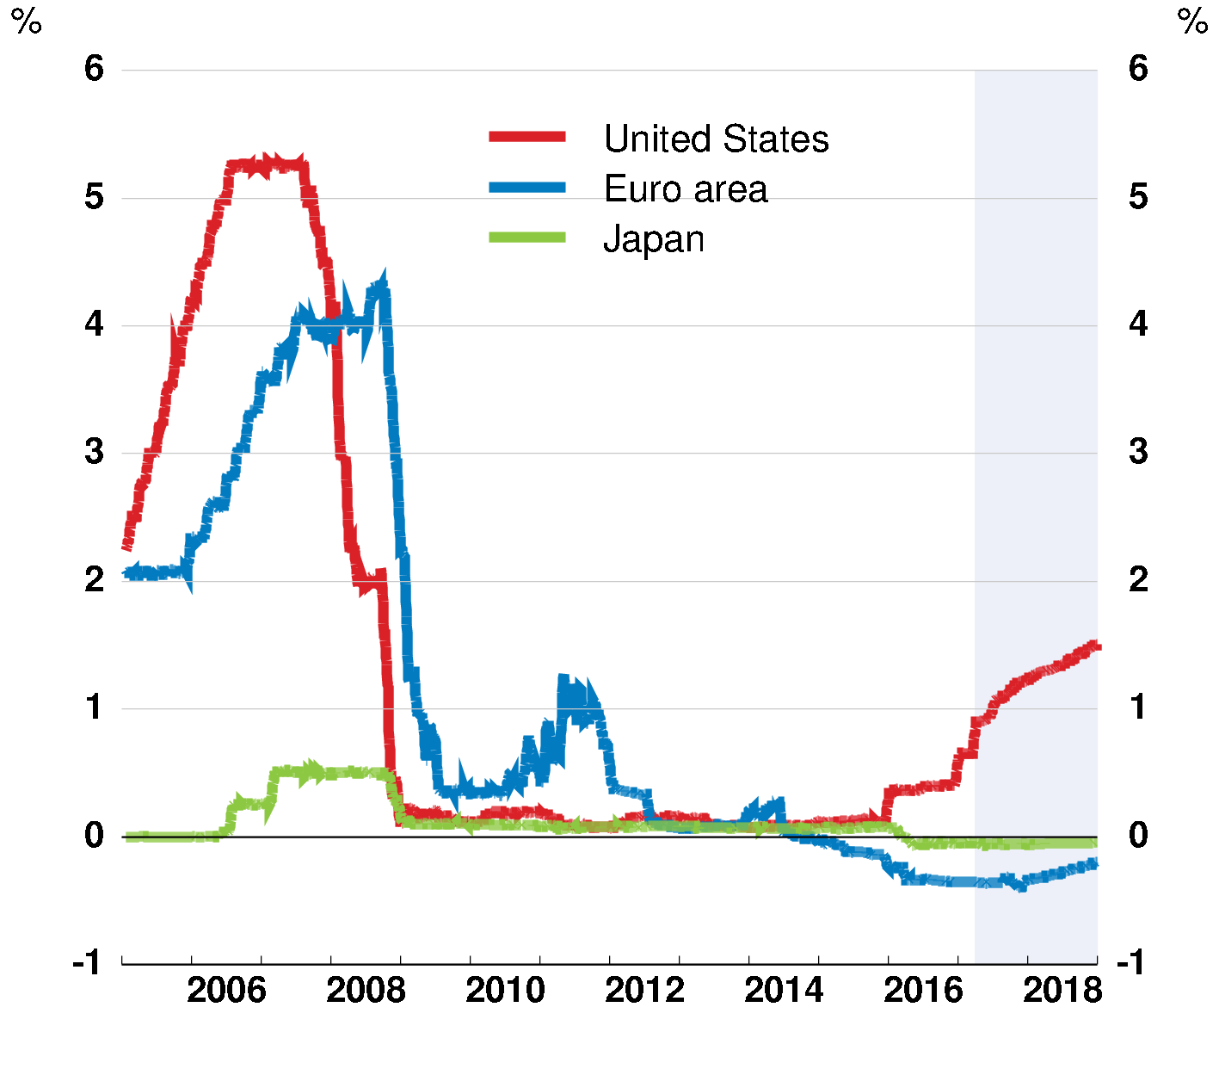
Inflation generally below objectives; potential interest rate divergence creates financial risks
Core inflation
Market-based expectations of overnight interest rates
15-day moving average
Note: Core inflation for Japan adjusted for the impact of consumption tax increases. Source: OECD June 2017 Economic Outlook database; Bloomberg; and OECD calculations.

Slide 12
Diagnosing the challenge
of structural trends

Slide 13
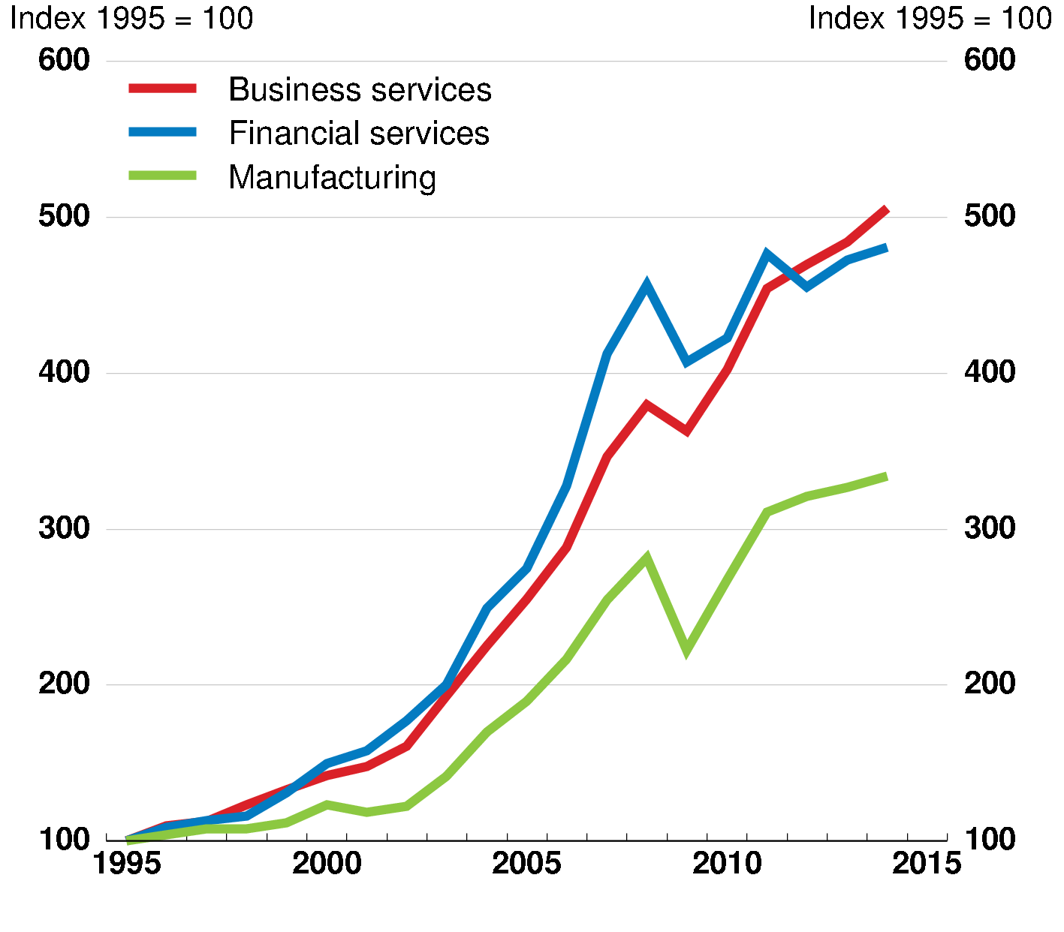
Trade specialisation and patterns have shifted
World goods trade
Share of world goods exports, volumes
World trade by type
Exports, values
Note: LHS – Dynamic Asian Economies includes Malaysia, the Philippines, Singapore, Thailand, Vietnam, Chinese Taipei and Hong Kong. RHS – Business services includes R&D, ICT, real estate and other business activities. Financial services includes financial intermediation, insurance, pension funding and other financial activities.
Source: OECD-WTO Trade in Value Added (TiVA) database; UN Comtrade database; and OECD calculations.

Slide 14
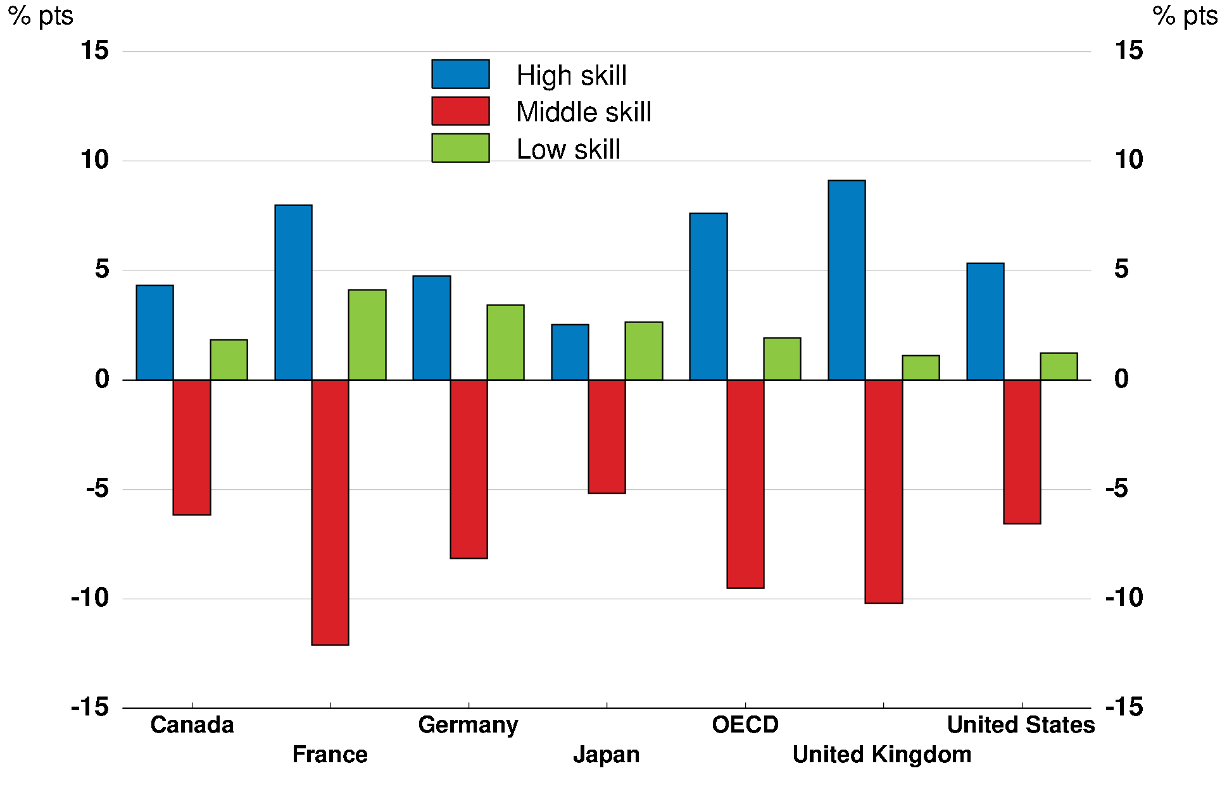
Job losses have centred on people with mid-level skills
Job polarisation by country
Change in share of total employment by skill level, 1995-2015
Note: OECD is the unweighted average of 24 countries. For Japan 1995-2010.
Source: OECD Employment Outlook 2017; European Union Labour Force Survey; Labour force surveys for Canada, Japan and the United States; and OECD calculations.

Slide 15
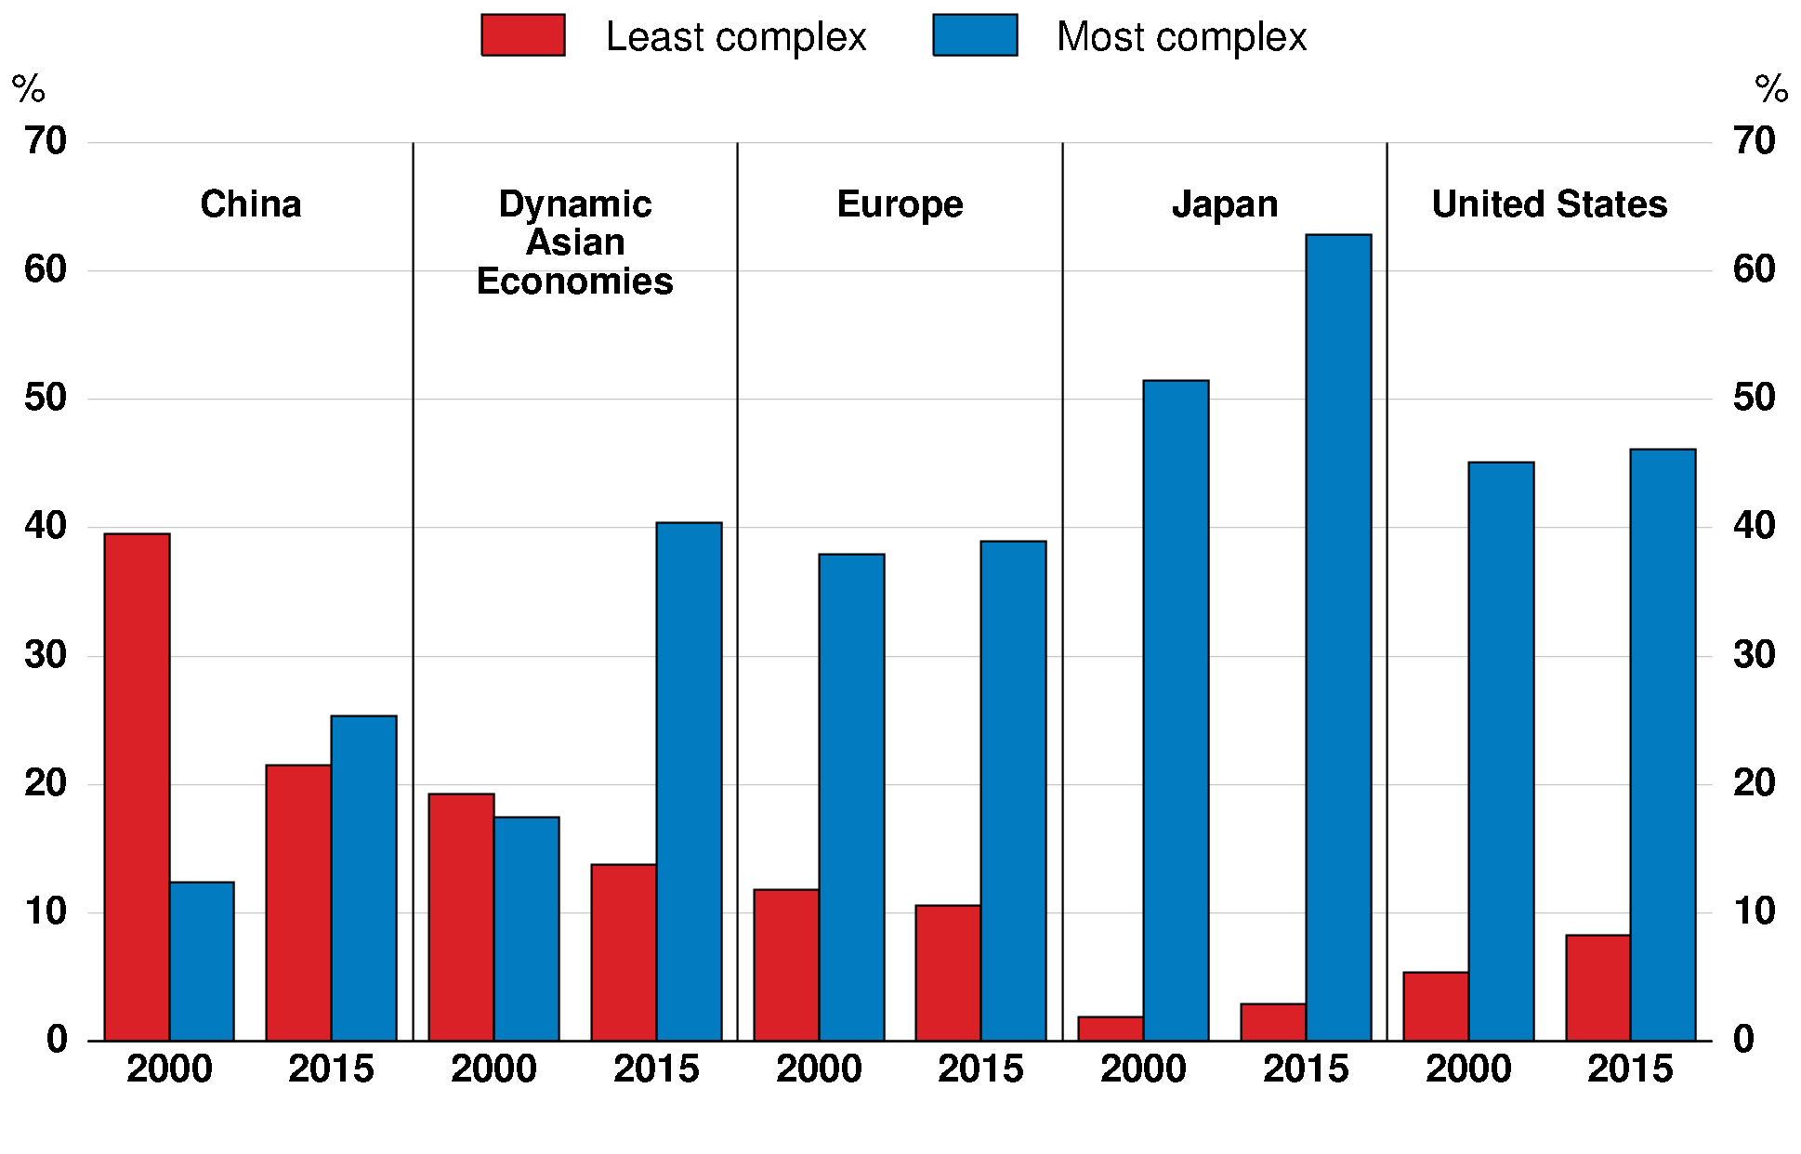
Advanced economies have moved up the value chain, but EMEs are moving up too
Share of export goods by complexity
Note: In nominal terms. Least complex is the 1st quartile of products by complexity (e.g. crayons), most complex is the 4th quartile (e.g. medical equipment), excluding major commodities. Dynamic Asian Economies includes Malaysia, the Philippines, Singapore, Thailand, Vietnam, Chinese Taipei and Hong Kong. Europe is the unweighted average of the Czech Republic, France, Germany, Ireland, Italy, Poland, Portugal and the UK.
Source: UN Comtrade database; and OECD calculations.

Slide 16
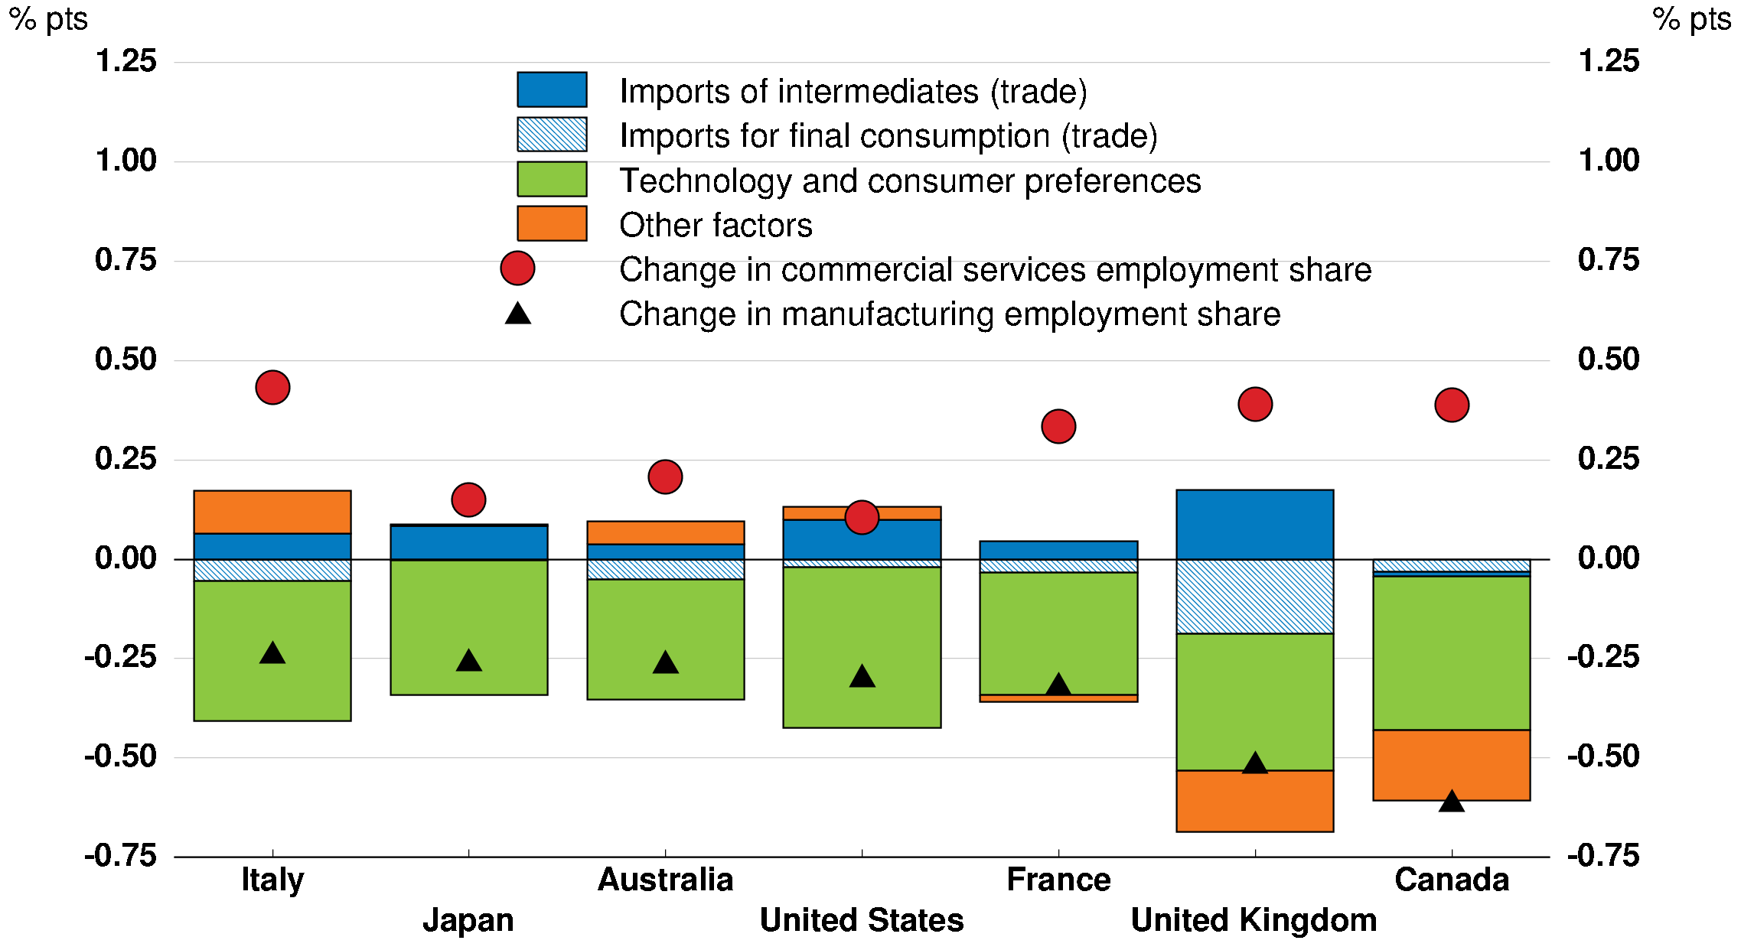
Manufacturing job losses and role for Technology & Consumer Preferences vs Trade
Factors explaining the decline in manufacturing jobs
Change in share of total employment, annual average 1990-2008
Note: Decomposition based on regression estimation. Each factor is based on the change over the period. Technology and consumer preferences include ICT and machinery investment, changes in the manufacturing consumption share and time specific effects.
Source: OECD Economic Outlook database; STAN database; and OECD calculations.

Slide 17
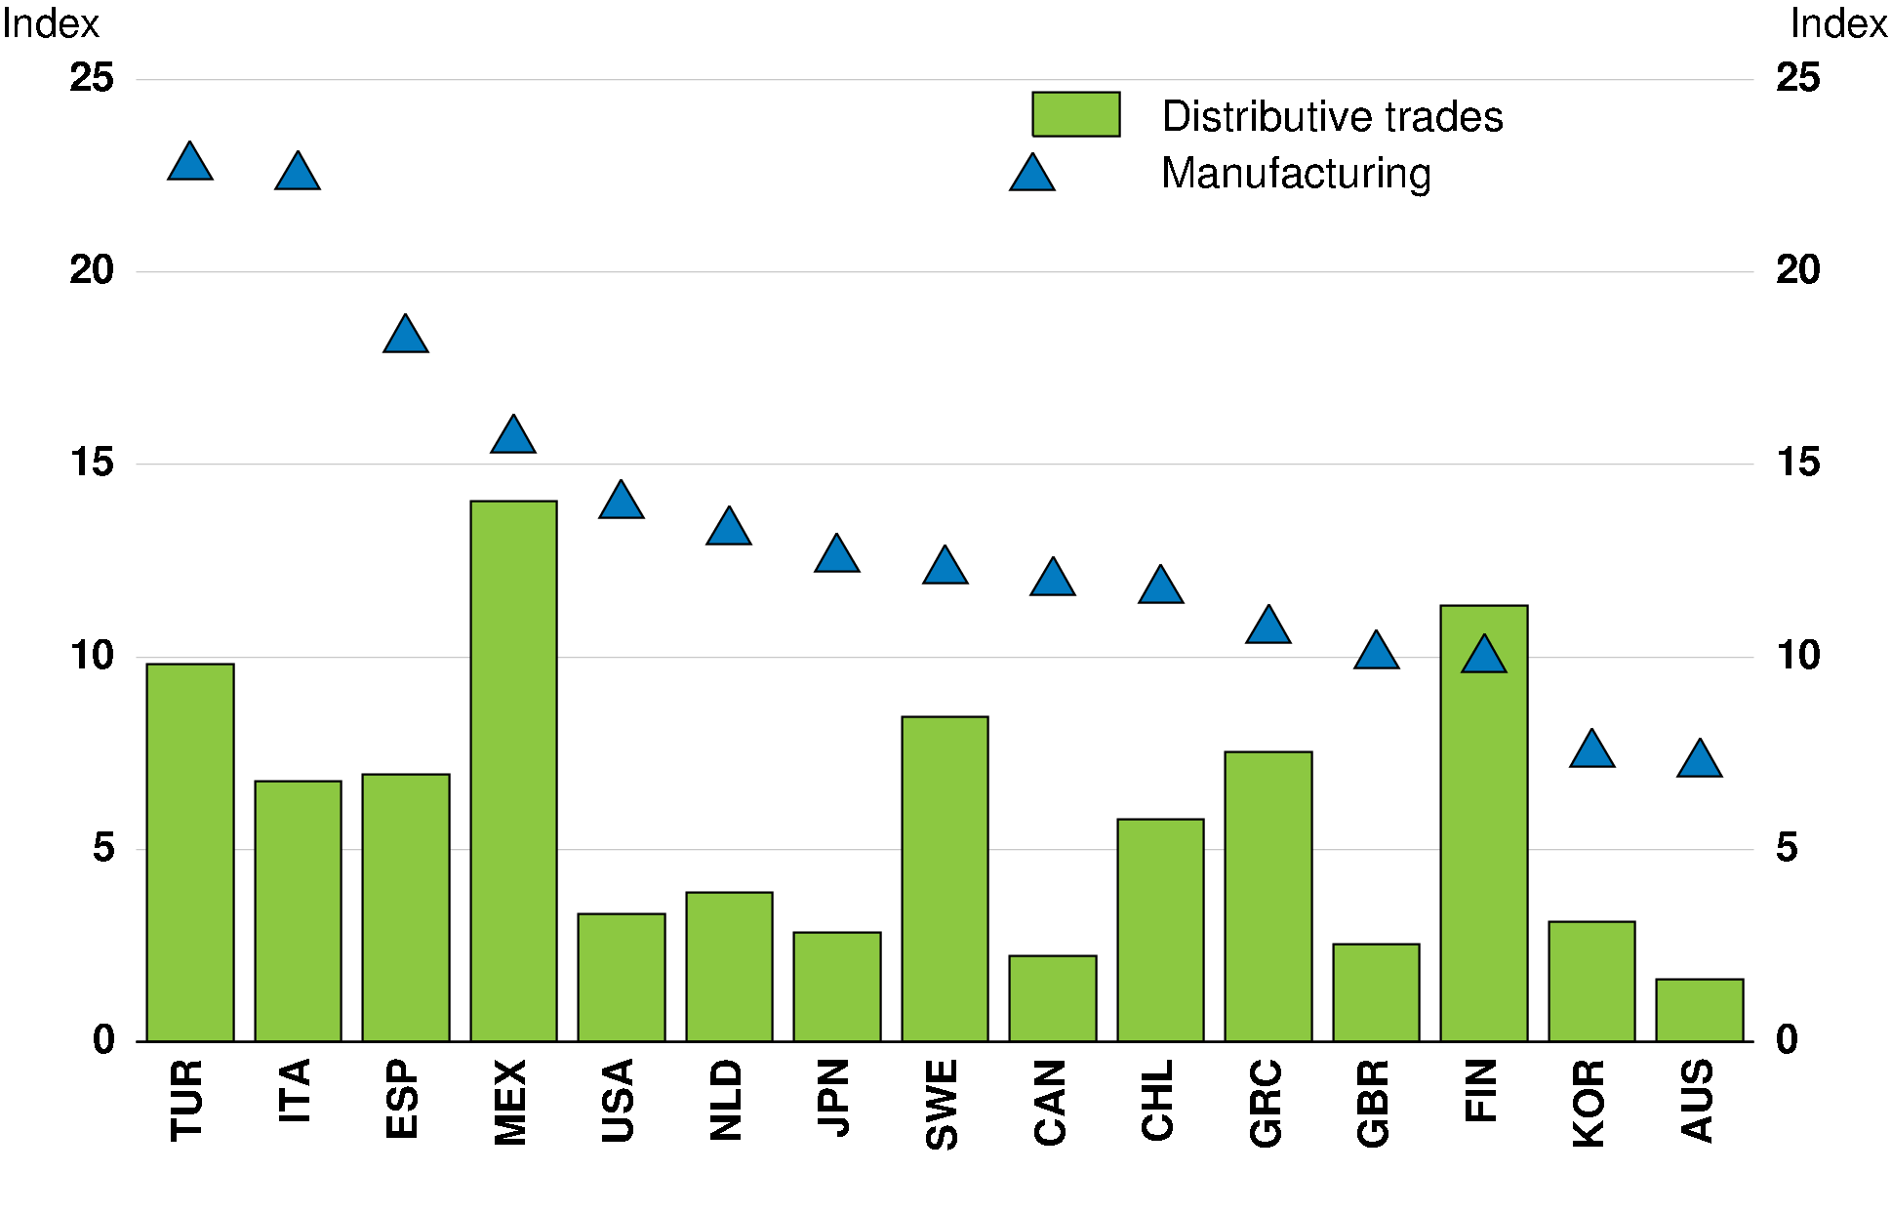
Decline in manufacturing matters because activity is regionally concentrated
Geographic concentration index by sector
Average from 2000 to 2015 or latest
More concentrated
Note: “Distributive trades” includes distributive trade, repairs, transportation and storage, accommodation and food service activities. Index measures the extent to which employment is concentrated in particular regions, varying between 0 (no concentration, where all regions of a country have the same manufacturing employment rate) and 100 (maximum concentration, where all manufacturing employment is concentrated in the smallest region). The index incorporates the size of the region and is based on OECD (2003) “Geographic Concentration and Territorial Disparity in OECD Countries”. Source: OECD Regional database; and OECD calculations.

Slide 18
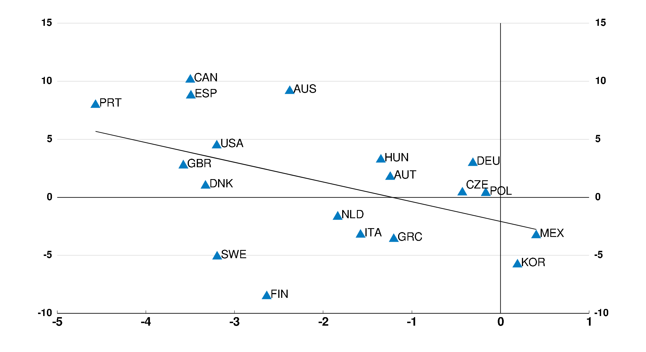
Countries with larger falls in manufacturing jobs have increased regional inequality
Change in average income inequality across regions 2000 to 2015 or latest, 90:50 percentiles ratio, % pts
Widening dispersion of regional incomes
Fall in share of manufacturing jobs
Change in national manufacturing employment rate 2000 to 2015 or latest, % pts
Source: OECD Regional database; and OECD calculations.

Slide 19
An integrated policy approach is needed to respond to structural trends and make globalisation work for all

Slide 20
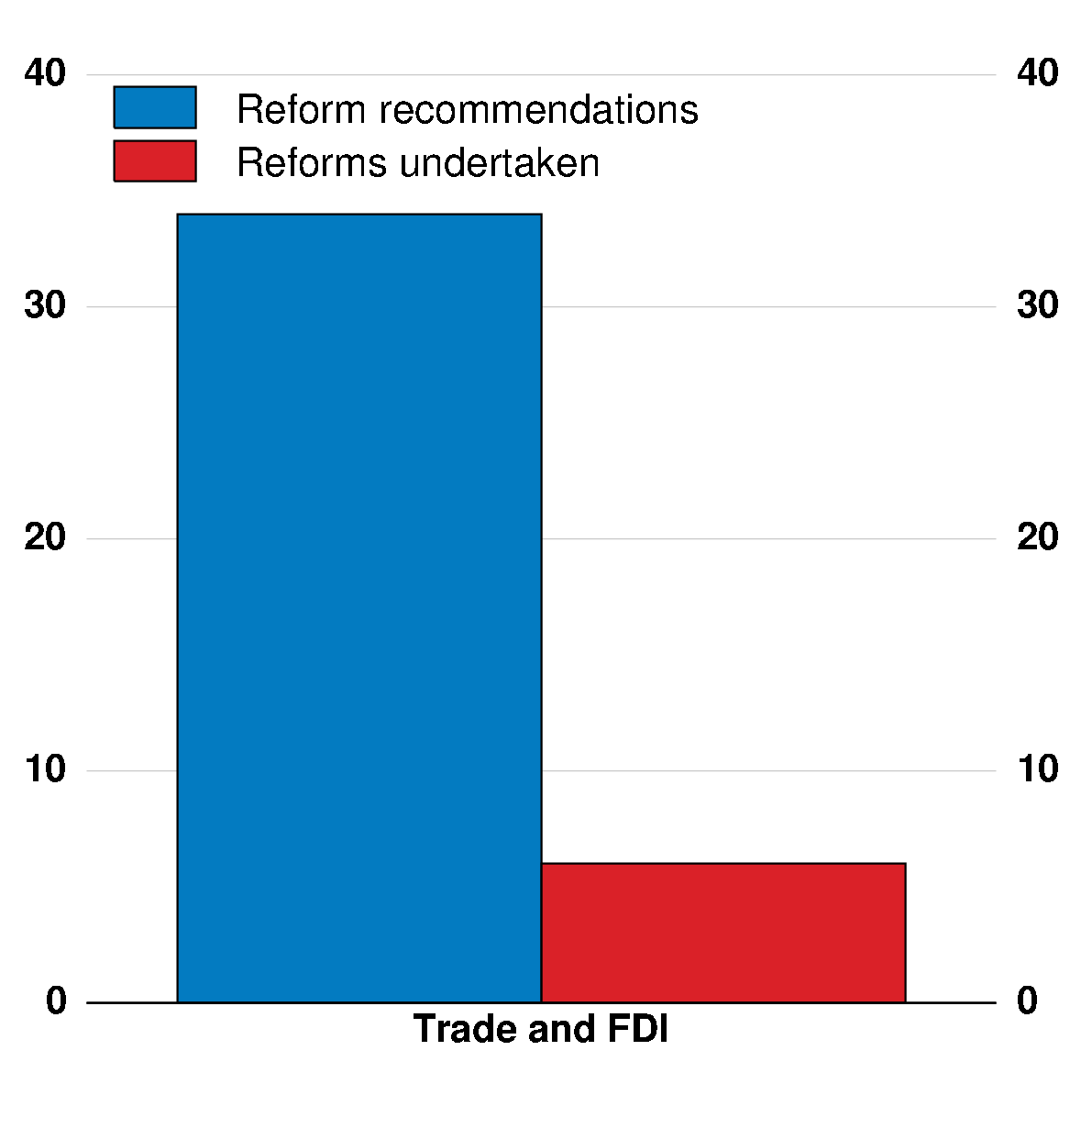
Make the international system work better, and create a more level playing field
Actions in response to OECD Going for Growth recommendations Number of reforms, 2015-16
Actions to improve the international environment:
Preserve institutions and standards, such as for labour and environmental protection
Pursue open markets for cross-border trade and investment
Promote multilateral cooperation, e.g. on tax base erosion and profit shifting and competition policy
Combat corruption, illicit trade and counterfeiting
Note: includes all OECD and BRIICS countries, the EU and Colombia.
Source: OECD Going for Growth 2017

Slide 21
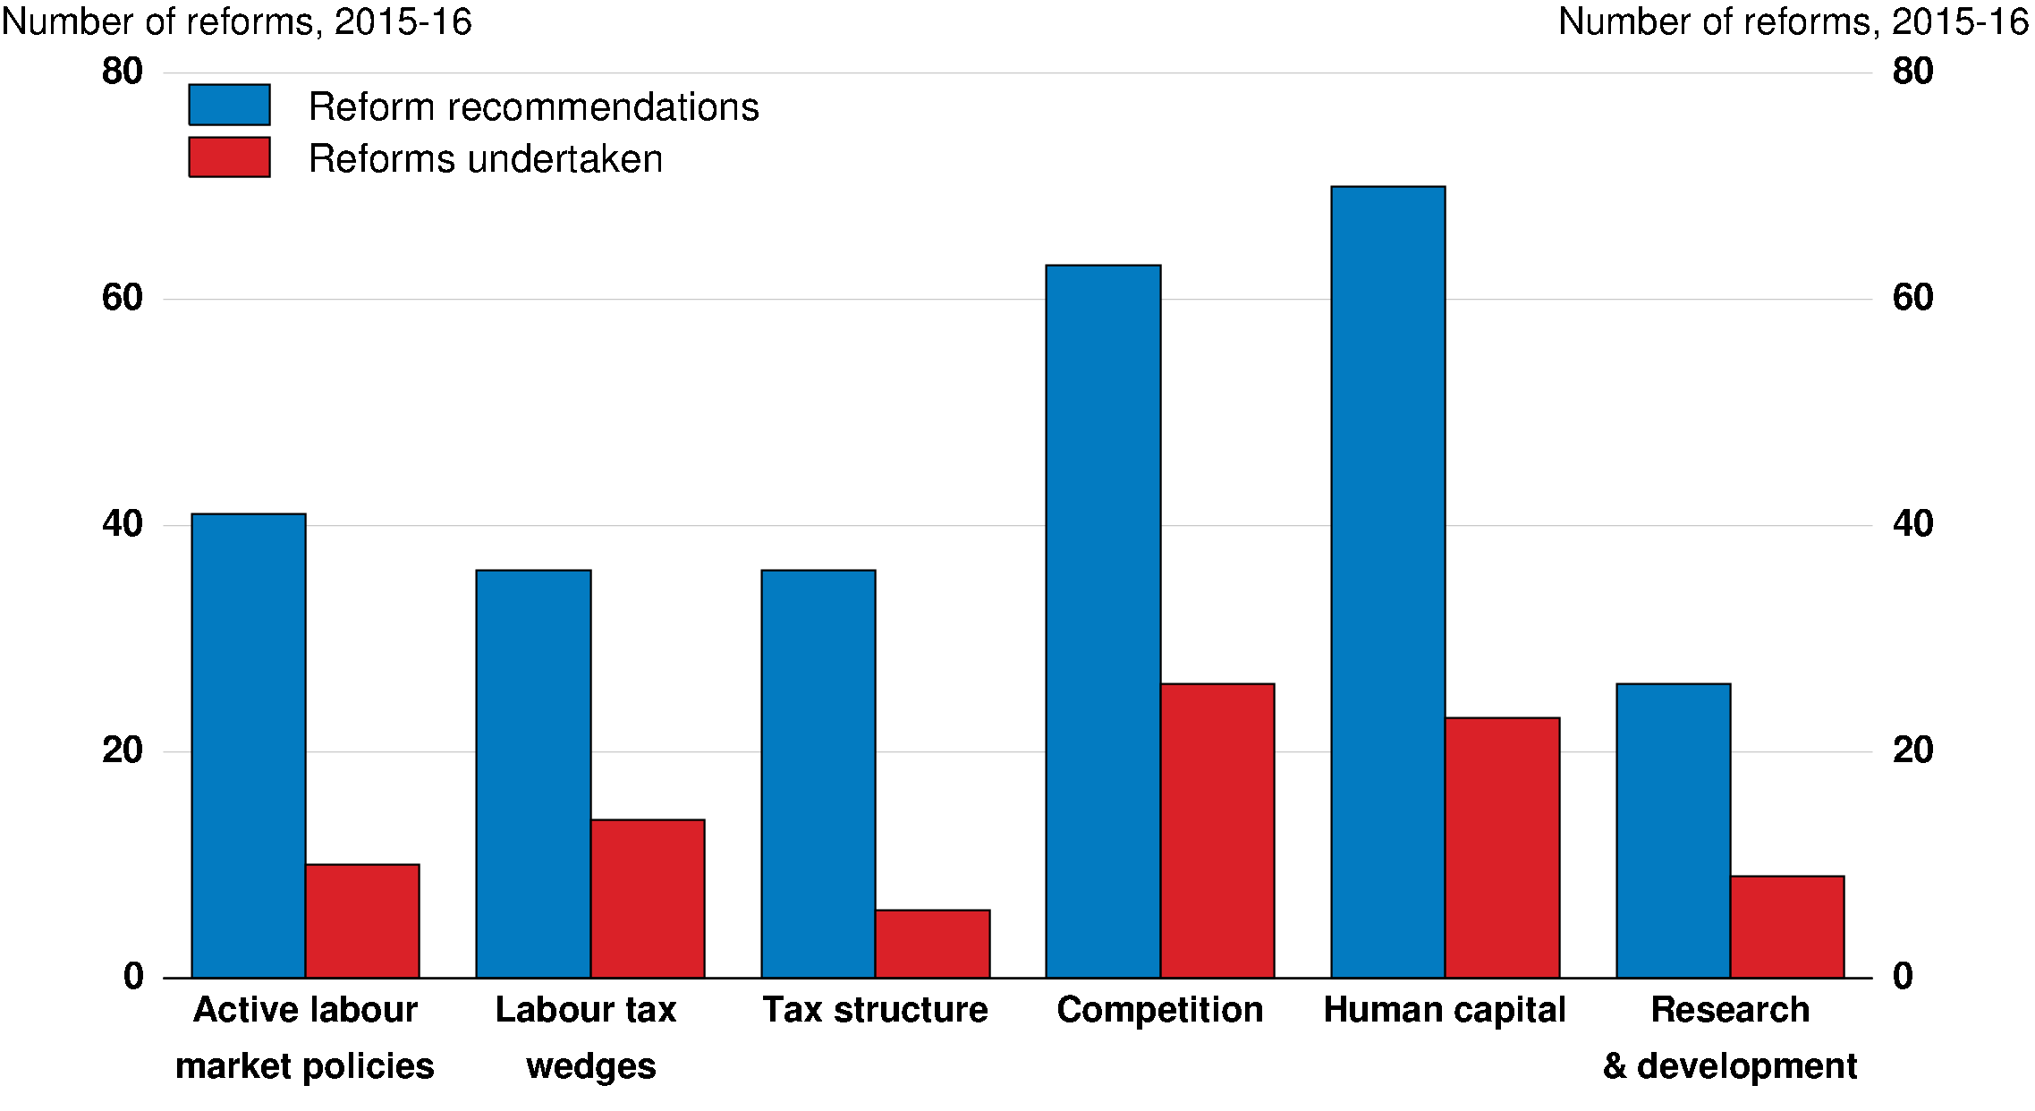
Implement domestic reform packages to strengthen inclusive growth
Actions in response to OECD Going for Growth recommendations
Note: includes all OECD and BRIICS countries, the EU and Colombia.
Source: OECD Going for Growth 2017

Slide 22
Help people and displaced workers to adapt and take new opportunities
 |  |  |  |  |  |  | Countries with OECD Going for Growth reform priority
Help laid-off workers to find a new job
Increase the scope and efficiency of active labour market policies |  |  |  |  |  |  | ARG ESP EST GBR GRC ISR ITA JPN LTU LUX LVA NLD SVN SVK USA ZAF
Boost job creation by reducing the tax wedge on low-skilled workers |  |  |  |  |  |  | BEL DEU ESP EST HUN ITA LVA NLD POL TUR
Better prepare people for work
Expand and improve vocational training and education |  |  |  |  |  |  | ARG BRA CHN DNK ESP EST FRA GBR GRC IND POL PRT TUR ZAF
Allocate education resources more equitably |  |  |  |  |  |  | CRI CZE DEU DNK FRA HUN NZL POL PRT SWE USA
Source: OECD Going for Growth 2017.

Slide 23
Act to strengthen inclusive growth and make globalisation work for all
Make the international system fairer and work better
Policies to encourage new firms, innovation & job creation
Targeted policies to help people seize new opportunities
International policies
Domestic policies

