Slide 2

Roger Lovis
RSM Technology Consulting
Digital & IT strategy
ERP & accounting systems
IT risk and security
IT resilience
System selection
IT project delivery
Roger Lovis
Partner, Technology Consulting
roger.lovis@rsmuk.com
T: (0)7976 855126

Slide 3




What’s going on out there?
Big Data & Analytics
The Cloud
How can I use technology to...
Improve service?
Manage costs?
Control operations?
Collaborate?
Mobile working
Social media
Internet of things
Internet transactions

Slide 4
Headline trends
Speed and agility
On-premise vs cloud
Accessibility & “ease of use”
Scalability
Automation
Innovation
Best of breed vs single platform solution
Personalisation
Disrupters

Slide 5
How can digital tools help my organisation achieve our objectives?

Slide 6
IT Strategy
Notes:
Broader than just ERP…fits with global vision & market positioning.

Slide 7
…[digital] technologies such as social media, mobility, and data analytics are not goals to attain…[but] are tools to get closer to customers, empower employees, and transform internal business processes
Westman, Bonnie and McAfee, “Leading Digital: Turning Technology into Business Transformation” (HBR, 2014)

Slide 8

Traditional pillars of IT strategy
IT projects need to be aligned with the business strategy, IT performance should be regularly monitored, and there should be effective communication between IT and business users.
IT
Governance
IT systems need to be suitable for business needs, data needs to be well managed and accessible and infrastructure needs to be effectively monitored and maintained.
IT staffing and IT support arrangements need to be appropriate to the level of need, with relevant skills in place and career paths and retention plans in place for staff.
Systems, Data
and
Infrastructure
IT Staffing
and Support

Slide 9
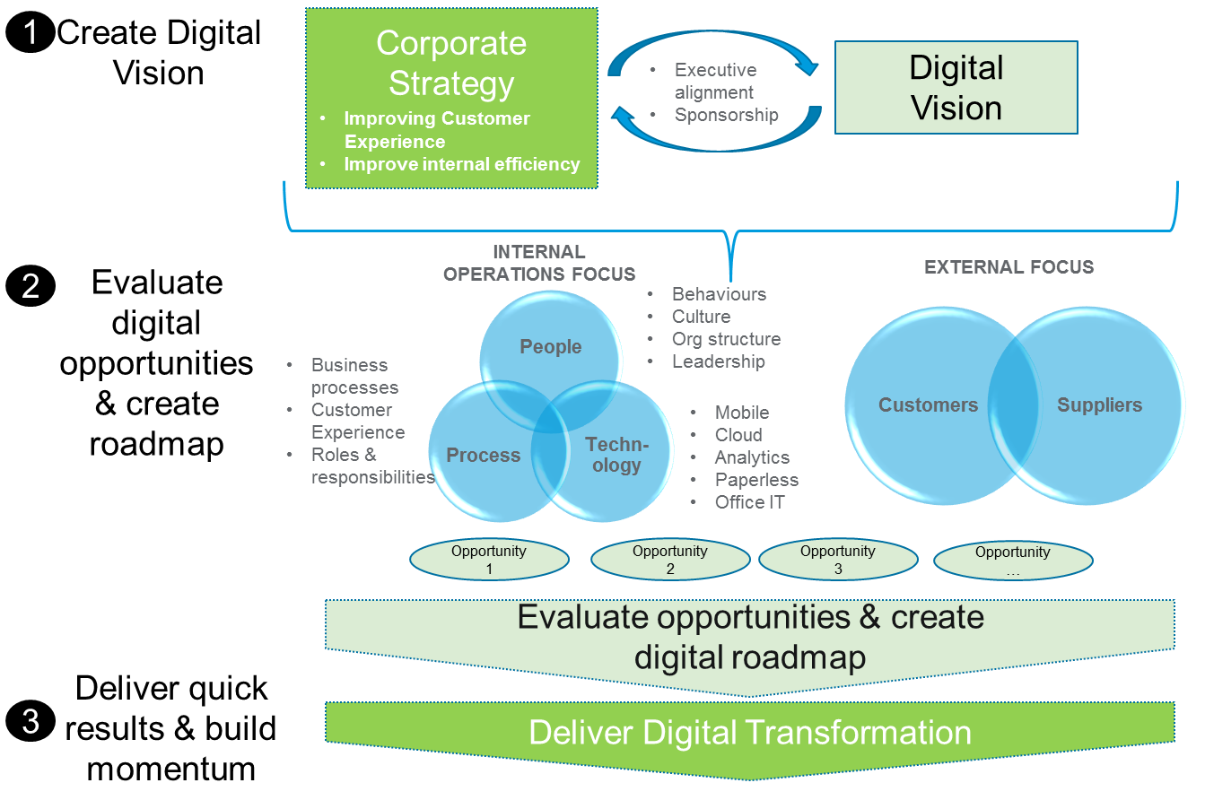
The journey – developing Digital Strategy
Notes:
Strategy is worth little if it cannot be operationalised …
Strategy horizons have shortened considerably
Agility
Collaboration
Don’t forget the soft side of strategy (skills, culture, etc)

Slide 10
How to approach digital transformation
In our experience of digital transformation, the following factors are key to success:
Create a Digital Vision
Establish clear leadership
Adopt a Continuous Improvement culture
Feedback and learning is key in digital transformation. As the organisation transforms, new opportunities will present themselves and an appropriate culture of continuous improvement is required, with staff acquiring new skills.
Select appropriate digital technologies
Create a clear vision for how digital technology can support and drive the organisation’s corporate strategy. This requires an understanding of the potential of new technology combined with a clearly defined commercial strategy
For digital transformation to succeed it requires full commitment from senior management across all functions. Therefore there has to be a clear and agreed vision that transcends departmental boundaries, with a clear sponsorship structure for digital initiatives
Our experience tells us that the best approach to digital change is to avoid dismissing early ideas in order to generate a long-list of digital initiatives, which can then be evaluated against the Digital Vision
Build momentum
No organisation can do everything at once. It is vital to be realistic with digital transformation, starting with quick wins and building momentum to drive the transformation forward.

Slide 11

Collaboration. Understanding. Ideas and insight.

Slide 12
RSM 25 Farringdon Street London EC4A 4AB
rsmuk.com
The UK group of companies and LLPs trading as RSM is a member of the RSM network. RSM is the trading name used by the members of the RSM network. Each member of the RSM network is an independent accounting and consulting firm each of which practises in its own right. The RSM network is not itself a separate legal entity of any description in any jurisdiction. The RSM network is administered by RSM International Limited, a company registered in England and Wales (company number 4040598) whose registered office is at 11 Old Jewry, London EC2R 8DU. The brand and trademark RSM and other intellectual property rights used by members of the network are owned by RSM International Association, an association governed by article 60 et seq of the Civil Code of Switzerland whose seat is in Zug.
RSM UK Consulting LLP, RSM Corporate Finance LLP, RSM Restructuring Advisory LLP, RSM Risk Assurance Services LLP, RSM Tax and Advisory Services LLP, RSM UK Audit LLP and RSM UK Tax and Accounting Limited are not authorised under the Financial Services and Markets Act 2000but we are able in certain circumstances to offer a limited range of investment services because we are members of the Institute of Chartered Accountants in England and Wales. We can provide these investment services if they are an incidental part of the professional services we have been engaged to provide. Baker Tilly Creditor Services LLP is authorised and regulated by the Financial Conduct Authority for credit-related regulated activities. RSM & Co (UK) Limited is authorised and regulated by the Financial Conduct Authority to conduct a range of investment business activities. Whilst every effort has been made to ensure accuracy, information contained in this communication may not be comprehensive and recipients should not act upon it without seeking professional advice.
© 2016 RSM UK Group LLP, all rights reserved.

