Slide 1
MENA Economic update - April 2021
Living with debt: how institutions can chart a path to recovery in the middle east and north Africa
Notes:
Thank you very much Roberta, for the very kind introduction. Good morning, good afternoon, and good evening.
This is my great honor and pleasure to be here, jointly with Ha, on behalf of the MENA Economic Update team, to present to you our semi-annual flagship report MENA Economic Update, April 2021.
Please allow me to start with a big thank you to the team.

Slide 2







Authors
Roberta Gatti
Chief Economist, Middle East and North Africa, The World Bank
DANIEL LEDERMAN
Deputy Chief Economist, Middle East And North Africa, The World Bank
ha minh nguyen Senior Economist, Office of the Chief Economist, Middle East and North Africa, The World Bank
Asif Islam Senior Economist, Office of the Chief Economist, Middle East and North Africa, The World Bank
rachel yuting fan Economist, Office of the Chief Economist, Middle East and North Africa, The World Bank
Claudio Rojas Consultant, Office of the Chief Economist, Middle East and North Africa, The World Bank
Sultan Alturki Consultant, Office of the Chief Economist, Middle East and North Africa, The World Bank
Notes:
We want to thank the team, Roberta, Daniel, Ha, Asif, Claudio, Sultan, for their incredibly hard work in this production.
Thank Daniel for his intellectual leadership.
We want to thank Roberta, our chief economist, for her push for the institutions and transparency angle

Slide 3
Main Findings
The Middle East and North Africa (MENA) region is still in crisis
MENA countries face a balancing act between short-term needs and long-run risks of public debt
Tough choices: public expenditure priorities depend on the phase of the recovery
Sunlight can help! Transparency can help chart a path to lasting recovery for MENA
Notes:
You can probably already see from the title: Living with debt: how institutions can chart a path to recovery in the middle east and north Africa
that this edition includes not only an update of the Economic Situation of the region, but also some reflections of the role of fiscal policy.
Here is our main findings of the report:
One year ago, the first cases of COVID-19 hit the MENA region. One year later, the region remains in a crisis.
The pandemic is forcing economies in the MENA region to borrow a lot. While addressing the immediate concerns of the disaster relief, MENA countries need to be aware of the tension between short-term needs and long-run risks of public debt, and a balancing act between the two would be essential.
Thus countries are facing touch choices, and public expenditure priorities depend on the phase of the recovery.
We want to emphasis that, in every stage of the recovery, transparency can help chart a path to lasting recovery for MENA.
Borrowing a sentence from our president David Malpass, sunlight is truly the best remedy.

Slide 4
A Region Still In Crisis: Long-Lasting Losses in GDP
By 2021, the regional economy is forecast to be 7.2 percentage points below the “no-pandemic” GDP level, equivalent to 227 billion dollars; GDP per capita (an indicator of the level of development that determines poverty) will still be lower than the 2019 level by approximately 5%
Notes:
MENA is still in crisis from an economic point of view.
The LHS panel is a comparison of growth in GDP levels. And the RHS is a comparison of growth in GDP per capita levels.
In both charts, the dotted lines represent the forecasts in a no-pandemic world, which is represented by MPO forecast in October 2019.
And the solid lines represent the latest forecast, one year into the pandemic, which is represented by MPO forecast in April 2021.
By end of 2021 GDP level will be 7.2 percentage points below where it was predicted to be in a no-pandemic world. This gap of 7.2 percentage points is equivalent to 227 billion dollars.
This drop results from a GDP contraction in 2020, compared to a positive growth predicted before pandemic. Add up to that, a slower forecasted growth for 2021.
This counterfactual comparison is even sharper if we look at GDP per capita levels, which is a better measure for living standards.
By the end of 2021, GDP per capita level will be 7 percentage points below where it was predicted to be in a no-pandemic world. More importantly, even with the positive growth in 2021, by end of 2021, the level of GDP per capita will still be 5% lower than its level back in 2019.

Slide 5
A Region Still in Crisis: GDP per capita Losses
Losses by 2021:
MENA: 7.0%
GCC: 7.3%
Middle-income oil exporters: 4.6%
Middle-income oil importers: 8.6%
Source: World Bank, Macro and Poverty Outlook (in April 2021 and October 2019) and World Bank staff’s calculation.
Note: The dotted lines show forecast GDP per capita levels in the counter-factual case of no pandemic (based on GDP per capita forecasts in October 2019). The straight lines show forecast GDP per capita levels in the case of pandemic (based on GDP per capita forecasts in April 2021).
Notes:
If we zoom in the loss in terms of GDP per capita, by decomposing MENA into three countries groups, then the biggest loss, compared to pre-pandemic forecast, would come from Developing oil importers (represented by red lines), followed by GCC (Gulf Cooperation Council countries, represented by blue lines), and other oil exporters (represented by gold lines).
Again, in both charts, the dotted lines represent the forecasts in a no-pandemic world, which is represented by MPO forecast in October 2019.
And the solid lines represent the latest forecast, one year into the pandemic, which is represented by MPO forecast in April 2021.
The region’s oil importing countries entered 2020 with the highest public debt. By the end of 2021, their GDP per capita will be 8.6 percentage points below where it could have been in a no-pandemic world, comparing the red dotted line and the red solid line.
This drop results from a GDP per capita contraction in 2020 and a slight recovery in 2021, compared to a 3% growth in both years in a no-pandemic world.
Last but not least from this chart, none of the country groups can return to its 2019 level by the end of 2021.

Slide 6
A Region Still In Crisis: Conservative Estimates Of Millions of New Poor
14.2 million
Notes:
Because of that, poverty is rising in the region.
In this chart, the black line represent the estimated headcount of poverty (i.e. those making less than $5.50 per day) in a no-pandemic world. And the redline is the estimated poverty headcount based on latest GDP forecasts.
The number of poor people in the region is expected to increase from 176 million in 2019 to 192 million people by the end of 2021. This is an extra 14 million people falling into poverty following the pandemic, all of whom wouldn’t have been in poverty if not hit by the pandemic.
Noted that this forecast provides only a lower threshold, because it assumes that every household is equally affected. Unfortunately, the effect of Covid‐19 is not equal to the population, and the poorer side of the population suffers most from the pandemic.

Slide 7
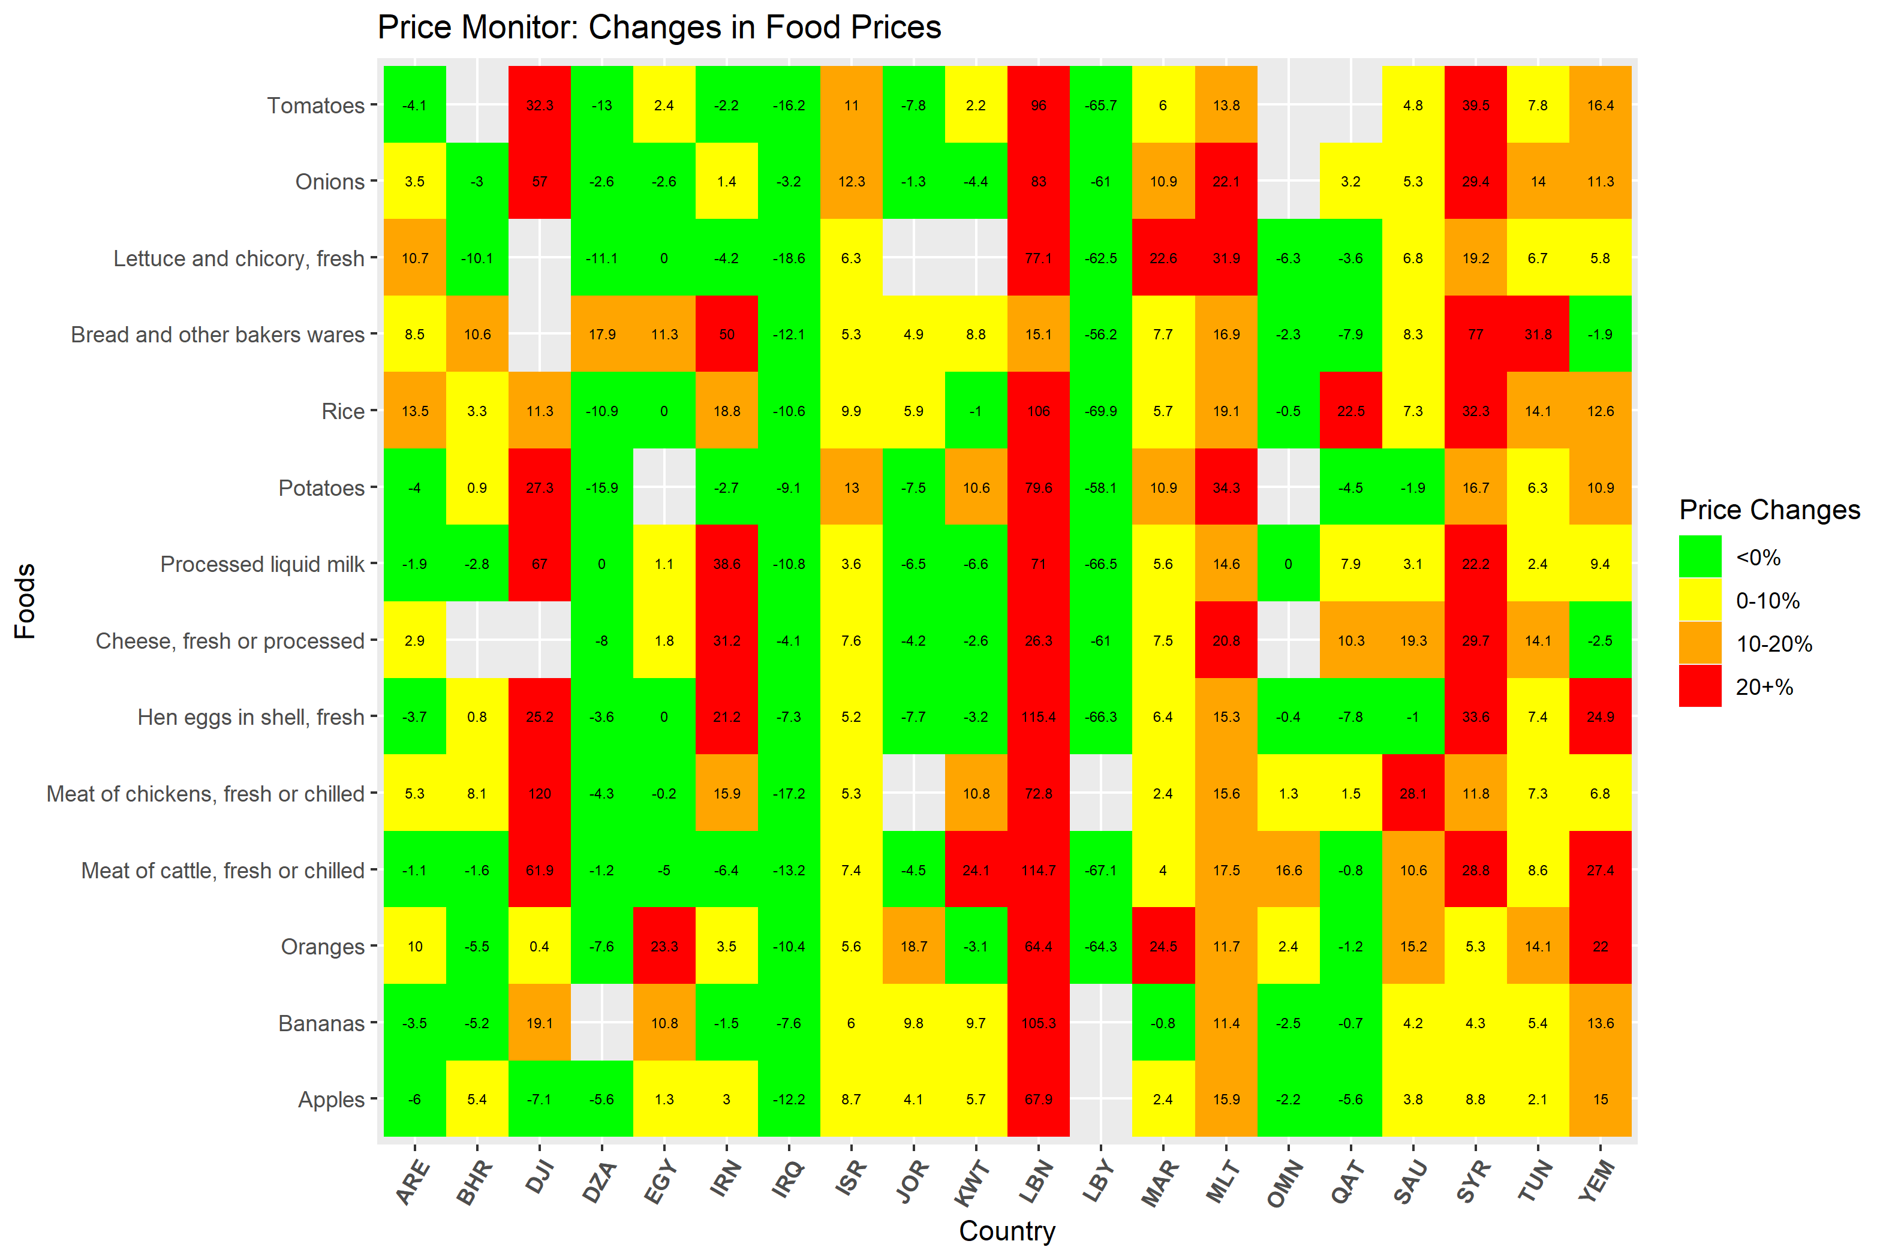
A Region Still In Crisis: Regressive Food-Price Inflation Feb 2020-March 2021
Notes:
One of the many aspects where inequality is in the rise, lies in the food price inflation.
In this chart, the horizonal axis represents countries in the MENA region, and the vertical axis represent different foods, such as rice, bread, tomatoes, etc. So each little square represent one food in one country. If the price is red, that means the food price is more than 20% compared to a year ago.
The country that’s most worrisome in this chart is Lebanon, where prices are almost all more than 20% more expensive, compared to a year ago, and some are more than 100% more expensive.
Syria, Yemen, Djibouti, Iran are also on the hot spot. Even in Morocco, prices for fruits and vegetables (oranges; lettuce) are more than 20% higher compared to a year ago.

Slide 8
Walking the Tightrope of Rising Public Debt
Balancing act is most difficult among MENA’s Middle-Income Oil-Importing economies.
Source: World Bank, Macro and Poverty Outlook (April 2021)
Note: Country groups are represented by median observation of the group. The bars show median debt of MENA country groups. The diamonds show median debt of the corresponding world’s income groups. Debt data are generally not available for MENA low income (Yemen and Syria). The high-income group in MPO is limited to only countries covered by the World Bank.
Notes:
With MENA remains in the crisis, countries are walking the tight rope of rising public debt.
The blue bars in this chart represent median public debt for each of the MENA country groups, the three bars on the left represent situations in 2019, and the three bars on the right represent median public debt in 2020.
The yellow diamonds represent world median public debt of the corresponding income group. MENA high income countries (i.e. GCC) are compared with world median of high-income countries, and MENA Middle-income oil exporters and oil importers are compared with world median of middle-income countries.
We could already see a global increase in public debt, when all three yellow diamonds moved higher in 2020 compared to 2019.
And MENA is no exception. Most worrisome are MENA oil importers that are highlighted with a red box, who entered 2020 with highest public debt.
During the pandemic, public debt in middle-income oil importers have increased from 72 to almost 90, high above the debt level of a typical world middle-income country.
MENA middle-income oil exporters had also accumulated debt, and have passed its peers in the middle income group.
For these countries, making decision about fiscal expenditure would be walking the tight rope.
My colleague Ha, will walk you through the details of this tight rope. ☺
-----------------------------------------------------------------------------------------------------
Debt/GDP is rising because of a combinations of factors:
--negative GDP growth in majority of countries, but most notably, Iraq (-11.9% in 2020); Tunisia (-8.8%); Morocco (-7%). Three exceptions (Iran: 1.7%; Egypt: 3.6% and Djibouti: 0.5%).
and rising debt. This in turn is due to:
primary deficits, which were the driving force in many oil exporters, largest in Libya (45% of GDP in 2020), but also GCC countries (e.g. Kuwait 25%, Oman: 14%; Bahrain: 12%).
a. Primary deficits were mainly due to drop in revenues: for oil exporters (Iraq: -41% drop in real revenue in 2020 compared to 2019; Lybia (-60%); UAE (-31%); Kuwait (-29%) and other GCC countries with similar magnitude); but also for oil importers, e.g., Tunisia (-6.1%); Morocco (-6.9%)
b. and in some cases, large countercyclical increases in spending, e.g., in Tunisia (real primary expenditure in 2020 was up 13% compared to 2019), Morocco (+7%). Note that many others also put together stimulus packages as well (e.g. Bahrain 4% of GDP and then partially extended; UAE: ~3% of GDP; Saudi Arabia: ~3% of GDP) although their primary expenditure did not increase as much as Tunisia and Morocco.
For example, the fiscal packages for Tunisia put together were around 2.3% of GDP (announced in March 2020 covering both 2020 and 2021), consists a combination of transfers, support to firms and sectors such as tourism in the form of interest rate subsidy and support to unemployed and self-employed (IMF)
Morocco created a special fund in early 2020 (3% of GDP) for health spending, defer social contribution, unemployment support, tax deferral, also support to informal workers (IMF).
By comparison, high income country like the US, the combined fiscal packages were much larger (11%+4% and most recent in 2021, 9% ~25% of GDP); Germany (20% of GDP as of December 2020); Japan (42% as of Dec 2020); Australia (16%) (https://time.com/5923840/us-pandemic-relief-bill-december/)
Other middle-income countries’ fiscal packages are usually <10% (Mexico ~1%; China: 5% of GDP; India: 8%; Brazil: 10%; Vietnam: 3.6%; Indonesia: 3.8%). On average, emerging markets and middle-income economies’ (EMMIEs) deployed all instruments for the fiscal response, with about 3.4 percent of GDP in expenditure and revenue measures and 2.5 percent of GDP in support through other instruments.
2. Interest payments
In some countries (Egypt), interest payments were around 10% of GDP in 2020. However, note that debt-GDP ratio in Egypt slightly declined (from 90% in 2019 to 87.5% in 2020), due to positive growth and primary balance.
These increases in public debt overlay on already worryingly high debt levels in MIC oil importers (for 2019 LB: 171% +; TN: 72% +; Egypt 90% flat; JO: 97% +) --- the MIC oil exporter IRAQ from 48% to 69%, Lybia from 49% to 137% (two factors: GDP drop 30%, and primary deficits (45% of GDP) due to drop in oil exports and oil revenue.

Slide 9
This Report
A Region Still In Crisis: Quantifies the socio-economic pain
Walking the Debt Tightrope: Articulates the tensions between immediate socio-economic needs and long-run risks in a region that already had high levels of debt in 2019
Tough Choices ahead: Discusses priorities during the pandemic, after the pandemic, and beyond
Sunlight Can Help: Highlights the role of institutions, especially transparency, in charting a path to recovery for the Middle East and North Africa

Slide 10
Walking the Debt Tightrope: Tension between Short-term Needs and Long-term Costs of Public Debt
Long Term Risks
Crowding out of private investment (as interest rate rises)
Crowding out of public investment as interest payments rise
Macroeconomic vulnerability, rollover risk, and likelihood of costly debt crises
Short Term Needs
Disaster Relief: Supporting firms and households
Public Health Spending
Notes:
Positive:
Disaster Relief: Support firms and households
Public Health Spending
Negative:
Crowding out of private investment (as interest rates rise)
Crowding out of public investment as interest payments rise
Macroeconomic vulnerability, rollover risk and likelihood of costly debt crises

Slide 11
Walking The Debt Tightrope Short-term Needs of Public Debt: Lessons From Disaster Relief
Historical Evidence:
During and immediately after disasters, debt grows faster (>2%) in disaster economies than in control group (economies-years with no disasters)
Growth plummets during disaster but recovers in the aftermath relative to control group.
Notes:
Evidence is based on over 300 episodes of severe natural disasters, with estimated reconstruction needs of at least 1% of GDP. The data cover episodes of natural disasters during 1960-2019. Sample is limited to developing economies.

Slide 12
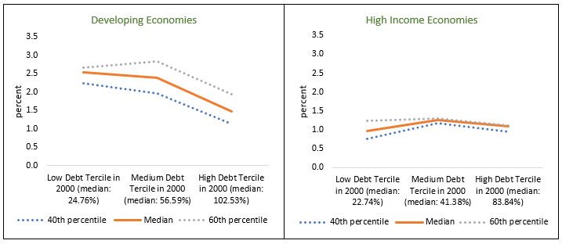
Walking the Debt Tightrope: Long-term Risks of Public Debt Association between High Public Debt and Low Growth during 2000-2019
Median Annual per Capita Growth During 2000-2019 across Countries Ranked by Central Government Debt in 2000

Slide 13
Priorities during the Pandemic: Public Spending for Disaster Relief and Public Health
During the pandemic: disaster relief, support households and firms
Aggregate demand stimulation might have little effect on GDP (the "fiscal multiplier") if the risk of Covid-19 remains
Investment in public health to save lives and generate long-term gains
Disease surveillance and data transparency
Testing and contact tracing
Vaccination campaigns
Also can reduce economic costs of the pandemic
Partial Correlation between Test Positivity Rates and GDP Downgrade
Sources: IMF, World Economic Outlook; Worldometer; Johns Hopkins University; World Bank, World Development Indicators; and World Bank staff calculations.
Note: The figure shows the partial correlation between 2020 growth adjustments between October 2020 and October 2019 and Covid-19 positivity rate (as of December 2020). The positivity rate is the number of Covid-19 cases as a percent of the total number of tests. Other explanatory variables include log of GDP per capita in 2019 (in U.S. dollars), total trade value in GDP in 2019 (percent), days since the first positive case until November 30, 2020, and tourism as a percent of exports in 2018.

Slide 14
Priorities as the Pandemic Subsides
Factors that reduce the need and efficacy of traditional fiscal stimulus | Potential benefits of (targeted) stimulus – healing economic scars
“Pent-up demand” can raise GDP without fiscal stimulus If consumers (e.g., foreign tourists) believe that the pandemic is over High debt has been associated with low fiscal multipliers (Huidrom et al., 2020) Fiscal multiplier of public investment is low when governance is poor (Izquierdo et al., 2019) | Financial constraints prevent enterprise re-entry Scarring of idled workers, particularly the young entering the labor force Support schools to recover lost human capital
Notes:
Pent-up demand: demand for goods and services are unusually strong

Slide 15
Mitigating the Costs of Public Debt after the Pandemic
Refinance maturing debt on more favorable terms by enhancing debt reporting transparency
Improving institutions: Indebted countries are more likely to enter costly debt-distressed periods when they experience low growth and weak governance.

Slide 16
Good Governance Can Help: Evidence from Episodes of Debt Distress
Note: Control group = developing countriess with no debt distress (debt restructuring) episodes
Notes:
Episodes of debt distress = episodes of debt restructuring, both “pre-emptive” and “defaults”.

Slide 17
Charting a Path to a Lasting Recovery: Sunlight Can Help!
During the pandemic
Reduce costs, accelerate recovery
Public health surveillance and transparency can reduce costs of the pandemic.
As the pandemic subsides
Raise investment’s impact
After the pandemic
Reduce costs, reduce risk
Transparency can reduce borrowing costs. Good governance can reduce the risks of debt distress.
Transparency in public investment decisions can raise its impact on economic activity (GDP)
Public health surveillance and transparency can accelerate the post-pandemic rebound (e.g., tourism; hospitality industries).

Slide 18
THANK YOU!

Slide 19
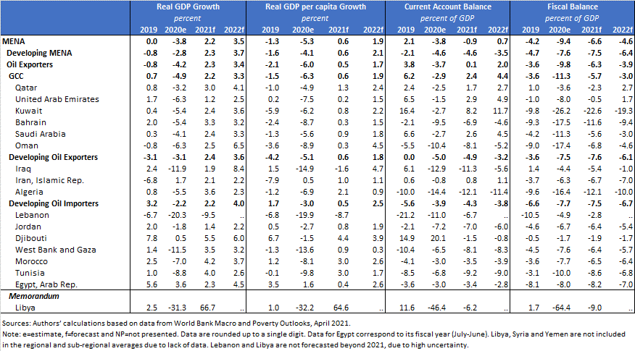
Appendix Table B1: World Bank’s Growth, Current Account and Fiscal Account Forecasts

Slide 20
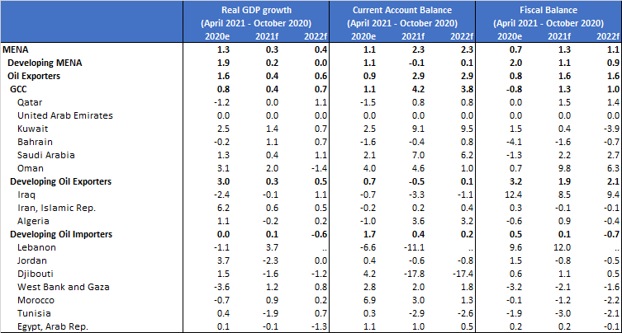
Appendix Table B2 Panel B (Between April 2021 and October 2020):

Slide 21
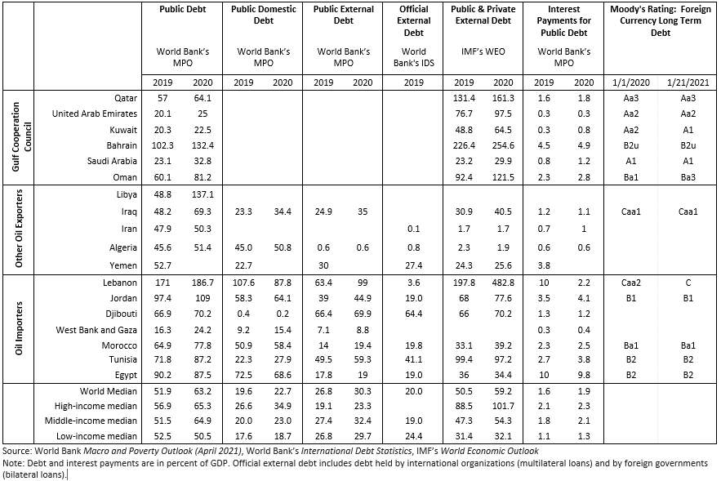
Appendix Table B3: Overview of MENA’s debt

Slide 22
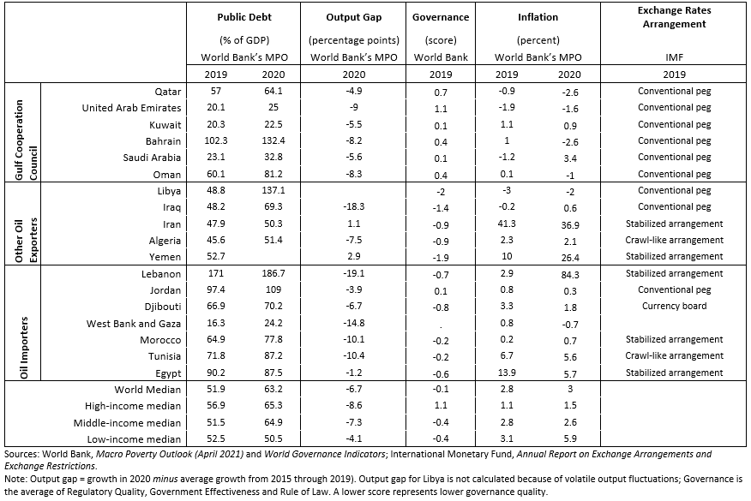
Appendix Table B4: Characteristics of MENA’s Economies

