Slide 1


Smart Enablers in Korea
Smart Rwanda days 2013 : Kigali
Smart Enablers
- Case of Korea
June 17, 2013
Wanil Choi
Research Fellow / Ph.D
National Information Society Agency
NIA
Dr. Wanil Choi
Notes:
Excellencies,
Distinguished guests,
Ladies and gentlemen,
It is a great honor for me to share our experience with you and work together for the rapid economic growth and reduction of poverty rate through smart ICT solution.
Due to the time constraint my presentation will be very condensed, however I’ll try to deliver the focal points from my presentation.

Slide 2






IT and Nat’ l Development : Past-Present-Future
Paper document
Computerization
Informatization
Creative utilization
1987
1995
2010
Information
Society
Paradigm
Now
Smart Society
Paradigm
Industrial
Society
Paradigm
Dawn of the Smart Revolution
Need for a new paradigm
Adoption
Growth
Maturity
Re-takeoff
Computerization
Informatization 1.0
Informatization 2.0
Notes:
To bring more benefits at the dawn of the smart revolution, we now need a new paradigm for another ICT revolution.
Quantum leap necessitate the correct review of current situation and robust foundation require in each ICT development stage. That is why we benchmark advanced cases.

Slide 3
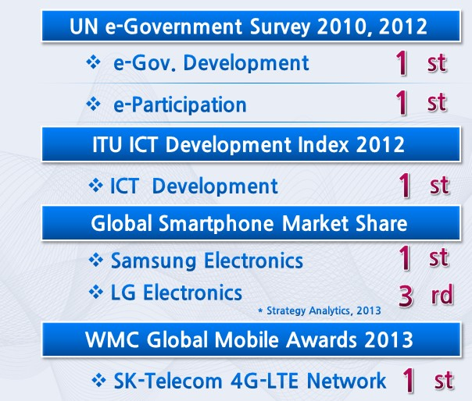

Rankings in Global IT Surveys
Notes:
The status of South Korea is that it is ranked at or near the top in several Global IT surveys in both the public and private sectors.

Slide 4
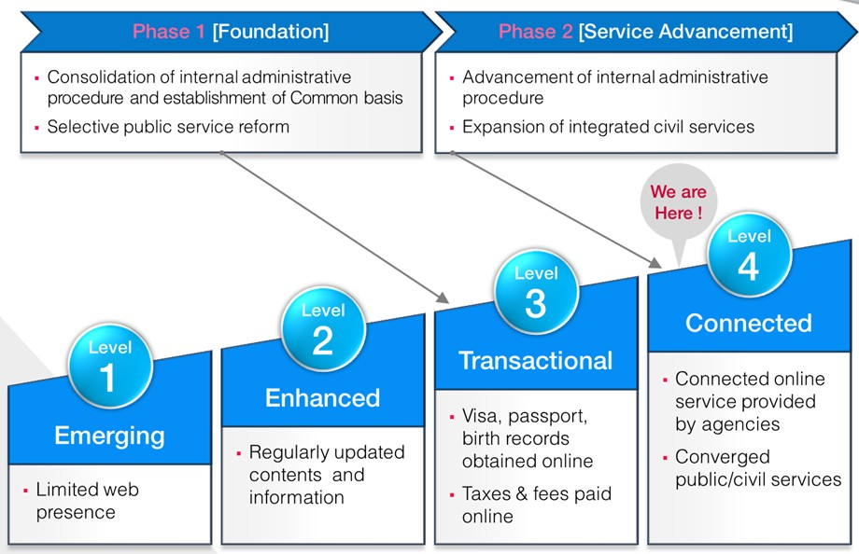
Current status of Korea’s e-Government
Notes:
This slide explains the different stages of e-Government development and current status of Korea.
According to a UN report, the Korean Government has completed Level 3 and is advancing on to Level 4.
At present, Korea has achieved 62% of the Level 4 stage.

Slide 5
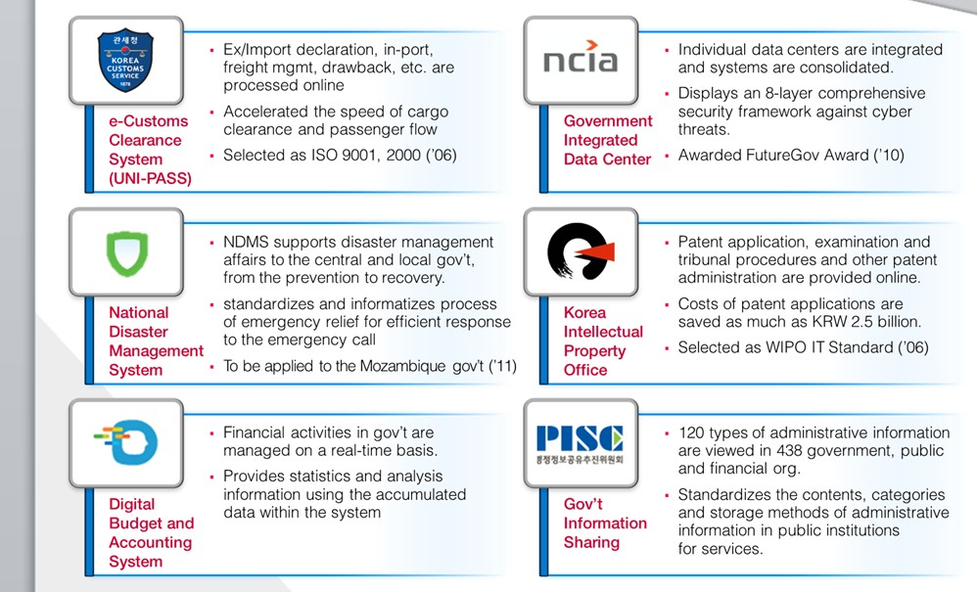
Best practices of Korea’s e-Government(1)
Notes:
This slide shows Korea’s best e-Government systems, that are widely recognized and exported worldwide.
Among them, Online Civil Service Portal, called Minwon24, and Korea National e-Procurement System called KONEPS,
Immigration Smart Service, were cited in various reports and also awarded by international organizations.

Slide 6
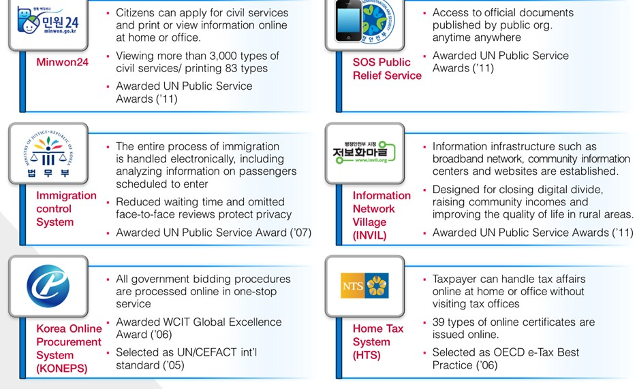
Best practices of Korea’s e-Government(2)
Notes:
Continuing on Best Practices, I would like to highlight:
NCIA (the Korean government’s Integrated Data Center), which integrated 47 government agencies’ information systems in order to consolidate and manage information security of governmental data,
And,
Public Information Sharing Center , which is an information exchange hub to better manage government information collectively.

Slide 7
Success factors of Korean e-Government
Transactional Stage
Connected Stage
Emerging Stage
Strong Government
Leadership
2. Sustained Investment
in e-Government
Budget
3. Technology Support
4. Change Management
of Public Officers'
in a Changing
e-Government
Environmenrt
5. Perforamnce-based
Program management
6. IT Governance
7. Customer Oriented
e-Government Services
Notes:
Here I provide some success factors by the Korea’s e-Government developing stages
Firstly, Strong Government Leadership.
Since the 1980s, the top government officers including the President understood the importance of e-government and actively involved in promoting it. This is why Korea was able to establish strategic and sustainable e-government plans.
Secondly, Sustained Investment in the e-Government Budget
Over the last decade, an average of 1% of the total national budget was invested into e-Government construct ion every year.
Third, Technology Support.
The Korean government has collaborated closely with system integration companies and specialized IT solution vendors that have adopted practical and efficient technology.

Slide 8
Success factors of Korean e-Government
Transactional Stage
Connected Stage
Emerging Stage
Strong Government
Leadership
2. Sustained Investment
in e-Government
Budget
3. Technology Support
4. Change Management
of Public Officers'
in a Changing
e-Government
Environmenrt
5. Perforamnce-based
Program management
6. IT Governance
7. Customer Oriented
e-Government Services
Notes:
Fourth, Effective Change Management.
To overcome issues such as public officers fear and resistance of workforce reduction, due to e-government services, change management re-training and education were carried out.
Fifth, Performance-based Program Management
To monitor and evaluate e-Government development, it is needed to set clear goals and objectives so we can measure its performance, In line with short and long-term plans.
Sixth, IT Governance.
Creation of IT Governance through establishing the specialized committee and assigning CIO, in line with legislative system is of critical.
Seventh, Customer Oriented e-Government Services
It is now an imperative for a government that we take customer-oriented approach into account to devise any e-Government services.

Slide 9
Strategic ICT Enablers
Shared ICT infrastructure
Broadband, Cloud, SNS, IoT etc.
Open data
Government Data Portal, Building of National DB etc.
Innovation infrastructure(e.g. innovation labs)
Affiliated R&D projects between industry, academy and Government
Nationwide education of computer use
School, senior citizen
Shared service across the public service(e.g. eProcurement)
Shared IT services thru GEAP and Special Task force
Institutional, legal and regulatory framework
Framework Act on Informatization, E-Government Act etc.
Security and Privacy issues
Raising and sustaining supply of Development Fund
Cultural and social environment for ICT use
Government lead ICT culture movment & Expansion of Internet access(e.g. PC room)
Needs for participation on policy making and public life via web
Effective ICT Governance scheme
Notes:
Based on the suggested scheme from the the organizing committee I briefly summarize strategic ICT enablers as shown in this slide and add some special points hereafter.

Slide 10
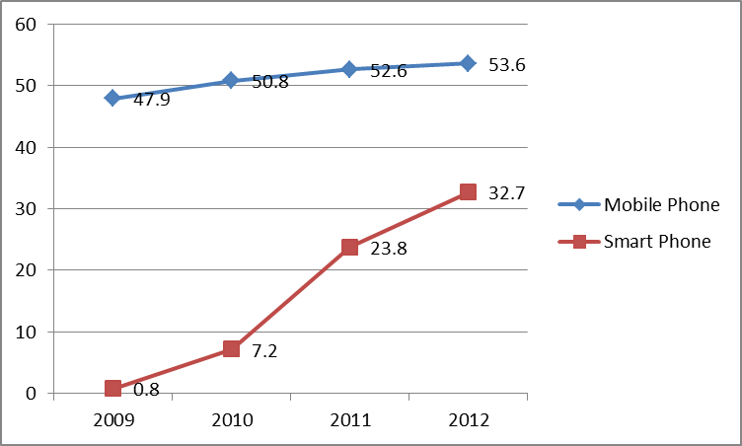
IT Status , South Korea
<Mobile/Smart Phone Subscribers>
<Broadband Leadership>
Smartphone Subscribers : 35M , May. 2013 - Population : 50M, 70% use smartphones
Exponential Growth : 2009 vs 2012 - Smartphone Users : 0.8M → 32.7M (40 times) - Wireless Data : 409TB → 51,416TB (126 times) * World Average Wireless Data : 17 times (Source : KT)
Rank | Country | Score
1 | South Korea | 157
2 | Hong Kong | 118
3 | Japan | 116
4 | Iceland | 115
5 | Luxembourg | 111
( Million subscriber )
(Univ. of Oxford, Oct. 2010)
<Avg. Measured Connection Speed>
Rank | Country | Speed (Mb/s)
1 | South Korea | 14.7
2 | Japan | 10.5
3 | Hong Kong | 9.0
4 | Switzerland | 8.7
5 | Latvia | 8.7
* Source : KCC (Korea Communications Commission), 2012.12
(Akamai, Jan., 2013)
Very high demand for mobile services
Notes:
There are approximately 35 million, or about 70% of Korean people, using smartphones in Korea now.
Smartphone users and wireless data traffic have exponentially increased, 40 times and 126 times each since 2009.
The world average growth rate for wireless data is 17 times.

Slide 11
Success factors of Korea’s IT infrastructure
Factors of advanced NW infra in Korea
The government’s aggressive and relentless efforts to implement IT infra policy
Korea's unique business model
Selection of ADSL techniques for initial Infra deployment
High priority investment to isolated and vulnerable areas from IT distribution such as schools and rural districts
Establishment of a pro-cyclical investment structure led by the government
Cultural and environmental characteristics
Virtuous circle of high speed public NW
Education of Informatization,
Dissemination policy of PC
Deregulation, competition policy
Government support
Expansion of infrastructure
Low user rate
Increase of broadband service
Private investment
Vitalization of telecom industy
Revenue increase of Telco
& Proliferation of informatization in the public sector
Notes:
The success of Korea’s high-speed broadband NW was attributable to various factors as pointed in this slide.
Among them I think that the strong government’s leading role and extra-ordinary arrangements for nationwide dissemination of internet services.
Let me take one example. To foster the supply of internet services, government devise the system of set-off refunding. Government gave financial support to the telcos who were not willing to invest money to the construction of NW infra because of the uncertainty to yield expected revenues. And deficit amount resulting from low price rate in its inception stage was set-off between Government ane telcos.

Slide 12
Korea’s Vision and Strategy on the Government Cloud Services
Vision
Realization of world best
government cloud service
WEB service and shared biz
Gov. biz to cloud environment 50% transfer
Objective
Adoption of Open OS• System S/W
Open source SW 40% adoption
IT resources cut thru sharing
IT op cost 30% reduction
Strategy
Service Oriented
Sharing
Open Based
Standardization
A1
A2
A3
A4
Fast & flexible
cloud infra
Delivery of
user-centric
cloud services
Governance
establishment
based on cloud
system
Agenda
Ensure the
foundation of
cloud vitalization
Notes:
Cloud computing becomes a main theme to adapt rapidly changing society.
Responding to the mobile environment and other smart medias like SNS, Korean government actively established national cloud computing policy and is implementing the possible objectives one by one.

Slide 13
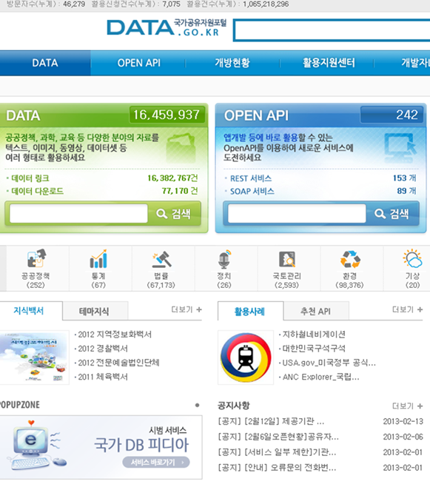
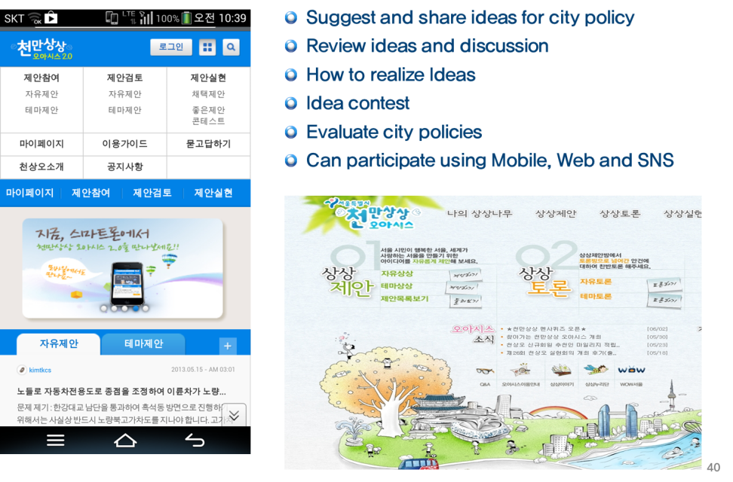
Implementation of Open Data Policy
Government Data Portal
Oasis of Millions of Creative Idea’ Seoul City
Notes:
Open data also has become critical issues not only private but public sector.
Major characteristics of Gov2.0 like participation and communication necessarily require data opened and shared betwreen gov and citizen.
We are operating the Gov data portal. And Seoul city have an excellent open data sytem named OASIS of Millions of creative Idea.

Slide 14
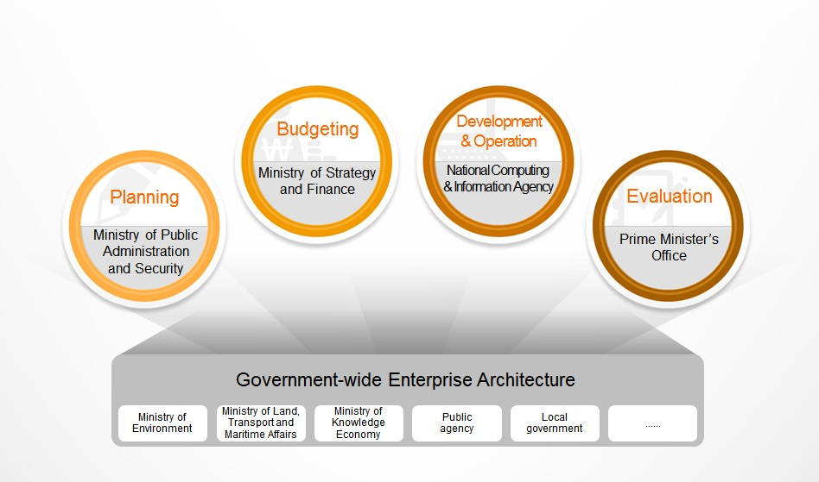
Government-wide Enterprise Architecture
Systematic and integrated governance
from planning to evaluation
Notes:
In Korea, four independent government departments as shown this slide are in charge of each four major processes of national information projects such as planning, budgeting, development and operation, evaluation. However they can communicate with a common language throughout nation informatization life-cycle because of GEA.
It can be achieved only by whole-of-government approach along with participation of all IT processes owners.

Slide 15
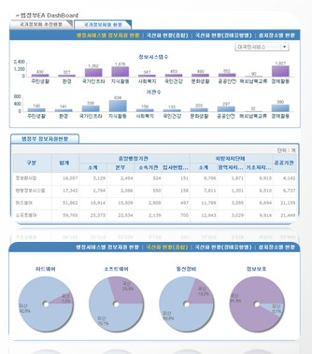
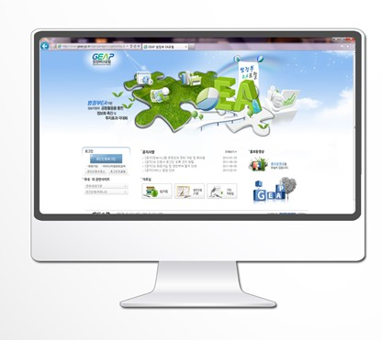
Government Enterprise Architecture portal (GEAP)
Notes:
GEA Portal serves as an IT Dashboard to provide detailed information about all public agencies’ IT resources at a glance. More than 1,400 public agencies in Korea have registered over 17,000 information systems and related national information projects through GEAP, which serves as an information resource sharing forum for all agencies. Most of all, the implementation of the Government-wide EA portal has made it possible to determine and analyze the current status of information resources efficiently, preventing information resource overlap among agencies.

Slide 16
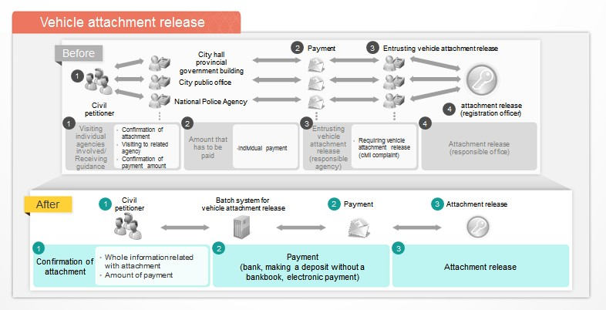
Collaboration and Integration of Government services via GEA
Notes:
This slide is an example of integrating related agency-level service into whole-of-government service due to government-wide goal.
This slide shows how the vehicle attachment release service has been changed and after integrating into whole-of-government service how many process and procedures has been decreased dramatically.

Slide 17
Vision of eGovFrame
Vision
Improve quality of e-Government services
and efficiency of ICT investment
Objectives
Reuse common functionalities
Improve
Interoperability
Up-to-date
ICT trends
Remove vendor dependency
Enhance SMEs competitiveness
Direction
Standardization
Establish SW framework standard for e-Government
Provide stable technical infrastructure
Openness
Ensure the neutrality of eGovFrame
Open all the assets to the public and global
Community
Share SW tools and technology by education
Promote the utilization of eGovframe
Notes:
We developed the e-Government Standard Framework for developing and operating the e-Government system
It not only improve the quality of e-Government services and efficiency of ICT investment but contribute to make fair competition environment created by sharing same basis
Reuse common functionalities
Improve Interoperability
Up-to-date ICT trends
Remove vendor dependency
Enhance SMEs competitiveness

Slide 18
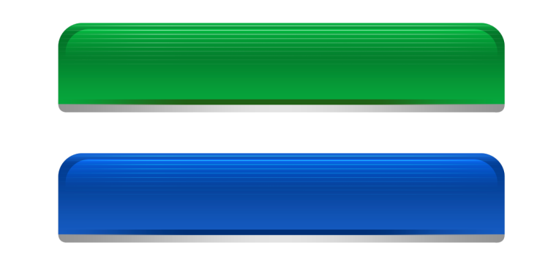
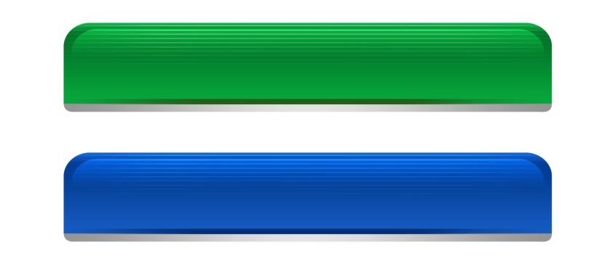

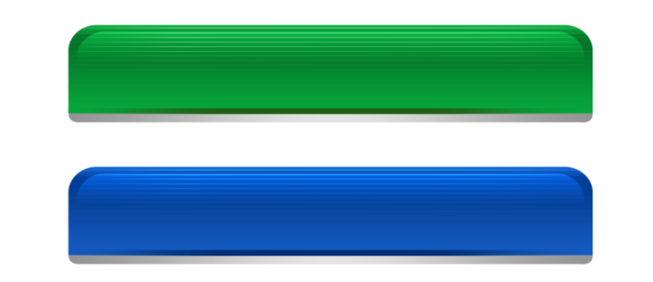
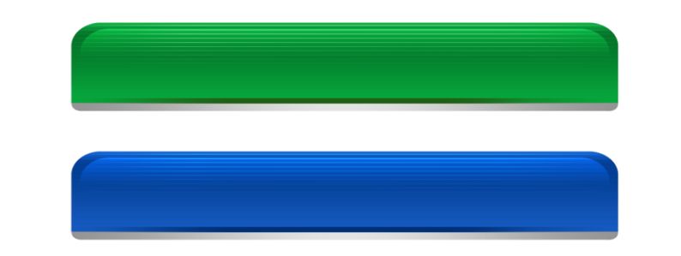






Platform approach with multi- benefits for ICT project
- Use of eGovFrame to enhance Productivity and quality
Past eGovernment Programs
eGovFrame
Current eGovernment Programs
Define
Common
Components
Reuse
Common
Components
A’ System
B’ System
C’ System
A System
B System
C System
Application
S/W
Application
S/W
Application
S/W
Application
S/W
Application
S/W
Application
S/W
Common
functions
Common
functions
B
B
B
Common
functions
B
B
B
B
C
C
C
C
C
F/W
F/W
F/W
F/W
F/W
H/W
H/W
H/W
Define
Standard
Framework
Framework
Apply
Standard
Framework
H/W
H/W
H/W
Duplicate development of the same feature in each project
Business dependency in subsequent projects
Limited opportunities for small business bid
Development based on the standard framework
Productivity and quality improvement by reusing common components
Management
eGovFrame Center
Management System for
eGovFrame
Notes:
eGovFrame’s main philosophy is the platform approach with multi- benefits for ICT project.
It has two basic ideas as following:
Development based on the standard framework
Productivity and quality improvement by reusing common components

Slide 19
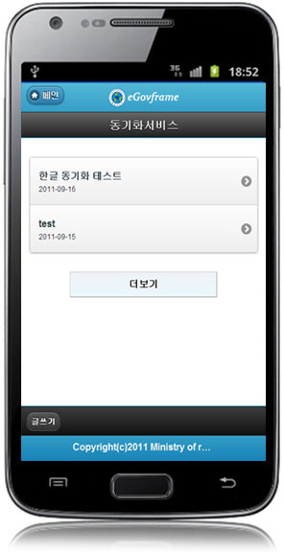
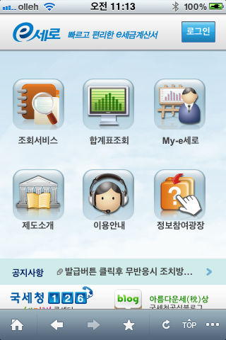
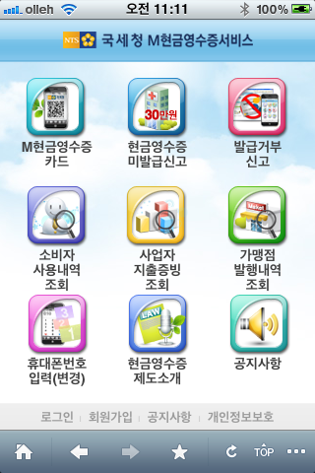
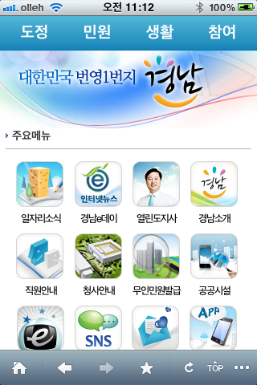
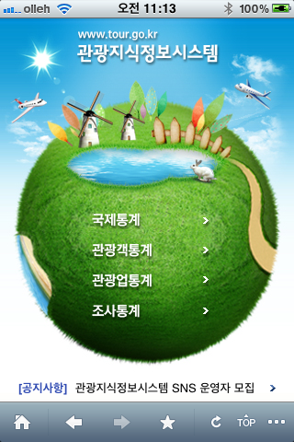




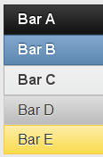
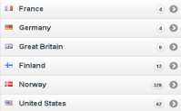
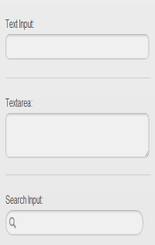




Applied cases of Mobile features
m-invoice
m-tax
m-administration
m-tour
Button icons
Header bars
Inline buttons
icon
Header bars
Navbars
Grouped buttons
Basic list
Footer bars
Icons list
Footer bars
Form element gallery
Button icons
Footer bars
Popup event
bar
Notes:
This slide shows the applied cases of mobile features using e-Govframe.
Continuing improvement is being made to adapt new ICT environment.

Slide 20



The Emergence of Smart Age
Enter “Smart Society,” a Megatrend leading paradigm shift of society
Going beyond information and ubiquitous society, we have already entered into the Smart Society where IT solves social issues and creates new values
Information Society
Ubiquitous Society
Smart Society
Putting the offline world online
Efficiency, Service Innovation
Connections of offline and online (IT and non-IT)
IT in everyday lives
On/Offline Convergence (Human-centric IT)
Value creation and problem solving through smart technology/value
Key concepts leading the change towards a Smart Society that can create new values include;
‘Sharing-Communication-Openness’,
‘Innovation-Cooperation-Creativity’, ‘Platform’
Notes:
Smart society has more strength to solve social issues effectively and produce new value than before.
Tha core key word are “sharing, communication and openness”, “innovatio n-collaboration-creativeness”, “Platform”.
Smart solution should naturally take into consideration them. And experts comments that simplicity is one of the critical characteristics. For customer-oriented services becomes major directions in the smart society.

Slide 21
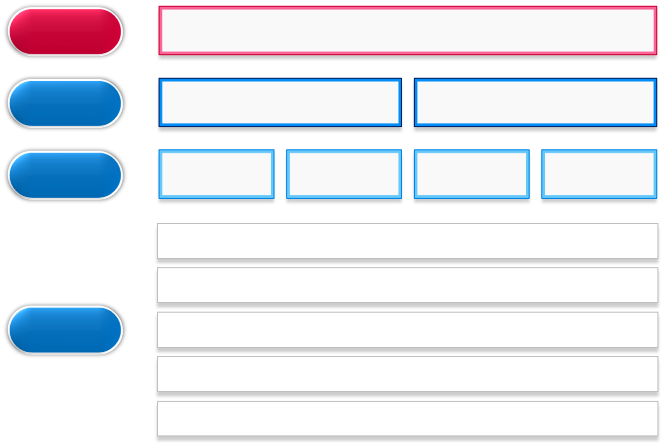

Towards Smart Government in South Korea
Realize a world best Smart e-Gov in tune with the people
Vision
Goals
Global e-Government Leader
World best
e-Government services
Strategy
Openness
Integration
Collaboration
Sustainable Green growth
Realize a world best m-Government
Establish a safe and warm society
Agenda
Promote smart work that balances work and life
Provide personalized services by communicating with citizens
Build a strong e-Government infrastructure
Notes:
New innovative national strategies that apply Smart ICT are needed to respond “smartly” and actively to today’s changing environment.
This is what we in Korea refer to as the “Smart e-Government” Strategy, composed of 5 agendas shown here.
Five key agendas that reach out beyond the limit of current e-Government include:
Firstly, the realization of the world’s best mobile e-Government is considered the most important one of the 5 agendas.
Second,
Third,
Forth,
Finally

Slide 22


Emergence of Smart Age and the New Role of IT
IT has changed from a core tool for efficiency to a
platform for open innovation and creative collaboration
Role of IT
[ AS IS ]
[ TO BE ]
Information Society
Smart
Society
IT = enabler
IT = platform
Increased
Productivity
Enhanced
Efficiency
Diversified Services
Problem Solving
Value Creation
New Service Expansion
Notes:
IT has undergo the changing role from the core instrument of efficiency to
the platform of open innovation and creative collaboration.

Slide 23




Realization of Smart-Government
Smart-Government
An advanced government promoting the use of public services and active citizen participation, anytime, anywhere through integration of smart devices and government services
C2CG
Citizen to Citizen&Gov
G2C
Gov to Citizen
G2G
Gov to Gov
Smart services for collaboration
Smart civil services
for citizen’s convenience
Smart administrative services for efficiency
Civil reporting on Smart Device, e-Poll, Idea suggestion, Policy discussion, Self supporting security, etc
Smart-Gov portal, Smart home tax, Real-time road traffic, Train ticket reservation, Smart-Tourism, Health/Drug Information, etc ( 1220 services , Nov. 2012 )
Smart internal office work - Smart memo reporting, Government SNS, etc
Smart field work - Fire/Disaster Management, Population Census, Verification of a vehicle tax payment, etc
Smart-Government Security Infrastructure
Notes:
In order to realize m-Government, 3 kinds of services are required.
That are C2CG, G2C, and G2G.
Among these C2CG is the most characteristic type in the smart government
First, C2CG. This means the services from citizen to citizen and government. Mobile services are used for collaboration between citizens and government. This is the type of service based on creative people power.
Second is a G2C type. Government provides valuable information to citizens, such as tax information, road traffic conditions, health, etc. Citizens can get real-time information at anywhere and anytime.
Third, G2G is for enhancing government officials productivity and their convenience, for example, work reporting processes, disaster management out in the field, etc.

Slide 24
Conclusion
EU : Enablers of ICT-driven Public sector innovation under horizon 2020 |  | Korea | Rwanda
Infra & processes | Cloud, EA, Methodology, PET, e-ID SNS, API, web3.0, Robot | Actively focusing on this point now | Cloud, EA, Methodology, PET, e-ID are Critical for advanced ICT. To build competency in this area is important
Open data & big data | Analysis of big data and visualization Opening public data | Important emerging issues both public and private sectors | Systematic accumulation of public data and preparation of open data technology
Policy modeling and making | Use of big data, mobile platform, AI to solve socio-economic issues | Some are in planning and | Research of proto-type of Rwanda mobile platform
Measurement and monitoring | Service performance measurement thru ICT tech, & tool | Strong emphasis on this now | Not yet, but preparation of structure
Civil servants & working practices | Cultural change ICT skill, problem solving & collaboration , service mind | Same and focal point | Same and focal point
Notes:
Analysing the EU’s recent research on the enablers of ICT-driven public sector innovation and Korea’s approach to Smart society, I ‘d like suggest some actionable considerations for Rwanda. Most of EU research agendas generally coincide with what we have thought and are taking actions.
The five categories might be generally included in the smart Rwanda program 3.0. The constraint of physical and human resources and capabilities will be barriers to achieve the vision. But taking step by step approach and applying smart strategy with strong passion for national development thru ICT can overcome those obstacles.
Infra & process has been and will always be the key enablers of ICT. Cloud, EA, methodology, PET, e-ID are critical for advanced ICT. To build independent competency in this area is very important.
Systematic data governance policy and the accumulation of basic public data is the prerequisite to next generation data policy and technology.
,
Research on proto-type of Rwanda mobile platform is challenging and killer application applicable to the whole Africa should actively .
Last, civil servants and working process is as essential in starting country as advanced country.

