Slide 1
Chapter-3
Introduction to Verilog HDL
FPGA Design flow using Verilog HDL

Slide 2
Hardware Description Languages
In the beginning HDLs were developed as a ‘standard way’ of drawing circuit schematics.
Modeled the interface of circuits, described how they were connected
Allowed connections between these modules
Supported some common logic functions
AND OR NOT XOR
Multiplexers
The functionality of hardware
concurrency
timing controls
The implementation of hardware
structure
net-list

Slide 3
History of HDLs
ISP (circa 1977) - research project at CMU
Simulation, but no synthesis
Abel (circa 1983) - developed by Data-I/O
Targeted to programmable logic devices
Not good for much more than state machines
Verilog (circa 1985) - developed by Gateway (now Cadence)
Similar to Pascal and C
Delays is only interaction with simulator
Fairly efficient and easy to write
IEEE standard
VHDL (circa 1987) - DoD sponsored standard
Similar to Ada (emphasis on re-use and maintainability)
Simulation semantics visible
Very general but verbose
IEEE standard

Slide 4
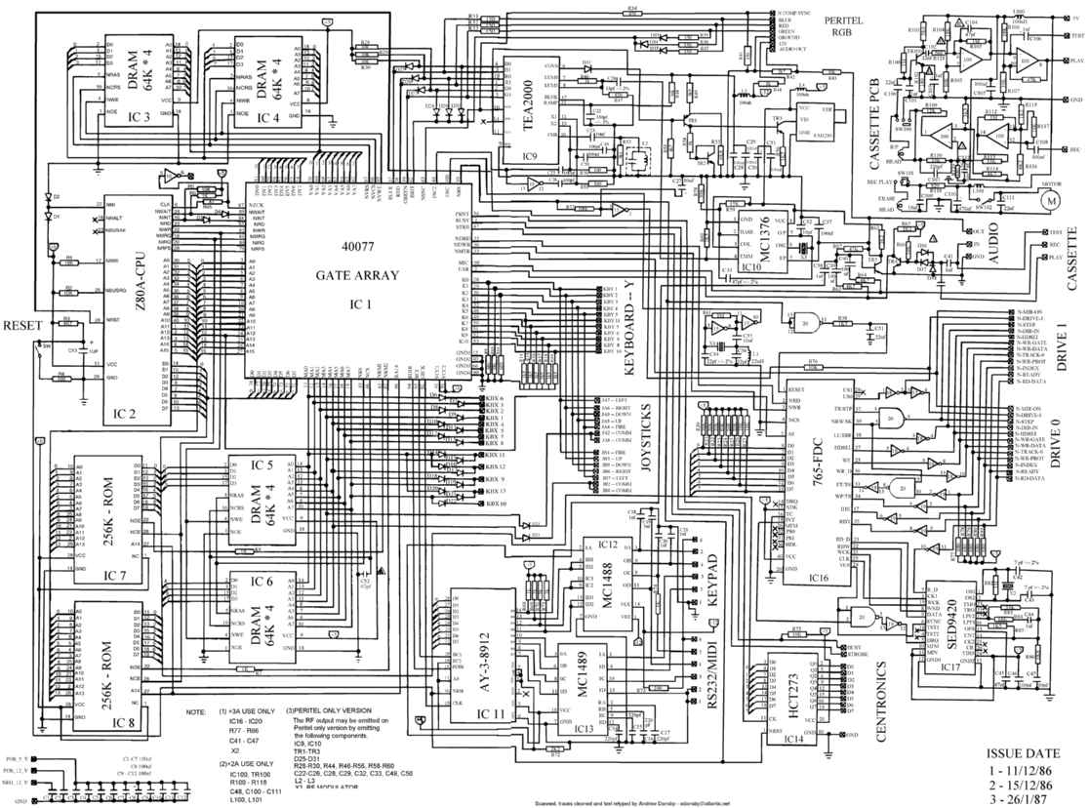
Convenient Way of Drawing Schematics

Slide 5
Convenient Way of Drawing Schematics
It is standard
Everybody will interpret the schematic the same way
It is not proprietary
HDLs are not tool specific
It is machine readable
It is easier for computers to understand the circuit
Only later on additional benefits were discovered
Simulation and Synthesis

Slide 6
Two Hardware Description Languages
Verilog
developed in 1984 by Gateway Design Automation
became an IEEE standard (1364) in 1995
More popular in US
VHDL (VHSIC Hardware Description Language)
Developed in 1981 by the Department of Defense
Became an IEEE standard (1076) in 1987
More popular in Europe
In this course we will use Verilog

Slide 7
Introduction and Basic Concept
What is Verilog?
Hardware Description Language(HDL)
Why use Verilog?
Because 60% of US companies use it.

Slide 8
Verilog
What’s an HDL?
Textual description of a circuit.
Human and machine readable.
Hierarchical.
Verilog is NOT A PROGRAM
Describe what the circuit IS.
Not what is DOES.

Slide 9
Why Verilog?
Why use an HDL?
Describe complex designs (millions of gates)
Input to synthesis tools (synthesizable subset)
Design exploration with simulation
Why not use a general purpose language
Support for structure and instantiation
Support for describing bit-level behavior
Support for timing
Support for concurrency
Verilog vs. VHDL
Verilog is relatively simple and close to C
VHDL is complex and close to Ada
Verilog has 60% of the world digital design market (larger share in US)

Slide 10
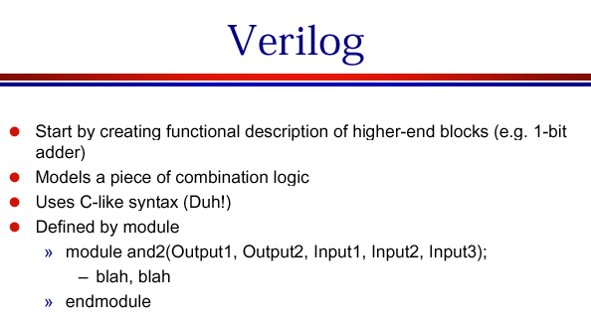
Why Verilog?

Slide 11
Modeling Structure: Modules
The module is the basic building block in Verilog
Modules can be interconnected to describe the structure of your digital system
Modules start with keyword module and end with keyword endmodule
Modules have ports for interconnection with other modules
Module AND <port list>
•
•
•
endmodule
Module CPU <port list>
•
•
•
endmodule

Slide 12
Verilog HDL and Verilog-XL
Verilog HDL
Hardware design language that allows you to design circuit.
Verilog-XL
High speed, event-driven simulator that reads Verilog HDL and simulates the behavior of hardware.

Slide 13
Modern Project Methodology
Always
inst1
inst2
inst3
Synthesis
mapping
Place and Route
clb 1
clb 2

Slide 14
Levels of design description
Algorithmic level
Level of description
most suitable for synthesis
Register Transfer Level
Logic (gate) level
Circuit (transistor) level
Physical (layout) level

Slide 15
Different Levels of Abstraction
Algorithmic
the function of the system
RTL
the data flow
the control signals
the storage element and clock
Gate
gate-level net-list
Switch
transistor-level net-list

Slide 16
Register Transfer Level (RTL) Design Description
…
Combinational
Logic
Combinational
Logic
Registers

Slide 17
Verilog for Digital System Design
Structural description
net-list using primitive gates and switches
continuous assignment using Verilog operators
RTL
functional description
timing controls and concurrency specification
procedural blocks (always and initial)
registers and latches
C + timing controls + concurrency

Slide 18
Behavioral vs Structural
Behavioral description describes functionality of design. It is independent of implementation.
There is a one-to-many mapping between a behavioral module and a structural module.
Structural description defines and decides on an implementation of a module.
Here we map the design to actual cells/gates.

Slide 19
Behavioral vs. Structural (2)
Rule of thumb:
Behavioral doesn’t have sub-components
Structural has sub-components:
Instantiated Modules
Instantiated Gates
Instantiated Primitives
Most modules are mixed
Obviously this is the most flexible

Slide 20
Behavioral vs. Structural

Slide 21
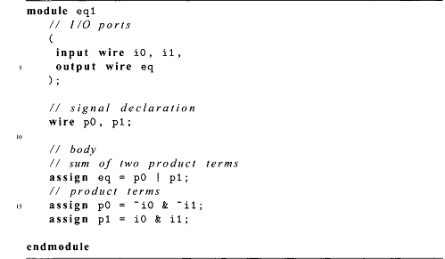
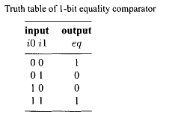
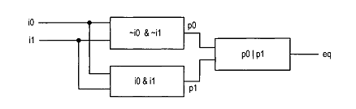
Consider a I-bit equality comparator with two inputs, iO and il, and an output, eq. The eq signal is asserted when iO and il are equal. Assume that we want to use basic logic gates, which include not, and, or, and xor cells, to implement the circuit. One way to describe the circuit is to use a sum-of-products format. The logic expression is
Gate-level implementation of a I-bit comparator
Graphical representation of a comparator program.

Slide 22
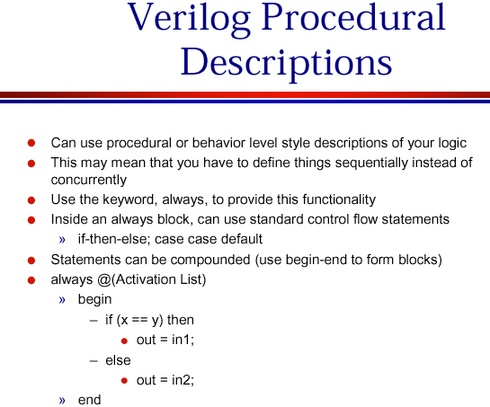

Slide 23
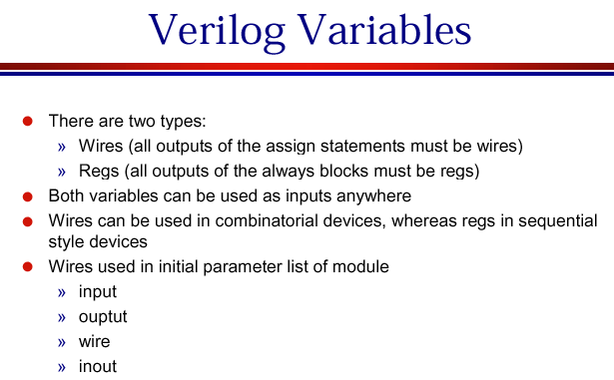

Slide 24
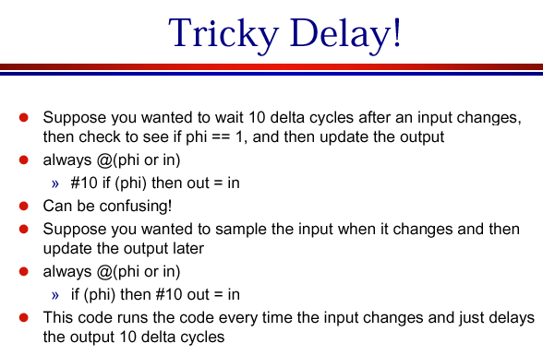

Slide 25
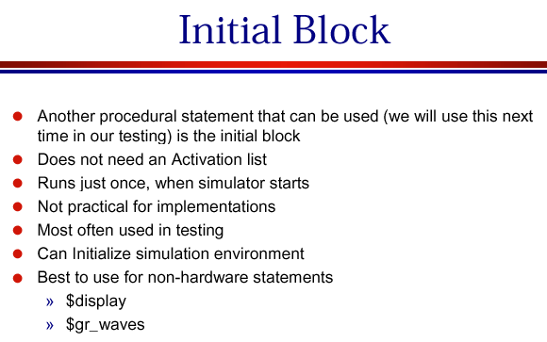

Slide 26
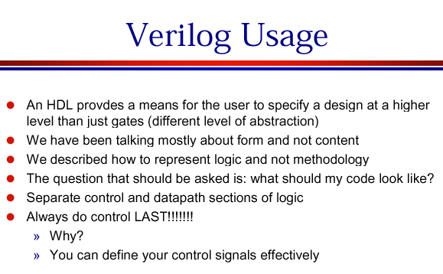

Slide 27
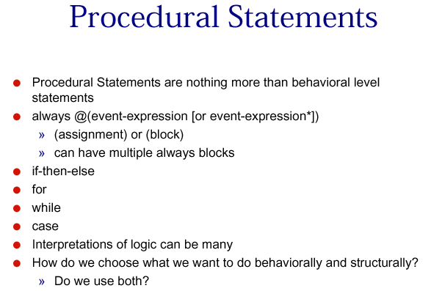

Slide 28
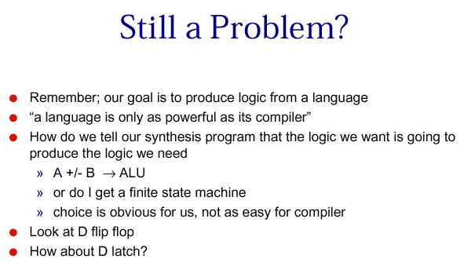

Slide 29
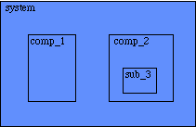
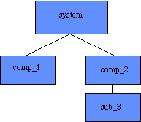
Hierarchical structure and Modules
Represent the hierarchy of a design
modules
the basic building blocks
ports
the I/O pins in hardware
input, output or inout

Slide 30
Event Driven Simulation
Verilog is really a language for modeling event-driven systems
Event : change in state
Simulation starts at t = 0
Processing events generates new events
When all events at time t have been processed simulation time advances to t+1
Simulation stops when there are no more events in the queue
Event
queue
0
t t+1
•••
•••
Events

Slide 31
Modeling Structure: Modules
The module is the basic building block in Verilog
Modules can be interconnected to describe the structure of your digital system
Modules start with keyword module and end with keyword endmodule
Modules have ports for interconnection with other modules
Module AND <port list>
•
•
•
endmodule
Module CPU <port list>
•
•
•
endmodule

Slide 32
Modeling Structure: Ports
Module Ports
Similar to pins on a chip
Provide a way to communicate with outside world
Ports can be input, output or inout
Module AND (i0, i1, o);
input i0, i1;
output o;
endmodule
i0
o
i1

Slide 33
Modeling Structure: Instances
Module instances
Verilog models consist of a hierarchy of module instances
In C++ speak: modules are classes and instances are objects
AND3
i0
i1
i2
o
Module AND3 (i0, i1, i2, o);
input i0, i1, i2;
output 0;
wire temp;
AND a0 (.i0(i0), .i1(i1), .o(temp));
AND a1 (.i0(i2), .i1(temp), .o(0));
endmodule

Slide 34
Logic Values
0: zero, logic low, false, ground
1: one, logic high, power
X: unknown
Z: high impedance, unconnected, tri-state

Slide 35
Variable Declaration
Declaring a net
wire [<range>] <net_name> [<net_name>*];
Range is specified as [MSb:LSb]. Default is one bit wide
Declaring a register
reg [<range>] <reg_name> [<reg_name>*];
Declaring memory
reg [<range>] <memory_name> [<start_addr> : <end_addr>];
Examples
reg r; // 1-bit reg variable
wire w1, w2; // 2 1-bit wire variable
reg [7:0] vreg; // 8-bit register
reg [7:0] memory [0:1023]; a 1 KB memory

Slide 36
Modules
The principal design entity
Module Name &
Port List
Definitions
Ports, Wire, Reg,
Parameter
Module Statements &
Constructs
Module
Instatiations

Slide 37
Modules are circuit components
Module has ports
External connections
A,B,C,X,Y in example
Port types
input
output
inout (tristate)
Use assign statements for Boolean expressions
and ⇔ &
or ⇔ |
not ⇔ ~
// previous example as a
// Boolean expression
module simple2 (X,Y,A,B,C);
input A,B,C;
output X,Y;
assign X = (A&B)|~C;
assign Y = ~C;
endmodule

Slide 38
Modeling Digital Systems
Verilog HDL is for writing models of a system
Reasons for modeling
requirements specification
documentation
testing using simulation
formal verification
synthesis
Goal
most reliable design process, with minimum cost and time
avoid design errors!

Slide 39
There are Two Main Styles of HDL (Verilog)
Structural
Describe how modules are interconnected
Each module contains other modules (instances)
… and interconnections between these modules
Describes a hierarchy
Behavioral
The module body contains functional description of the circuit
Contains logical and mathematical operators
Practical circuits would use a combination of both

Slide 40
Domains and Levels of Modeling
Structural
Functional
high level of abstraction
low level of abstraction
Geometric

Slide 41
Domains and Levels of Modeling
Structural
Functional
Algorithm (behavioral)
Register-Transfer Language
Boolean Equation
Differential Equation
Geometric

Slide 42
Domains and Levels of Modeling
Structural
Functional
Processor-Memory Switch
Register-Transfer
Gate
Transistor
Geometric

Slide 43
Domains and Levels of Modeling
Structural
Functional
Polygons
Sticks
Standard Cells
Floor Plan
Geometric

Slide 44
Structural vs Behavioral Models
Structural model
Just specifies primitive gates and wires
i.e., the structure of a logical netlist
You basically know how to do this now.
Behavioral model
More like a procedure in a programming language
Still specify a module in Verilog with inputs and outputs...
...but inside the module you write code to tell what you want to have happen, NOT what gates to connect to make it happen
i.e., you specify the behavior you want, not the structure to do it
Why use behavioral models
For test bench modules to test structural designs
For high-level specs to drive logic synthesis tools

Slide 45
Structural Modeling
Structural Verilog describes connections of modules (netlist)
and a0(.i0(a), .i1(b), .o(out));

Slide 46
Structural Verilog
module xor_gate (out,a,b); input a,b; output out; wire abar, bbar, t1, t2; not inva (abar,a); not invb (bbar,b); and and1 (t1,abar,b); and and2 (t2,bbar,a); or or1 (out,t1,t2);
endmodule
8 basic gates (keywords):
and, or, nand, nor
buf, not, xor, xnor

Slide 47
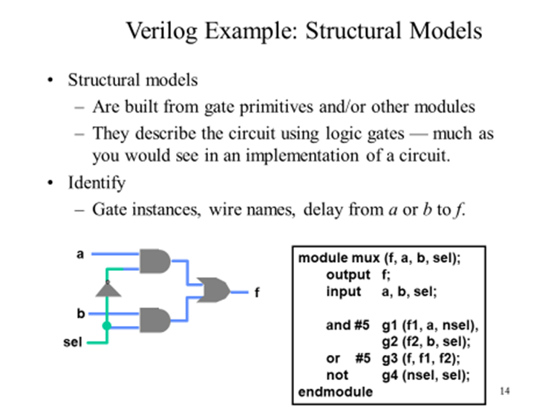

Slide 48
Example
4-bit adder
module add4 (s,c3,ci,a,b)
input [3:0] a,b ; // port declarations
input ci ;
output [3:0] s : // vector
output c3 ;
wire [2:0] co ;
add a0 (co[0], s[0], a[0], b[0], ci) ;
add a1 (co[1], s[1], a[1], b[1], co[0]) ;
add a2 (co[2], s[2], a[2], b[2], co[1]) ;
add a3 (c3, s[3], a[3], b[3], co[2]) ;
endmodule
Simpler than VHDL
Only Syntactical
Difference
c3
a3
a2
a1
a0
ci

Slide 49
Behavioral Verilog
Describe circuit behavior
Not implementation
A
Sum
B
Adder
Cout
Cin
module full_addr (Sum,Cout,A,B,Cin); input A, B, Cin; output Sum, Cout; assign {Cout, Sum} = A + B + Cin; endmodule
{Cout, Sum} is a concatenation

Slide 50
Behavioral 4-bit adder
module add4 (SUM, OVER, A, B);
input [3:0] A;
input [3:0] B;
output [3:0] SUM;
output OVER;
assign {OVER, SUM[3:0]} = A[3:0] + B[3:0];
endmodule
Buses are implicitly connected—
If you write BUS[3:2], BUS[1:0],
they become part of BUS[3:0]
“[3:0] A” is a 4-wire bus labeled “A”
Bit 3 is the MSB
Bit 0 is the LSB
Can also write “[0:3] A”
Bit 0 is the MSB
Bit 3 is the LSB

Slide 51
Major Data Type Class
Nets
Registers
Parameters

Slide 52
Nets
Net data type represent physical connections between structural entities.
A net must be driven by a driver, such as a gate or a continuous assignment.
Verilog automatically propagates new values onto a net when the drivers change value.

Slide 53
Data types
Net
physical wire between devices
the default data type
used in structural modeling and continuous assignment
types of nets
wire, tri : default
wor, trior : wire-ORed
wand, triand : wire-ANDed
trireg : with capacitive storage
tri1 : pull high
tri0 ; pull low
supply1 ; power
supply0 ; ground

Slide 54
Reg and Parameters
Reg
variables used in RTL description
a wire, a storage device or a temporary variable
reg : unsigned integer variables of varying bit width
integer : 32-bit signed integer
real : signed floating-point
time : 64-bit unsigned integer
Parameters
run-time constants

Slide 55
Verilog Simulator
Circuit Description
Testfixture
Verilog Simulator
Simulation Result

Slide 56
Sample Design
module fadder ( sum, cout, a, b , ci );
// port declaration
output sum, cout;
input a, b, ci;
reg sum, cout;
// behavior description
always @( a or b or ci )
begin
sum = a ^ b ^ ci;
cout = ( a&b ) | ( b&ci ) | ( ci&a);
end
endmodule
1-bit full adder
sum
a
b
ci
cout
Simpler than VHDL
Only Syntactical Difference

Slide 57
Basic Instructions

Slide 58
Lexical Conventions in Verilog
Type of lexical tokens :
Operators ( )
White space
Comment
Number ( )
String
Identifier
Keyword ( )

Slide 59
Special Language Tokens
$<identifier>: System tasks and functions
$time
$stop
$finish
$monitor
$ps_waves
$gr_waves
$gr_regs
#<delay specification>
used in
gate instances and procedural statements
unnecessary in RTL specification

Slide 60
Modeling Structures
Net-list
structural description for the top level
Continuous assignments (combination circuits)
data flow specification for simple combinational
Verilog operators
Procedural blocks (RTL)
always and initial blocks
allow timing control and concurrency
C-like procedure statements
primitives (=truth table, state transition table)
function and task (≈function and subroutine)

Slide 61
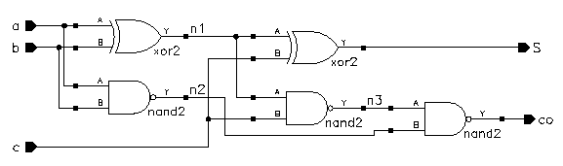
A full-adder
module add (co, s, a, b, c)
input a, b ,c ;
output co, s ;
xor (n1, a, b) ;
xor (s, n1, c) ;
nand (n2, a, b) ;
nand (n3,n1, c) ;
nand (co, n3,n2) ;
endmodule

Slide 62
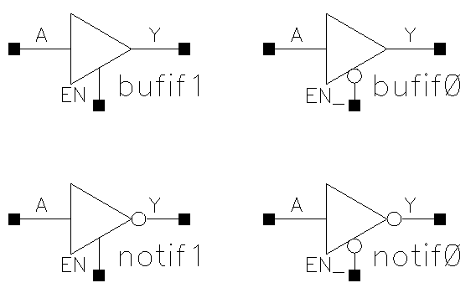
Verilog Primitives
Basic logic gates only
and
or
not
buf
xor
nand
nor
xnor
bufif1, bufif0
notif1, notif0

Slide 63
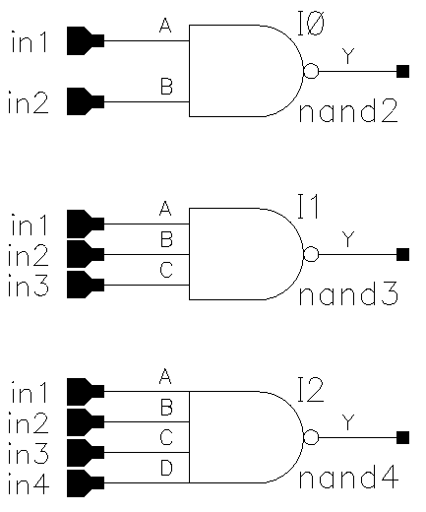
Primitive Pins Are Expandable
One output and variable number of inputs
not and buf
variable number of outputs but only one input
nand (y, in1, in2) ;
nand (y, in1, in2, in3) ;
nand (y, in1, in2, in3, in4) ;

Slide 64
Continuous Assignments
Describe combinational logic
Operands + operators
Drive values to a net
assign out = a&b ; // and gate
assign eq = (a==b) ; // comparator
wire #10 inv = ~in ; // inverter with delay
wire [7:0] c = a+b ; // 8-bit adder
Avoid logic loops
assign a = b + a ;
asynchronous design

Slide 65
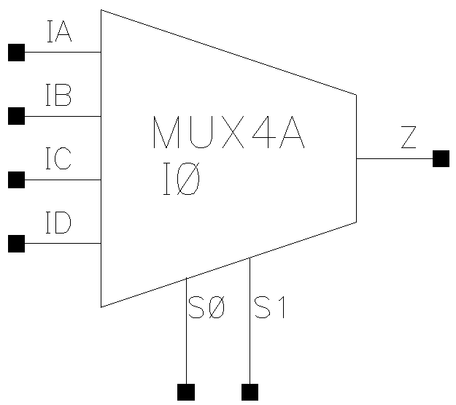
Logical and Conditional Operators
Logical, bit-wise and unary operators
a = 1011; b = 0010
logical bit-wise unary
a || b = 1 a | b = 1011 |a = 1
a && b = 1 a &b = 0010 &a = 0
Conditional operator
assign z = ({s1,s0} == 2'b00) ? IA :
({s1,s0} == 2'b01) ? IB :
({s1,s0} == 2'b10) ? IC :
({s1,s0} == 2'b11) ? ID :
1'bx ;
assign s = (op == ADD) ? a+b : a-b ;

Slide 66
Continuous assignment
Assignment is continuously evaluated
Corresponds to a logic gate
Assignments execute in parallel
Boolean operators (~ for bit-wise negation)
assign A = X | (Y & ~Z);
assign B[3:0] = 4'b01XX;
assign C[15:0] = 16'h00ff;
assign #3 {Cout, Sum[3:0]} = A[3:0] + B[3:0] + Cin;
bits can assume four values (0, 1, X, Z)
variables can be n-bits wide (MSB:LSB)
gate delay (used by simulator)

Slide 67
Invalid sequential assigns
assign A = X | (Y & ~Z);
assign B = W | A;
assign A = Y & Z;
“Reusing” a variable on the left
side of several assign statements is not allowed
assign A = X | (Y & ~Z);
assign B = W | A;
assign X = B & Z;
Cyclic dependencies also are bad
A depends on X
which depends on B
which depends on A

Slide 68
Example: 4-bit comparator
module Compare1 (Equal, Alarger, Blarger, A, B); input A, B; output Equal, Alarger, Blarger; assign Equal = (A & B) | (~A & ~B); assign Alarger = (A & ~B); assign Blarger = (~A & B); endmodule
Starting with 1-bit comparator
Top-down design and bottom-up design are both okay
Module ordering doesn’t matter because modules execute in parallel

Slide 69
4-bit comparator
// Make a 4-bit comparator from 4 1-bit comparators module Compare4(Equal, Alarger, Blarger, A4, B4); input [3:0] A4, B4; output Equal, Alarger, Blarger; wire e0, e1, e2, e3, Al0, Al1, Al2, Al3, B10, Bl1, Bl2, Bl3; Compare1 cp0(e0, Al0, Bl0, A4[0], B4[0]); Compare1 cp1(e1, Al1, Bl1, A4[1], B4[1]); Compare1 cp2(e2, Al2, Bl2, A4[2], B4[2]); Compare1 cp3(e3, Al3, Bl3, A4[3], B4[3]); assign Equal = (e0 & e1 & e2 & e3); assign Alarger = (Al3 | (Al2 & e3) |
(Al1 & e3 & e2) |
(Al0 & e3 & e2 & e1)); assign Blarger = (~Alarger & ~Equal); endmodule

Slide 70
Functions
Use functions for complex combinational logic
module and_gate (out, in1, in2); input in1, in2; output out;
assign out = myfunction(in1, in2);
function myfunction;
input in1, in2;
begin
myfunction = in1 & in2;
end
endfunction
endmodule
Benefit:
Functions force a result
⇒ Compiler will fail if function
does not generate a result

Slide 71
Always code blocks
Variables that appear on the left hand side in an always block must be declared as “reg”s
reg A, B, C;
always @ (W or X or Y or Z)
begin
A = X | (Y & ~Z);
B = W | A;
A = Y & Z;
if (A & B) begin
B = Z;
C = W | Y;
end
end
Sensitivity list:
block is executed
each time one of
them changes value
Statements in an always block are executed in sequence
BAD: All variables must be assigned on every control path!!!

Slide 72
Assignments
Blocking assignments (Q = A)
Variable is assigned immediately
New value is used by subsequent statements
Non-blocking assignments (Q <= A)
Variable is assigned after all scheduled statements are executed
Value to be assigned is computed but saved for later parallel assignment
Usual use: Register assignment
Registers simultaneously take new values after the clock edge

Slide 73
Blocking vs. non-blocking
Example: Swap
always @(posedge CLK) begin temp = B; B = A; A = temp; end
always @(posedge CLK) begin A <= B; B <= A; end

Slide 74
Operators
Arithmetic Operators
+, -, *, /, %
Relational Operators
<, <=, >, >=
Equality Operators
==, !=, ===, !==
Logical Operators
!, &&, ||
Bit-Wise Operators
~, &, |, ^, ~^
Unary Reduction
&, ~&, |, ~|, ^, ~^
Shift Operators
>>, <<
Conditional Operators
?:
Concatenations
{}

Slide 75
Operator Precedence
[ ] bit-select or part-select
( ) parentheses
!, ~ logical and bit-wise negation
&, |, ~&, ~|, ^, ~^, ^~ reduction operators
+, - unary arithmetic
{ } concatenation
*, /, % arithmetic
+, - arithmetic
<<, >> shift
>, >=, <, <=
relational
==, != logical equality
& bit-wise AND
^, ^~, ~^
bit-wise XOR and XNOR
| bit-wise OR
&& logical AND
|| logical OR
? : conditional

Slide 76
Operators
{ } concatenation
+ - * /
arithmetic
% modulus
> >= < <=
relational
! logical NOT
&& logical AND
|| logical OR
== logical equality
!= logical inequality
? : conditional
~ bit-wise NOT
& bit-wise AND
| bit-wise OR
^ bit-wise XOR
^~ ~^ bit-wise XNOR
& reduction AND
| reduction OR
~& reduction NAND
~| reduction NOR
^ reduction XOR
~^ ^~ reduction XNOR
<< shift left
>> shift right

Slide 77
Simple Behavioral Model: the always block
always block
Always waiting for a change to a trigger signal
Then executes the body
module and_gate (out, in1, in2); input in1, in2; output out; reg out; always @(in1 or in2) begin
out = in1 & in2;
end
endmodule
Not a real register!!
A Verilog register
Needed because of
assignment in always block
Specifies when block is executed I.e., triggered by which signals

Slide 78
always Block
Procedure that describes the function of a circuit
Can contain many statements including if, for, while, case
Statements in the always block are executed sequentially
(Continuous assignments <= are executed in parallel)
Entire block is executed at once
Final result describes the function of the circuit for current set of inputs
intermediate assignments don’t matter, only the final result
begin/end used to group statements

Slide 79
Verilog while/repeat/forever
while (expression) statement
Execute statement while expression is true
repeat (expression) statement
Execute statement a fixed number of times
forever statement
Execute statement forever

Slide 80
Numbers
Format : <size>’<base><value>
Example : 8’d16
8’h10
8’b00010000
8’o20

Slide 81
Keywords
Note : All keywords are defined in lower case
Examples :
module, endmodule
input, output, inout
reg, integer, real, time
not, and, nand, or, nor, xor
parameter
begin, end
fork, join
specify, endspecify

Slide 82
Value Set in Verilog
4-value logic system in Verilog :
‘0’
‘X’
‘1’
‘Z’
0

Slide 83
Registers & Parameters
Registers represent abstract storage elements.
A register holds its value until a new value is assigned to it.
Registers are used extensively in behavior modeling and in applying stimuli.
Parameters are not variables, they are constants.

Slide 84
Assignments
Assignment : drive values into nets and registers.
Continuous Assignments – Any changes in the RHS of continuous assignment are evaluated and the LHS is update.
Example : (1) assign out = ~in;
(2) assign reg_out; = reg_in << shift

Slide 85
Assignments ( cont. )
Blocking procedural assignment.
rega = regb + regc;
Non-blocking procedural assignment.
rega <= regb * regc;

Slide 86
Blocking vs. Non-Blocking (1)
Verilog Fragment
Result
always @ (a) begin
b = a;
c = b;
end
C = B = A
A-----B-------C
always @ (posedge Clock) begin
b <= a;
c <= b;
end
B = Old A
C = Old B
B
C
A
D
Q
D
Q
Clock

Slide 87
Blocking vs. Non-Blocking (2)
Use Non-Blocking for FlipFlop Inference
posedge/negedge require Non-Blocking
Else simulation and synthesis wont match

Slide 88
Blocking vs. Non-Blocking (3)
If you use blocking for FlipFlops:
YOU WILL NOT GET WHAT YOU WANT!
always @ (posedge Clock) begin
b = a; // b will go away
c = b; // c will be a FlipFlop
end
// b isn’t needed at all
always @ (posedge Clock) begin
c = b; // c will be a FlipFlop
b = a; // b will be a FlipFlop
end

Slide 90
Defining a module
A module is the main building block in Verilog
We first need to declare:
Name of the module
Types of its connections (input, output)
Names of its connections

Slide 91
Defining a module
module example (a, b, c, y);
input a;
input b;
input c;
output y;
// here comes the circuit description
endmodule

Slide 92
A question of style
The following two codes are identical
module test ( a, b, y );
input a;
input b;
output y;
endmodule
module test ( input a,
input b, output y );
endmodule

Slide 93
What if we have busses?
You can also define multi-bit busses.
[ range_start : range_end ]
Example:
input [31:0] a; // a[31], a[30] .. a[0]
output [15:8] b1; // b1[15], b1[14] .. b1[8]
output [7:0] b2; // b2[7], b2[6] .. b1[0]
input clk; // single signal

Slide 94
Basic Syntax
Verilog is case sensitive:
SomeName and somename are not the same!
Names cannot start with numbers:
2good is not a valid name
Whitespace is ignored
// Single line comments start with a //
/* Multiline comments
are defined like this */

Slide 95
Good Practices
Develop/use a consistent naming style
Use MSB to LSB ordering for busses (little-endian)
Try using “a[31:0]” and not “a[0:31]”
Define one module per file
Makes managing your design hierarchy easier
Use a file name that equals module name
i.e. module TryThis is defined in a file called TryThis.v

Slide 96
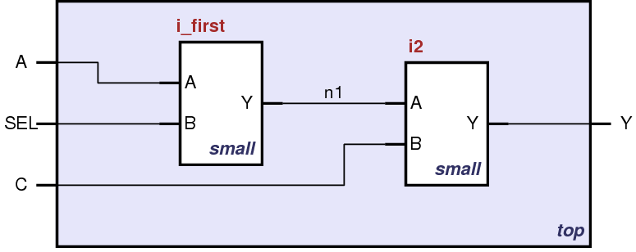
Structural HDL: Instantiating a Module

Slide 97
What Happens with HDL code?
Automatic Synthesis (combine)
Modern tools are able to map a behavioral HDL code into gate-level schematics
They can perform many optimizations
… however they can not guarantee that a solution is optimal
Most common way of Digital Design these days
Simulation
Allows the behavior of the circuit to be verified without actually manufacturing the circuit
Simulators can work on behavioral or gate-level schematics

Slide 98
Behavioral HDL: Defining Functionality
module example (a, b, c, y);
input a;
input b;
input c;
output y;
// here comes the circuit description
assign y = ~a & ~b & ~c |
a & ~b & ~c |
a & ~b & c;
endmodule

Slide 99
Behavioral HDL: Synthesis Results

Slide 100
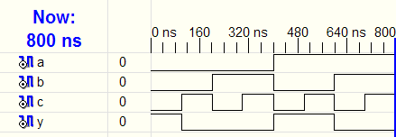
Behavioral HDL: Simulating the Circuit

Slide 101
Bitwise Operators
module gates(input [3:0] a, b,
output [3:0] y1, y2, y3, y4, y5);
/* Five different two-input logic
gates acting on 4 bit busses */
assign y1 = a & b; // AND
assign y2 = a | b; // OR
assign y3 = a ^ b; // XOR
assign y4 = ~(a & b); // NAND
assign y5 = ~(a | b); // NOR
endmodule

Slide 102
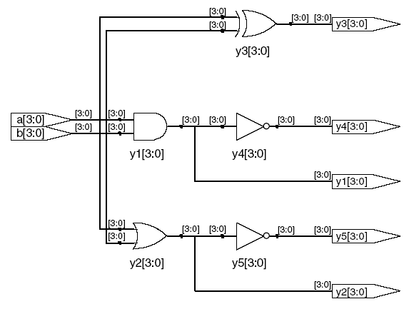
Bitwise Operators: Synthesis Results

Slide 103
Reduction Operators
module and8(input [7:0] a,
output y);
assign y = &a;
// &a is much easier to write than
// assign y = a[7] & a[6] & a[5] & a[4] &
// a[3] & a[2] & a[1] & a[0];
endmodule

Slide 104
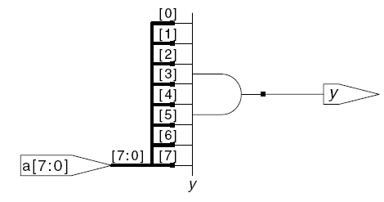
Reduction Operators: assign y = &a;

Slide 105
Conditional Assignment
module mux2(input [3:0] d0, d1,
input s,
output [3:0] y);
assign y = s ? d1 : d0;
// if (s) then y=d1 else y=d0;
endmodule
? : is also called a ternary operator as it operates on three inputs:
s
d1
d0.

Slide 106
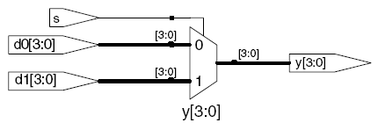
Conditional Assignment: y = s ? d1: d0;

Slide 107
More Conditional Assignments
module mux4(input [3:0] d0, d1, d2, d3
input [1:0] s,
output [3:0] y);
assign y = s[1] ? ( s[0] ? d3 : d2)
: ( s[0] ? d1 : d0);
// if (s1) then
// if (s0) then y=d3 else y=d2
// else
// if (s0) then y=d1 else y=d0
endmodule

Slide 108
Number Representation in Verilog
Verilog | Stored Number | Verilog | Stored Number
4’b1001 | 1001 | 4’d5 | 0101
8’b1001 | 0000 1001 | 12’hFA3 | 1111 1010 0011
8’b0000_1001 | 0000 1001 | 8’o12 | 00 001 010
8’bxX0X1zZ1 | XX0X 1ZZ1 | 4’h7 | 0111
‘b01 | 0000 .. 0001 | 12’h0 | 0000 0000 0000

Slide 109
Precedence of operations in Verilog
Highest
~ | NOT
*, /, % | mult, div, mod
+, - | add,sub
<<, >> | shift
<<<, >>> | arithmetic shift
<, <=, >, >= | comparison
==, != | equal, not equal
&, ~& | AND, NAND
^, ~^ | XOR, XNOR
|, ~| | OR, NOR
?: | ternary operator
Lowest

Slide 110
What have seen so far:
Describing structural hierarchy with Verilog
Instantiate modules in an other module
Writing simple logic equations
We can write AND, OR, XOR etc
Multiplexer functionality
If … then … else
We can describe constants
But there is more:

Slide 111
Verilog tips
Do not write C-code
Think hardware, not algorithms
Verilog is inherently parallel
Compilers don’t map algorithms to circuits well
Do describe hardware circuits
First draw a dataflow diagram
Then start coding

Slide 112
The Verilog Language
Structural and behavioral model of Verilog language For reference Only

Slide 113
The Verilog Language
Originally a modeling language for a very efficient event-driven digital logic simulator
Later pushed into use as a specification language for logic synthesis
Now, one of the two most commonly-used languages in digital hardware design (VHDL is the other)
Virtually every chip (FPGA, ASIC, etc.) is designed in part using one of these two languages
Combines structural and behavioral modeling styles

Slide 114
Structural Modeling
When Verilog was first developed (1984) most logic simulators operated on netlists
Netlist: list of gates and how they’re connected
A natural representation of a digital logic circuit
Not the most convenient way to express test benches

Slide 115
Behavioral Modeling
A much easier way to write testbenches
Also good for more abstract models of circuits
Easier to write
Simulates faster
More flexible
Provides sequencing
Verilog succeeded in part because it allowed both the model and the testbench to be described together

Slide 116
How Verilog Is Used
Virtually every ASIC is designed using either Verilog or VHDL (a similar language)
Behavioral modeling with some structural elements
“Synthesis subset”
Can be translated using Synopsys’ Design Compiler or others into a netlist
Design written in Verilog
Simulated to death to check functionality
Synthesized (netlist generated)
Static timing analysis to check timing

Slide 117
Two Main Components of Verilog
Concurrent, event-triggered processes (behavioral)
Initial and Always blocks
Imperative code that can perform standard data manipulation tasks (assignment, if-then, case)
Processes run until they delay for a period of time or wait for a triggering event
Structure (Plumbing)
Verilog program build from modules with I/O interfaces
Modules may contain instances of other modules
Modules contain local signals, etc.
Module configuration is static and all run concurrently

Slide 118
Two Main Data Types
Nets represent connections between things
Do not hold their value
Take their value from a driver such as a gate or other module
Cannot be assigned in an initial or always block
Regs represent data storage
Behave exactly like memory in a computer
Hold their value until explicitly assigned in an initial or always block
Never connected to something
Can be used to model latches, flip-flops, etc., but do not correspond exactly
Shared variables with all their attendant problems

Slide 119
Discrete-event Simulation
Basic idea: only do work when something changes
Centered around an event queue
Contains events labeled with the simulated time at which they are to be executed
Basic simulation paradigm
Execute every event for the current simulated time
Doing this changes system state and may schedule events in the future
When there are no events left at the current time instance, advance simulated time soonest event in the queue

Slide 120
Four-valued Data
Verilog’s nets and registers hold four-valued data
0, 1
Obvious
Z
Output of an undriven tri-state driver
Models case where nothing is setting a wire’s value
X
Models when the simulator can’t decide the value
Initial state of registers
When a wire is being driven to 0 and 1 simultaneously
Output of a gate with Z inputs

Slide 121
Four-valued Logic
Logical operators work on three-valued logic
0 1 X Z
0 0 0 0 0
1 0 1 X X
X 0 X X X
Z 0 X X X
Output 0 if one input is 0
Output X if both inputs are gibberish

Slide 122
Structural Modeling

Slide 123
Nets and Registers
Wires and registers can be bits, vectors, and arrays
wire a; // Simple wire
tri [15:0] dbus; // 16-bit tristate bus
tri #(5,4,8) b; // Wire with delay
reg [-1:4] vec; // Six-bit register
trireg (small) q; // Wire stores a small charge
integer imem[0:1023]; // Array of 1024 integers
reg [31:0] dcache[0:63]; // A 32-bit memory

Slide 124
Modules and Instances
Basic structure of a Verilog module:
module mymod(output1, output2, … input1, input2);
output output1;
output [3:0] output2;
input input1;
input [2:0] input2;
…
endmodule
Verilog convention lists outputs first

Slide 125
Instantiating a Module
Instances of
module mymod(y, a, b);
look like
mymod mm1(y1, a1, b1); // Connect-by-position
mymod (y2, a1, b1),
(y3, a2, b2); // Instance names omitted
mymod mm2(.a(a2), .b(b2), .y(c2)); // Connect-by-name

Slide 126
Gate-level Primitives
Verilog provides the following:
and nand logical AND/NAND
or nor logical OR/NOR
xor xnor logical XOR/XNOR
buf not buffer/inverter
bufif0 notif0 Tristate with low enable
bifif1 notif1 Tristate with high enable

Slide 127
Delays on Primitive Instances
Instances of primitives may include delays
buf b1(a, b); // Zero delay
buf #3 b2(c, d); // Delay of 3
buf #(4,5) b3(e, f); // Rise=4, fall=5
buf #(3:4:5) b4(g, h); // Min-typ-max

Slide 128
User-Defined Primitives
Way to define gates and sequential elements using a truth table
Often simulate faster than using expressions, collections of primitive gates, etc.
Gives more control over behavior with X inputs
Most often used for specifying custom gate libraries

Slide 129
A Carry Primitive
primitive carry(out, a, b, c);
output out;
input a, b, c;
table
00? : 0;
0?0 : 0;
?00 : 0;
11? : 1;
1?1 : 1;
?11 : 1;
endtable
endprimitive
Always have exactly one output
Truth table may include don’t-care (?) entries

Slide 130
A Sequential Primitive
Primitive dff( q, clk, data);
output q; reg q;
input clk, data;
table
// clk data q new-q
(01) 0 : ? : 0; // Latch a 0
(01) 1 : ? : 1; // Latch a 1
(0x) 1 : 1 : 1; // Hold when d and q both 1
(0x) 0 : 0 : 0; // Hold when d and q both 0
(?0) ? : ? : -; // Hold when clk falls
? (??) : ? : -; // Hold when clk stable
endtable
endprimitive

Slide 131
Continuous Assignment
Another way to describe combinational function
Convenient for logical or datapath specifications
wire [8:0] sum;
wire [7:0] a, b;
wire carryin;
assign sum = a + b + carryin;
Define bus widths
Continuous assignment: permanently sets the value of sum to be a+b+carryin
Recomputed when a, b, or carryin changes

Slide 132
Behavioral Modeling

Slide 133
Initial and Always Blocks
Basic components for behavioral modeling
initial
begin
… imperative statements …
end
Runs when simulation starts
Terminates when control reaches the end
Good for providing stimulus
always
begin
… imperative statements …
end
Runs when simulation starts
Restarts when control reaches the end
Good for modeling/specifying hardware

Slide 134
Initial and Always
Run until they encounter a delay
initial begin
#10 a = 1; b = 0;
#10 a = 0; b = 1;
end
or a wait for an event
always @(posedge clk) q = d;
always begin wait(i); a = 0; wait(~i); a = 1; end

Slide 135
Procedural Assignment
Inside an initial or always block:
sum = a + b + cin;
Just like in C: RHS evaluated and assigned to LHS before next statement executes
RHS may contain wires and regs
Two possible sources for data
LHS must be a reg
Primitives or cont. assignment may set wire values

Slide 136
Imperative Statements
if (select == 1) y = a;
else y = b;
case (op)
2’b00: y = a + b;
2’b01: y = a – b;
2’b10: y = a ^ b;
default: y = ‘hxxxx;
endcase

Slide 137
For Loops
A increasing sequence of values on an output
reg [3:0] i, output;
for ( i = 0 ; i <= 15 ; i = i + 1 ) begin
output = i;
#10;
end

Slide 138
While Loops
A increasing sequence of values on an output
reg [3:0] i, output;
i = 0;
while (I <= 15) begin
output = i;
#10 i = i + 1;
end

Slide 139
Modeling A Flip-Flop With Always
Very basic: an edge-sensitive flip-flop
reg q;
always @(posedge clk)
q = d;
q = d assignment runs when clock rises: exactly the behavior you expect

Slide 140
Blocking vs. Nonblocking
Verilog has two types of procedural assignment
Fundamental problem:
In a synchronous system, all flip-flops sample simultaneously
In Verilog, always @(posedge clk) blocks run in some undefined sequence

Slide 141
A Flawed Shift Register
This doesn’t work as you’d expect:
reg d1, d2, d3, d4;
always @(posedge clk) d2 = d1;
always @(posedge clk) d3 = d2;
always @(posedge clk) d4 = d3;
These run in some order, but you don’t know which

Slide 142
Non-blocking Assignments
Nonblocking rule:
RHS evaluated when assignment runs
This version does work:
reg d1, d2, d3, d4;
always @(posedge clk) d2 <= d1;
always @(posedge clk) d3 <= d2;
always @(posedge clk) d4 <= d3;
LHS updated only after all events for the current instant have run

Slide 143
Nonblocking Can Behave Oddly
A sequence of nonblocking assignments don’t communicate
a = 1;
b = a;
c = b;
Blocking assignment:
a = b = c = 1
a <= 1;
b <= a;
c <= b;
Nonblocking assignment:
a = 1
b = old value of a
c = old value of b

Slide 144
Nonblocking Looks Like Latches
RHS of nonblocking taken from latches
RHS of blocking taken from wires
a = 1;
b = a;
c = b;
“
”
a
b
c
1
1
a
a <= 1;
b <= a;
c <= b;
“
”
b
c

Slide 145
Building Behavioral Models

Slide 146
Modeling FSMs Behaviorally
There are many ways to do it:
Define the next-state logic combinationally and define the state-holding latches explicitly
Define the behavior in a single always @(posedge clk) block
Variations on these themes

Slide 147
FSM with Combinational Logic
Output o is declared a reg because it is assigned procedurally, not because it holds state
module FSM(o, a, b, reset);
output o;
reg o;
input a, b, reset;
reg [1:0] state, nextState;
always @(a or b or state)
case (state)
2’b00: begin
nextState = a ? 2’b00 : 2’b01;
o = a & b;
end
2’b01: begin nextState = 2’b10; o = 0; end
endcase
Combinational block must be sensitive to any change on any of its inputs
(Implies state-holding elements otherwise)

Slide 148
FSM with Combinational Logic
module FSM(o, a, b, reset);
…
always @(posedge clk or reset)
if (reset)
state <= 2’b00;
else
state <= nextState;
Latch implied by sensitivity to the clock or reset only

Slide 149
FSM from Combinational Logic
always @(a or b or state)
case (state)
2’b00: begin
nextState = a ? 2’b00 : 2’b01;
o = a & b;
end
2’b01: begin nextState = 2’b10; o = 0; end
endcase
always @(posedge clk or reset)
if (reset)
state <= 2’b00;
else
state <= nextState;
This is a Mealy machine because the output is directly affected by any change on the input

Slide 150
FSM from a Single Always Block
Expresses Moore machine behavior:
Outputs are latched
Inputs only sampled at clock edges
module FSM(o, a, b);
output o; reg o;
input a, b;
reg [1:0] state;
always @(posedge clk or reset)
if (reset) state <= 2’b00;
else case (state)
2’b00: begin
state <= a ? 2’b00 : 2’b01;
o <= a & b;
end
2’b01: begin state <= 2’b10; o <= 0; end
endcase
Nonblocking assignments used throughout to ensure coherency.
RHS refers to values calculated in previous clock cycle

Slide 151
Simulating Verilog

Slide 152
How Are Simulators Used?
Testbench generates stimulus and checks response
Coupled to model of the system
Pair is run simultaneously
Testbench
System Model
Stimulus
Response
Result checker

Slide 153
Writing Testbenches
Inputs to device under test
module test;
reg a, b, sel;
mux m(y, a, b, sel);
initial begin
$monitor($time,, “a = %b b=%b sel=%b y=%b”,
a, b, sel, y);
a = 0; b= 0; sel = 0;
#10 a = 1;
#10 sel = 1;
#10 b = 1;
end
Device under test
$monitor is a built-in event driven “printf”
Stimulus generated by sequence of assignments and delays

Slide 154
Simulation Behavior
Scheduled using an event queue
Non-preemptive, no priorities
A process must explicitly request a context switch
Events at a particular time unordered
Scheduler runs each event at the current time, possibly scheduling more as a result

Slide 155
Two Types of Events
Evaluation events compute functions of inputs
Update events change outputs
Split necessary for delays, nonblocking assignments, etc.
Evaluation event reads values of b and c, adds them, and schedules an update event
Update event writes new value of a and schedules any evaluation events that are sensitive to a change on a
a <= b + c

Slide 156
Simulation Behavior
Concurrent processes (initial, always) run until they stop at one of the following
#42
Schedule process to resume 42 time units from now
wait(cf & of)
Resume when expression “cf & of” becomes true
@(a or b or y)
Resume when a, b, or y changes
@(posedge clk)
Resume when clk changes from 0 to 1

Slide 157
Simulation Behavior
Infinite loops are possible and the simulator does not check for them
This runs forever: no context switch allowed, so ready can never change
while (~ready)
count = count + 1;
Instead, use
wait(ready);

Slide 158
Simulation Behavior
Race conditions abound in Verilog
These can execute in either order: final value of a undefined:
always @(posedge clk) a = 0;
always @(posedge clk) a = 1;

Slide 159
Simulation Behavior
Semantics of the language closely tied to simulator implementation
Context switching behavior convenient for simulation, not always best way to model
Undefined execution order convenient for implementing event queue

Slide 160
Verilog and Logic Synthesis

Slide 161
Logic Synthesis
Verilog is used in two ways
Model for discrete-event simulation
Specification for a logic synthesis system
Logic synthesis converts a subset of the Verilog language into an efficient netlist
One of the major breakthroughs in designing logic chips in the last 20 years
Most chips are designed using at least some logic synthesis

Slide 162
Logic Synthesis
Takes place in two stages:
Translation of Verilog (or VHDL) source to a netlist
Register inference
Optimization of the resulting netlist to improve speed and area
Most critical part of the process
Algorithms very complicated and beyond the scope of this class: Take Prof. Nowick’s class for details

Slide 163
Translating Verilog into Gates
Parts of the language easy to translate
Structural descriptions with primitives
Already a netlist
Continuous assignment
Expressions turn into little datapaths
Behavioral statements the bigger challenge

Slide 164
What Can Be Translated
Structural definitions
Everything
Behavioral blocks
Depends on sensitivity list
Only when they have reasonable interpretation as combinational logic, edge, or level-sensitive latches
Blocks sensitive to both edges of the clock, changes on unrelated signals, changing sensitivity lists, etc. cannot be synthesized
User-defined primitives
Primitives defined with truth tables
Some sequential UDPs can’t be translated (not latches or flip-flops)

Slide 165
What Isn’t Translated
Initial blocks
Used to set up initial state or describe finite testbench stimuli
Don’t have obvious hardware component
Delays
May be in the Verilog source, but are simply ignored
A variety of other obscure language features
In general, things heavily dependent on discrete-event simulation semantics
Certain “disable” statements
Pure events

Slide 166
Register Inference
The main trick
reg does not always equal latch
Rule: Combinational if outputs always depend exclusively on sensitivity list
Sequential if outputs may also depend on previous values

Slide 167
Register Inference
Combinational:
reg y;
always @(a or b or sel)
if (sel) y = a;
else y = b;
Sequential:
reg q;
always @(d or clk)
if (clk) q = d;
Sensitive to changes on all of the variables it reads
Y is always assigned
q only assigned when clk is 1

Slide 168
Register Inference
A common mistake is not completely specifying a case statement
This implies a latch:
always @(a or b)
case ({a, b})
2’b00 : f = 0;
2’b01 : f = 1;
2’b10 : f = 1;
endcase
f is not assigned when {a,b} = 2b’11

Slide 169
Register Inference
The solution is to always have a default case
always @(a or b)
case ({a, b})
2’b00: f = 0;
2’b01: f = 1;
2’b10: f = 1;
default: f = 0;
endcase
f is always assigned

Slide 170
Inferring Latches with Reset
Latches and Flip-flops often have reset inputs
Can be synchronous or asynchronous
Asynchronous positive reset:
always @(posedge clk or posedge reset)
if (reset)
q <= 0;
else q <= d;

Slide 171
Simulation-synthesis Mismatches
Many possible sources of conflict
Synthesis ignores delays (e.g., #10), but simulation behavior can be affected by them
Simulator models X explicitly, synthesis doesn’t
Behaviors resulting from shared-variable-like behavior of regs is not synthesized
always @(posedge clk) a = 1;
New value of a may be seen by other @(posedge clk) statements in simulation, never in synthesis

Slide 172
Compared to VHDL
Verilog and VHDL are comparable languages
VHDL has a slightly wider scope
System-level modeling
Exposes even more discrete-event machinery
VHDL is better-behaved
Fewer sources of nondeterminism (e.g., no shared variables)
VHDL is harder to simulate quickly
VHDL has fewer built-in facilities for hardware modeling
VHDL is a much more verbose language
Most examples don’t fit on slides

