Slide 1
Chapter
Seven:
System
Testing
Department of Software Engineering
ITSC-AAIT
Dr. Sunkari
Software Quality Assurance & Testing
1

Slide 2
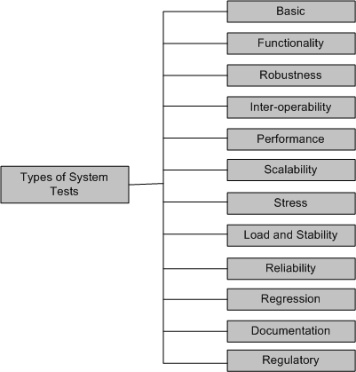
Types
of
System
Tests
Software Quality Assurance & Testing
2

Slide 3
Types
of
System
Tests
▪ Basic tests provide an evidence that the system can be installed, configured and be
brought to an operational state.
▪ Functionality tests provide comprehensive testing over the full range of the
requirements, within the capabilities of the system.
▪ Robustness tests determine how well the system recovers from various input errors
and other failure situations.
▪ Inter-operability tests determine whether the system can inter-operate with other
third party products.
▪ Performance tests measure the performance characteristics of the system, e.g.,
throughput and response time, under various conditions.
Software Quality Assurance & Testing
3

Slide 4
Types
of
System
Tests
▪ Scalability tests determine the scaling limits of the system, in terms of user scaling,
geographic scaling, and resource scaling
▪ Stress tests put a system under stress in order to determine the limitations of a system
and, when it fails, to determine the manner in which the failure occurs
▪ Load and Stability tests provide evidence that the system remains stable for a long
period of time under full load
▪ Reliability tests measure the ability of the system to keep operating for a long time
without developing failures.
▪ Regression tests determine that the system remains stable as it cycles through the
integration of other subsystems and through maintenance tasks.
▪ Documentation tests ensure that the system’s user guides are accurate and usable
Software Quality Assurance & Testing
4

Slide 5
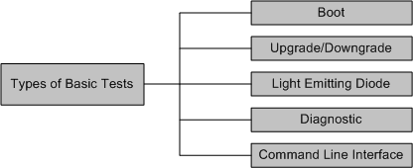
Basic
Tests
▪ Boot: Boot tests are designed to verify that the system can boot up its software image
(or, build) from the supported boot options.
▪ Upgrade/Downgrade: Upgrade/downgrade tests are designed to verify that the
system software can be upgraded or downgraded (rollback) in a graceful manner.
Software Quality Assurance & Testing
5

Slide 6
Basic
Tests
▪ Light Emitting Diode: The LED (Light Emitting Diode) tests are designed to verify that
the system LED status indicators functioning as desired.
▪ Diagnostic: Diagnostic tests are designed to verify that the hardware components (or,
modules) of the system are functioning as desired
▪ Power-On Self Test
▪ Ethernet Loop Back Test
▪ Bit Error Rate Test
▪ Command line Interface: Command Line Interface (CLI) tests are designed to verify
that the system can be configured.
Software Quality Assurance & Testing
6

Slide 7
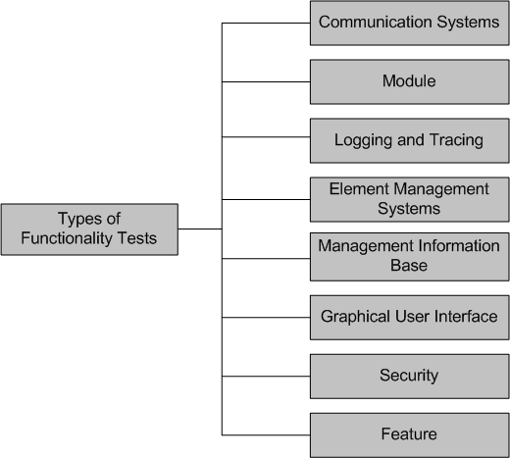
Functionality
Tests
Software Quality Assurance & Testing
7

Slide 8
Functionality
Tests
▪ Communication Systems Tests
▪ These tests are designed to verify the implementation of the communication
systems as specified in the customer requirements specification
▪ Four types of communication systems tests are recommended
▪ Basic interconnection tests
▪ Capability tests
▪ Behavior tests
▪ System resolution tests
▪ Module Tests
▪ Module Tests are designed to verify that all the modules function individually as desired within the systems
▪ The idea here is to ensure that individual modules function correctly within the whole system.
▪ For example, an Internet router contains modules such as line cards, system controller, power supply, and fan tray. Tests are designed to verify each of the functionalities
Software Quality Assurance & Testing
8

Slide 9
Functionality
Tests
▪ Logging and Tracing Tests
▪ Logging and Tracing Tests are designed to verify the configurations and
operations of logging and tracing
▪ This also includes verification of “flight data recorder: non-volatile Flash memory”
logs when the system crashes.
▪ Element Management Systems (EMS) Tests
▪ EMS tests verifies the main functionalities, which are to manage, monitor and upgrade the communication systems network elements(NEs)
▪ It includes both EMS client and EMS servers functionalities
▪ Management Information Base (MIB) Tests
▪ MIB tests are designed to verify
▪ Standard MIBs including MIB II
▪ Enterprise MIBs specific to the system
Software Quality Assurance & Testing
9

Slide 10
Functionality
Tests
▪ Graphical User Interface Tests
▪ Tests are designed to look-and-feel the interface to the users of an application
system
▪ Tests are designed to verify different components such as icons, menu bars,
dialog boxes, scroll bars, list boxes, and radio buttons.
▪ The GUI can be utilized to test the functionality behind the interface, such as accurate response to database queries
▪ Tests the usefulness of the on-line help, error messages, tutorials, and user manuals
▪ The usability characteristics of the GUI is tested, which includes the following
▪ Accessibility: Can users enter, navigate, and exit with relative ease?
▪ Responsiveness: Can users do what they want and when they want in a way that
is clear?
▪ Efficiency: Can users do what they want to with minimum number of steps and
time?
▪ Comprehensibility: Do users understand the product structure with a minimum
amount of effort?
Software Quality Assurance & Testing
10

Slide 11
Functionality
Tests
▪ Security Tests
▪ Security tests are designed to verify that the system meets the security
requirements
▪ Confidentiality
▪ It is the requirement that data and the processes be protected from
unauthorized disclosure
▪ Integrity
▪ It is the requirement that data and process be protected from unauthorized modification
▪ Availability
▪ It is the requirement that data and processes be protected form the
denial of service to authorized users
▪ Security test scenarios should include negative scenarios such as misuse and
abuse of the software system
Software Quality Assurance & Testing
11

Slide 12
Functionality
Tests
▪ Security Test: Useful types of security tests includes the following:
▪ Verify that only authorized accesses to the system are permitted
▪ Verify the correctness of both encryption and decryption algorithms for systems
where data/messages are encoded.
▪ Verify that illegal reading of files, to which the perpetrator is not authorized, is
not allowed
▪ Ensure that virus checkers prevent or curtail entry of viruses into the system
▪ Ensure that the system is available to authorized users when a zero-day attack occurs
▪ Try to identify any “backdoors” in the system usually left open by the software developers
▪ Feature Tests
▪ These tests are designed to verify any additional functionalities which are defined in requirement specification but not covered in the other functional Testing categories. Examples: Data conversion testing and Cross-functionality testing
Software Quality Assurance & Testing
12

Slide 13
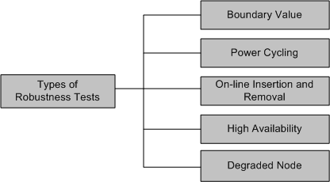
Robustness
Tests
▪ Robustness means how much sensitive a system is to erroneous input and changes its
operational environment
▪ Tests in this category are designed to verify how gracefully the system behaves in error
situations and in a changed operational environment.
Software Quality Assurance & Testing
13

Slide 14
Robustness
Tests
▪ Boundary value
▪ Boundary value tests are designed to cover boundary conditions, special values,
and system defaults
▪ The tests include providing invalid input data to the system and observing how
the system reacts to the invalid input.
▪ Power cycling
▪ Power cycling tests are executed to ensure that, when there is a power glitch in a deployment environment, the system can recover from the glitch to be back in normal operation after power is restored
▪ On-line insertion and removal
▪ On-line Insertion and Removal (OIR) tests are designed to ensure that on-line insertion and removal of modules, incurred during both idle and heavy load operations, are gracefully handled and recovered.
Software Quality Assurance & Testing
14

Slide 15
Robustness
Tests
▪ High Availability
▪ The concept of high availability is also known as fault tolerance
▪ High availability tests are designed to verify the redundancy of individual
modules, including the software that controls these modules.
▪ The goal is to verify that the system gracefully and quickly recovers from hardware and software failures without adversely impacting the operation of the system
▪ High availability is realized by means of proactive methods to maximize service up-time, and to minimize the downtime
▪ Degraded Node
▪ Degraded node (also known as failure containment) tests verify the operation of
a system after a portion of the system becomes non-operational
▪ It is a useful test for all mission-critical applications.
Software Quality Assurance & Testing
15

Slide 16
Interoperability
Tests
▪ Tests are designed to verify the ability of the system to inter-operate with third party
products
▪ The re-configuration activities during interoperability tests is known as configuration
testing
▪ Another kind of inter-operability tests is called (backward) compatibility tests
▪ Compatibility tests verify that the system works the same way across different platforms, operating systems, data base management systems
▪ Backward compatibility tests verify that the current software build flawlessly works with older version of platforms.
Software Quality Assurance & Testing
16

Slide 17
Performance
Tests
▪ Tests are designed to determine the performance of the actual system compared to
the expected one.
▪ Tests are designed to verify response time, execution time, throughput, resource
utilization and traffic rate.
▪ One needs to be clear about the specific data to be captured in order to evaluate
performance metrics.
▪ For example, if the objective is to evaluate the response time, then one needs to capture.
▪ End-to-end response time (as seen by external user)
▪ CPU time
▪ Network connection time
▪ Database access time
▪ Network connection time
▪ Waiting time
Software Quality Assurance & Testing
17

Slide 18
Scalability
Tests
▪ Tests are designed to verify that the system can scale up to its engineering limits
▪ Scaling tests are conducted to ensure that the system response time remains the
same, or increases by a small amount, as the number of users are increased.
▪ There are three major causes of these limitations:
▪ data storage limitations
▪ network bandwidth limitations
▪ speed limit
▪ Extrapolation is often used to predict the limit of scalability
Software Quality Assurance & Testing
18

Slide 19
Stress
Tests
▪ The goal of stress testing is to evaluate and determine the behavior of a software
component while the offered load is in excess of its designed capacity
▪ The system is deliberately stressed by pushing it to and beyond its specified limits
▪ It ensures that the system can perform acceptably under worst-case conditions, under an expected peak load. If the limit is exceeded and the system does fail, then the recovery mechanism should be invoked
▪ Stress tests are targeted to bring out the problems associated with one or more of the following:
▪ Memory leak
▪ Buffer Allocation and Memory Carving
Software Quality Assurance & Testing
19

Slide 20
Load
and
Stability
Tests
▪ Tests are designed to ensure that the system remains stable for a long period of time
under full load
▪ When a large number of users are introduced and applications that run for months
without restarting, a number of problems are likely to occur:
▪ the system slows down
▪ the system encounters functionality problems
▪ the system crashes altogether
▪ Load and stability testing typically involves exercising the system with virtual users and measuring the performance to verify whether the system can support the anticipated load.
▪ This kind of testing help one to understand the ways the system will work in real-life
situations.
Software Quality Assurance & Testing
20

Slide 21
Reliability
Tests
▪ Reliability tests are designed to measure the ability of the system to remain
operational for long periods of time.
▪ The reliability of a system is typically expressed in terms of mean time to failure
(MTTF)
▪ The average of all the time intervals between successive failures is called the MTTF.
▪ After a failure is observed, the developers analyze and fix the defects, which consumes some time – let us call this interval the repair time.
▪ The average of all the repair times is known as the mean time to repair (MTTR)
▪ Now we can calculate a value called mean time between failure (MTBF) as MTBF = MTTF + MTTR
Software Quality Assurance & Testing
21

Slide 22
Regression
Tests
▪ In this category, new tests are not designed, instead, test cases are selected from the
existing pool and executed
▪ The main idea in regression testing is to verify that no defect has been introduced into
the unchanged portion of a system due to changes made elsewhere in the system
▪ During system testing, many defects are revealed and the code is modified to fix those
defects
▪ One of four different scenarios can occur for each fix:
▪ The reported defect is fixed
▪ The reported defect could not be fixed inspite of making an effort
▪ The reported defect has been fixed, but something that used to work before has been failing
▪ The reported defect could not be fixed inspite of an effort, and something that
used to work before has been failing
Software Quality Assurance & Testing
22

Slide 23
Regression
Tests
▪ One possibility is to re-execute every test case from version n − 1 to version n before
testing anything new
▪ A full test of a system may be prohibitively expensive.
▪ A subset of the test cases is carefully selected from the existing test suite to
▪ maximize the likelihood of uncovering new defects
▪ reduce the cost of testing
Software Quality Assurance & Testing
23

Slide 24
Documentation
Tests
▪ Documentation testing means verifying the technical accuracy and readability of the
user manuals, tutorials and the on-line help
▪ Documentation testing is performed at three levels:
▪ Read test: In this test a documentation is reviewed for clarity, organization, flow,
and accuracy without executing the documented instructions on the system
▪ Hands-on test: Exercise the on-line help and verify the error messages to evaluate their accuracy and usefulness.
▪ Functional test: Follow the instructions embodied in the documentation to verify
that the system works as it has been documented.
Software Quality Assurance & Testing
24

Slide 25
Regulatory
Tests
▪ In this category, the final system is shipped to the regulatory bodies in those countries
where the product is expected to be marketed
▪ The idea is to obtain compliance marks on the product from various countries
▪ Most of these regulatory bodies issue safety and EMC (electromagnetic compatibility)/ EMI (electromagnetic interference) compliance certificates (emission and immunity)
▪ The regulatory agencies are interested in identifying flaws in software that have potential safety consequences
▪ The safety requirements are primarily based on their own published standards
Software Quality Assurance & Testing
25

Slide 26
Software Safety
6/11/2017 Software Design, Verification and Validation 26
▪ A hazard is a state of a system or a physical situation which when combined with
certain environmental conditions, could lead to an accident or mishap
▪ An accident or mishap is an unintended event or series of events that results in death,
injury, illness, damage or loss of property, or harm to the environment
▪ Software safety is defined in terms of hazards
▪ A software in isolation cannot do physical damage. However, a software in the context
of a system and an embedding environment could be vulnerable
▪ Examples:
▪ A software module in a database application is not hazardous by itself, but when
it is embedded in a missile navigation system, it could be hazardous
▪ If a missile takes a U-turn because of a software error in the navigation system,
and destroys the submarine that launched it, then it is not a safe software

Slide 27
Safety
Assurance
▪ There are two basic tasks performed by a safety assurance engineering team:
▪ Provide methods for identifying, tracking, evaluating, and eliminating hazards
associated with a system
▪ Ensure that safety is embedded into the design and implementation in a timely and cost effective manner, such that the risk created by the user/operator error is minimized
Software Quality Assurance & Testing
27

Slide 28
Reading
Software
Testing and Quality Assurance: Theory
Page [224-253]
and
Practice
And
read other online references
Software Quality Assurance & Testing
28

