Slide 1
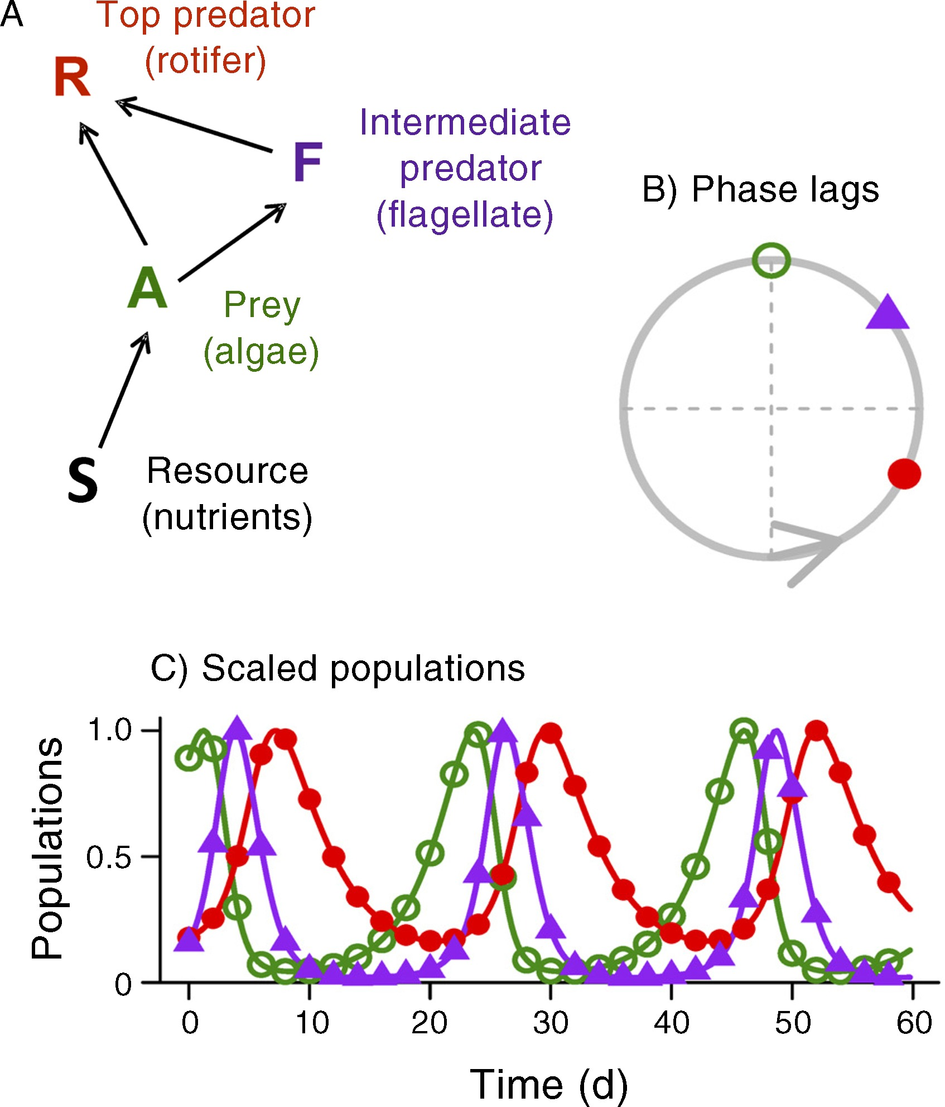
Temporal dynamics of a simple community with intraguild predation: an experimental test
Ecology, Volume: 94, Issue: 4, Pages: 773-779, First published: 01 April 2013, DOI: (10.1890/12-0786.1)
Notes:
(A) Structure of the three‐species food web with intraguild predation found in our chemostat experiments and theoretical models. Arrows represent uptake of the nutrient substrate, S, by the prey (the alga, A, Chlorella autotrophica) and consumption of the prey by the intermediate predator (the flagellate, F, Oxyrrhis marina) and the top predator (the rotifer, R, Brachionus plicatilis). (B, C) Theoretical predictions for the tri‐trophic food web dynamics (green open circles, algae; purple solid triangles, flagellates; red solid circles, rotifers). (B) The general qualitative predictions for the phase relationship between cycle peaks in the prey, A, followed by the intermediate predator, F, and finally the top predator, R. The large circle, rotating counterclockwise, represents the tri‐trophic population cycles with each species reaching its peak abundance when it comes to the top of the circle. (C) An example of the tri‐trophic cycles in the model when all three species coexist (abundances for each species scaled to a maximum of 1). Parameter values: δ = 0.15, kA = 0.15, kR = 0.25, r = 0.7, g = 0.7, η = 1.5, h = 7, αA = 2, αF = 1, IF = 0.001. Parameter definitions: δ is the dilution rate (fraction of chemostat growth medium replaced each day); kA and kR are the half‐saturation constants for algal substrate uptake and rotifer grazing, respectively; r, g, η, and h are the maximum per capita rate parameters for algal substrate uptake, rotifers grazing on algae, flagellates grazing on algae, and rotifers grazing on flagellates, respectively; αA and αF are the handling‐time parameters for flagellates grazing on algae and rotifers grazing on flagellates, respectively; IF is the rate of flagellate exogenous input.
IF THIS IMAGE HAS BEEN PROVIDED BY OR IS OWNED BY A THIRD PARTY, AS INDICATED IN THE CAPTION LINE, THEN FURTHER PERMISSION MAY BE NEEDED BEFORE ANY FURTHER USE. PLEASE CONTACT WILEY'S PERMISSIONS DEPARTMENT ON PERMISSIONS@WILEY.COM OR USE THE RIGHTSLINK SERVICE BY CLICKING ON THE 'REQUEST PERMISSIONS' LINK ACCOMPANYING THIS ARTICLE. WILEY OR AUTHOR OWNED IMAGES MAY BE USED FOR NON-COMMERCIAL PURPOSES, SUBJECT TO PROPER CITATION OF THE ARTICLE, AUTHOR, AND PUBLISHER.

