Slide 1
Using neural ordinary differential equations to infer ecological interactions from time series data
Sebastian Nuxoll
MATH-437
University of Idaho
April 29, 2024
Using NODEs to infer interactions

Slide 2
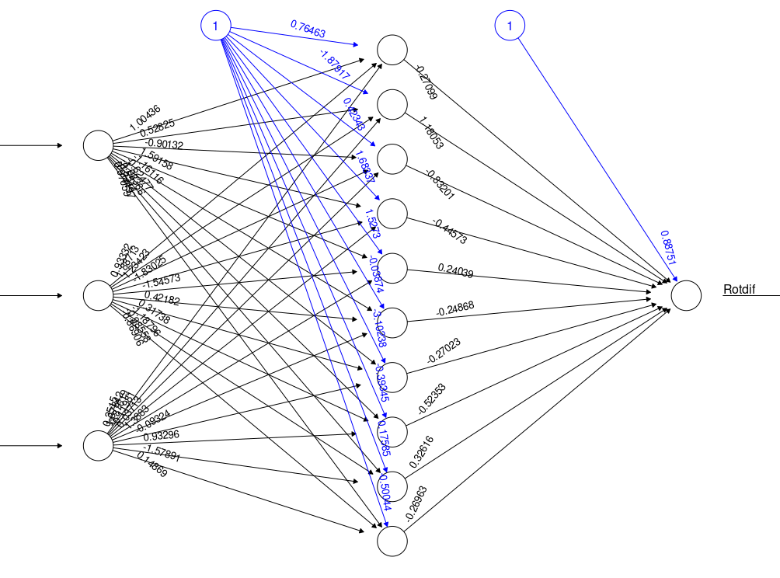
Neural Networks
Using NODEs to infer interactions

Slide 3
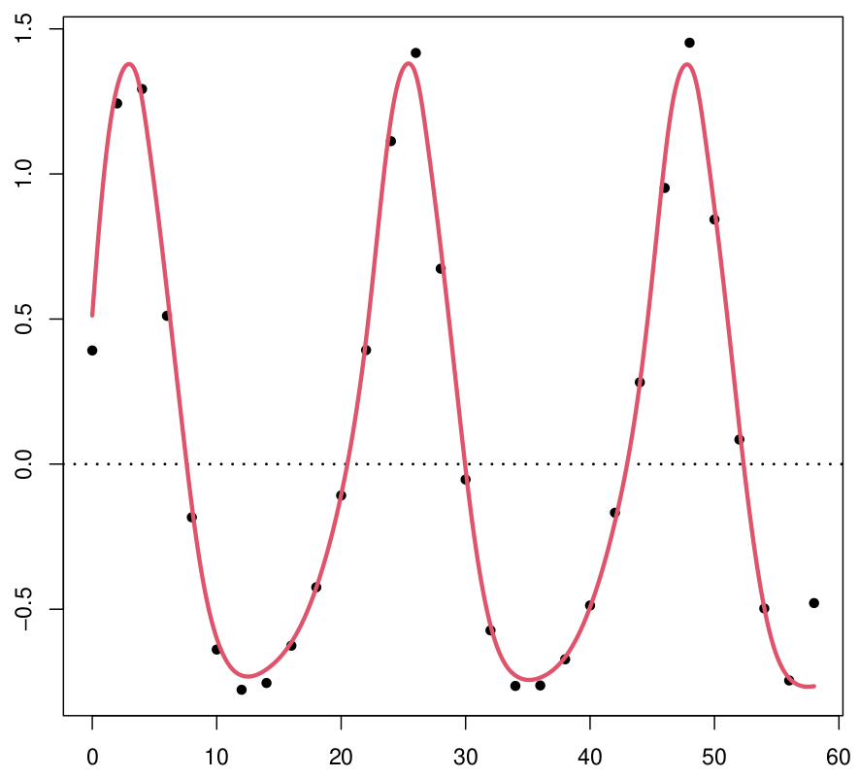
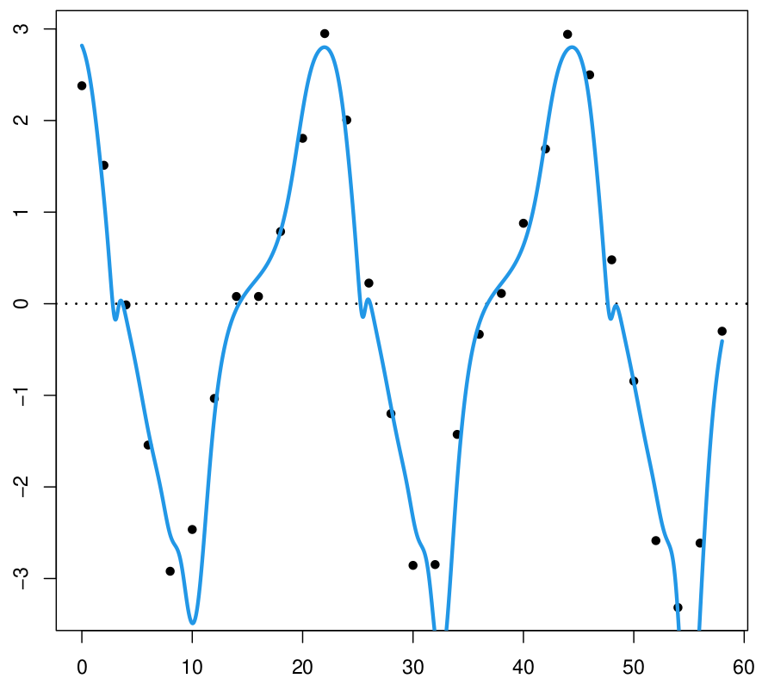
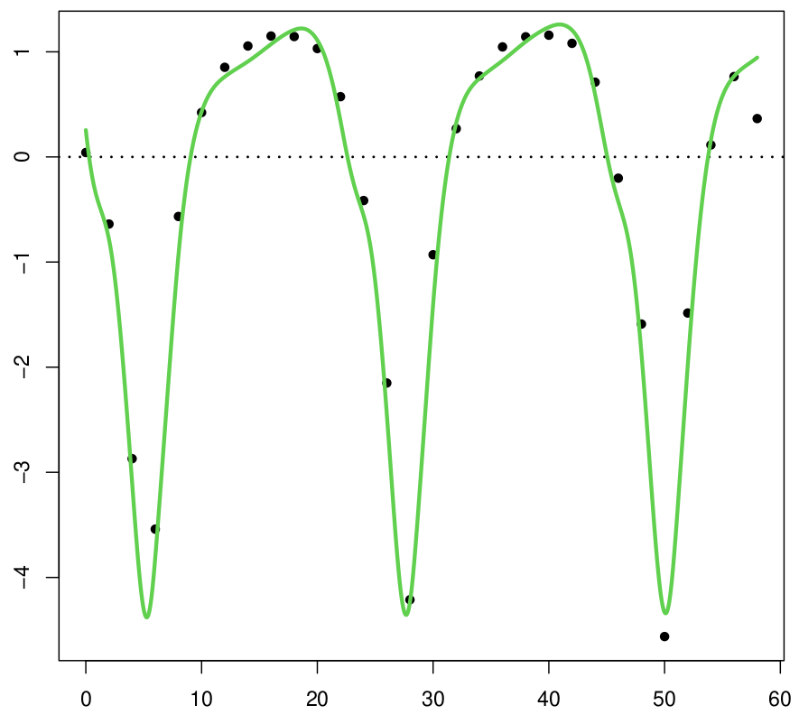
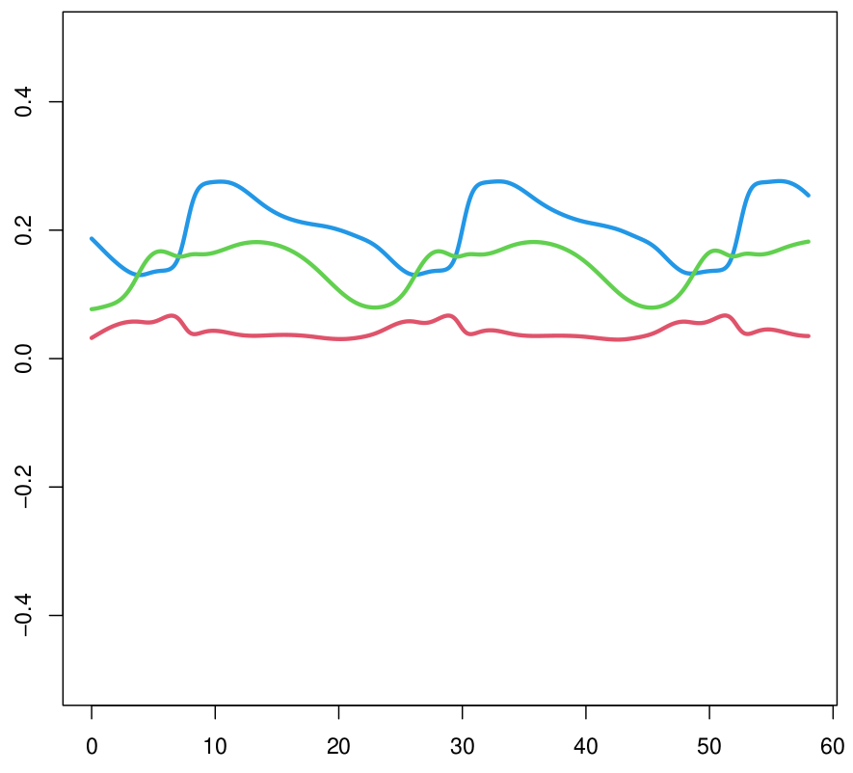
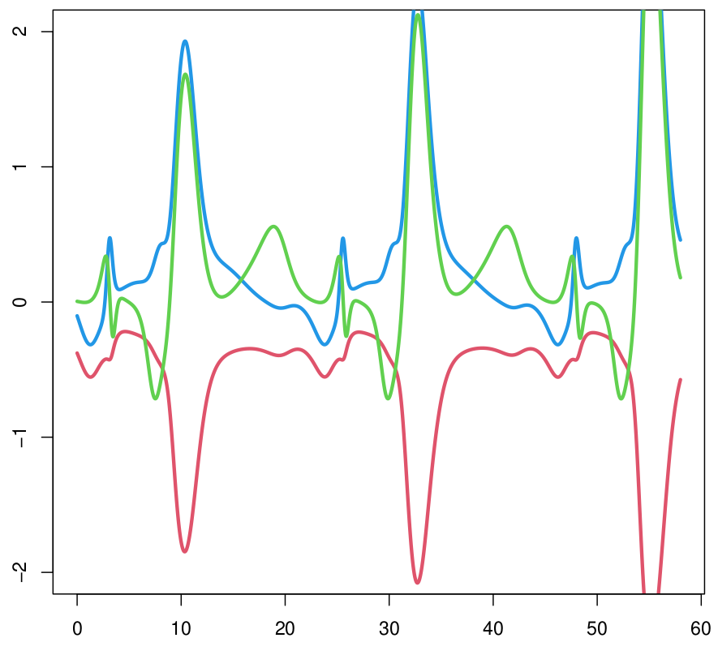
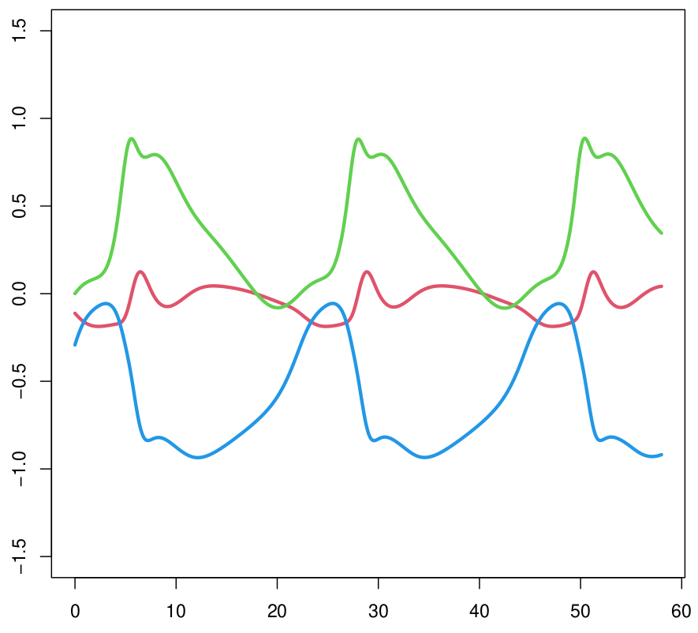
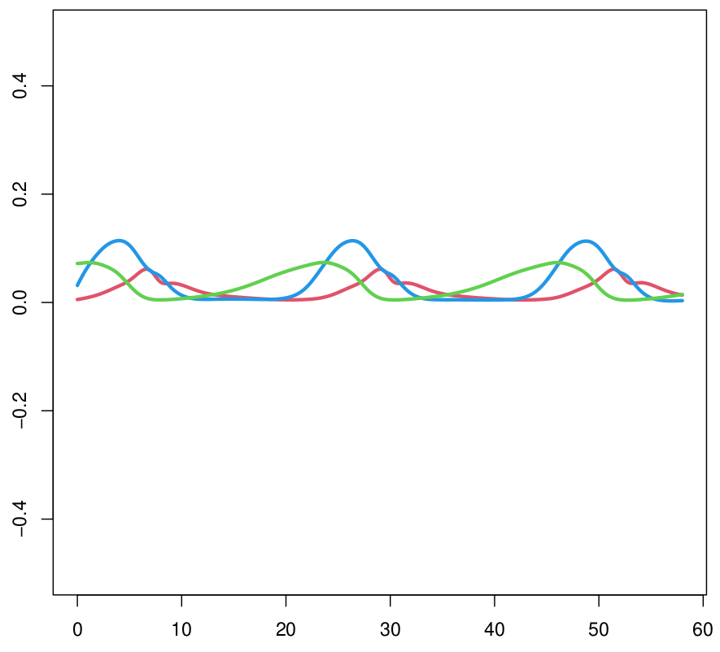
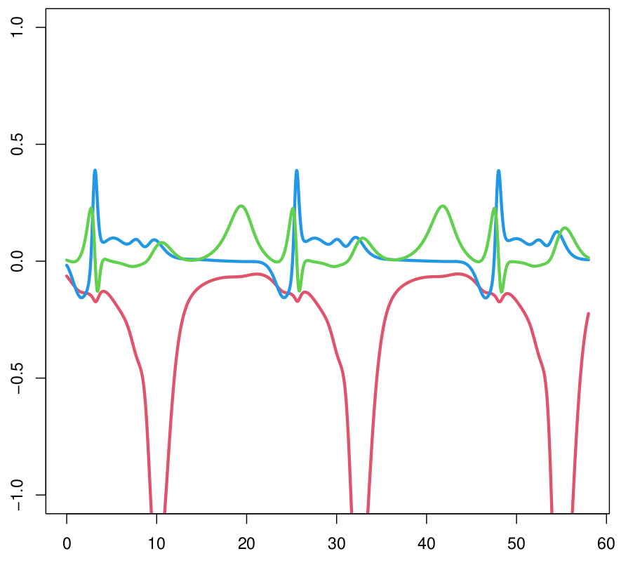
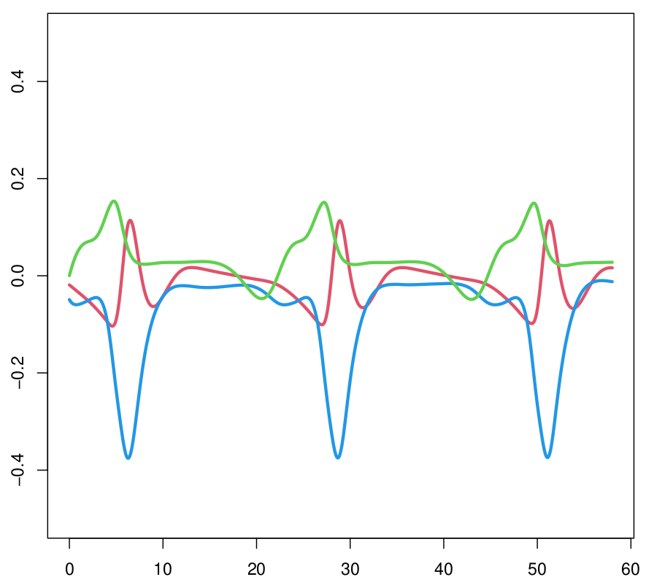
Effects and Strength with a Sigmoid activation function
Rotifer
Flagellate
Algae
Per Cap. Growth Rate
Effect
Strength
Time
Using NODEs to infer interactions

Slide 4
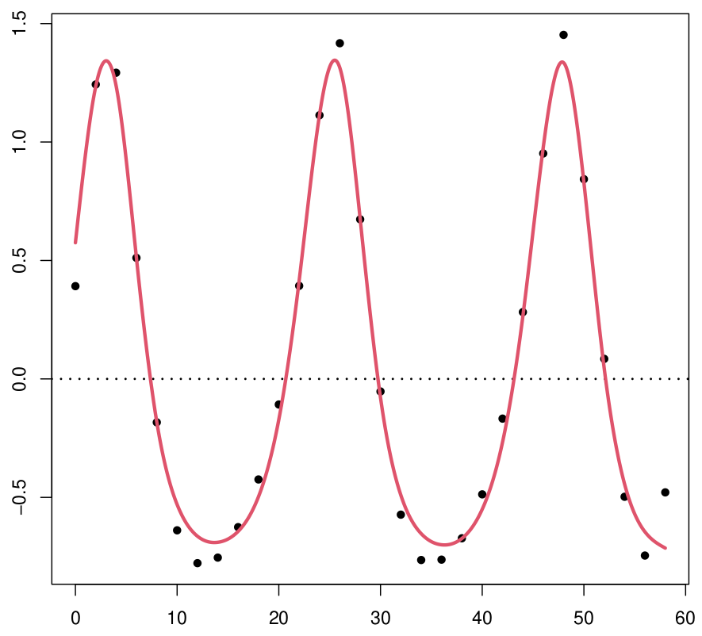
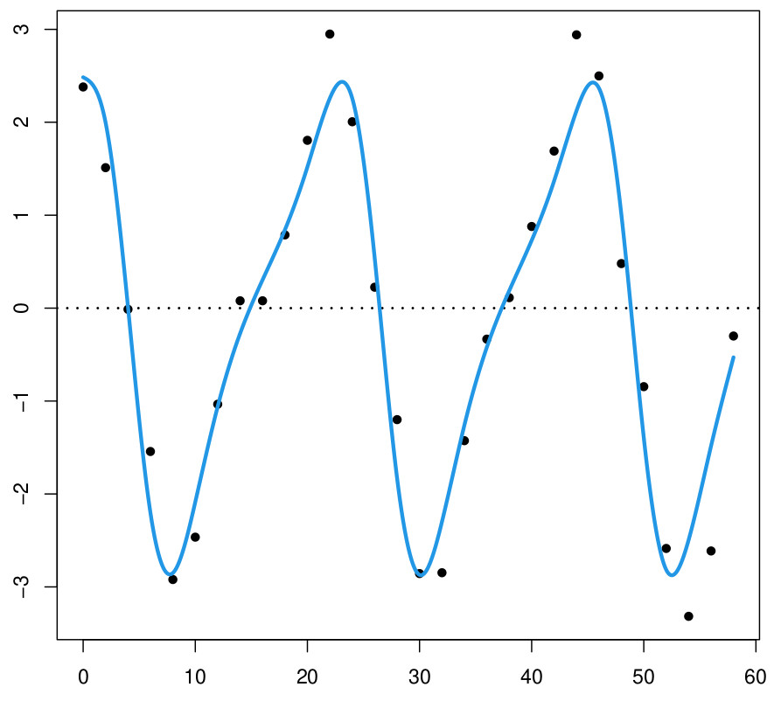
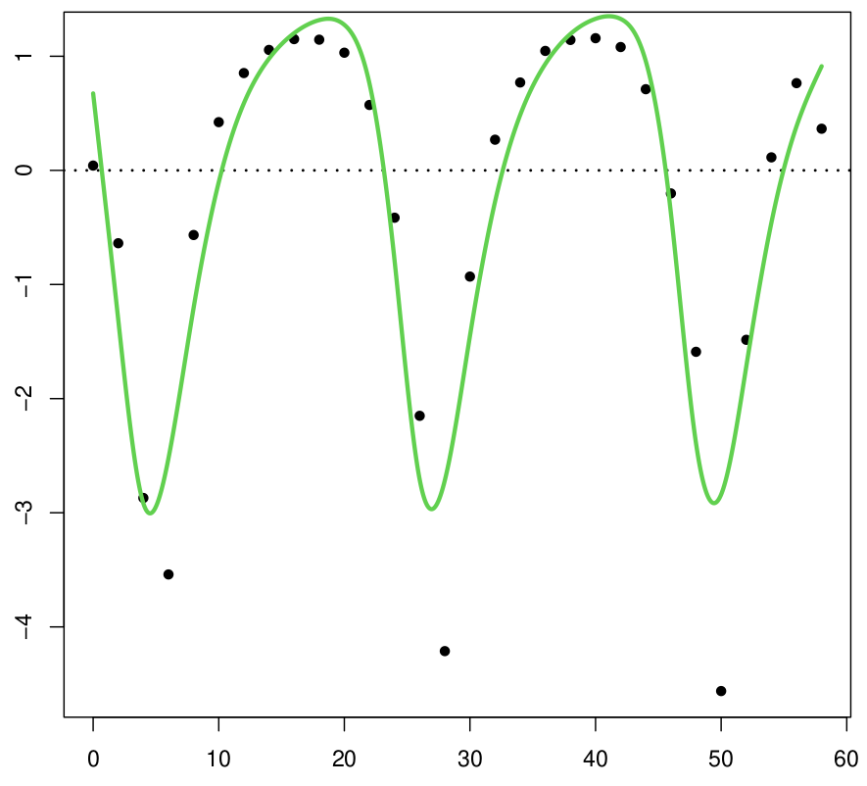
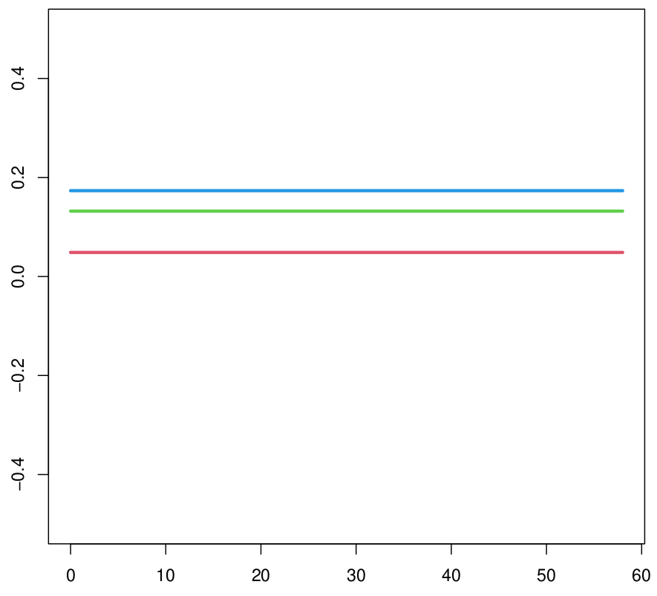
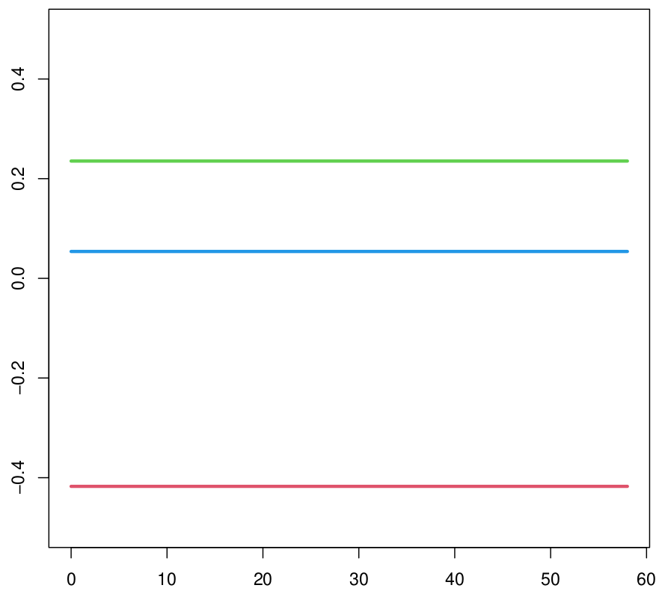
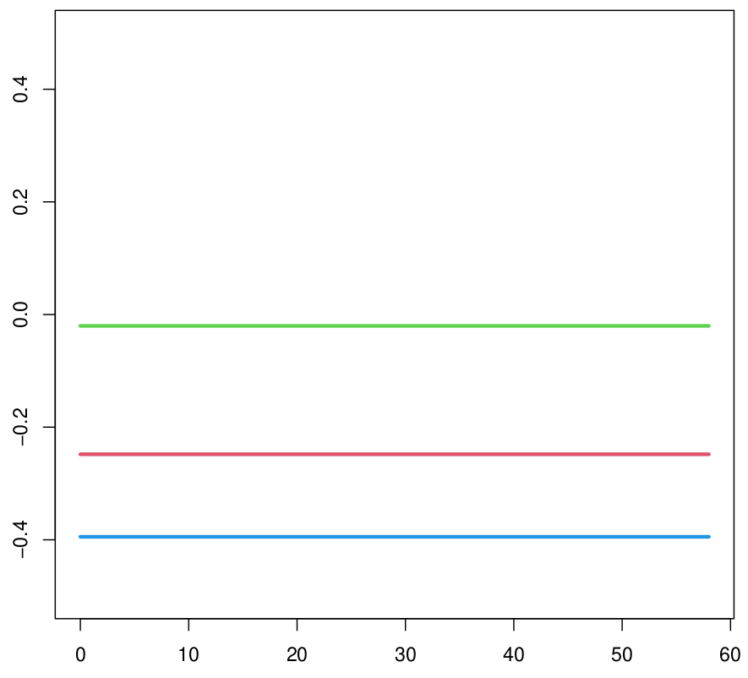
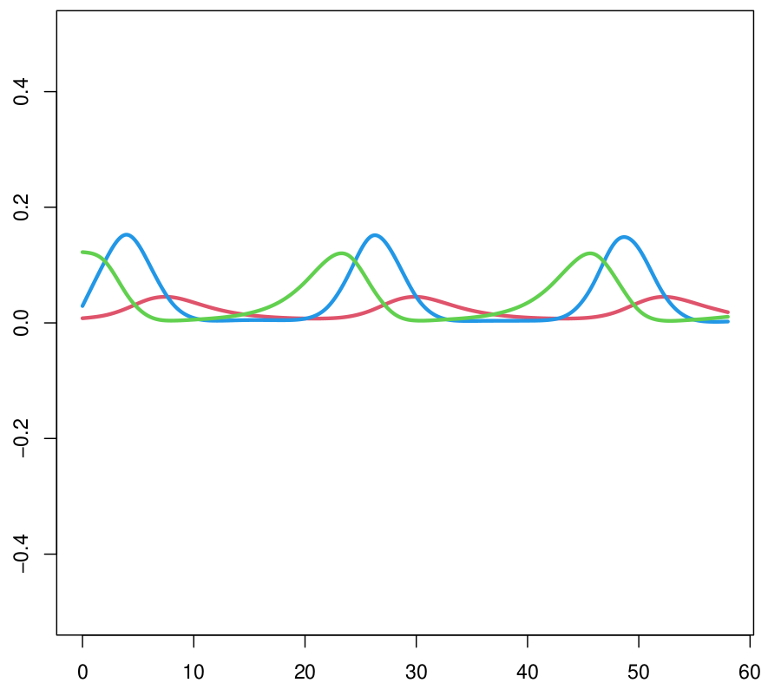
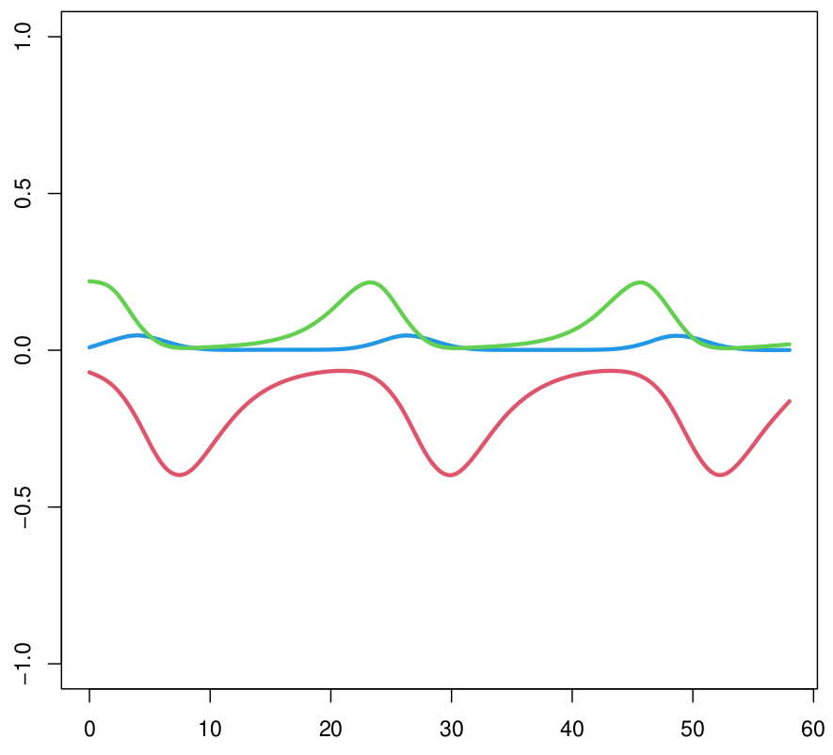
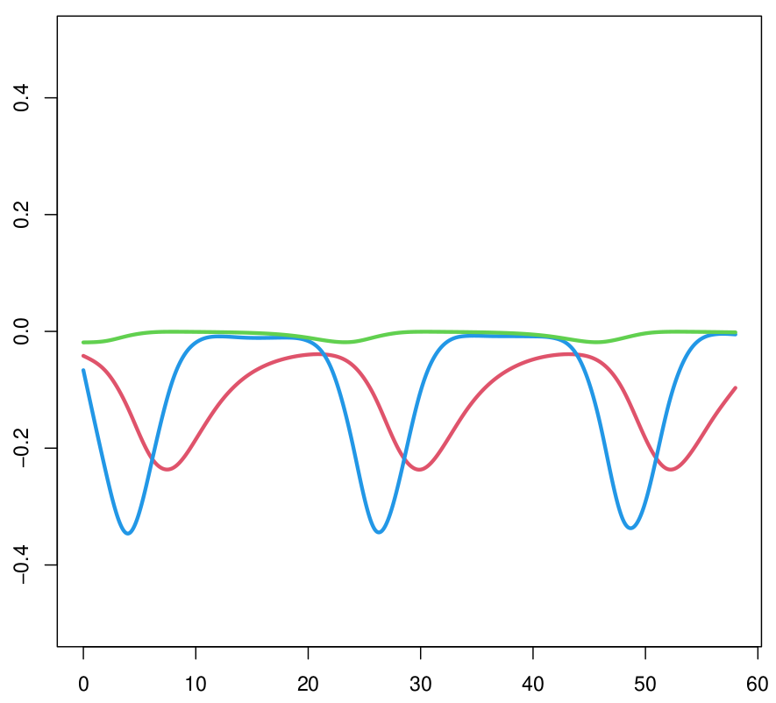
Effects and Strength with a no activation function
Rotifer
Flagellate
Algae
Per Cap. Growth Rate
Effect
Strength
Time
Using NODEs to infer interactions

Slide 5
Bibliography
Bonnaffé, W., & Coulson, T. (2022). Fast fitting of neural ordinary differen-tial equations by Bayesian neural gradient matching to infer ecological interactions from time series data. arXiv:2209.06184
Bonnaffé, W., Sheldon, B. C., & Coulson, T. (2021). Neural ordinary differential equations for ecological and evolutionary time series analysis. Methods in Ecology and Evolution, 2, 1–­46.
Hiltunen, T., Jones, L. E., Ellner, S. P., & Hairston, N. G. J (2013). Temporal dynamics of a simple community with intraguild predation: An experimental test. Ecology, 94(4), 773–­779. https://doi.org/10.1890/12-­0786.1
Using NODEs to infer interactions

Slide 6
Thank You for Your Attention!
Short Presentation Title

