Slide 1



Slide 2
https://www.jenkins.io/download/

Slide 3
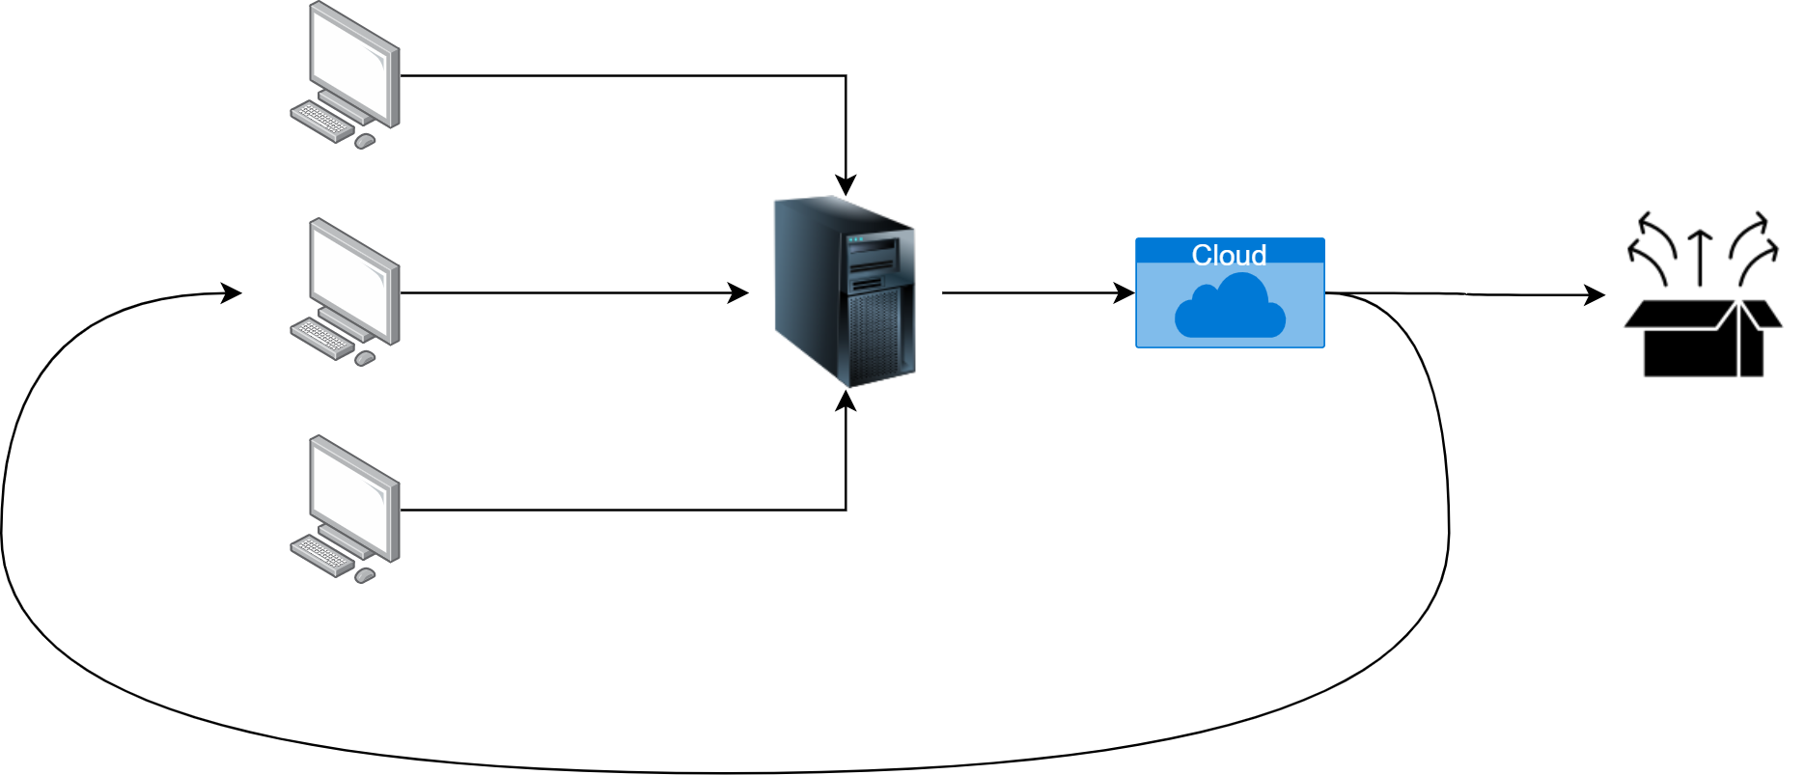

Slide 4



Scheduling

Slide 5









Slide 6

Extensible

Slide 7
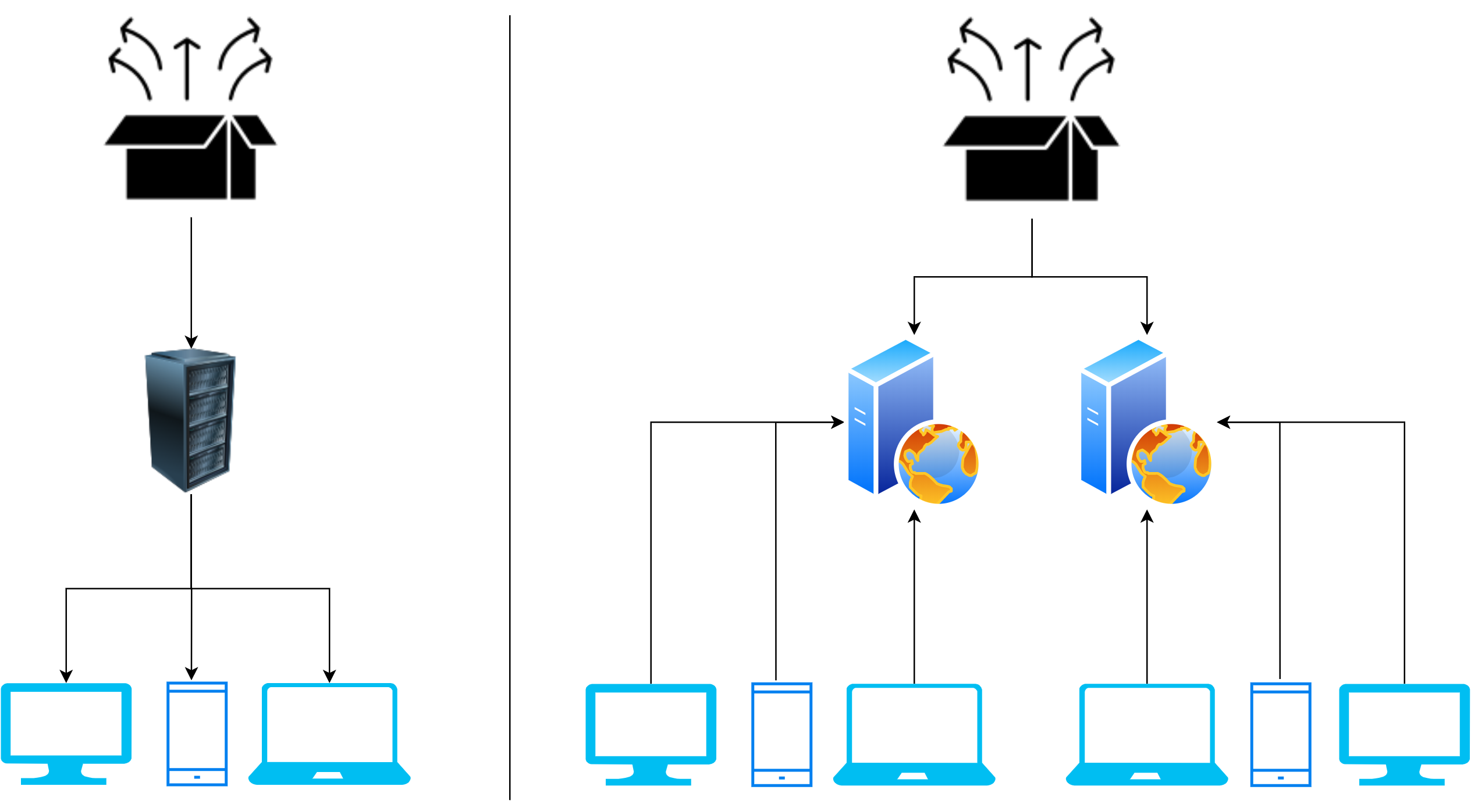

Slide 8

STRG+SHIFT+F

