Slide 1
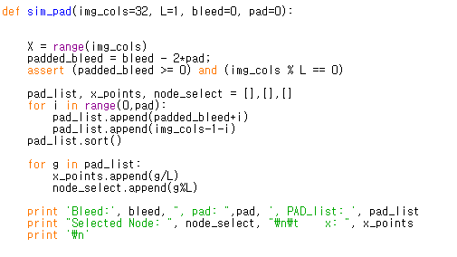

Conv
ReLU
$$B_{padded}=B−P$$
PAD
Conv
Node selection for Padding

Slide 2
L =2
L =4
L =8
B = 6, P = 1
L =2
L =4
L =8

Slide 3
B = 6, P = 2
L =2
L =4
L =8
B = 6, P = 3
L =2
L =4
L =8

Slide 4


$$x=0$$
$$x=0$$
1
1
2
3
4
5
6
7
8
9
2
3
4
5
6
7
8
9
1
1
1
1
2
3
4
5
2
3
2
3
4
5
2
3
6
7
8
9
4
5
6
7
8
9
4
5
6
7
6
7
8
9
8
9
1
1
2
3
4
5
6
7
8
9
2
3
4
5
6
7
8
9

Slide 5


$$x=0$$
1
2
$$x=0$$
1
2
3
3
4
5
6
7
8
9
A
4
5
6
7
8
9
A
B
1
2
3
4
1
2
1
1
2
3
5
6
3
4
5
6
2
3
4
5
6
7
7
8
7
8
9
A
4
5
8
9
A
B
9
A
6
7
8
9
A
B
1
2
1
2
3
3
4
5
6
7
8
9
A
4
5
6
7
8
9
A
B

Slide 6
B = 8, P = 1
L =3
L =5

Slide 7
B = 8, P = 2
L =3
L =5

Slide 8
B = 8, P = 3
L =3
L =5

Slide 9
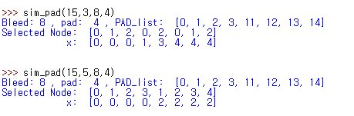
B = 8, P = 4
L =3
L =5

