Slide 1
Database Technologies
Foundational Concepts
Sebastian Raba

Slide 2
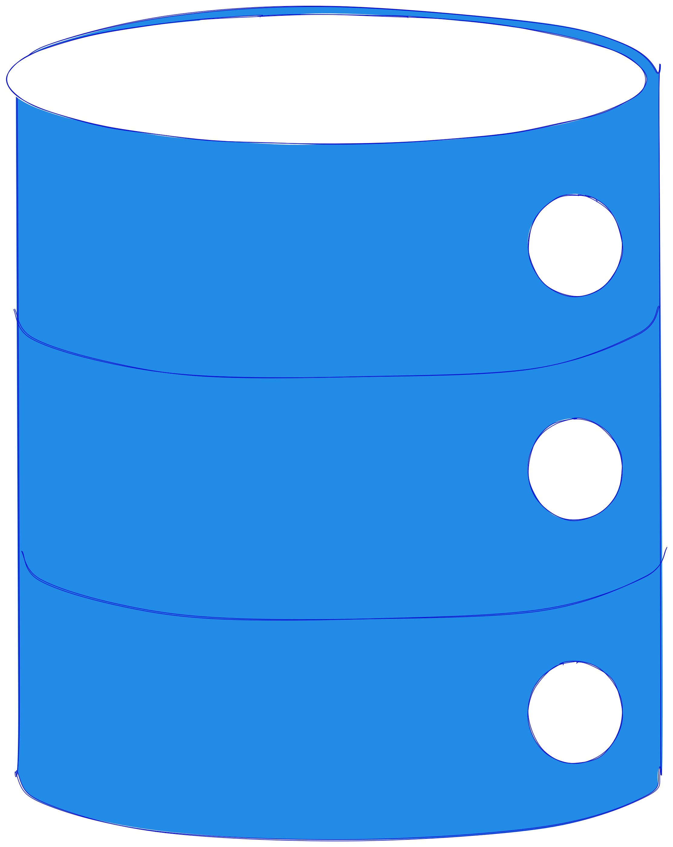
What is a Database
A structured collection of data
Designed for efficiency, integrity and security
Store, organise and retrieve information reliably

Slide 3
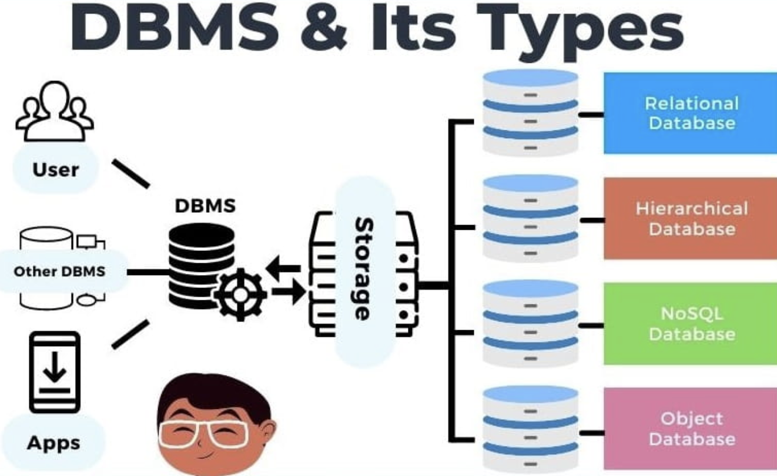
DBMS
DBMS stands for Database Management System.
It's the software that manages the database itself.
Key Functions:
Storing and retrieving data.
Ensuring data integrity and security.
Managing concurrent access (multiple users at once).
Providing a query language (like SQL).

Slide 4
Types of Databases
Relational Databases (SQL):
Organize data into tables with predefined schemas
Ideal for structured data with clear relationships (e.g., e-commerce, banking).
Non-Relational Databases (NoSQL):
Flexible, schema-less.
Four main types: Key-Value, Document, Columnar, and Graph.
Ideal for unstructured data or high-scale, distributed systems.
Notes:
Examples for NoSQL Databases 💻

Slide 5
Types of Databases

Slide 6


Relational Dbs
MySQL, PostgreSQL
Relational databases, often called SQL databases, organize data into tables with a predefined schema. Their structured nature is a key feature, ensuring data integrity and consistency.
Use Case:
Commonly used for large-scale corporate applications, business intelligence systems, and financial applications that need robust security and reporting features. It integrates seamlessly with other Microsoft products.

Slide 7
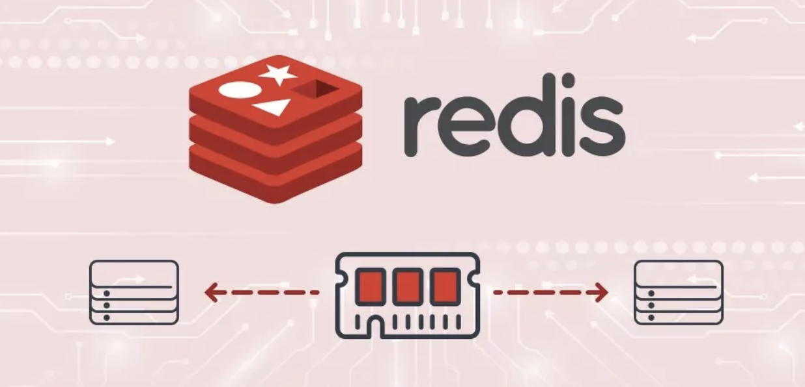
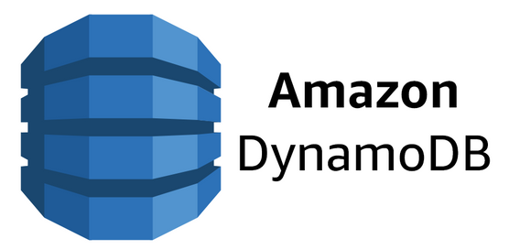
Key-Value Databases
Redis, DynamoDB.
Think of them as a giant hash map or dictionary where each item has a unique key and a value.
Use Case:
Ideal for sessions, user profiles, or caching where you need extremely fast access to data using a simple key lookup.
Notes:
For instance, a shopping cart's content could be stored with a key like user:1234:cart and a value of a JSON string.

Slide 8


Document Databases
MongoDB, Couchbase
They store and retrieve data as "documents" in formats like JSON or BSON. This is great for data with a flexible or evolving schema.
Use Case:
Perfect for content management systems, blogs, or e-commerce product catalogs where different products might have different attributes

Slide 9


Columnar Databases
Cassandra, HBase
Data is stored in columns instead of rows. This allows for very efficient aggregation and scanning of large datasets.
Use Case:
Best suited for analytical workloads, business intelligence, or time-series data where you often need to read and aggregate data from a small number of columns across a large number of rows.
Notes:
For example, analyzing website traffic data where you want to know the total page views by URL.

Slide 10


Graph Databases
Neo4j, Amazon Neptune
These are designed to store and navigate relationships between data points. They use nodes and edges to model complex connections.
Use Case:
Excellent for social networks (finding friends of friends), recommendation engines ("users who bought this also bought..."), and fraud detection where you need to trace relationships and patterns across a large network of transactions.

Slide 11
Discussion

Slide 12
Relational Model and ERD

Slide 13
The Foundation of Relational Databases
Data is organized into relations, which we call tables.
Each table has:
Rows (Tuples): A single record or instance of an entity.
Columns (Attributes): The fields that define the data in the table.
Notes:
The Foundation of Relational Databases

Slide 14
Tables and Keys
Primary Key (PK): A column that uniquely identifies each row in a table. It cannot be null and must be unique.
Foreign Key (FK): A column (or set of columns) that links to the primary key of another table. It establishes a relationship between tables.
Analogy: A student ID is a Primary Key. The student ID in the Courses table is a Foreign Key that links to the Students table.

Slide 15
Entity-Relationship Diagrams (ERDs)
A visual way to model the structure of a database.
Uses symbols to represent entities, their attributes, and the relationships between them.
Key components:
Entities: The objects or concepts (e.g., Customer, Order).
Attributes: The properties of an entity (e.g., CustomerName, OrderDate).
Relationships: How entities connect (e.g., a Customer places an Order).
Notes:
Entity-Relationship Diagrams (ERDs)

Slide 16
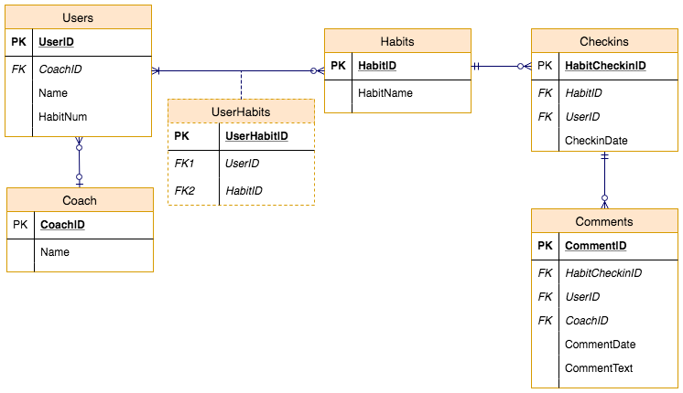

Slide 17
Hands on

Slide 18
Normalization

Slide 19
What is normalisation?
A process for organizing data to reduce redundancy and improve data integrity.
Why it's important:
Avoids data duplication.
Makes updates, insertions, and deletions easier and safer.
Ensures data consistency.

Slide 20
Normal Forms
1NF, 2NF, 3NF
1NF (First Normal Form): Each column must contain atomic, single values. No repeating groups.
2NF (Second Normal Form): Must be in 1NF, and all non-key attributes must be fully dependent on the primary key.
3NF (Third Normal Form): Must be in 2NF, and all non-key attributes are not transitively dependent on the primary key (i.e., they don't depend on other non-key attributes).
Notes:
Note to presenter: Use a single, clear example that you can walk through as you normalize it from 1NF to 3NF.

Slide 21
1NF
OrderID | OrderDate | CustomerID | CustomerName | CustomerAddress | ISBN | BookTitle | AuthorName | Quantity
1001 | 2025-07-20 | 201 | John Smith | 123 Main St, Anytown | 978-0321765723 | The Catcher in the Rye | J.D. Salinger | 1
1001 | 2025-07-20 | 201 | John Smith | 123 Main St, Anytown | 978-0451524935 | 1984 | George Orwell | 2
1002 | 2025-07-21 | 202 | Jane Doe | 456 Elm St, Anytown | 978-0451524935 | 1984 | George Orwell | 1

Slide 22
2NF
Orders
OrderID | OrderDate | CustomerID | CustomerName | CustomerAddress
1001 | 2025-07-20 | 201 | John Smith | 123 Main St, Anytown
1002 | 2025-07-21 | 202 | Jane Doe | 456 Elm St, Anytown
Order Items
Books
ISBN | OrderID | Quantity
978-0321765723 | 1001 | 1
978-0451524935 | 1001 | 2
978-0451524935 | 1002 | 1
ISBN | BookTitle | AuthorName
978-0321765723 | The Catcher in the Rye | J.D. Salinger
978-0451524935 | 1984 | George Orwell

Slide 23
3NF
Order_items
Books
ISBN | OrderID | Quantity
978-0321765723 | 1001 | 1
978-0451524935 | 1001 | 2
978-0451524935 | 1002 | 1
ISBN | BookTitle | AuthorName
978-0321765723 | The Catcher in the Rye | J.D. Salinger
978-0451524935 | 1984 | George Orwell
Customers
Orders
CustomerID | CustomerName | CustomerAddress
201 | John Smith | 123 Main St, Anytown
202 | Jane Doe | 456 Elm St, Anytown
OrderID | OrderDate | CustomerID
1001 | 2025-07-20 | 201
1002 | 2025-07-21 | 202

Slide 24
DDL
DDL is used to define and manage database objects.
CREATE TABLE: The most common DDL command.
Constraints: Rules enforced on data columns.
PRIMARY KEY, FOREIGN KEY (recap).
UNIQUE: Ensures all values in a column are different.
NOT NULL: Ensures a column cannot have a null value.
DEFAULT: Sets a default value for a column.

Slide 25
Hands on

Slide 26
Introduction to SQL

Slide 27
Structured Query Language
Structured Query Language
The standard language for communicating with relational databases.
It's used for:
Creating and managing the database structure.
Inserting, updating, and deleting data.
Querying and retrieving data.

Slide 28
DDL X DML
DDL (Data Definition Language): Defines the database schema.
CREATE, ALTER, DROP
DML (Data Manipulation Language): Manipulates the data within the schema.
INSERT, UPDATE, DELETE, SELECT

Slide 29
INSERT INTO table_name (col1, col2) VALUES (val1, val2);
Adds a new row to a table.
UPDATE table_name SET col1 = val1 WHERE condition;
Modifies existing rows in a table.
SELECT col1, col2 FROM table_name WHERE condition;
The most powerful and used command! Retrieves data from a table.
DELETE FROM table_name WHERE condition;
Removes one or more rows from a table. Caution is key!

