Slide 1
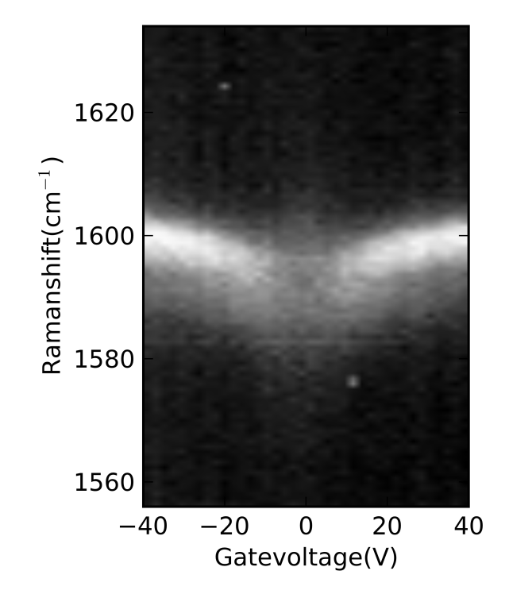
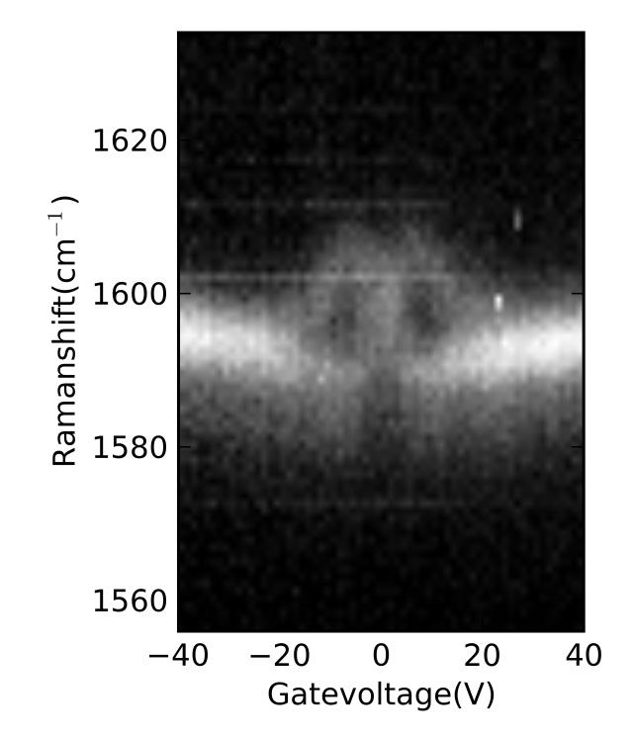
a)
b)
B=0T
B=12.6T
n(10¹²cm⁻²)
-3 -1.5 0 1.5
ν
-9.5 -4.5 0 4.5

