Slide 1
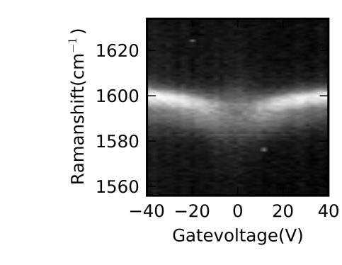
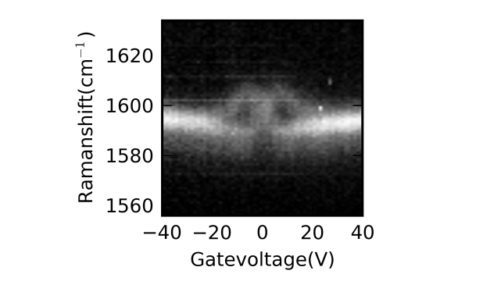

SPECTRO-GRAPH
E_{n}
$$Δn=±1$$
n=2
LASER
n=1
ELECTRIC READOUT
n=0
Stage
n=-1
n=-2

