Slide 1
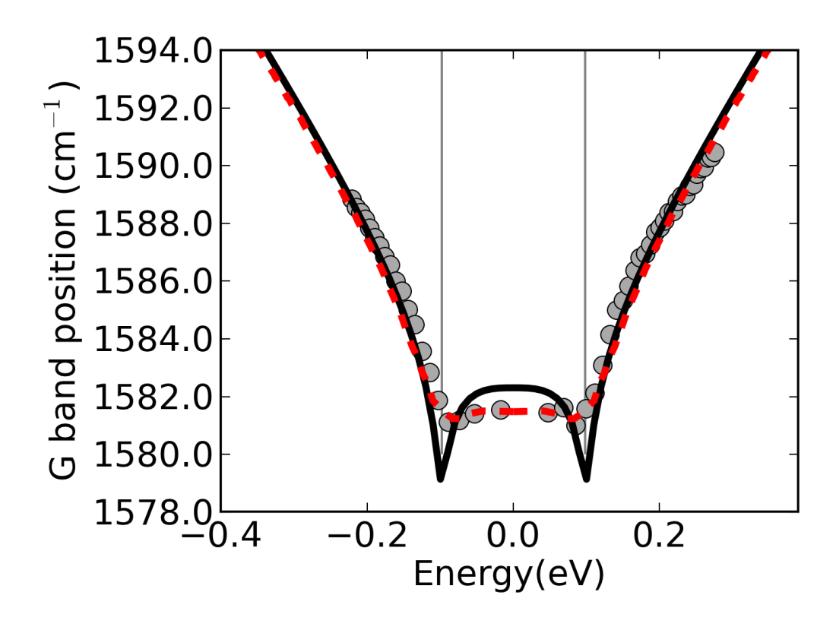
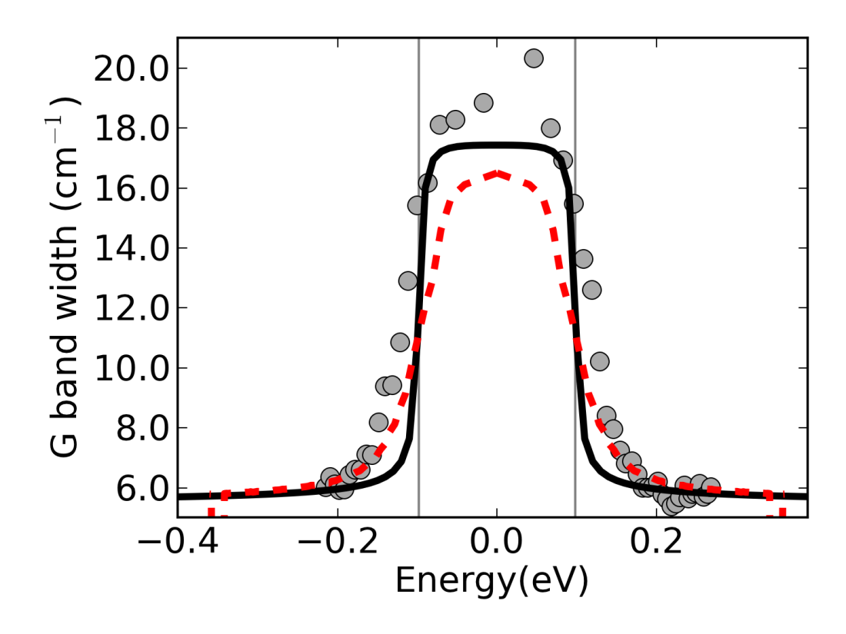
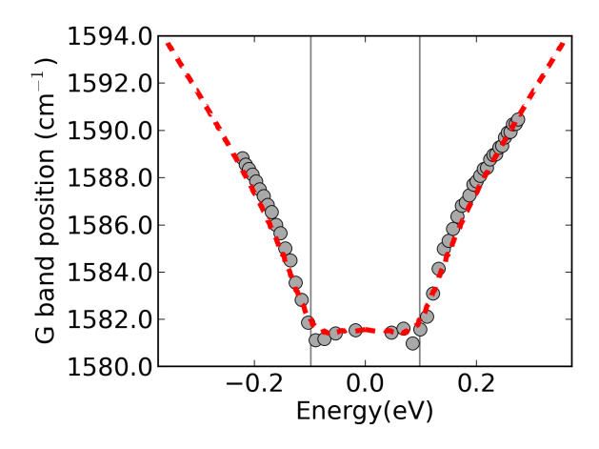
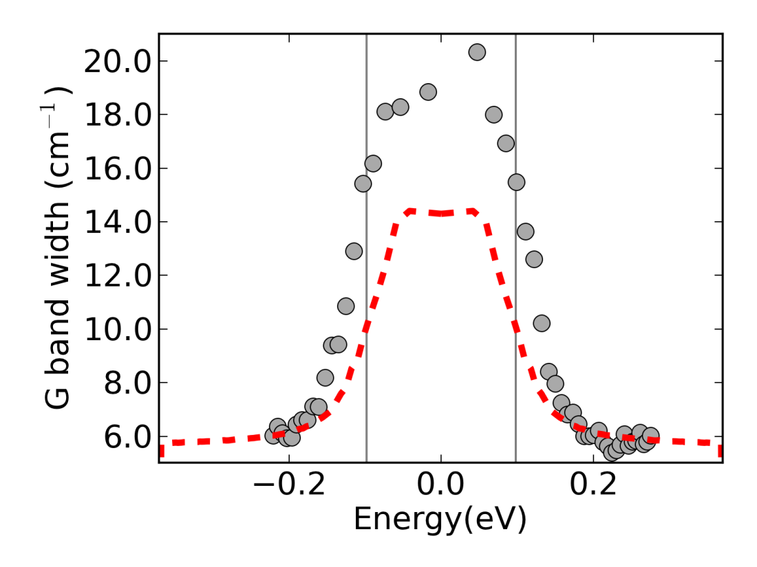
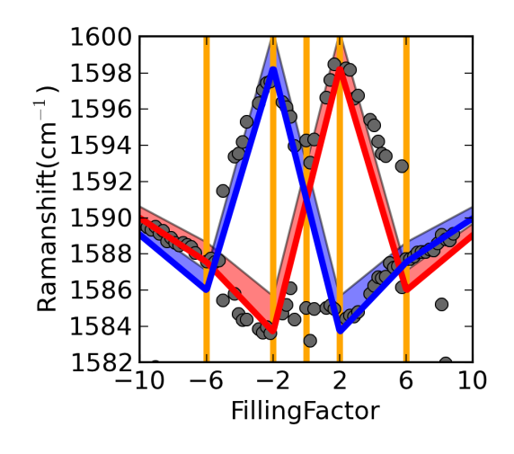



(a)
B=0T, v_{F}=1.10x10⁶ms⁻¹, λ=4.8x10⁻³
$$ℏω_{G}$$
$$∝λ$$
$$ℏω_{G}$$
(b)
B=0T, v_{F}=1.18x10⁶ms⁻¹, λ=4.8x10⁻³
$$∝λ$$
(c)
B=12.6T, v_{F}=1.18x10⁶ms⁻¹, λ=4.8x10⁻³

