Slide 1
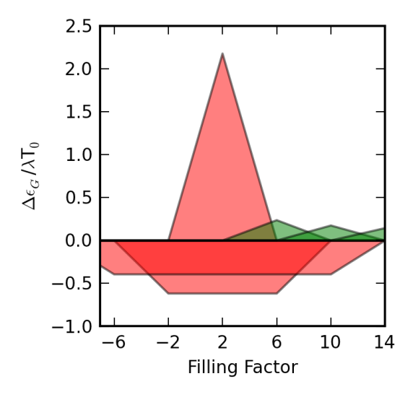
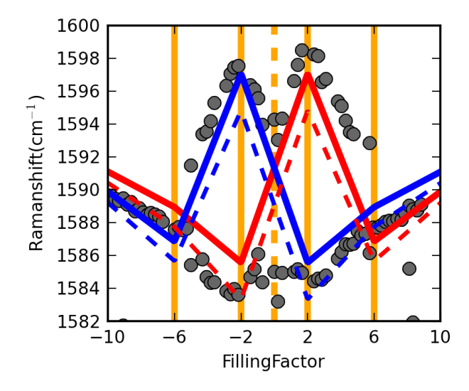









a)
b)
c)
$$Δn=±1$$
B=12.6T
E_{n}
$$(T_{1},f_{1}^{+})$$
- only
n=2
n=1
$$(S_{1},f_{1}^{+})$$
$$(S_{2},f_{2}^{+})$$
n=0
$$ℏω_{G}$$
$$(T_{3},f_{3}^{+})$$
n=-1
$$(T_{2},f_{2}^{+})$$
n=-2
T₀
T₁
S₁
$$ν$$
$$ν$$

