Slide 1
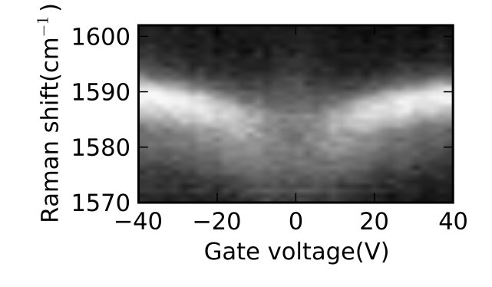
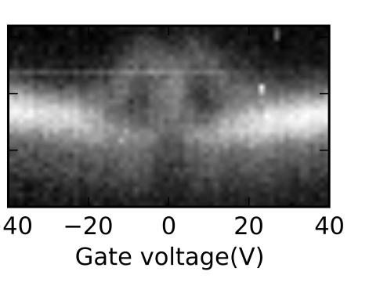
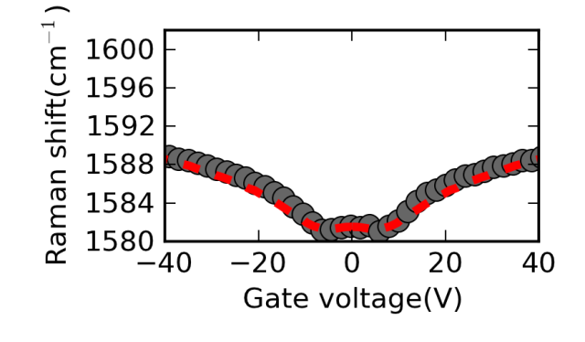
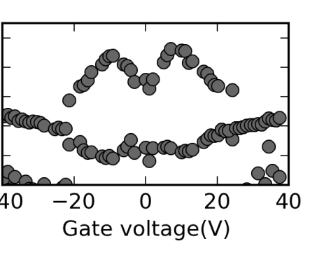
a)
B=0T
b)
B=12.6T
n(10¹²cm⁻²)
-3 -1.5 0 1.5
Filling Factor ν
-6
0
6
c)
d)
-6
0
6

