Slide 1
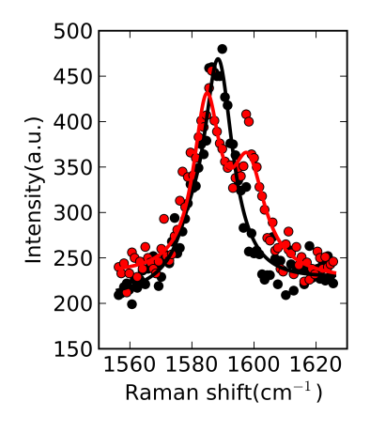
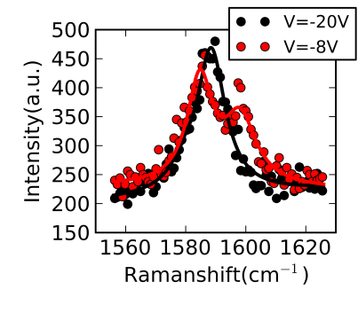


a)
b)
$ν$=-4.7
SPECTRO-GRAPH
$ν$=-1.8
LASER
633nm
Intensity(a.u.)
T=4K
V_{bg}
Stage
B=12.6T

