Slide 1
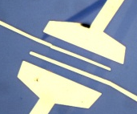
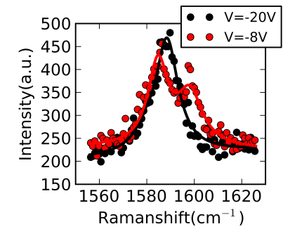
a)
b)
5μm
SPECTRO-GRAPH
LASER
633nm
c)
ν=-4.7
ν=-1.8
T=4K
V_{bg}
Stage
B=12.6T

