Slide 1
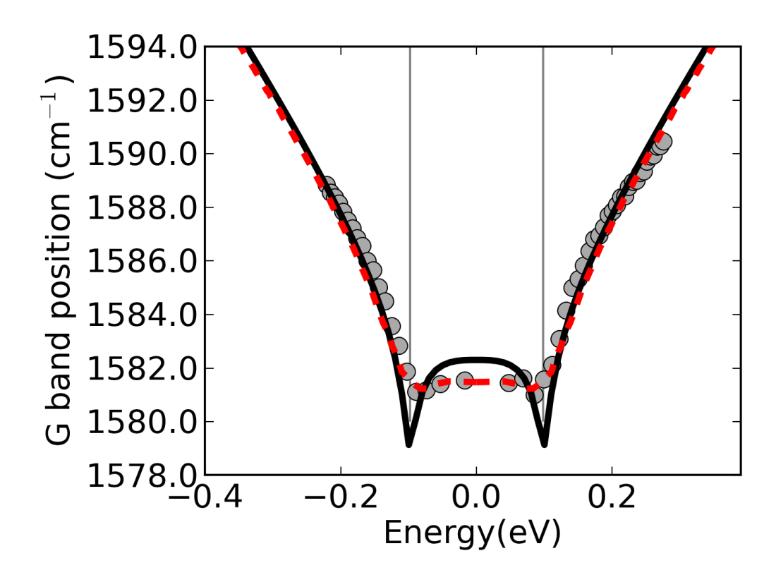
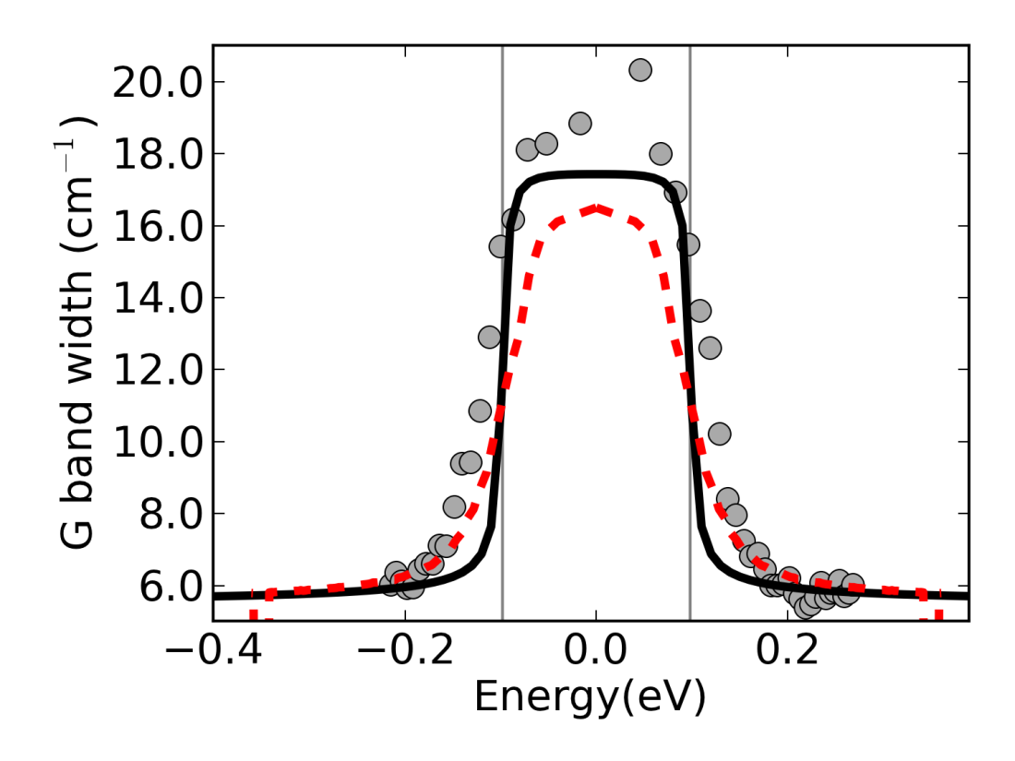
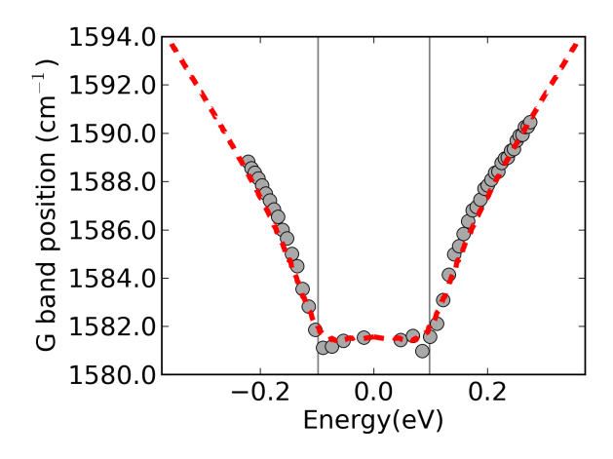
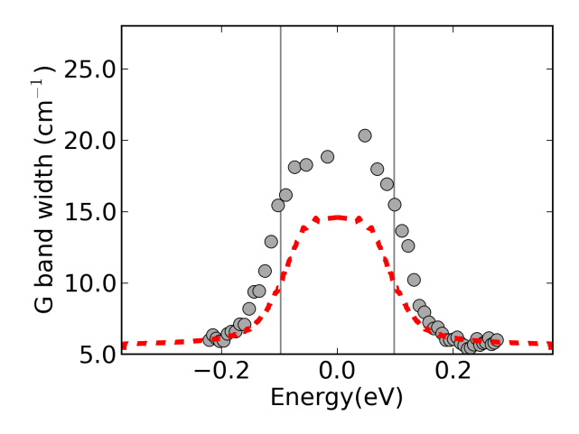
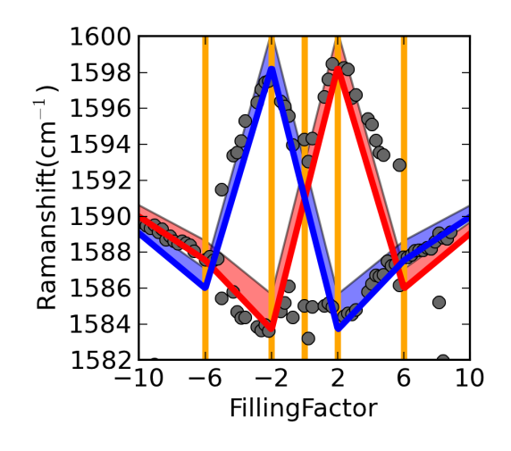


(a) B=0T, v_{F}=1.10x10⁶ms⁻¹
$$ℏω_{G}$$
$$ℏω_{G}$$
(b) B=0T, v_{F}=1.18x10⁶ms⁻¹
(c) B=12.6T, v_{F}=1.18x10⁶ms⁻¹

