Slide 1
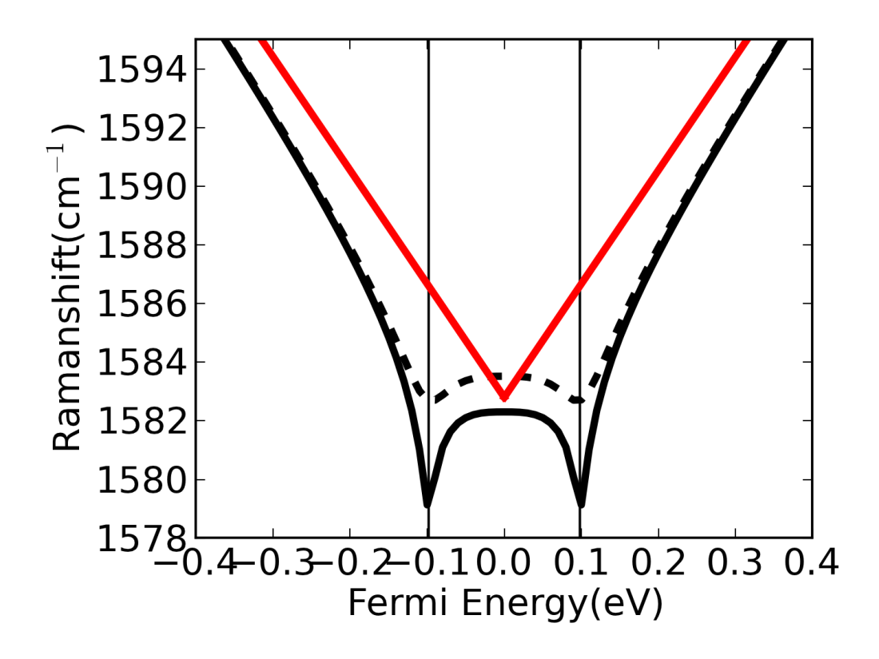
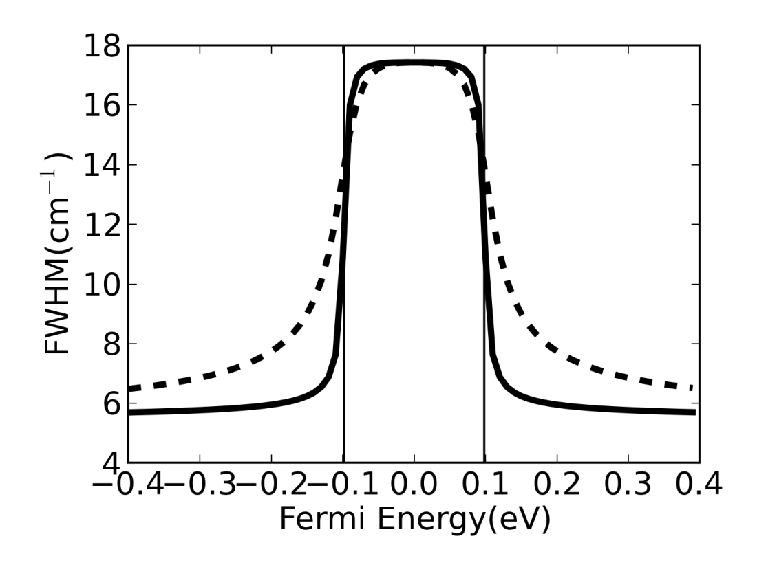
(a)
(b)
δ=10meV
δ=50meV
δ=10meV
δ=50meV

