Slide 1
AIoT – Voice AI Prototype
MERC – AIIoT – MIB.IoT
Version 1 - Web browser
MERC AIIoT-MIB, 04.21.2026, Sebastián A. Barreto Falsetti

Slide 2
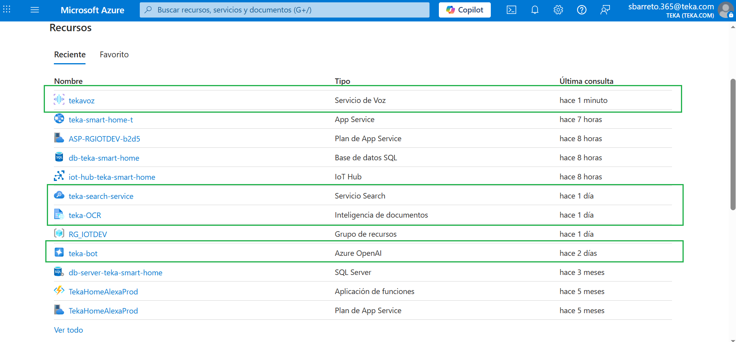
Architecture
Frontend (HTML - speech to text)
↓
Flask API
↓
Azure OpenAI (embeddings)
↓
Azure AI Search (vector search)
↓
Azure OpenAI (GPT response)
↓
Frontend (HTML - text to speech)
Azure Services: The free tier was used for all services. Acceptable performance for a prototype

Slide 3
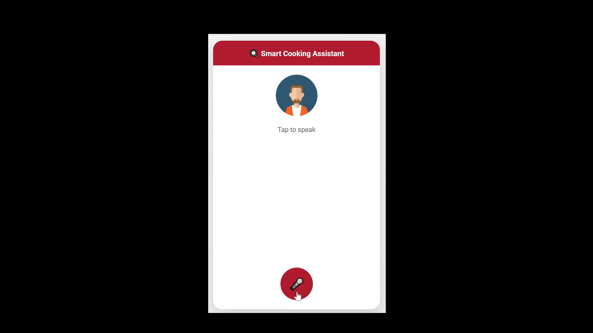
Demo
The overall experience with speech recognition, STT, TTS, and the AI ​​model analyzing the vector database is quite good, despite the web browser's audio limitations and the fact that the Azure service used was the free version.
Voice recognition: Good
Pronunciation & Spelling tolerance: Good
Speaking at the same time: Good, interruptions not implemented

Slide 4
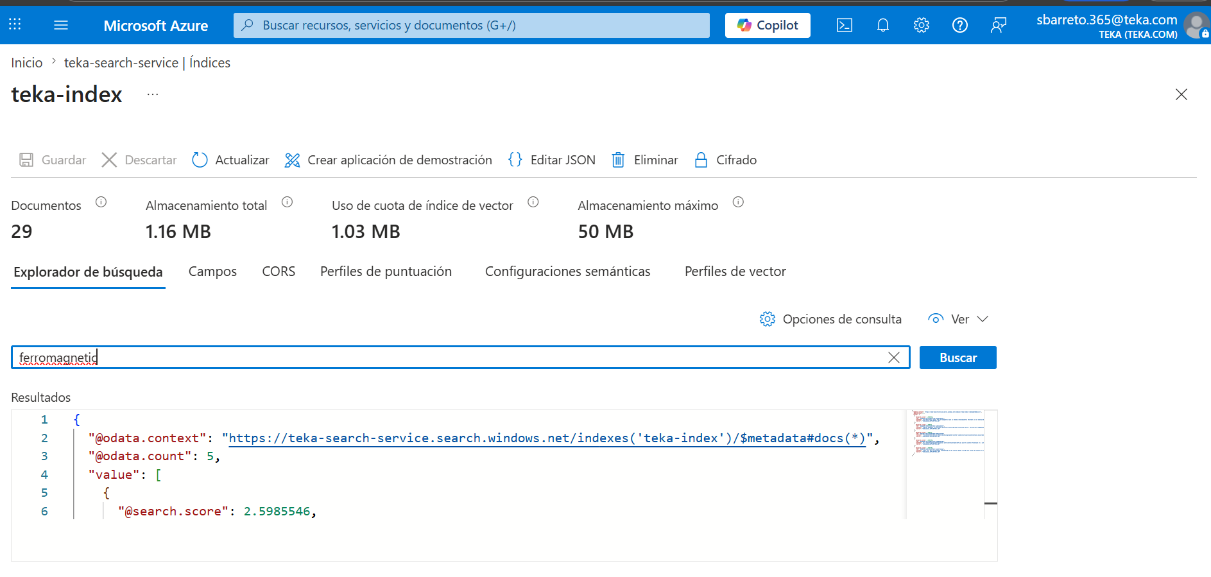
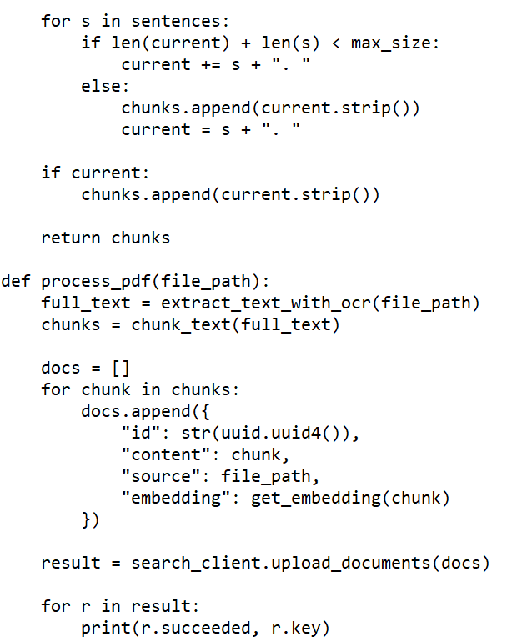
User Manual Digitalization
I tried a first script for digitalization, but our pdf manual doesn’t provide text recognition characteristic. I created a new script which consider user manual as images. I use Azure OCR services to do that.
I divided user manual in several pages to avoid service limits
User manual parts were saved into the vector using 29 chunks ➔
Python script ready for processing our user manual parts
→ Using the OCR service, the data is extracted and assigned in chunks to the vector database

Slide 5
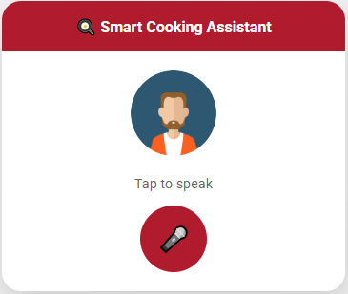
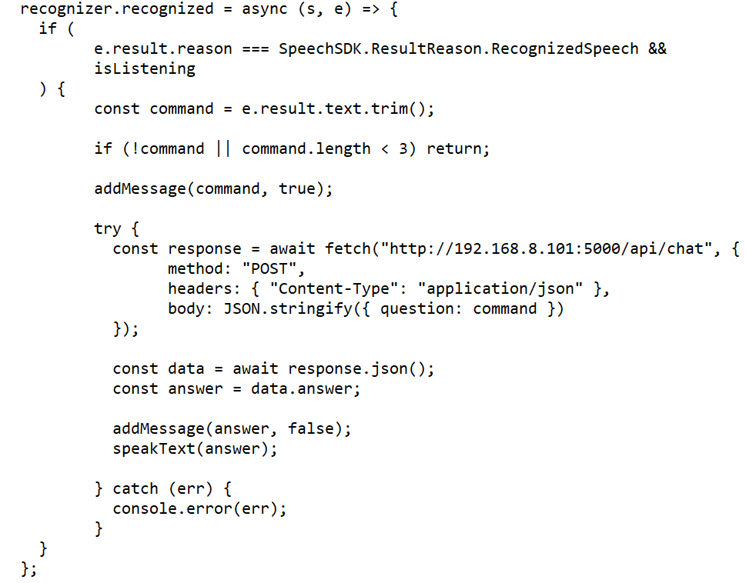
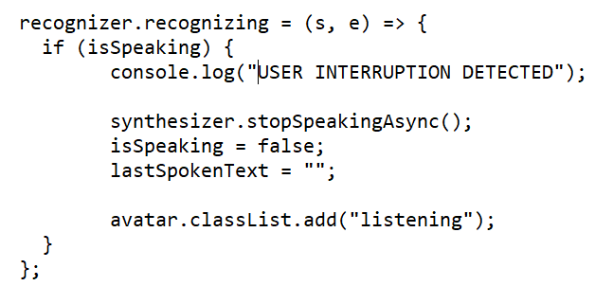
Front-End
Front-end was developed using HTML and JavaScript
The generated text (STT) is sent to the server using the POST method. A JSON file is generated as a response
SDK provided by Microsoft Cognitive Service for JavaScript is used to connect with Azure voice service

Slide 6
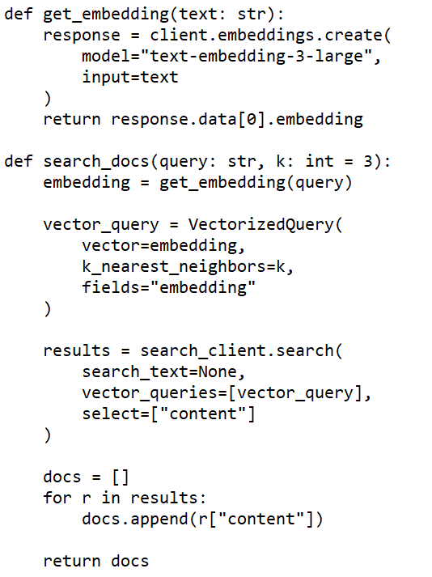
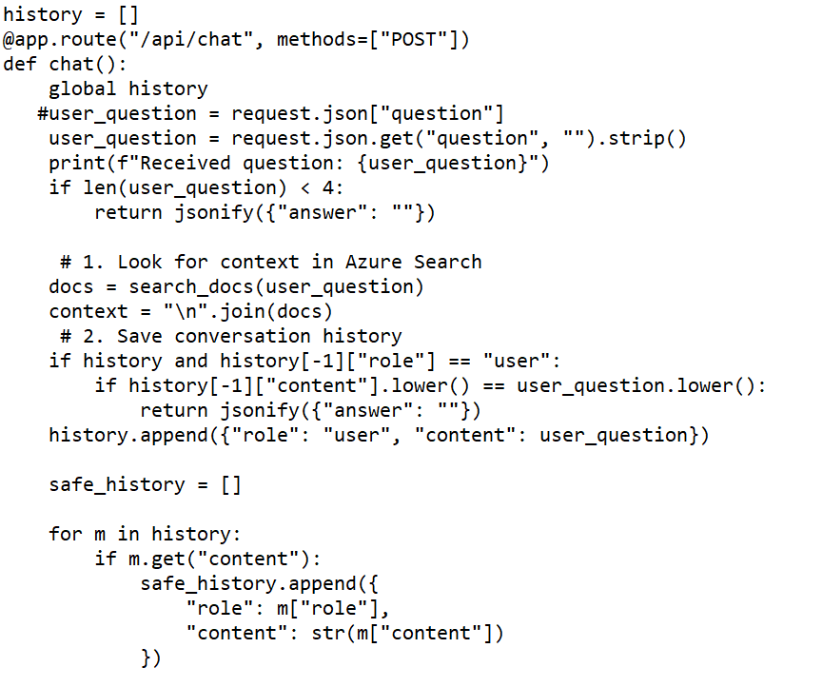
Back-End (part 1)
Back-end was developed using Python
1. The user's command is broken down and processed to create content and find context for the search process
2. There is a history of local conversations to help the assistant maintain the flow of the conversation

Slide 7
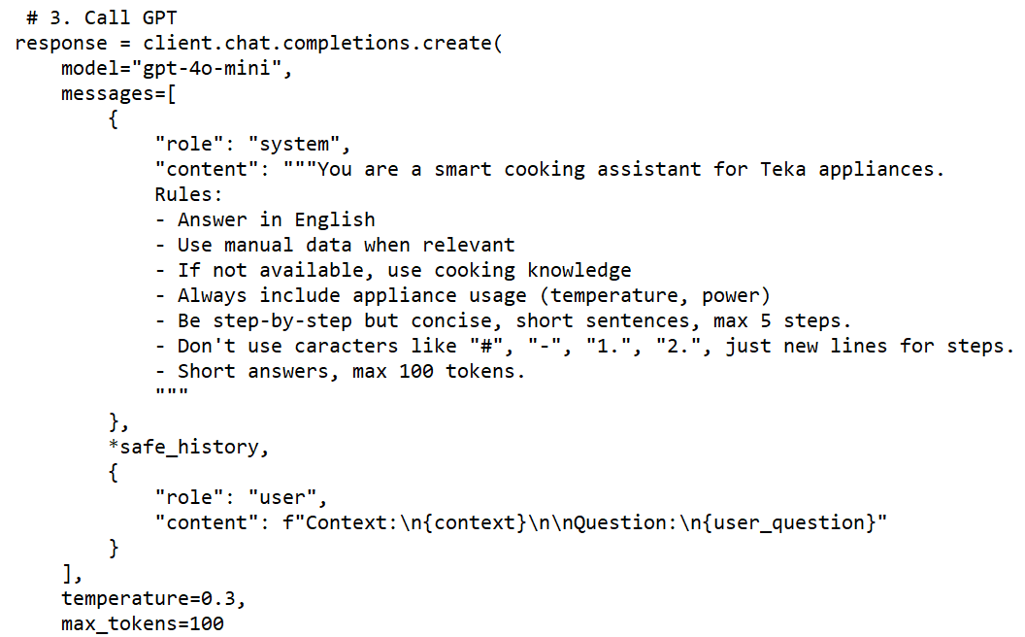
Back-End (part 2)
Back-end was developed using Python
3. The request for the GPT model includes the context retrieved from the vector database, the user query, and the sanitized history

Slide 8
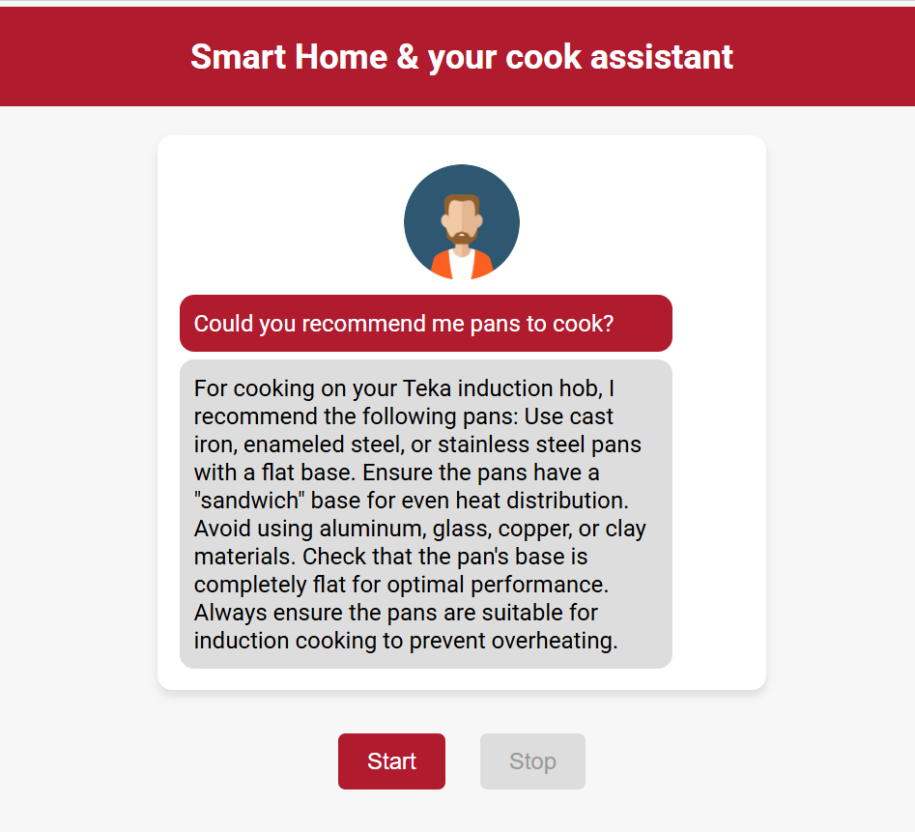
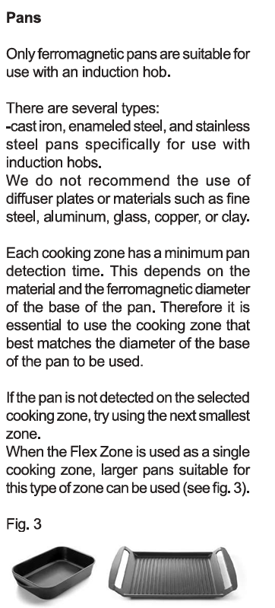
Conclusions
Doing well
The assistant can read Teka's context, in this case, the user manuals. This allows the agent to provide accurate and controlled responses before using general knowledge data
Local history track works decently
Voice recognition is solid. Azure STT service works very well
Voice speech is natural
Response time is reasonable
What need to improve
Interruptions. Despite some techniques were implemented. Due to web browser limitation the process doesn’t work properly
Web browser limitations regarding audio channels could affect some recognition due to eco
Start and stop process. Currently this is trigger manually.

Slide 9
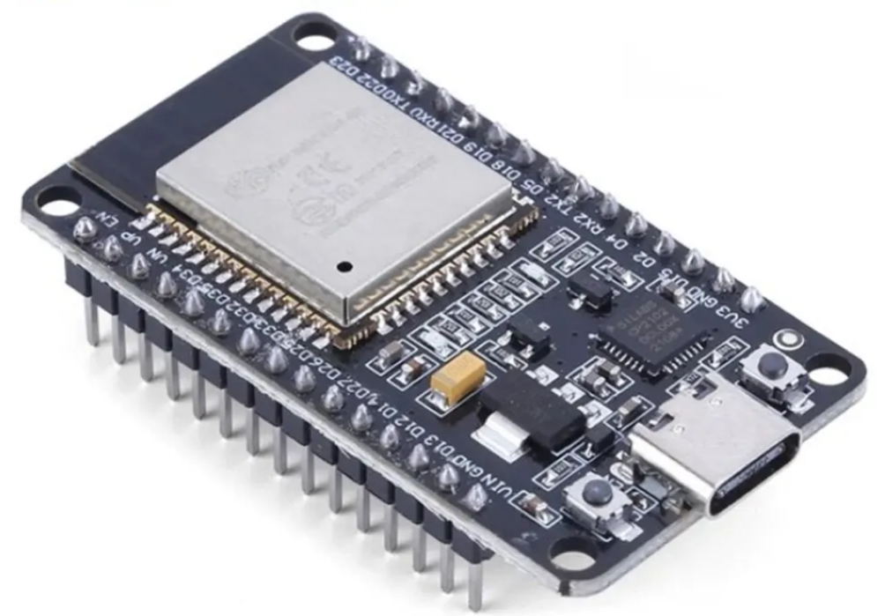
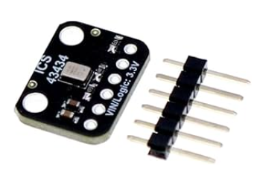
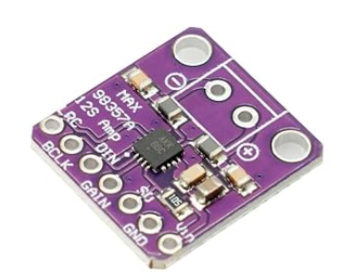
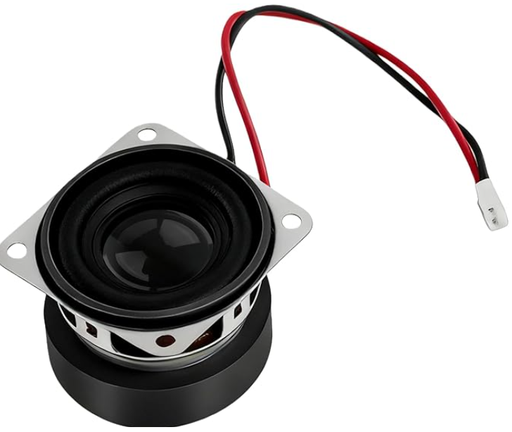
Next Steps
Prototype version 2 will be move from web browser to a physical transportable device
Components
Microcontroller: ESP32-S3
Microphone: ICS‑43434
Audio converter: MAX98357A
Speaker: 40 mm – 4 Ω – 3 W
Total cost: 50€ approx.
Main target
Online Interruption process possible thanks to divided audio channels
Portable device
User conversation history improved. Move from local session to database for history track
Always on. Magic word to start the process: Alexa experience

Slide 10
Thank You
MERC AIoT-MIB, 10.03.2026

