Slide 1
G1 Food Logging System
User’s Profile
Name
Gender
Age
Weight
kgs
Height
cm
Create Profile

Slide 2
G1 Food Logging System
User’s Profile
Name
Gender
Male
Female
Female (Pregnant)
Female (Breastfeeding)
Age
Weight
kg
Height
cm
Create Profile

Slide 3
G1 Food Logging System
User’s Profile
Name
Gender
Age
2 – 3 4 - 8
9 – 11 12 – 13
14 – 18 19 – 50
51 – 70 70+
Weight
kg
Height
cm
Create Profile

Slide 4
G1 Food Logging System
User’s Profile
Name
Gender
Age
Weight
kgs
lbs
kgs
Height
cm
Create Profile

Slide 5
G1 Food Logging System
User’s Profile
Name
Gender
Age
Weight
kgs
Height
cm
cm
inches
Create Profile

Slide 6

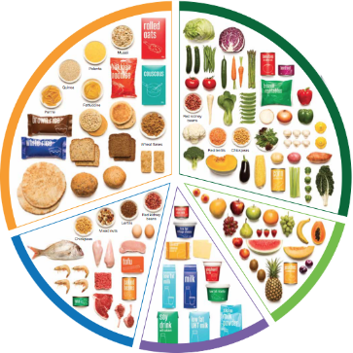
G1 Food Logging System
Log by Food Group
HELP
Daily Summary << 6 Oct 2015 >>

Slide 7
G1 Food Logging System
Log by Food Group
HELP
Group 1 - Grain
3
+
Breakfast
-
Done
Cancel
?
Daily Summary << 6 Oct 2015 >>

Slide 8
G1 Food Logging System
Log by Food Group
HELP
Group 2 - Meat
3
+
Breakfast
-
Done
Cancel
?
Daily Summary << 6 Oct 2015 >>

Slide 9
G1 Food Logging System
Log by Food Group
HELP
Group 3 - Dairy
3
+
Breakfast
-
Done
Cancel
?
Daily Summary << 6 Oct 2015 >>

Slide 10
G1 Food Logging System
Log by Food Group
HELP
Group 4 - Fruit
3
+
Breakfast
-
Done
Cancel
?
Daily Summary << 6 Oct 2015 >>

Slide 11
G1 Food Logging System
Log by Food Group
HELP
Group 5 - Vegetable
3
+
Breakfast
-
Done
Cancel
?
Daily Summary < 6 Oct 2015 >
Daily Summary << 6 Oct 2015 >>

Slide 12
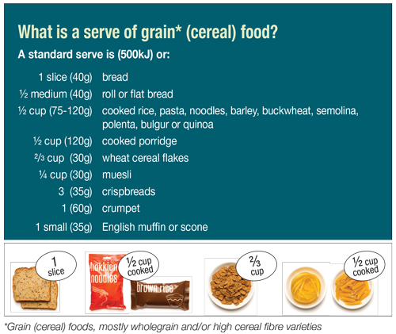
G1 Food Logging System
Group 1 - Grains

Slide 13
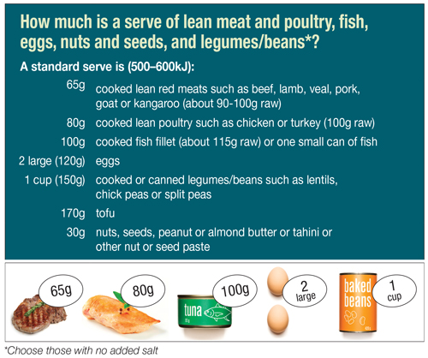
G1 Food Logging System
Group 2 - Meats

Slide 14
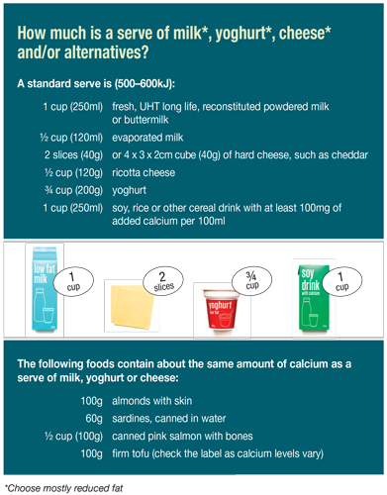
G1 Food Logging System
Group 3 - Dairy

Slide 15
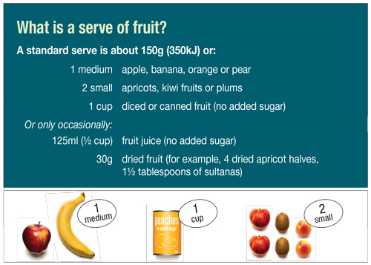
G1 Food Logging System
Group 4 - Fruits

Slide 16
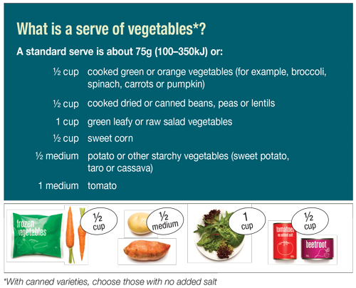
G1 Food Logging System
Group 5 - Vegetable

Slide 17

G1 Food Logging System
<< 6 Oct 2015 >>
Time | Meal | Serve
Breakfast | Grain | 1 | Edit
 | Dairy | 2 | Edit
Lunch | Grain | 2 | Edit
 | Vegetable | 1 | Edit
 | Meat | 3 | Edit
Dinner | Meat | 1 | Edit
 | Grain | 1 | Edit
Extras | Fruit | 3 | Edit

Slide 18
G1 Food Logging System
<< 6 Oct 2015 >>
Group 1 - Grain
3
+
Breakfast
-
Done
Cancel
?
Time | Meal | Qty.
Breakfast | Grain | 1 | Edit
 | Dairy | 2 | Edit
Lunch | Grain | 2 | Edit
 | Vegetable | 1 | Edit
 | Meat | 3 | Edit
Dinner | Meat | 1 | Edit
 | Grain | 1 | Edit
Extras | Fruit | 3 | Edit

Slide 19
G1 Food Logging System
<< 6 Oct 2015 >>
Group 5 - Vegetable
3
+
Breakfast
-
Done
Cancel
?
Time | Meal | Qty.
Breakfast | Grain | 1 | Edit
 | Dairy | 2 | Edit
Lunch | Grain | 2 | Edit
 | Vegetable | 1 | Edit
 | Meat | 3 | Edit
Dinner | Meat | 1 | Edit
 | Grain | 1 | Edit
Extras | Fruit | 3 | Edit

Slide 20
G1 Food Logging System
Instruction
Click on a food group
Enter serving amount
Select either breakfast/ lunch/dinner/extras
Click “Done” when finish
Not sure about the serving size, click “?”
Click “Daily Summary” for detail log and editing
Click arrows << or >> view status report on other days

