Slide 1
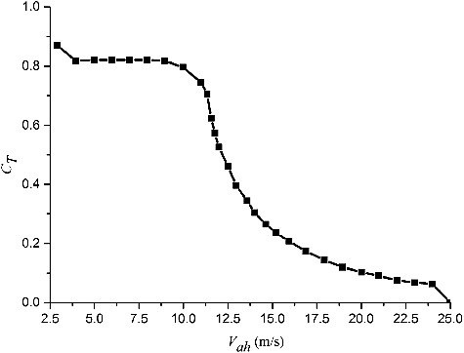
Figure 2. Wind thrust coefficient of NREL 5-MW baseline wind turbine.
Published in: Kunpeng Wang; Chunyan Ji; Hongxiang Xue; Wenyong Tang; Ships and Offshore Structures Ahead of Print
DOI: 10.1080/17445302.2016.1241365
Copyright © 2016 Informa UK Limited, trading as Taylor & Francis Group

