Slide 1
Python, the efficient way
Sebastián Arango Muñoz
TW: @charangostation
IG: @sebasarango118

Slide 2
About me

Slide 3



Lead Data Scientist @ Experimentality
MSc. (asp) in Software Engineering @ EAFIT
BSc. in Electronics Engineering @ UdeA

Slide 4
About Python

Slide 5
Fundamentals
Interpreted language (over C).
Strong | dynamic typing.
Self-managed memory architecture.
Promotes rapid development.
Large community.

Slide 6

But...is it efficient?

Slide 7
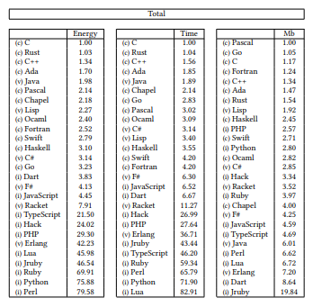
“Energy Efficiency across Programming Languages”. R, Pereira et al. 2017.

Slide 8
Some best practices

Slide 9
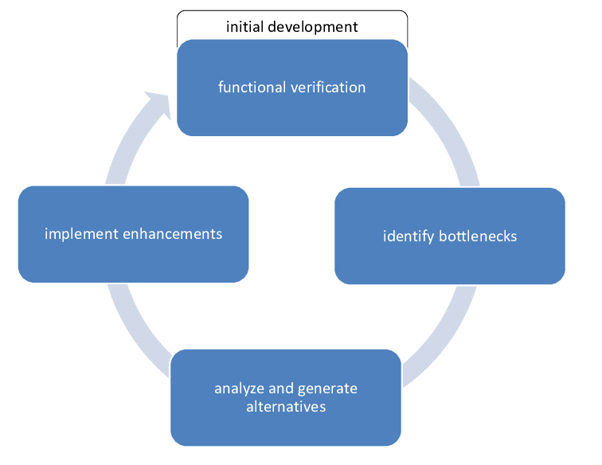
Development Cycle
Get it right.
Test it right.
Profile it.
Optimise.
Repeat.

Slide 10
In general
Only optimize what needs to be optimized (your time and effort are resources, too!).
Choose the right data structures.
Choose the right algorithms.

Slide 11
Strings

Slide 12




Strings

Slide 13
Strings

Slide 14
Loops

Slide 15


Loops

Slide 16

Loops

Slide 17


Loops

Slide 18
Variable Scope

Slide 19
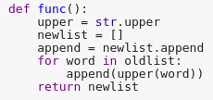
Variable Scope

Slide 20
Initialization

Slide 21

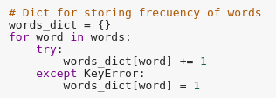
Initialization

Slide 22

Initialization

Slide 23
Imports

Slide 24
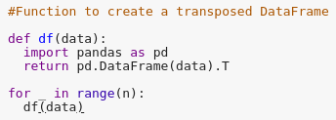
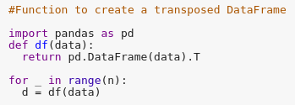
Imports

Slide 25
Vectors

Slide 26
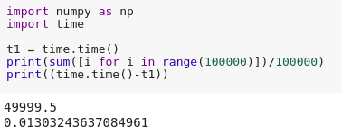
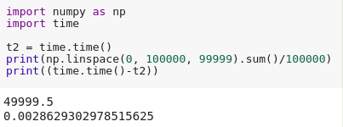
Vectors

Slide 27
Library Design

Slide 28
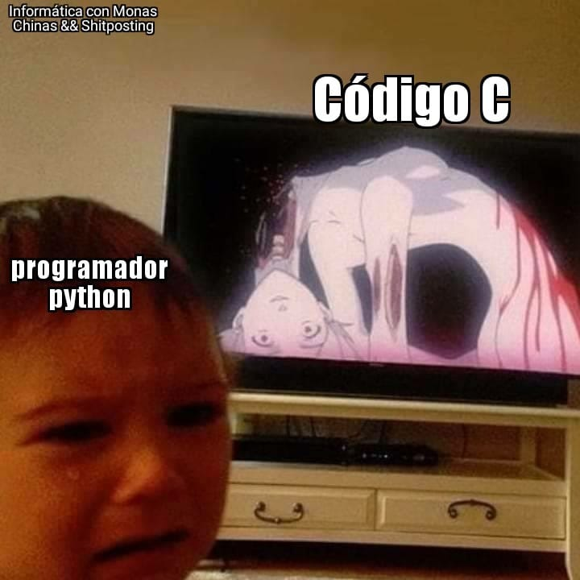
Library Design
Cython
CPython
Learn to detect whether Python is the right choice.

Slide 29
Demo

Slide 30
Questions?

Slide 31
Thank You!

