Slide 1
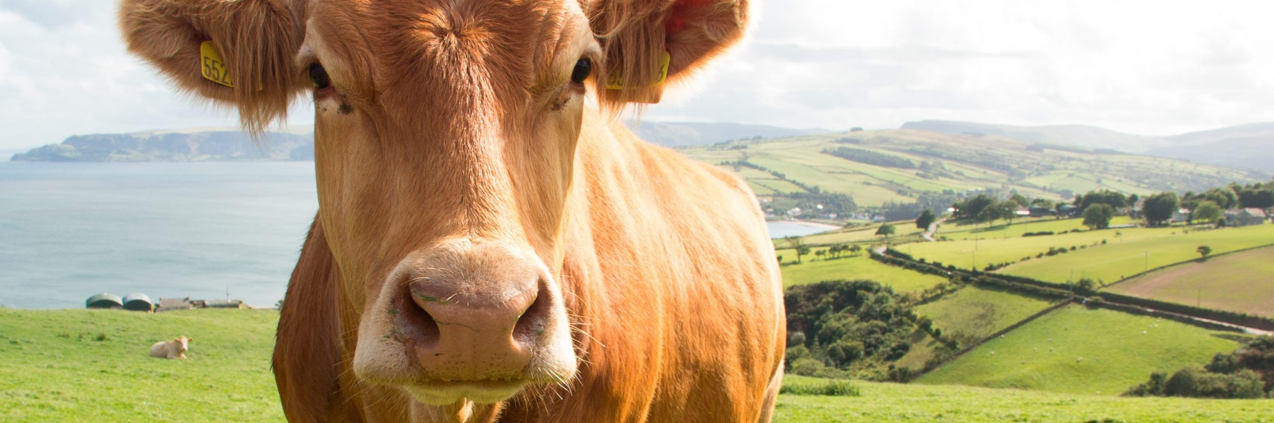

IMAGE COMPRESSION FOR PRECISION LIVESTOCK FARMING

Slide 2

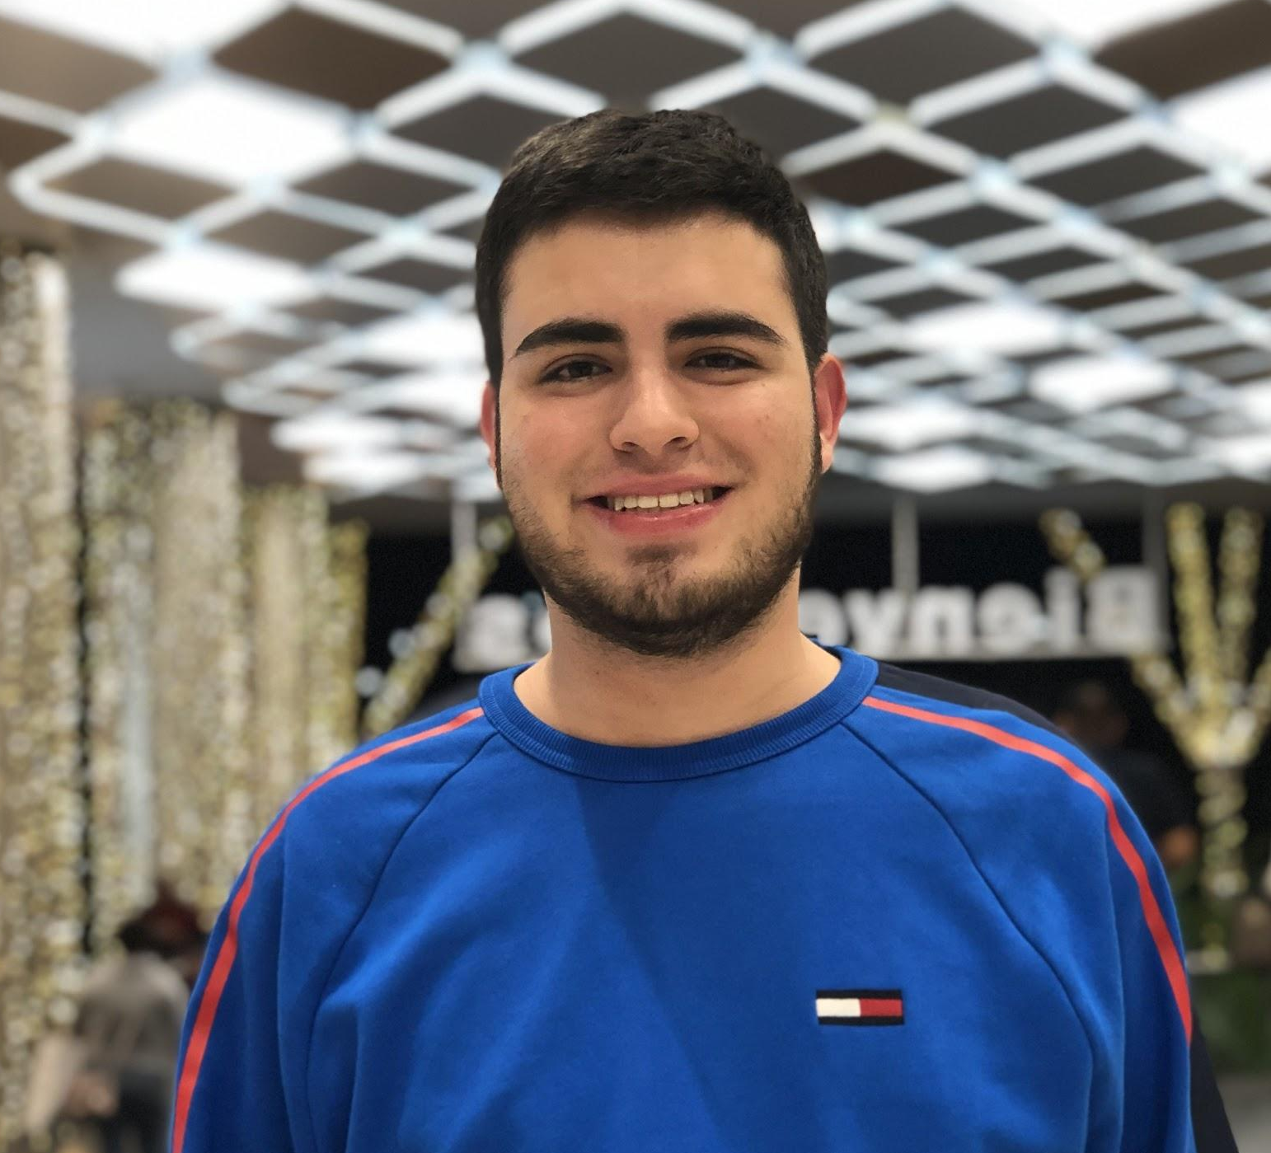
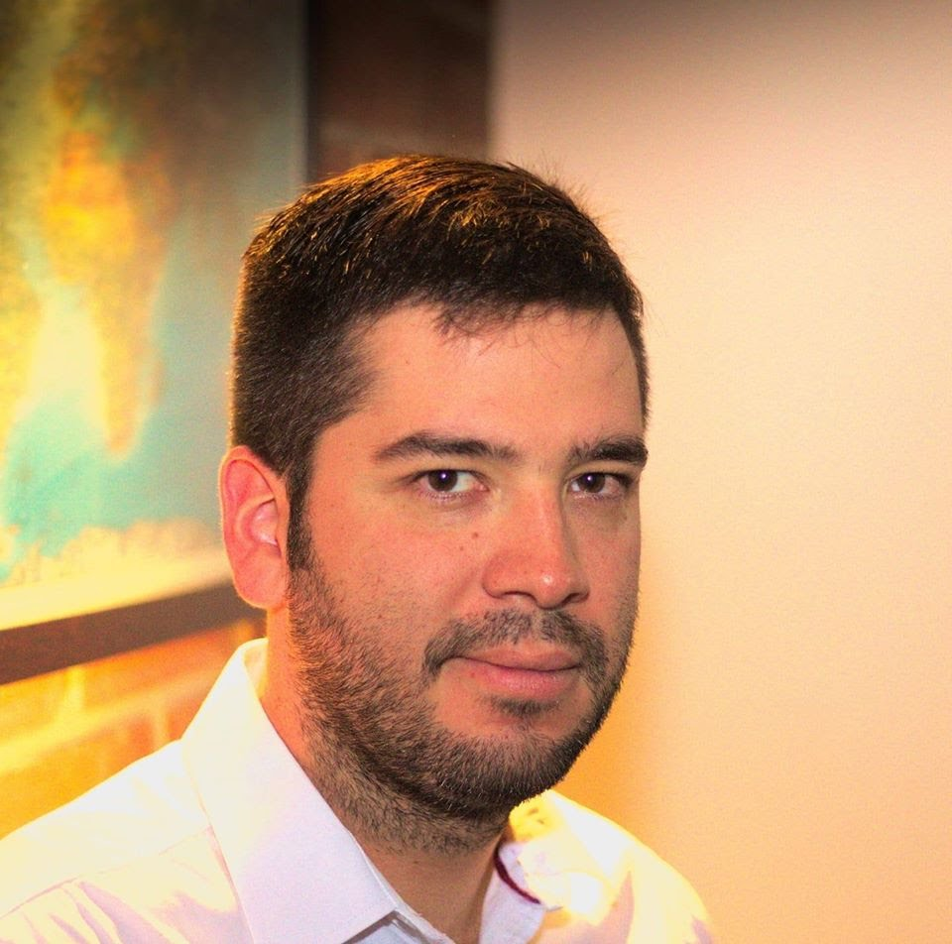

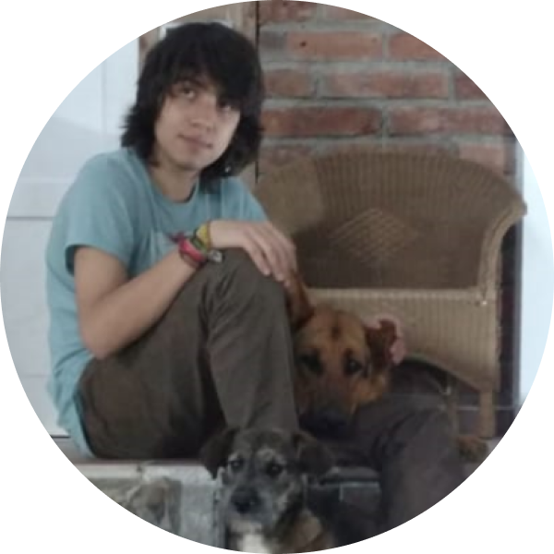

Team Presentation
Sebastian
Beleño
Jairo
Marulanda
Simón Marín
Mauricio
Toro
https://github.com/sebasbeleno/ICPLF-ST0245-Eafit

Slide 3
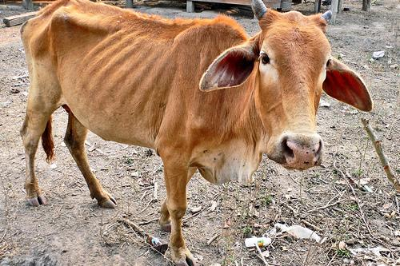
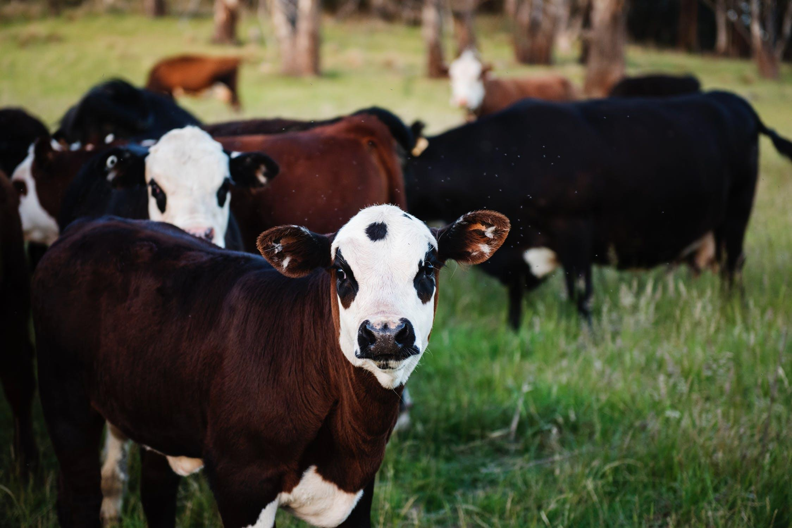
Training Process
Convolutional Neural Network
Sick-Cattle Images
Classification Algorithm
Classification Model
Healthy-Cattle Images

Slide 4
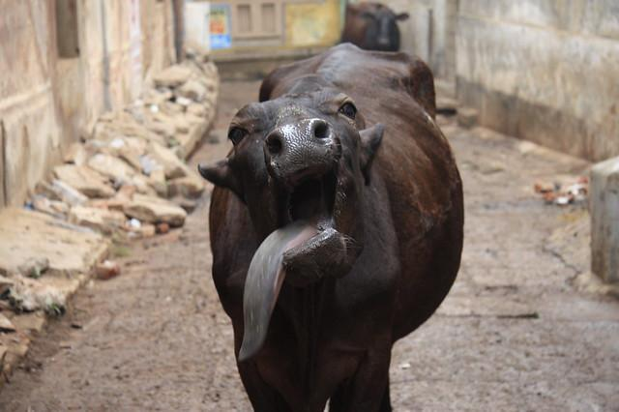
Testing Process
Linear interpolation
Is sick
Cattle Image
Compression Algorithm
Classification Model
Output

Slide 5
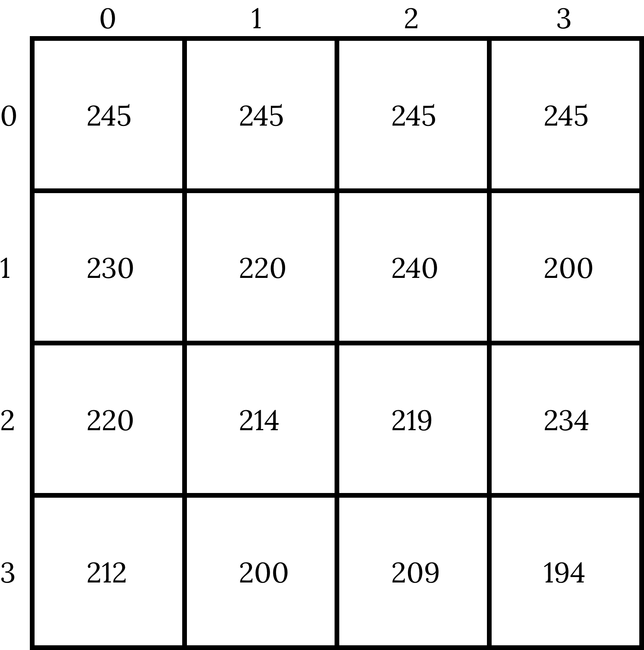
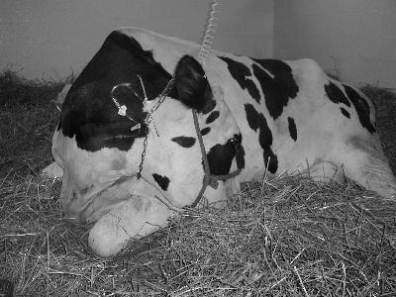

Compression Algorithm Design
We use a 2d Array to represent the image in their 2 components x and y. Each position of the array represents the intensity of this pixel. This facilitates the access to the pixels.

Slide 6
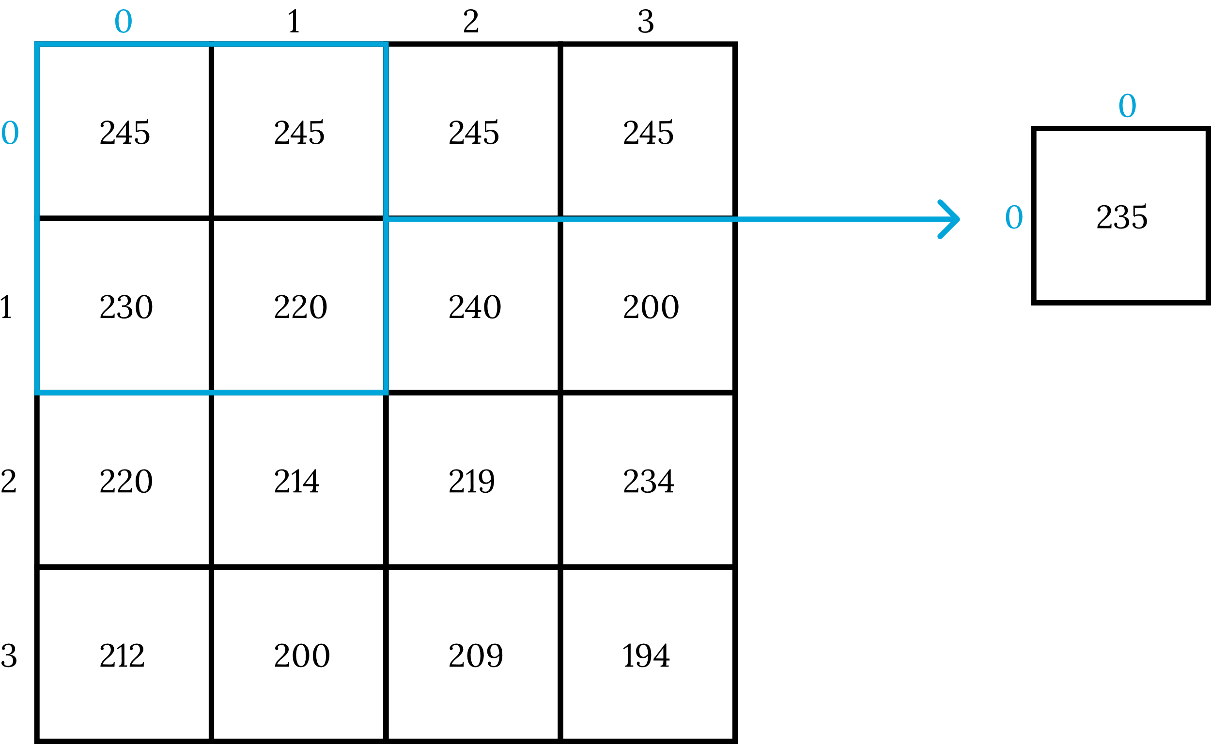
Compression Algorithm Design
To calculate the value of each one new pixel of the compressed image we take a block of 4 pixels from the original image and get its average, the result it's going to be to save in the new 2d array.

Slide 7
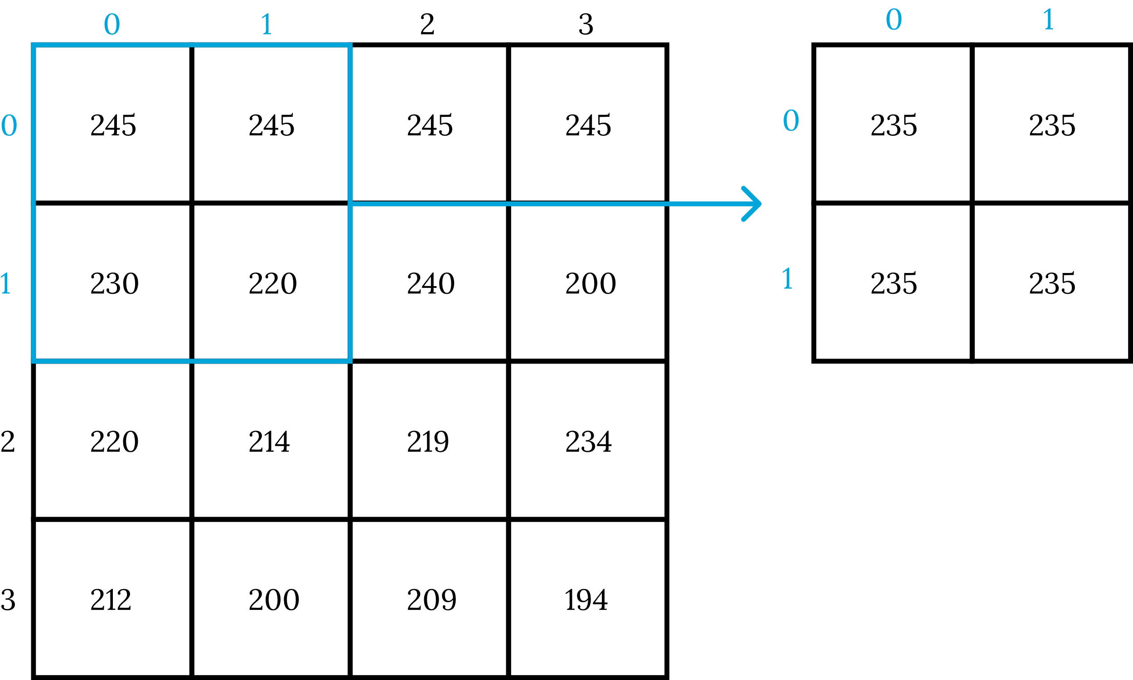
Compression Algorithm Design
The method is the same, we take a block of 4 pixel from the original image and get the average. But unlike of the scaling method we save the result in the same position from the original image in the new compress image.

Slide 8
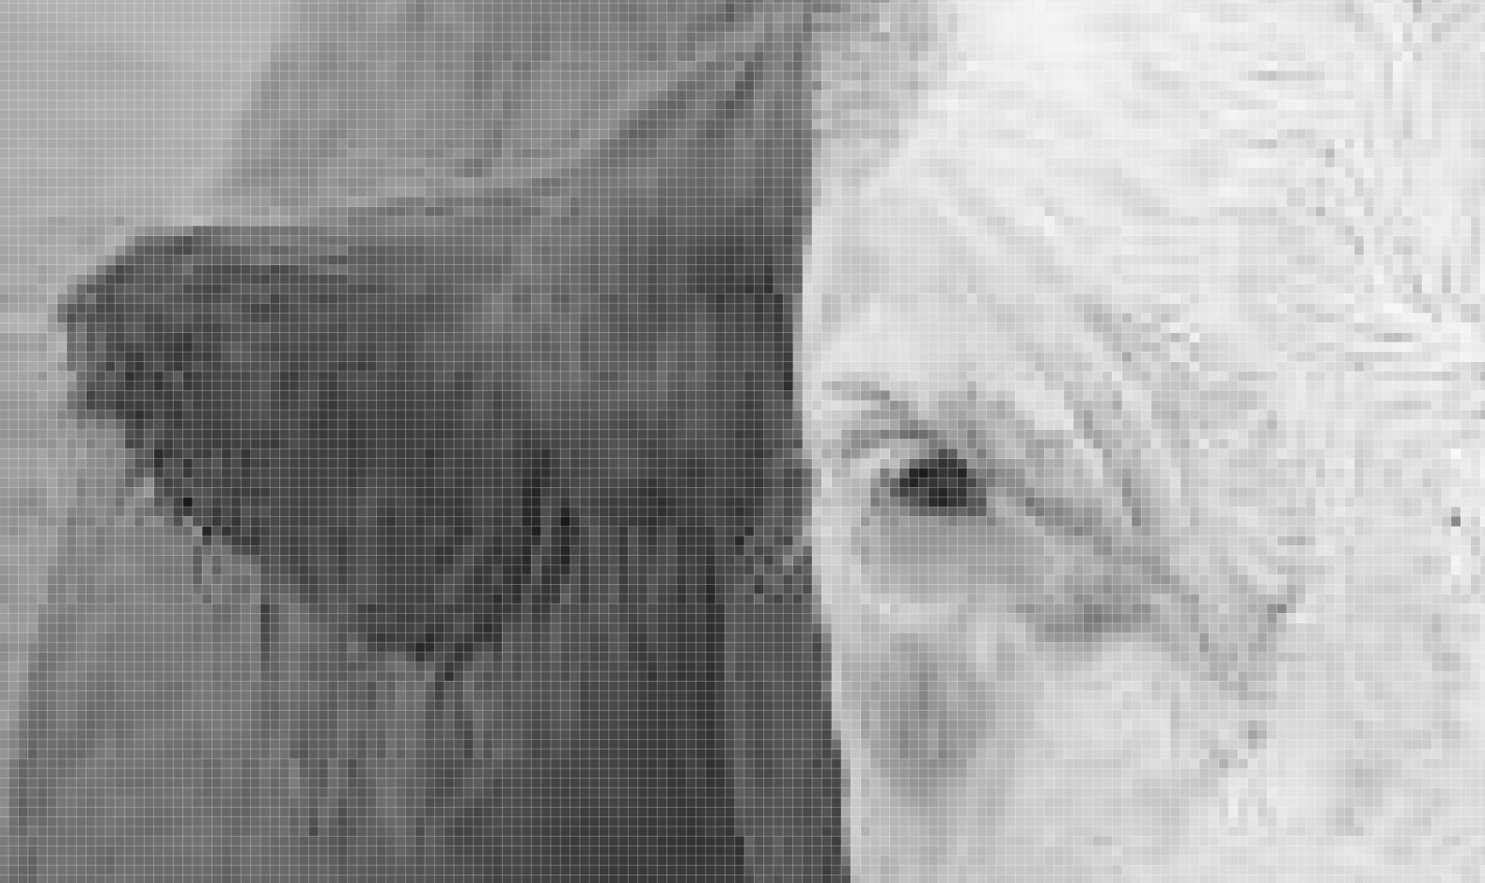
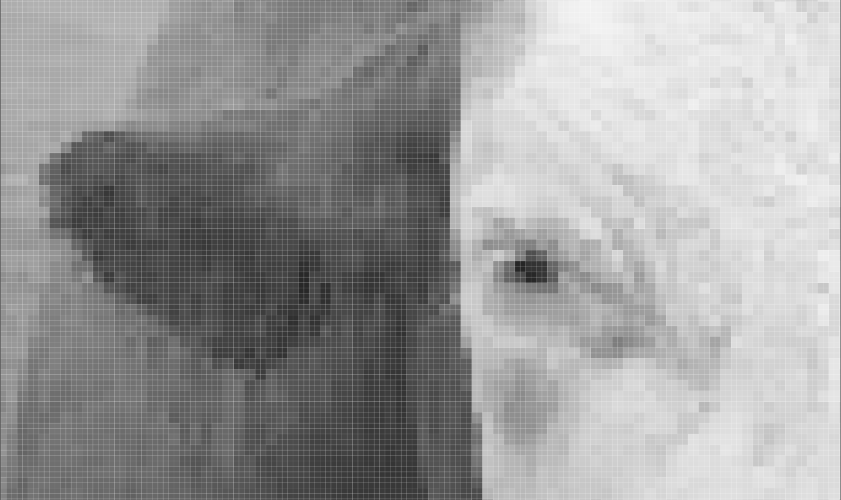
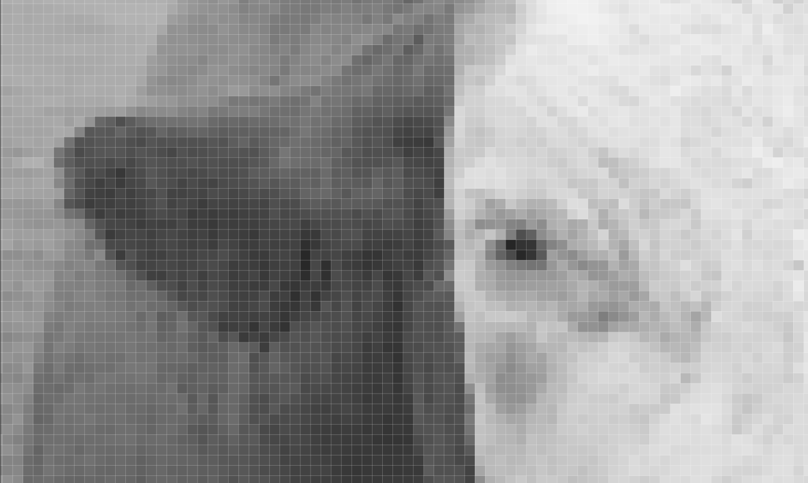
Compression Algorithm Design
Original
With scaling
Without scaling

Slide 9
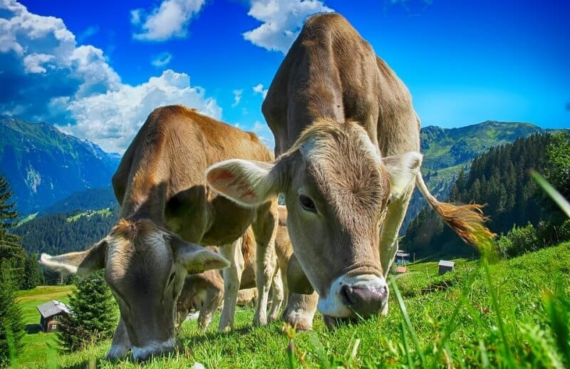
Keep this title
Complete this slide
For the third deliverable
Compression Algorithm Complexity
DO NOT use red color in the slides
Create the table in Powerpoint. Do not copy pixelated screenshots from the technical report please!
 | Time Complexity | Memory Complexity
Image compression | O(N²*M*2^{M}) | O(N*M*2^{M})
Image decompression | O(N*M) | O(1)
Time and memory complexity of the (In this semester, one could be LZS, LZ77, LZ78, Huffman… please choose) algorithm. Please explain what do N and M mean in this problem. PLEASE DO IT!
Explain the tables in your
own words
Include a HD picture related to the problem of animal health in precision livestock farming
Use superindices to represent the exponents. DO NOT use the ^ symbol

Slide 10
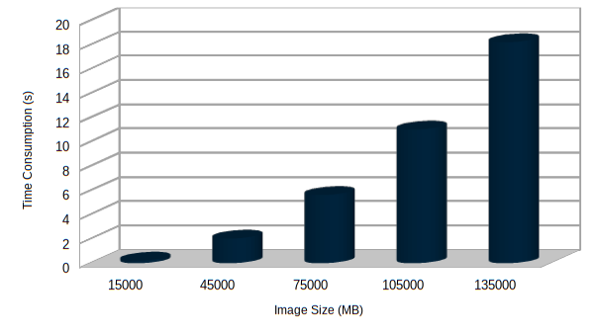
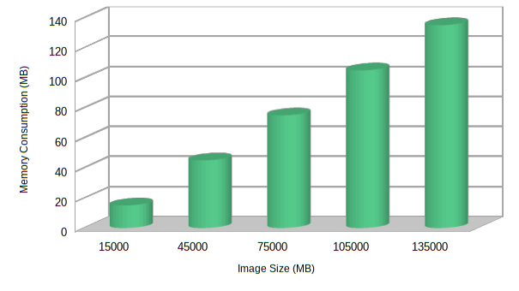


Complete this slide
For the third deliverable
Time and Memory Consumption
Keep this title
DO NOT use red color in the slides
Create the plots in Excel. Do not copy pixelated screenshots from the technical report please!
Time Consumption
Memory Consumption
Please, include measurement units in both X axis and Y axis, for instance, MB, s, KB, minutes...

Slide 11
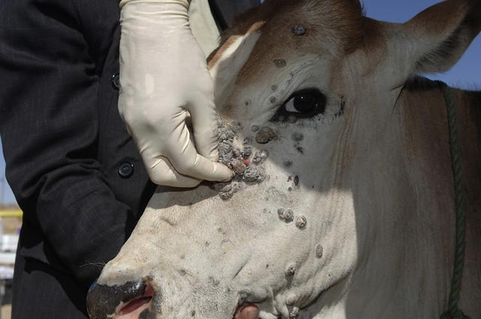
Keep this title
Complete this slide
For the third deliverable
Average Compression Ratio
DO NOT use red color in the slides
Create the table in Powerpoint. Do not copy pixelated screenshots from the technical report please!
 | Compression Ratio
Healthy Cattle | 100 : 1
Sick Cattle | 98 : 1
Average compression ratio for Healthy Cattle and Sick Cattle.
Explain the tables in your
own words
Include a HD picture related to the problem of animal health in precision livestock farming

Slide 12
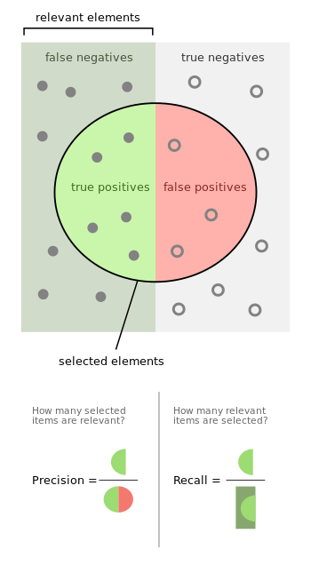
Keep this title
Complete this slide
For the third deliverable
Classification Evaluation Metrics
DO NOT use red color in the slides
Use vectorized figures to
explain the algorithm the evaluation metrics, so they are not pixelated like mines
Use these
Colors for
Your figures
Explain Accuracy too…
Create a graphical representation using the notation proposed in this slide
If possible, avoid equations for simple concepts that can be
explained through diagrams

Slide 13
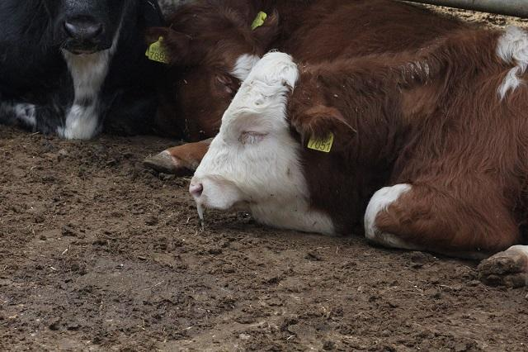
Keep this title
Complete this slide
For the third deliverable
Classification Evaluation Metrics
DO NOT use red color in the slides
Create the table in Powerpoint. Do not copy pixelated screenshots from the technical report please!
 | Testing data set (original images) | Testing data set (compressed images)
Accuracy | 0.3 | 0.2
Precision | 0.25 | 0.21
Recall | 0.12 | 0.11
Evaluation metrics using a testing dataset of ?? healthy cattle and ?? sick cattle images. Compressed images were obtained with ??? algorithm (Please, complete with your algorithm)
Include a HD picture related to the problem of animal health in precision livestock farming
Explain the tables in your
own words

Slide 14
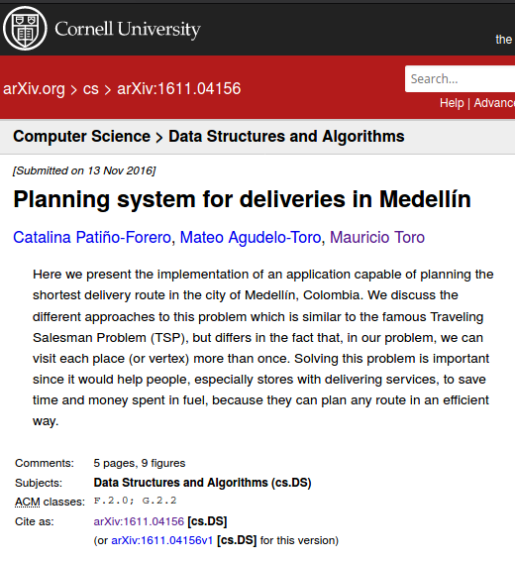
Complete this slide
For the third deliverable
Report Accepted on arXiv
Keep this title
DO NOT use red color in the slides
Include the citation of the report in arXiv and link. Alternatively, use OSF
C. Patiño-Forero, M. Agudelo-Toro, and M. Toro. Planning system for deliveries in Medellín. ArXiv e-prints, Nov. 2016. Available at: https://arxiv.org/abs/1611.04156
Include a screenshot
Include the teaching assistant and professor, please

Slide 15
THANK YOU!.
DO NOT use red color in the slides
Please do not forget the acknowledgements to your scholarship (if you have one)
Supported by
The first two authors are supported by a Sapiencia grant financed by Medellín municipality. All the authors would like to thank the "Vicerrectoría de Descubrimiento y Creación", of Universidad EAFIT, for their support on this research

